Slide 1
Control Systems Engineering: International Exchange Programs
Exchange programmes dedicated to Students of the Master in Control Systems Engineering
Yokohama National University, Japan (dead-line for applications expired)
Imperial College of London: Prof. M.E. Valcher
KTH Royal Institute of Technology in Stockholm: Prof. A. Chiuso
University of Barcelona (Spain): Prof. R. Carli
University of Aveiro (Portugal): Prof. R. Carli
Lulea University of Technology (Sweden): Prof. R. Carli
University of Louvain (Belgium): Prof. R. Carli
University of Vigo (Portugal): Prof. R. Carli
University of Toulouse (France): Prof. A. Cenedese

Slide 2
Yokohama National University (Japan)
Framework: Ulisse Programme
University website: https://www.ynu.ac.jp/english/
Exams offered: https://www.ynu.ac.jp/english/education/
Contact Persons:
YNU: Prof. Kenji Hasegawa Hasegawa-kenji-py@ynu.ac.jp
UNIPD: Alessandro Beghi (Alessandro.beghi@unipd.it )

Slide 3
Imperial College
ERASMUS CODE: UK-LONDON015
EXCHANGE POSITIONS: 1
MAX DURATION OF THE STAY: 6 months
REQUIREMENTS: Recommended Level B2/C1
EXAMS/FINAL PROJECT: only project
STUDY LEVEL: only Master(Laurea Magistrale)
CONSTRAINTS: only projects in Automation/Computer Engineering
CONTACT PERSON: Maria Elena Valcher
meme@dei.unipd.it
CONS
PROS
CONS
Excellent college
Top level research
Great venue
Very expensive place
No university housing

Slide 4
Imperial College
UNIVERSITY WEBSITE:
https://www.imperial.ac.uk/
WEBSITE WITH RESEARCH OF THE CONTROL &
POWER GROUP OF THE HOSTING DEPARTMENT:
http://www.imperial.ac.uk/electrical- engineering/research/control-and-power/
Spazio per immagine Rappresentativa
dell’università o della città
CONTACT PERSON ABROAD:
ALESSANDRO ASTOLFI a.astolfi@imperial.ac.uk
OTHER INFORMATION: one position available and lots of potential applications. Apply only if you have high grades.

Slide 5
Royal Institute of Technology - KTH
ERASMUS CODE: : S -STOCKHO04
EXCHANGE POSITIONS: 2
MAX DURATION OF THE STAY: 6 months
REQUIREMENTS: English B2
EXAMS/FINAL PROJECT: only project
STUDY LEVEL: Master
CONSTRAINTS: only MD students from Automation, Control Systems Engineering
CONTACT PERSON: Alessandro Chiuso
chiuso@dei.unipd.it
PROS
CONS
International environment
Cutting edge research
English Language
Only 2 positions available
Only for thesis
Only for Automation/CSE

Slide 6
Royal Institute of Technology (KTH)
UNIVERSITY WEBSITE:
https://www.kth.se/en
Research pages
Division of Decision and Control Systems
CONTACT PERSON ABROAD:
Prof. Bo Wahlberg bo@kth.se RESEARCH AREAS
Learning and Identification – Control – Optimization
Networked Control Systems – Multi Agent Systems
Nonlinear Control – Robotics

Slide 7
Universidade de Aveiro
ERASMUS CODE: P-AVEIRO01
EXCHANGE POSITIONS: 3
MAX DURATION OF THE STAY: 9 months
STUDY LEVEL: Bachelor/Master
EXAMS/FINAL PROJECT: both
REQUIREMENTS: B2 english; a basic language course in Portoguese is suggested (see CLA website) http://cla.unipd.it/attivita/corsi/erasmus-out/)
CONSTRAINTS: priority to MD in Automation/Control Systems and Electronics Eng., but open to all Bachelor and Master students at DEI
CONTACT PERSON: Prof. Ruggero Carli carlirug@dei.unipd.it

Slide 8
Universidade de Aveiro
UNIVERSITY WEBISITE:
https://www.ua.pt/
ERASMUS STUDENTS:
http://www.ua.pt/gri/students
LIST OF EXAMS OFFERED BY THE FOREIGN
UNIVERSITY: https://www.ua.pt/pt/estudar
CONTACT PERSON ABROAD:
prof. Amaro Fernandes de Sousa asou@ua.pt
POSITIVE FEEDBACK from past students:
City is lovely with a reasonable living cost
Equipped labs (in particular in the robotic field)

Slide 9
Universidad Politecnica de Catalunya - ETSEIB
ERASMUS CODE: E-BARCELO03
EXCHANGE POSITIONS: 2
MAX DURATION OF THE STAY: 10 months
STUDY LEVEL: Bachelor/Master
EXAMS/THESIS: both
REQUIREMENTS: English B2, Spanish B2 (suggested)
CONTRAINTS: Recommended to students of the following Bachelor and Master degrees: Information, Electronics, Automation/Control Systems Engineering, Biomedical, Bioengineering, Computer Engineering
CONTACT PERSON: Ruggero Carli
carlirug@dei.unipd.it
PROS
CONS
Low cost of living
Several labs
International environment
Priority to Master theses in Automation

Slide 10
Universidad Politecnica de Catalunya - ETSEIB
Technische Universität Graz
UNIVERSITY WEBSITE:
https://etseib.upc.edu/en/school
https://etseib.upc.edu/en/mobility-students/do-you-want-to-come
LIST OF EXAMS OFFERED BY THE FOREIGN UNIVERSITY:
https://etseib.upc.edu/en/Academic%20programmes
CONTACT PERSON ABROAD:
Ana Maria Brau Riera ana.maria.brau@upc.edu
POSITIVE FEEDBACK FROM PAST STUDENTS: in particular from the ones who have performed the Master thesis projects in the fields of robotics and machine learning

Slide 11
Universidad de Vigo
ERASMUS CODE: E –VIGO01
EXCHANGE POSITIONS: 1
MAX DURATION OF THE STAY: 9 months
EXAMS/FINAL PROJECT: both
STUDY LEVEL: Bachelor/Master
CONTRAINTS: Recommended to Bachelor and Master degrees: Information, Biomedical, Bioengineering, Automation/Control Systems and Electronics Eng.
REQUIREMENTS: English B2, Spanish B1 (recommended)
CONTACT PERSON: Ruggero Carli
carlirug@dei.unipd.it
PROS
CONS
Low cost of living
Several labs
International environment
Priority to Master theses in Automation

Slide 12
Universidad de Vigo
Technische Universität Graz
UNIVERSITY WEBSITE:
https://www.uvigo.gal/uvigo_en/index.html
LIST OF EXAMS OFFERED BY THE FOREIGN UNIVERSITY:
https://eei.uvigo.es/eei_gl/estudos/oferta-formativa/
CONTACT PERSON ABROAD:
Prof. Rafael Sanz Domingues rsanz@uvigo.es
FURTHER INFORMATION:
New degree course in Biomedical Engineering available for both Bachelor and for the 1st year of Master Degree students
https://eei.uvigo.es/en/studies/bachelor-s-degree/biomedical-engineering/
…unfortunately we do not have recent feedback from students, since none has partecipated to this Erasmus flow in the last three years…

Slide 13
Universitè Catholique de Louvain
ERASMUS CODE: B-LOUVAIN01
EXCHANGE POSITIONS: 6
MAX DURATION OF THE STAY: 5 months
EXAMS/FINAL PROJECT: both
STUDY LEVEL: MD in Electronics, ICT, Automation/Control Systems, Bioengineering and Computer Engineering
CONTRAINTS: None
REQUIREMENTS: English B2/French B1 (recommended)
CONTACT PERSON: Ruggero Carli
carlirug@dei.unipd.it
CONS
PROS
CONS
Wide list of offered classes
International environment
None

Slide 14
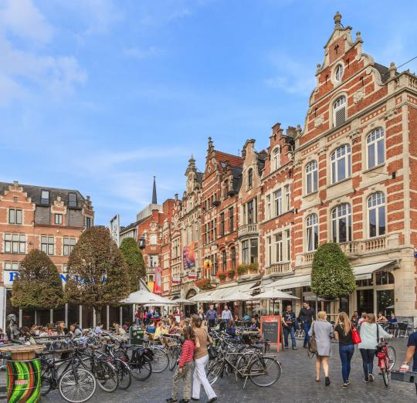
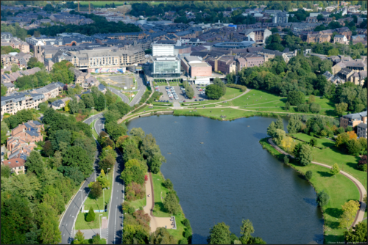
Universitè Catholique de Louvain
Technische Universität Graz
UNIVERSITY WEBSITE:
www.uclouvain.be/ects
LIST OF EXAMS OFFERED BY THE FOREIGN UNIVERSITY:
https://uclouvain.be/en/faculties/epl/study-programmes.html
Other useful links: www.uclouvain.be/en-visa (Visa), www.uclouvain.be/assurances (Insurance), www.uclouvain.be/en-logement (Housing), www.uclouvain.be/en-aide-handi (Special needs)
CONTACT PERSON ABROAD:
Emmanuelle Brun
Emmanuelle.brun@uclouvain.be
Positive feedback from students…
…but the competition for this flow is very high (in average
25 applications in last years)

Slide 15
Lulea Tekniska Universitet
Lulea Tekniska Universitet
SWEDEN
Mittuniversitetet Sundsvall
Kungliga Tekniska Högskolan Stockholm
Chalmers Tekniska Högskola
Göteborg

Slide 16
Lulea Tekniska Universitet
ERASMUS CODE: S-LULEA01
EXCHANGE POSITIONS: 2
MAX DURATION OF THE STAY: 9 months
STUDY LEVEL : Master
EXAMS/ FINAL PROJECT: both REQUIREMENTS : English B2
CONTRAINTS: Suggested to MD students in Automation/Control Systems Eng. and Mechatronics
CONTACT PERSON: Ruggero Carli carlirug@dei.unipd.it
PROS
CONS
Several labs
International environment
Priority to Master thesis in Automation
High cost of living

Slide 17
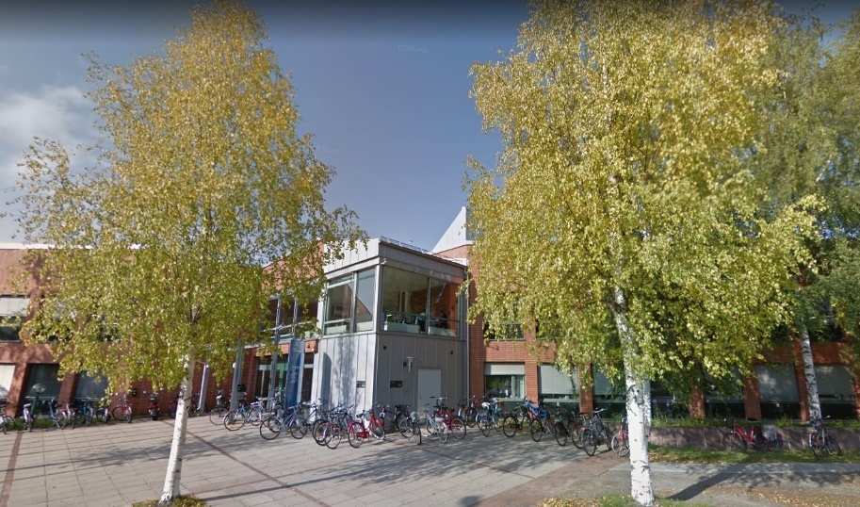
Lulea Tekniska Universitet Universitet
Technische Universität Graz
UNIVERSITY WEBSITE:
https://www.ltu.se/?l=en
LIST OF EXAMS OFFERED BY THE FOREIGN UNIVERSITY:
https://www.ltu.se/edu/Exchange-Studies/exchangesearch?l=en
CONTACT PERSON ABROAD:
Khalid Atta khalid.atta@ltu.se
SUGGESTION: to take exams it is better to go during the first semester (end of August- end of December)
FEEDBACK FROM PAST STUDENTS: Extremely positive; the weather is cold but the university environment is warmy!

Slide 18
France, Belgium, Switzerland
Universiteit Gent
BELGIUM
Katholieke Universitet Leuven
Université catholique de Louvain
ECAM Bruxelles
Uni Paris Descartes
ENSSAT Lannion
Uni Rennes
FRANCE
ETH Zürich
EPF Lausanne
SWITZERLAND
Grenoble INP
Université St.Etienne
Institut Polytechnique de
Bordeaux
Université Toulouse III Paul Sabatier

Slide 19
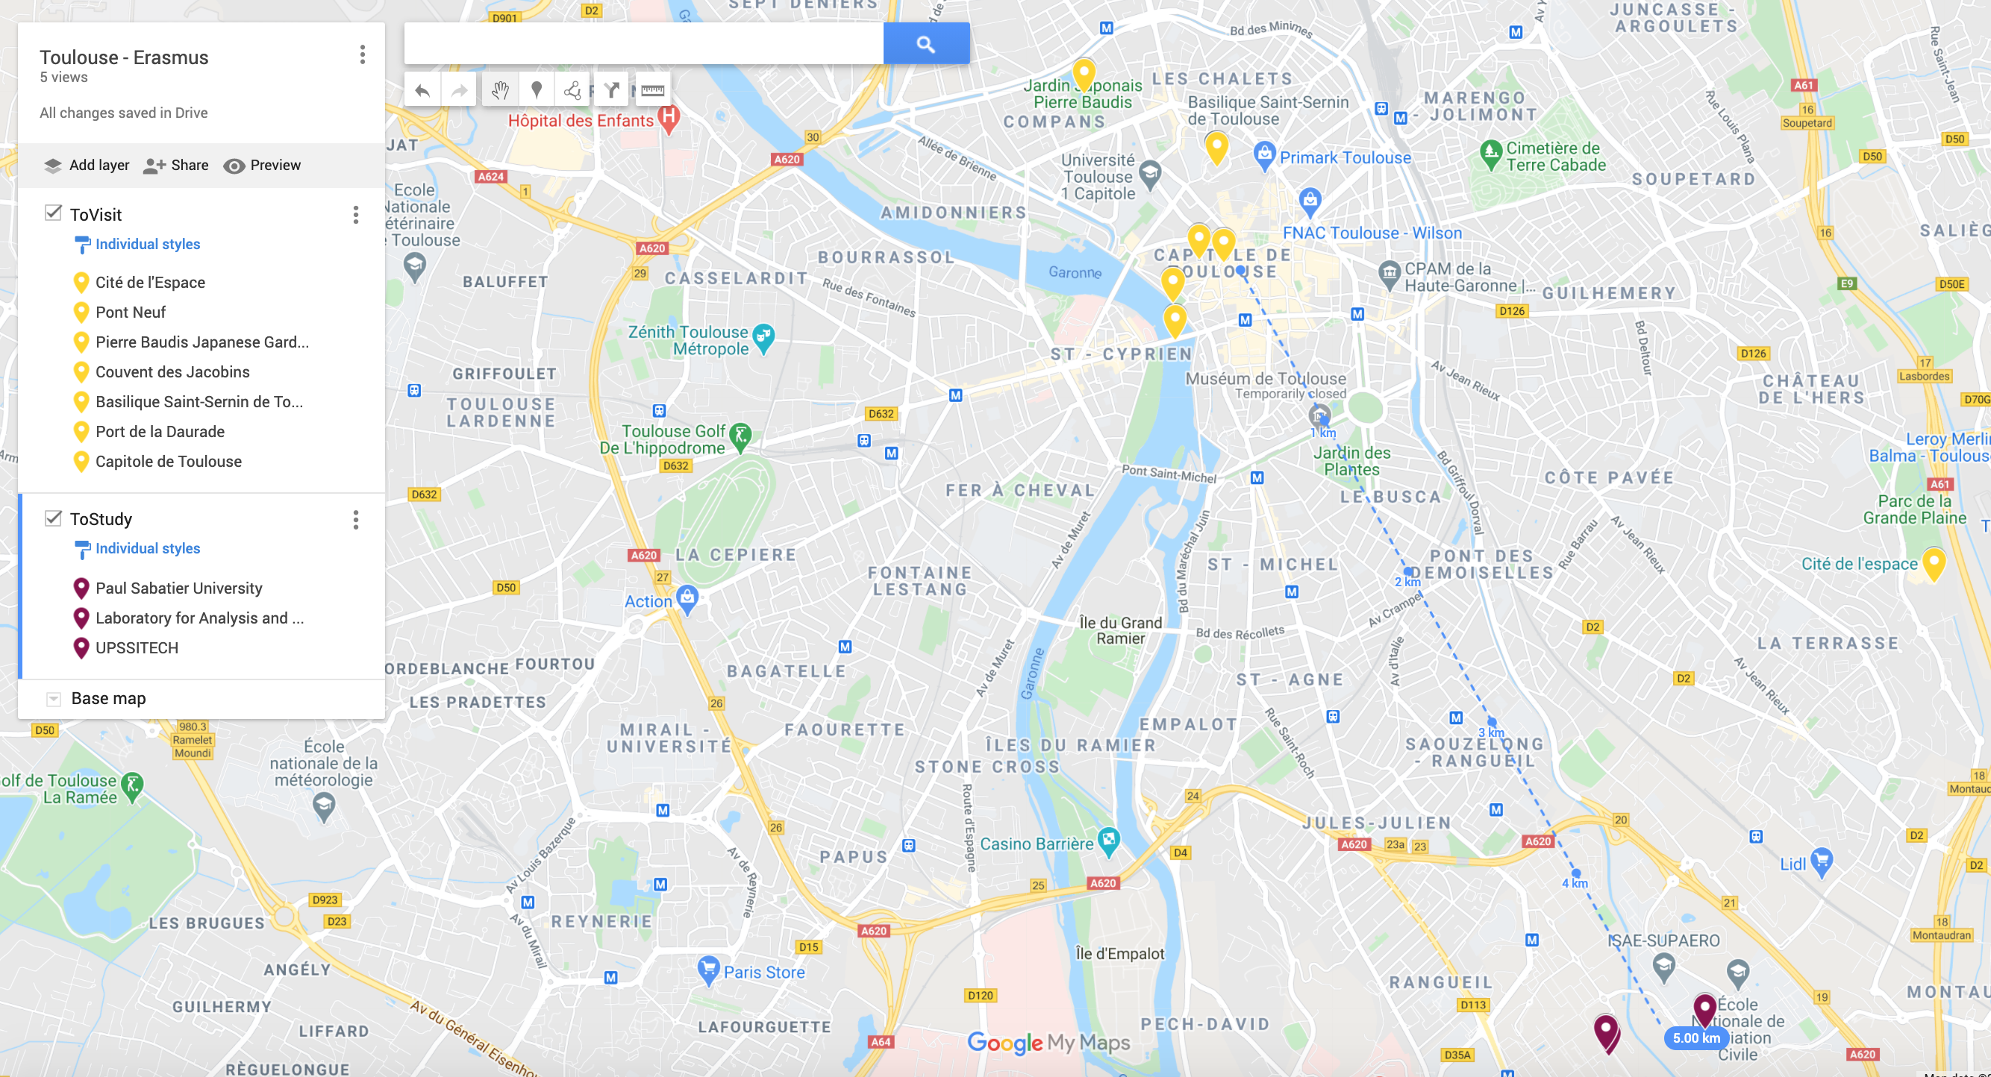
Université Toulouse III – Paul Sabatier

Slide 20
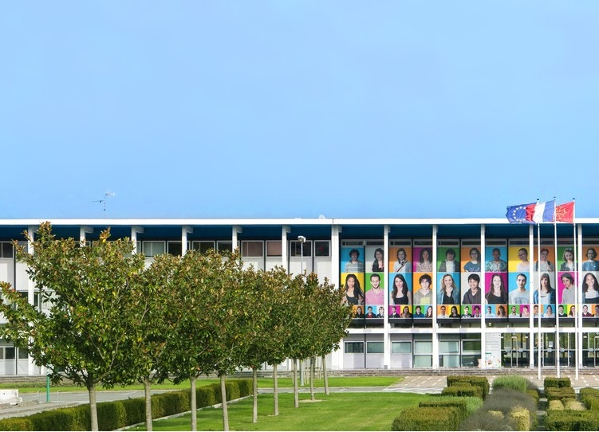
Université Toulouse III – Paul Sabatier
ERASMUS CODE: F-TOULOUS03
EXCHANGE POSITIONS: 2
MAX DURATION OF THE STAY: 5 months
REQUIREMENTS: French B2
(English B2 for the courses taught in English)
EXAMS/FINAL PROJECT: both
STUDY LEVEL: Master
CONSTRAINTS: Automation/Control Systems, ICT, Electronics Engineering
CONTACT PERSON: Angelo Cenedese
angelo.cenedese@unipd.it

Slide 21
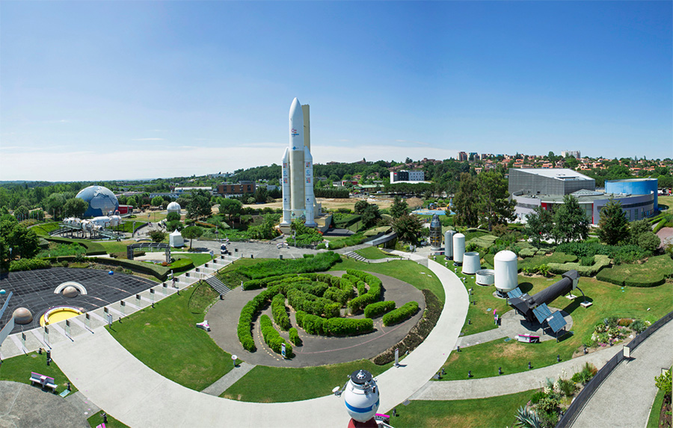
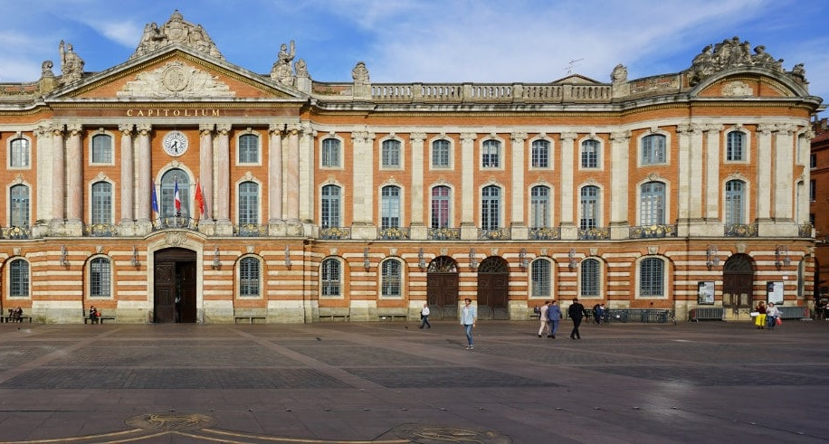
Université Toulouse III – Paul Sabatier
UNIVERSITY WEBSITE:
https://www.univ-tlse3.fr/venir-erasmus
LIST OF EXAMS OFFERED BY THE FOREIGN UNIVERSITY:
https://www.univ-tlse3.fr/mentions-de-masters
https://www.upssitech.eu/formation/departement-systemes-robotiques-interactifs-sri/
CONTACT PERSON ABROAD:
Rosemary Duchesne (international office)
Relations Internationales
rose-marie.duchesne@univ-tlse3.fr

