Slide 1

Network Science
A.Y. 25/26
ICT for Internet & multimedia, Data science, Physics of data

Slide 2
Semantic networks
network science tools for their study

Slide 3
Data collection
how to get data from the Internet using APIs

Slide 4

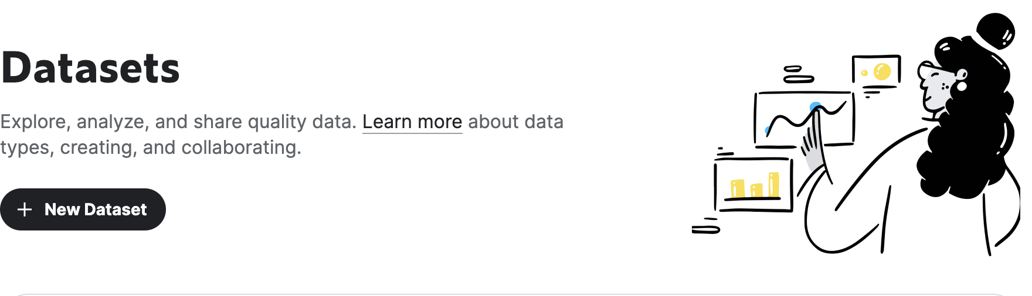
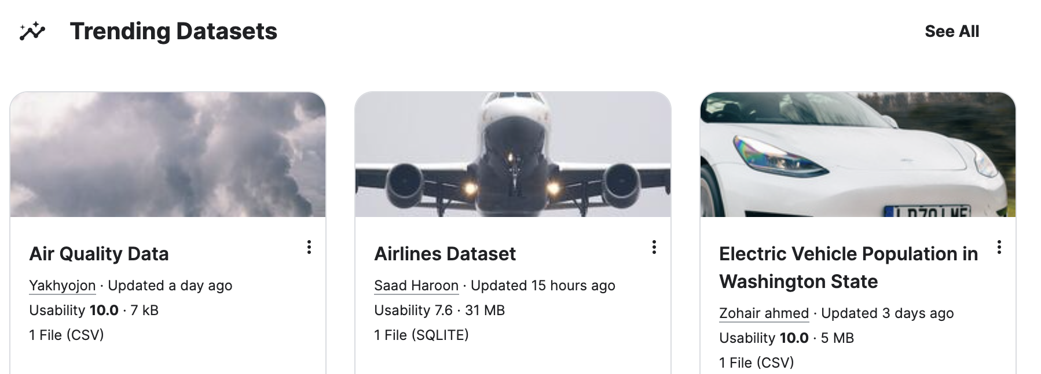
Kaggle
https://www.kaggle.com/

Slide 5
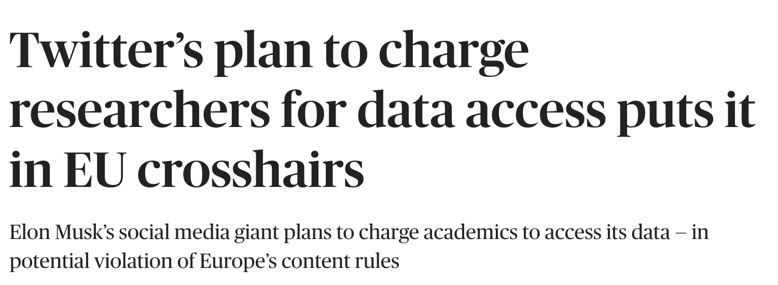
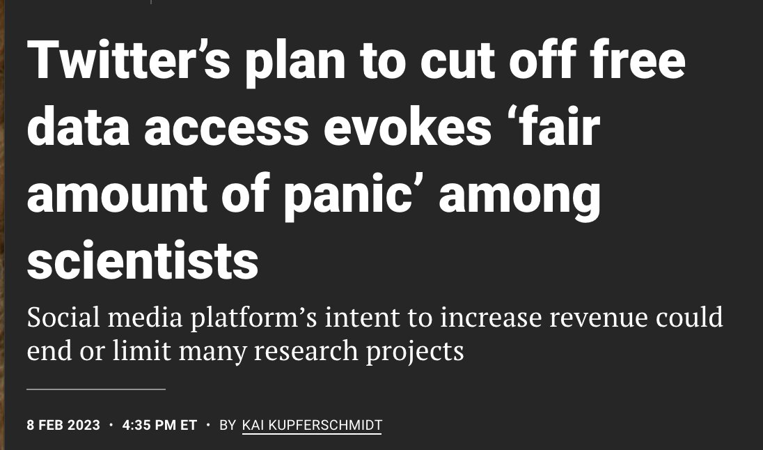

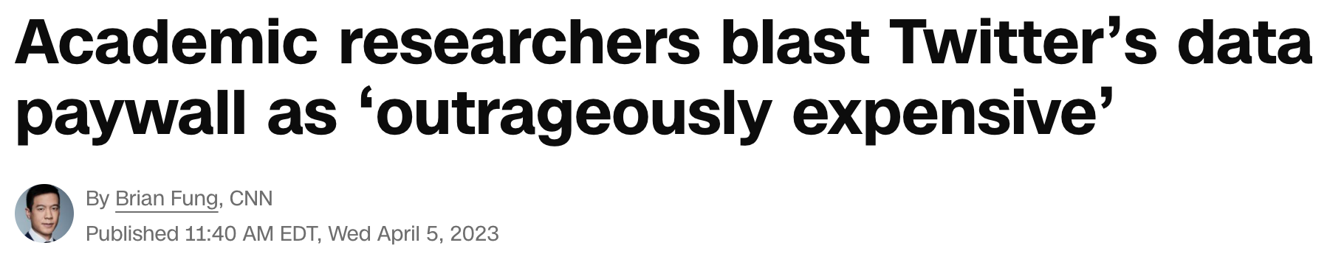
Twitter
no longer available unless you pay 5k$ per month ☹
https://developer.twitter.com/en/portal/dashboard
BY MARK SCOTT
MARCH 22, 2023

Slide 6
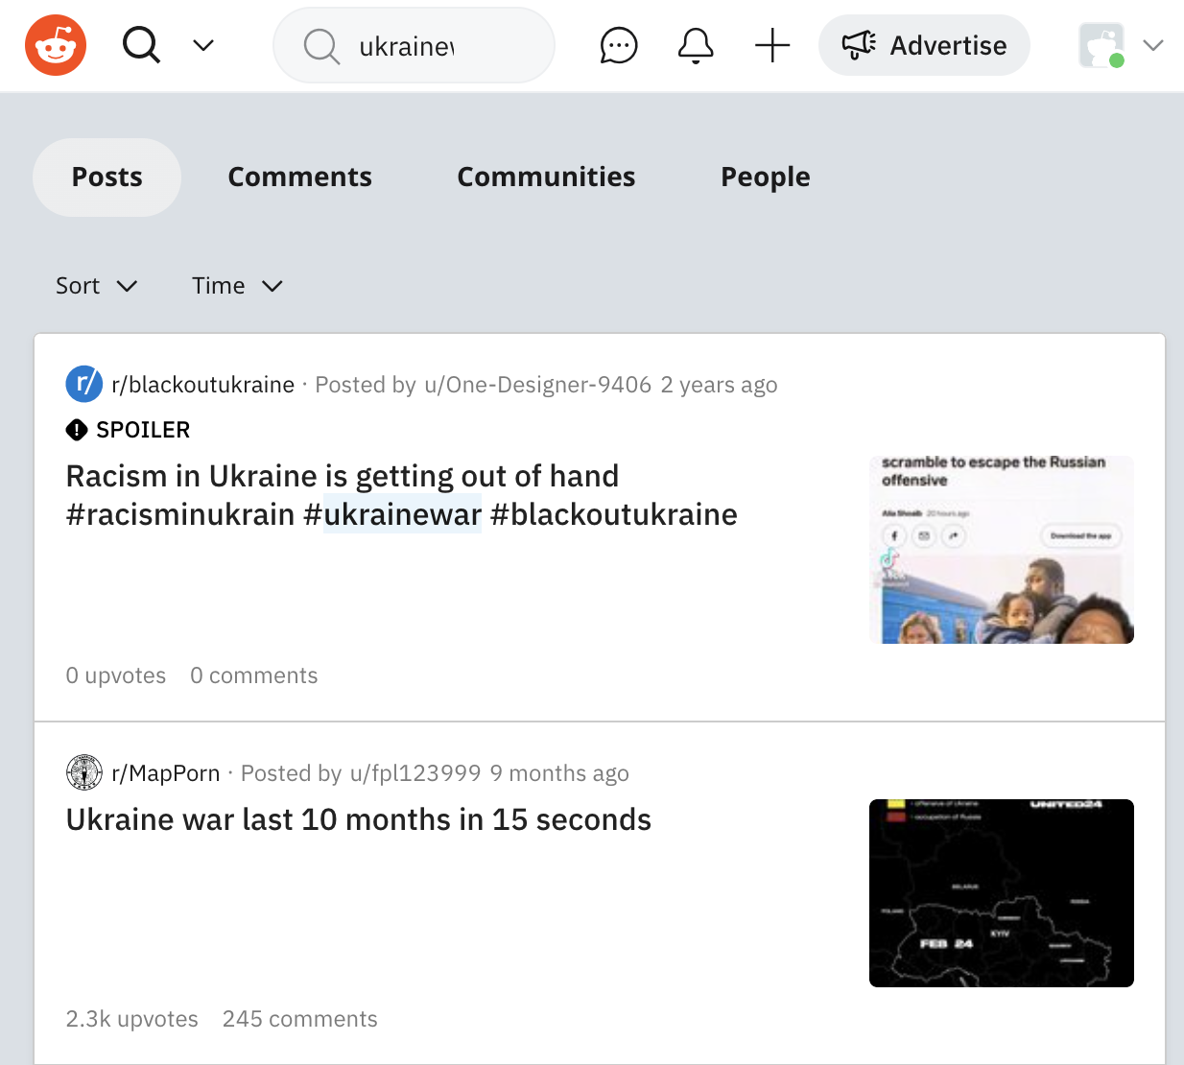
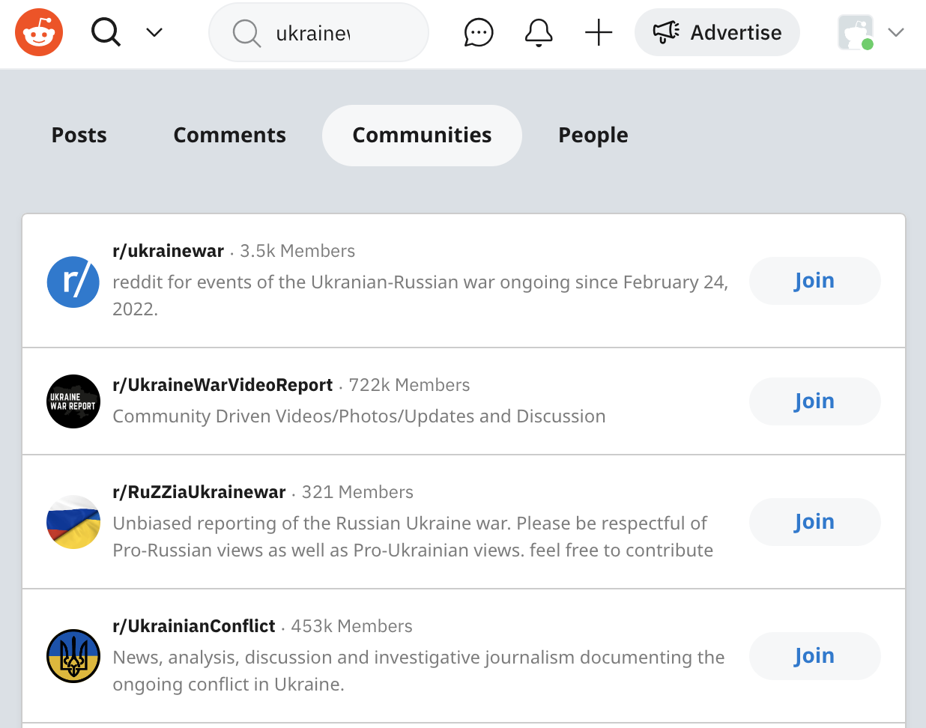
Reddit
https://www.reddit.com
Reddit
Subreddit

Slide 7
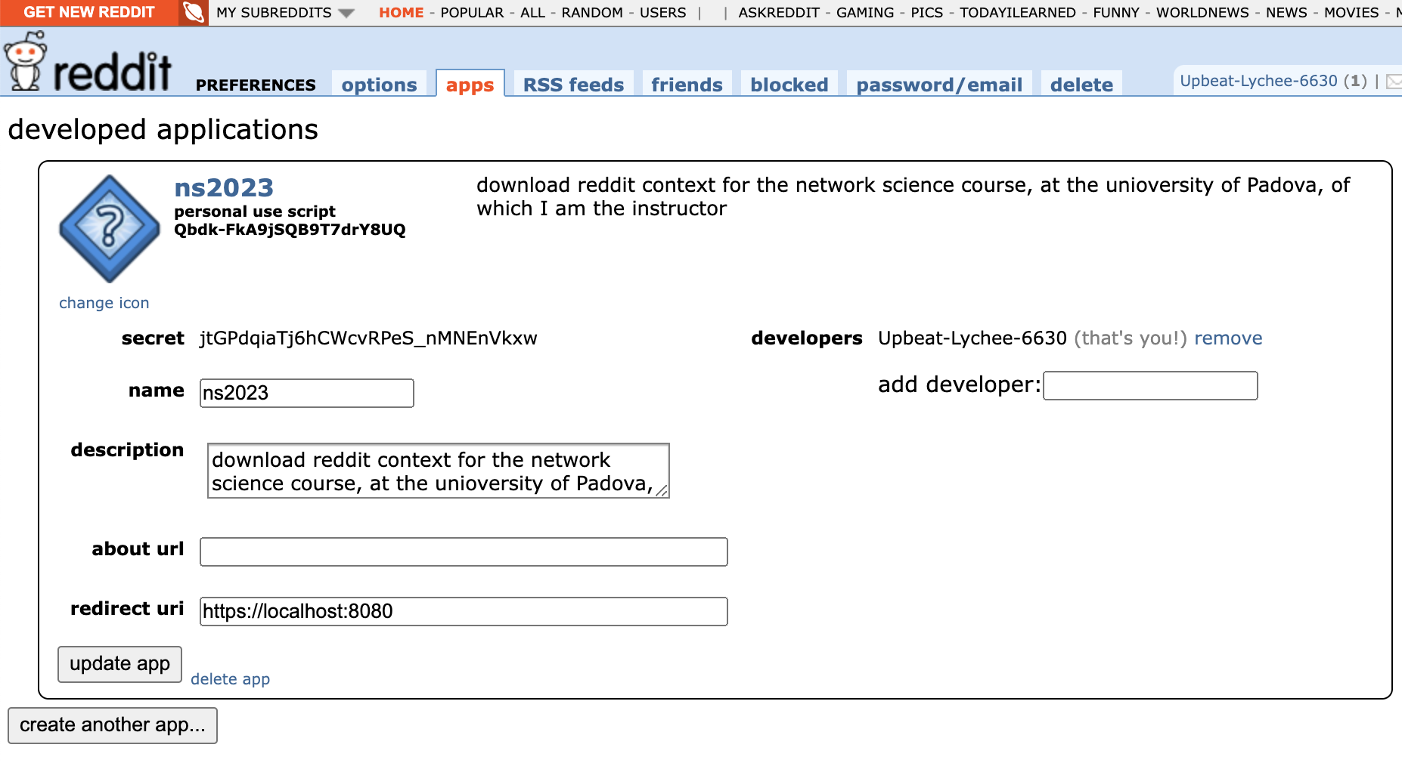
Reddit apps
https://www.reddit.com/prefs/apps
client_id
username
client_secret
register asap… will be using this in the 1st lab

Slide 8
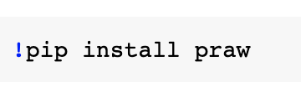
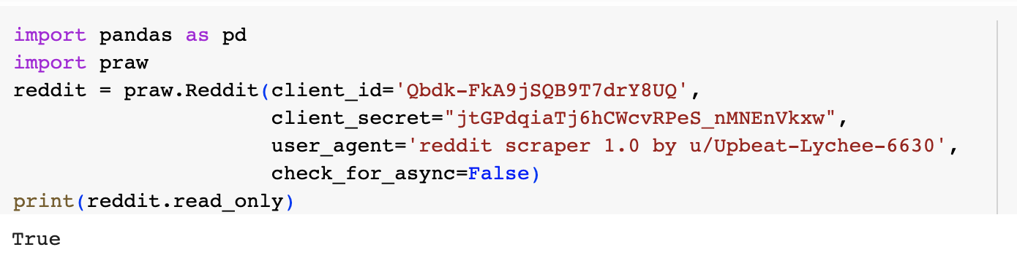
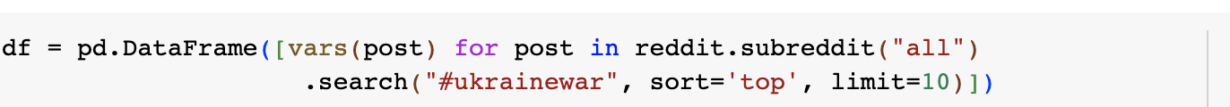
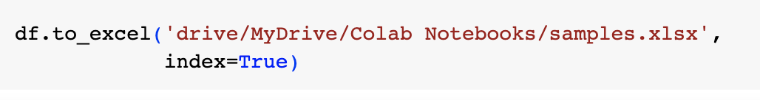
Python Reddit API Wrapper – PRAW
https://praw.readthedocs.io/en/stable/ (v7.7.1)
your own description of your app, including version and username
from Reddit apps
"relevance", "hot", "top", "new", or "comments"
max 250 per call
can also add time_filter = "all", "day", "hour", "month", "week", or "year"

Slide 9
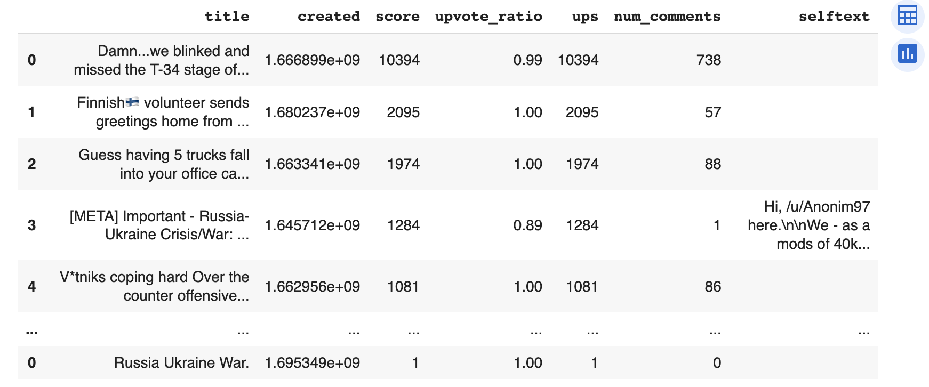
Reddit data
an example
there is a list of 116 entries per post, on which you can choose!!!
from this you extract the date

Slide 10
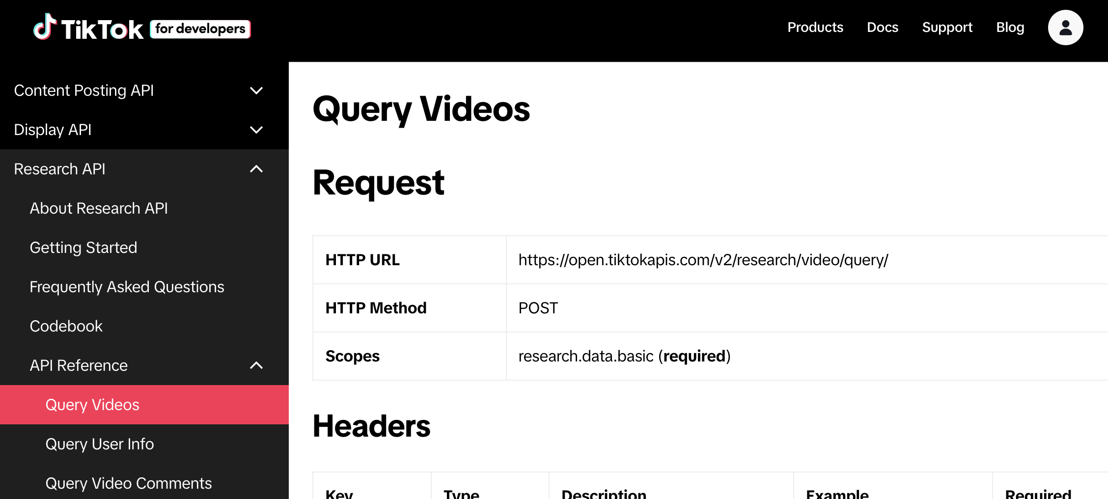

TikTok
developers.tiktok.com

Slide 11
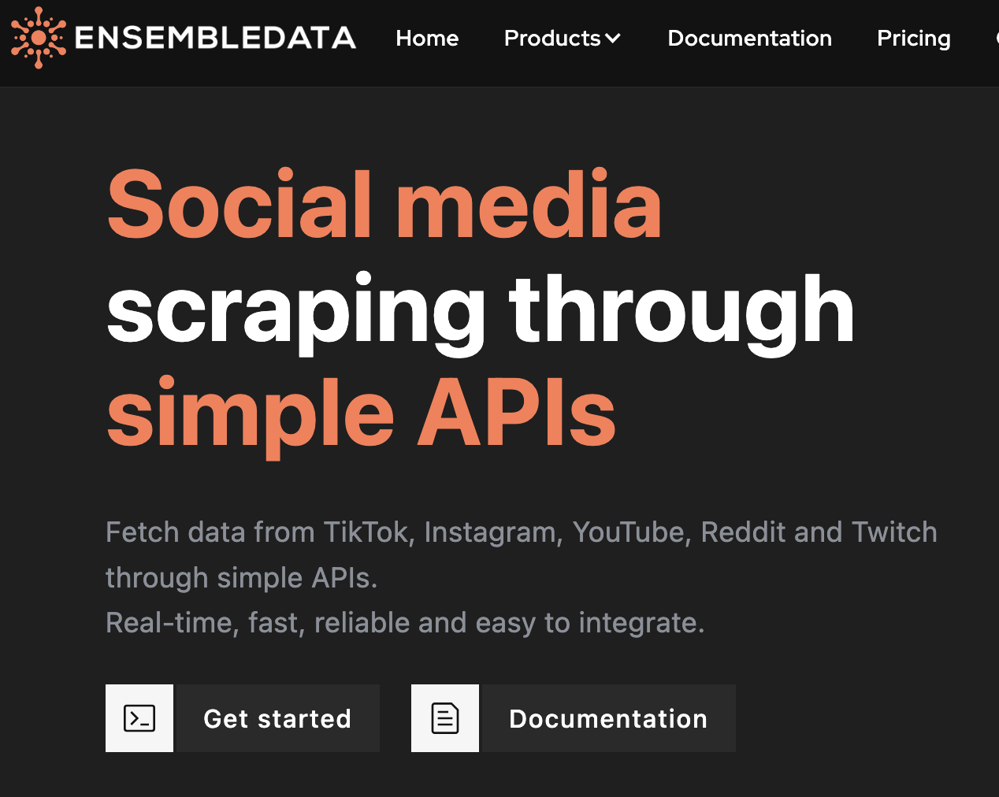
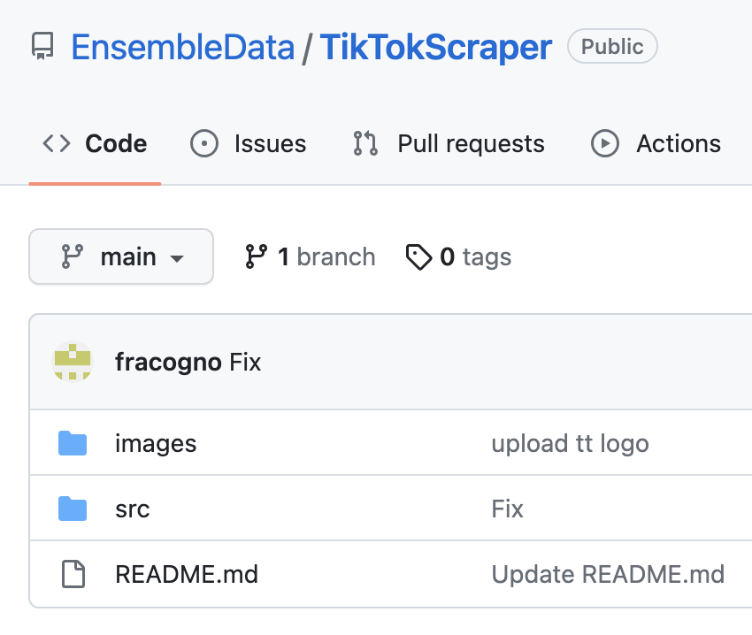
TikTok
https://www.ensembledata.com/
1 week trial period… register later on
https://github.com/EnsembleData/TikTokScraper

Slide 12
Data preprocessing
how to polish raw data from the Internet

Slide 13
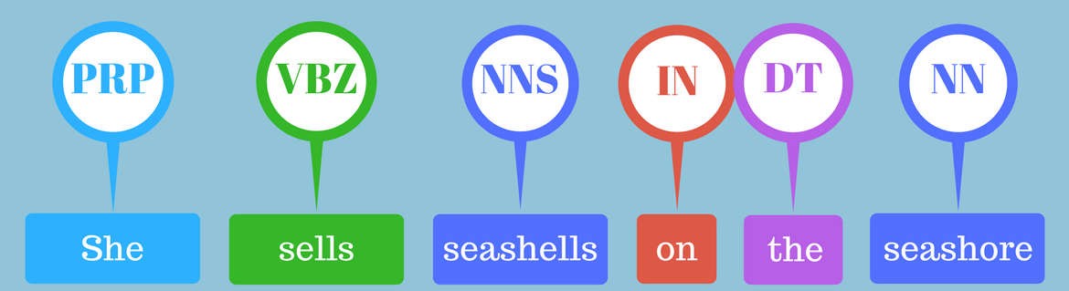
NLP cleaning process
of text sources
1. Superficial cleaning
Removing website links
Removing accented characters
Removing text inside square brackets
Removing moderator messages
Removing double spaces
Removing non-text special words and characters
Removing extra-used new lines
Limiting all the repetitions to two characters and removing the extra characters
Removing punctuation except main sentence punctuation
Removing sentences that represent the rules of the community
Fixing contractions
Removing emoji
Removing hashtags and mentions
Removing numbers
Lowercasing
Correct spellings
2. Subsentence
Tokenise subsentences
3. Deep cleaning
Stop word removal
Word tokenization
POS tagging
Lemmatization
useful for long text samples (e.g., Reddit)
truly polished text, useful for building a semantic network
the bare minimum to polish the text, useful as an input to sentiment analysis

Slide 14
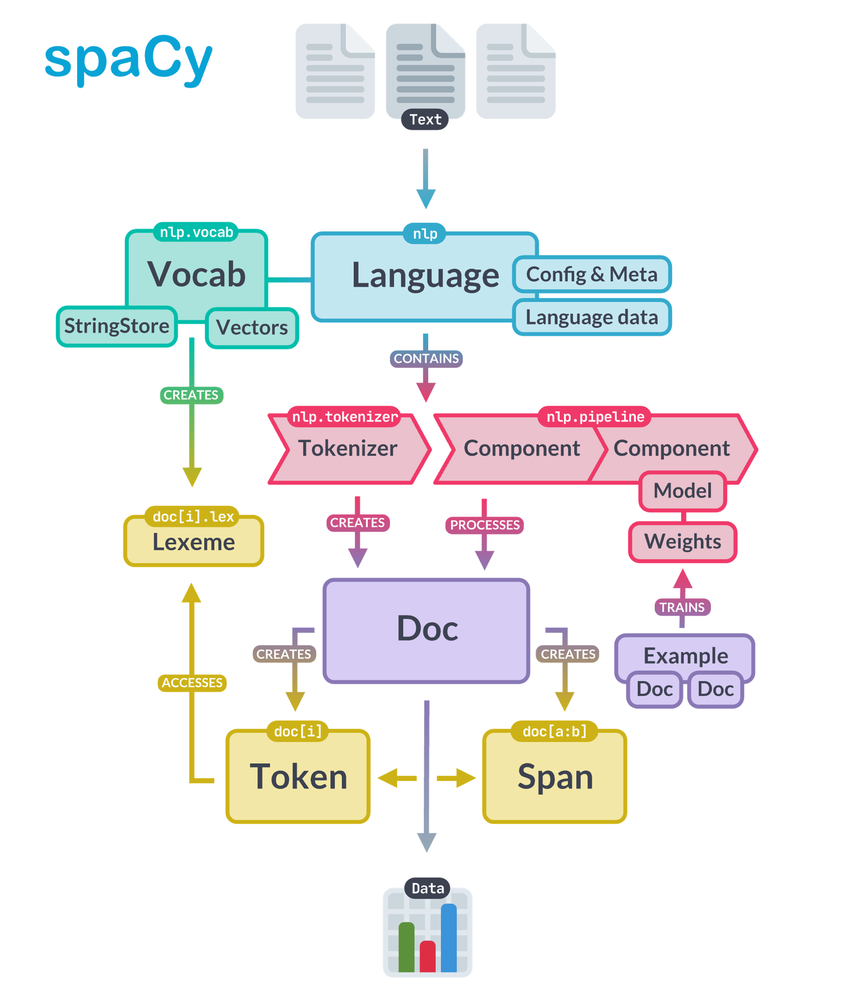
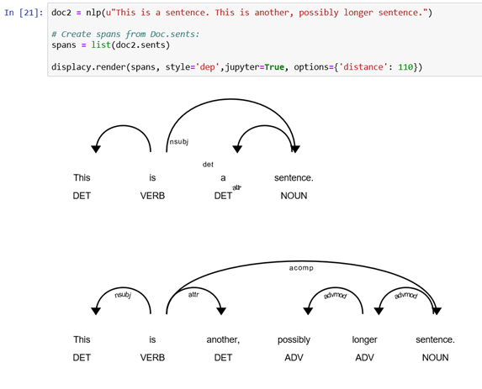
SpaCy
https://spacy.io/

Slide 15

SpaCy part-of-speech (POS) tags
https://spacy.io/
POS | description | example
ADJ | adjective | big, old, green, incomprehensible, first
ADP | adposition | in, to, during
ADV | adverb | very, tomorrow, down, where, there
AUX | auxiliary | is, has (done), will (do), should (do)
CONJ | conjunction | and, or, but
CCONJ | coordinating conjunction | and, or, but
DET | determiner | a, an, the
INTJ | interjection | psst, ouch, bravo, hello
NOUN | noun | girl, cat, tree, air, beauty
NUM | numeral | 1, 2017, one, seventy-seven, IV, MMXIV
POS | description | example
PART | particle | ’s, not,
PRON | pronoun | I, you, he, she, myself, themselves, somebody
PROPN | proper noun | Mary, John, London, NATO, HBO
PUNCT | punctuation | ., (, ), ?
SCONJ | subordinating conjunction | if, while, that
SYM | symbol | $, %, §, ©, +, −, ×, ÷, =, :), 😝
VERB | verb | run, runs, running, eat, ate, eating
X | other | sfpksdpsxmsa
SPACE | space

Slide 16
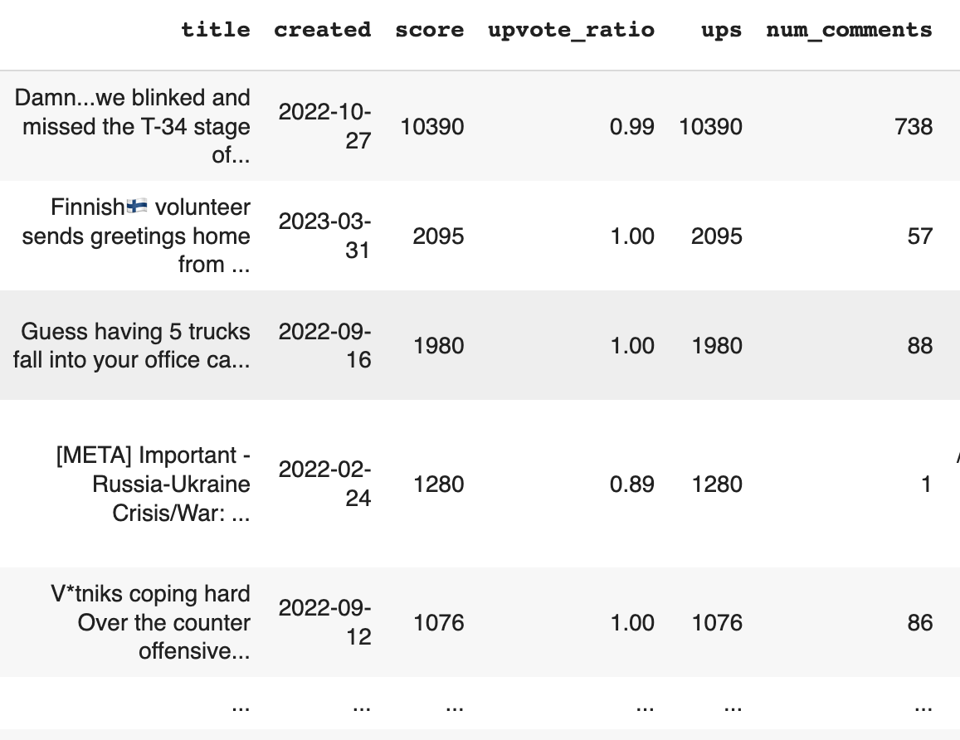
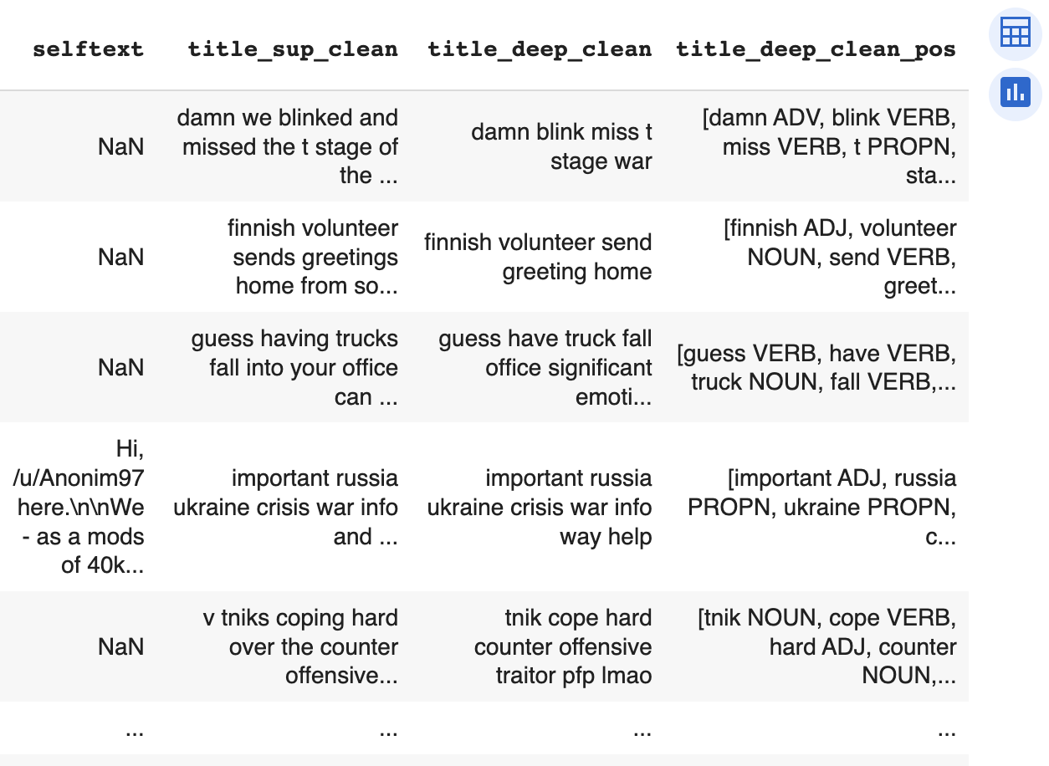
Example
ukrainewar from Reddit
true date
superficial cleaning
deep cleaning
only ADJ, ADV, NOUN, PRON, PROPN, VERB kept

Slide 17
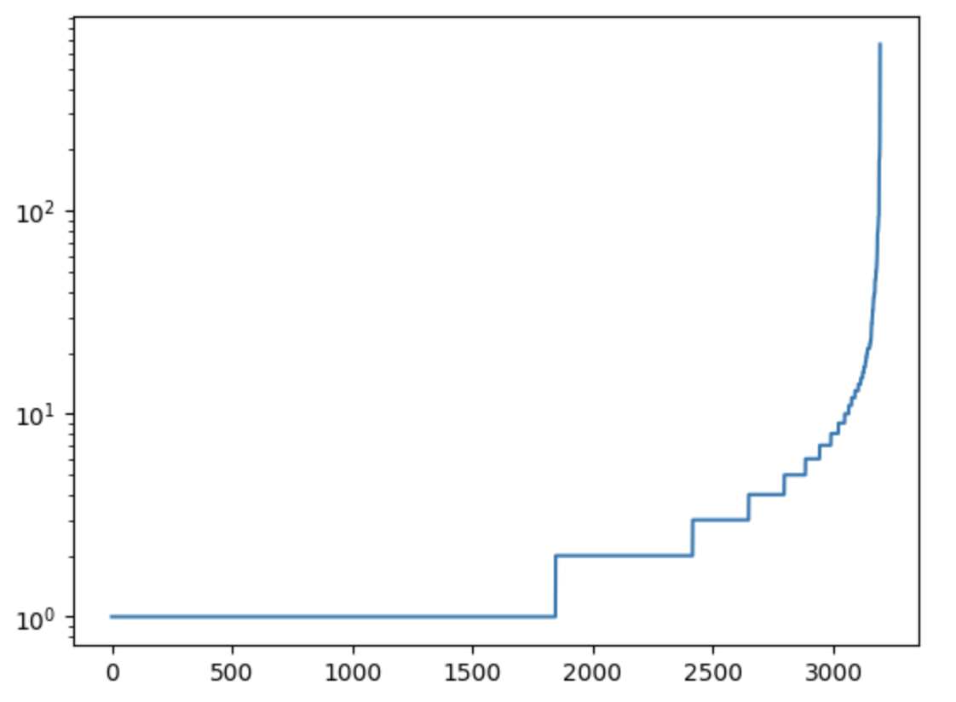
Example
always check words occurrencies
occurrence
(i.e., number of times it appears in the documents)
high-occurrence words build the true semantic network
might want to discard words with very low occurrence
word index

Slide 18
Building the semantic network
bipartite and projected counterparts

Slide 19
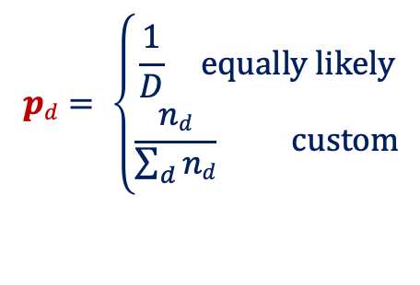
Probability matrices
linking words to documents
number of occurrences of words in documents
probability of words given a documents
0 | 1 | 1 | 1
1 | 1 | 1 | 1
1 | 0 | 1 | 0
0 | 0 | 1 | 1
1 | 0 | 1 | 1
0 | ½ | ⅕ | ¼
⅓ | ½ | ⅕ | ¼
⅓ | 0 | ⅕ | 0
0 | 0 | ⅕ | ¼
⅓ | 0 | ⅕ | ¼
#globalwarming
#climatechange
N_{wd} =
P_{w|d} =
#climateaction
#gretathunberg
#environment
we capture the statistical properties by normalizing by columns
$$pd= \left\{\begin{aligned}\frac{1}{D} equally likely \\ \frac{nd}{\sum_{d}{nd}} custom\end{aligned}\right.$$
we identify a document probability

Slide 20
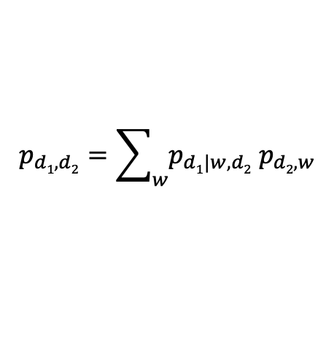
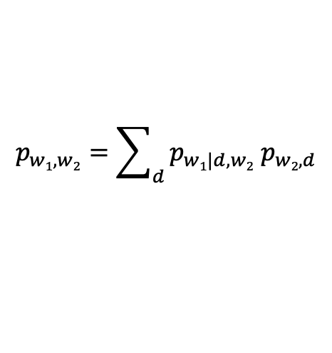
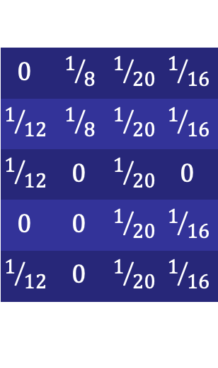
Probability matrices
projecting to words or documents
bipartite network
$$p_{w1,w2}=\sum_{d}{p_{w1|d,w2}{ p}_{w2,d}}$$
joint probability of words and documents
P_{wd} = P_{w|d} diag(p_{d})
P_{ww} = P_{wd} diag(p_{d})⁻¹ P_{wd}^{T}
$$0$$ | $$1/8$$ | $$1/{20}$$ | $$1/{16}$$
$$1/{12}$$ | $$1/8$$ | $$1/{20}$$ | $$1/{16}$$
$$1/{12}$$ | $$0$$ | $$1/{20}$$ | $$0$$
$$0$$ | $$0$$ | $$1/{20}$$ | $$1/{16}$$
$$1/{12}$$ | $$0$$ | $$1/{20}$$ | $$1/{16}$$
p_{w} = P_{ww} 1
projection on words
projection on documents
$$p_{d1,d2}=\sum_{w}{p_{d1|w,d2}{ p}_{d2,w}}$$
P_{dd} = P_{wd}^{T} diag(p_{w})⁻¹ P_{wd}
marginal probabilities
p_{w} = P_{wd} 1
p_{d} = P_{wd}^{T} 1
p_{d} = P_{dd} 1

Slide 21
Bipartite and projected networks
a comparison
H₁
bipartite network P_{wd}
H₂
H₅
H₁
T₁
H₃
H₄
H₂
projection on hashtags P_{ww}
T₂
H₃
projection on tweets P_{dd}
T₃
H₄
T₁
Tweets
H₅
Hashtags
T₂
T₃

Slide 22
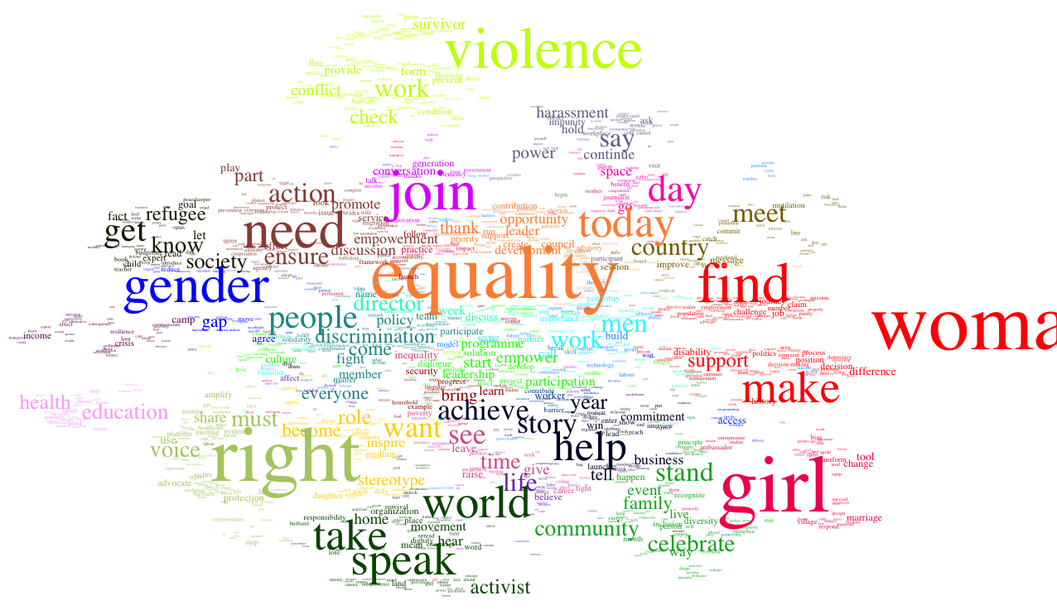
Projection on words
an example
#metoo tweets

Slide 23
Sentiment analysis
adding useful insights to your data

Slide 24
Socio-psychological markers
beyond simple sentiment
Sentiment – e.g., positive, negative, neutral
enduring cognitive content that defines the affective state
Emotion – e.g., anger, disgust, fear, joy, sadness
intense affective state of short duration with a precise cause
Ingroup bias – e.g., use of pronouns I, we, us
tendency to favor one’s own group over other groups
Outgroup bias – e.g., use of pronoun they
tendency to dislike members of groups we don’t identify with
Agency – e.g., use of action verbs do, take, make
perception that an individual is able to contribute to/a group
can collectively reach a social change

Slide 25
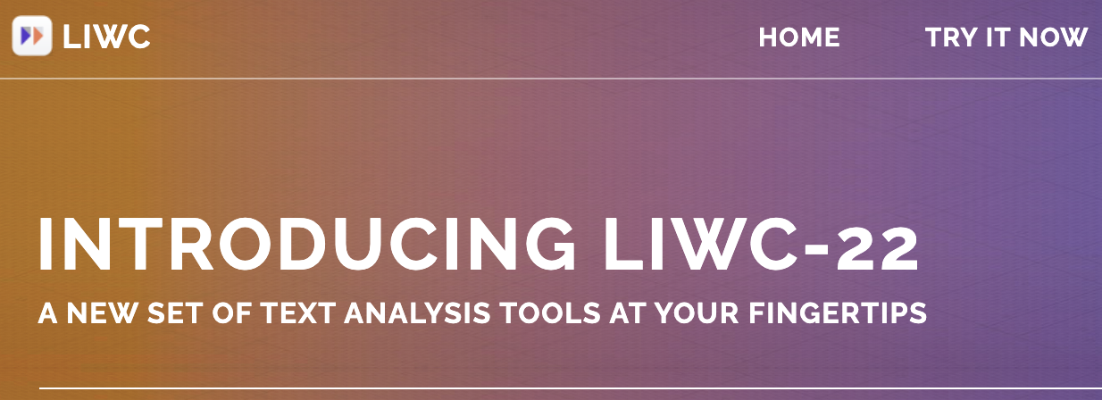
LIWC linguistic inquiry and word count
Tausczik, Pennebaker. "The psychological meaning of words:
LIWC and computerized text analysis methods." (2010)
https://citeseerx.ist.psu.edu/document?repid=rep1&type=pdf&doi=79d2494cc10a9633c42115df84bb74ed447080f6
https://www.liwc.app/
word count (or dictionary) methodology
over 60 dictionaries coded and validated for their accuracy in reflecting psychological content
simplicity of implementation and usage
state-of-the-art in psychology
one licence available in the instructor’s PC ☺

Slide 26
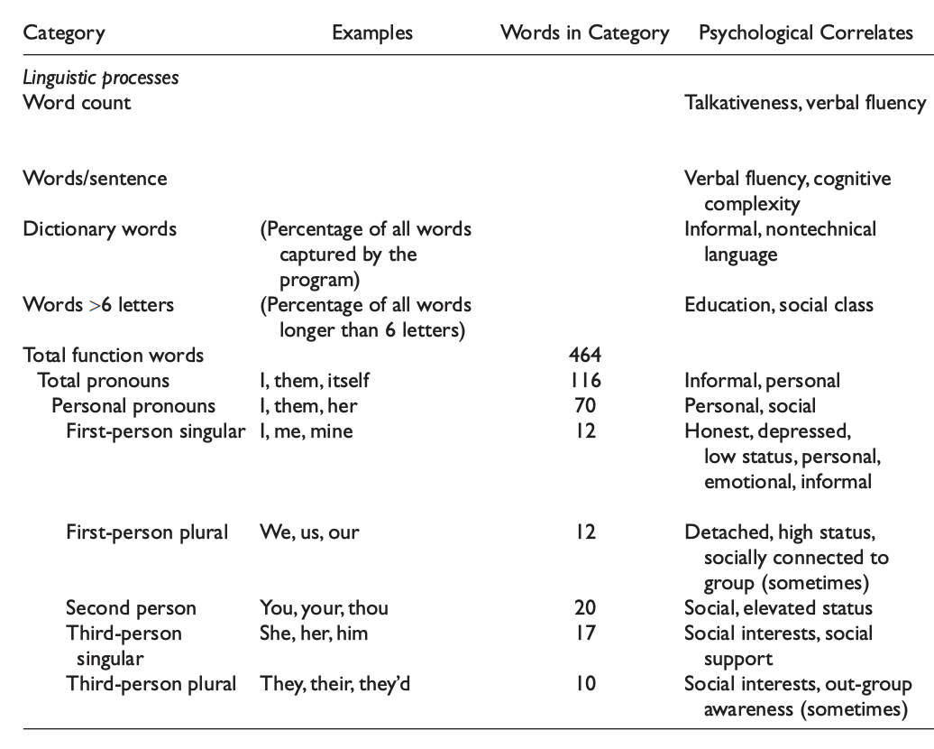
LIWC categories
ingroup and outgroup
ingroup
outgroup

Slide 27
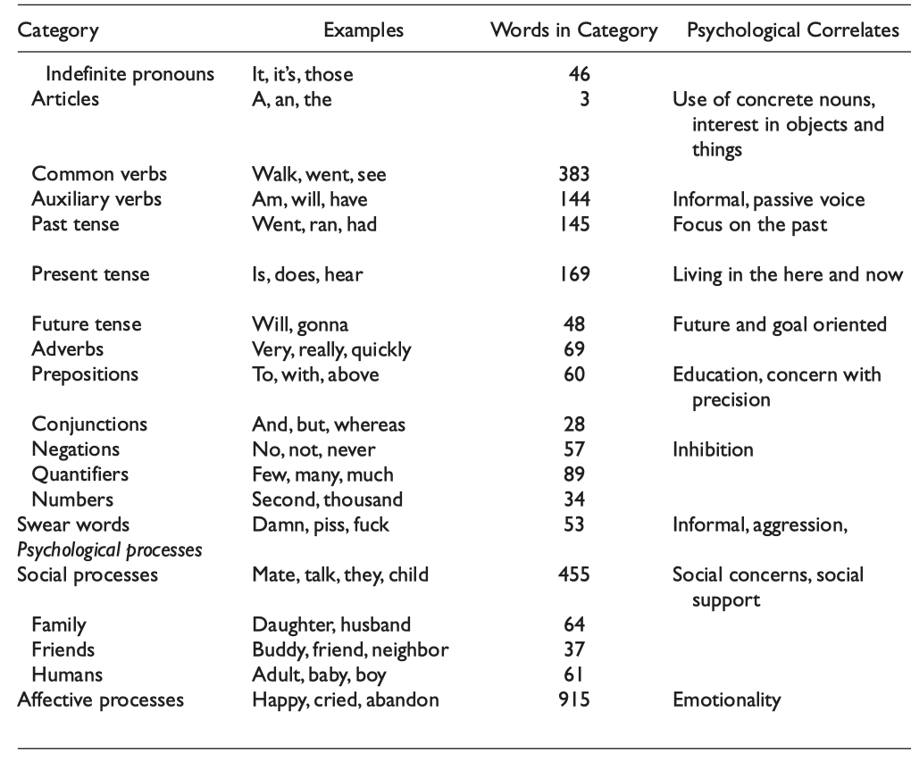
LIWC categories
goal orientation, aggression, social concern, emotionality
focus on past, present or future

Slide 28
LIWC categories
a full list
WC | Analytic | Clout | Authentic | Tone | WPS | Sixltr | Dic | function | pronoun
ppron | i | we | you | shehe | they | ipron | article | prep | auxverb
adverb | conj | negate | verb | adj | compare | interrog | number | quant | affect
posemo | negemo | anx | anger | sad | social | family | friend | female | male
insight | cause | discrep | tentat | certain | differ | percept | see | hear | feel
bio | body | health | sexual | ingest | drives | affiliation | achieve | power | reward
risk | focus past | focus present | focus future | relativ | motion | space | time | work | leisure
home | money | relig | death | informal | swear | netspeak | assent | nonflu | filler
AllPunc | Period | Comma | Colon | SemiC | QMark | Exclam | Dash | Quote | Apostro
Parenth | cogproc
Choose the ones of interest to your project!

Slide 29
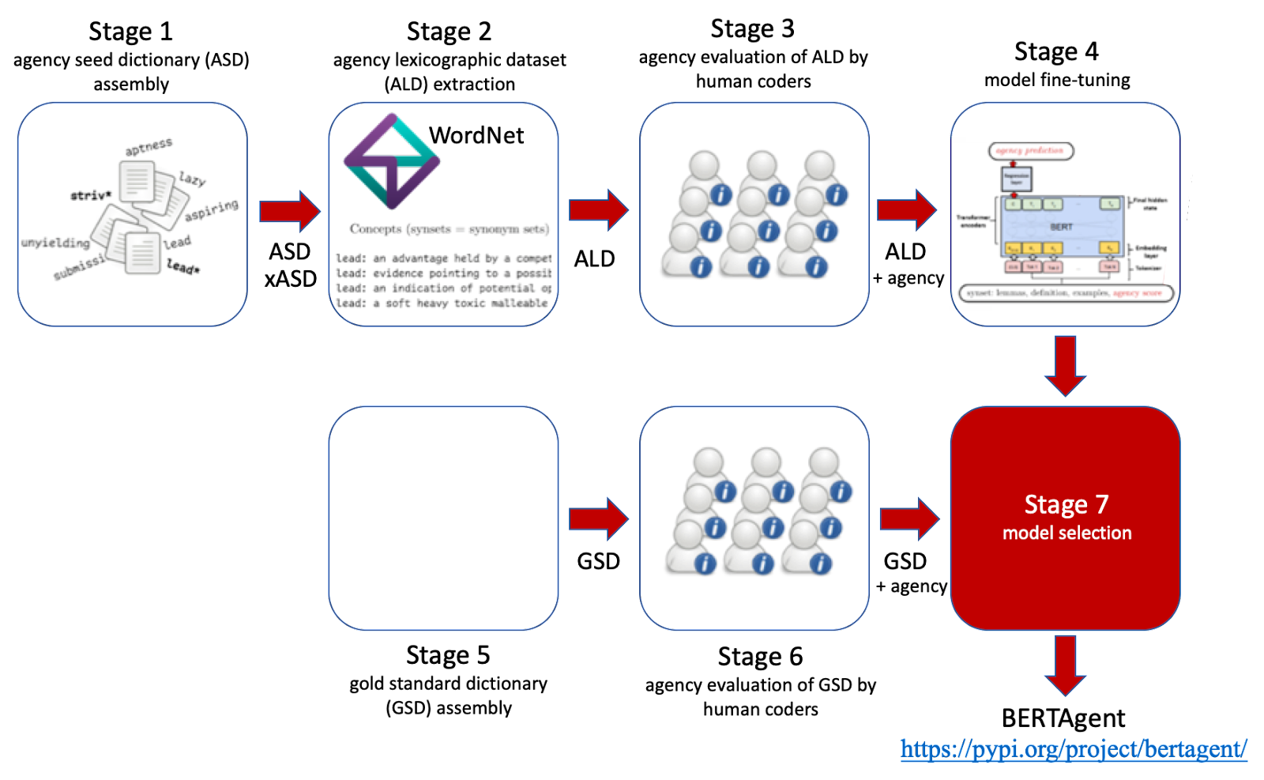
BERTAgent
Nikadon et al., «BERTAgent: A novel tool to quantify agency
in textual data,» (2023) https://psyarxiv.com/qw6u3
agency in text
uses deep learning
based on BERTA
a validated tool
available on Python

Slide 30
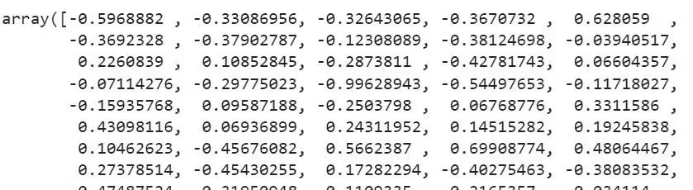
BERT
Training a NLP tool
Fight for your rights!
sentence (words)
Agency = 0.83
embedding
value
Map
0.02
loss
BERT
Comparison
NLP parameters are set to provide an agency value close to what is evaluated by humans
A large and dedicated dataset is needed!
reference value
Human evaluated agency = 0.85

Slide 31
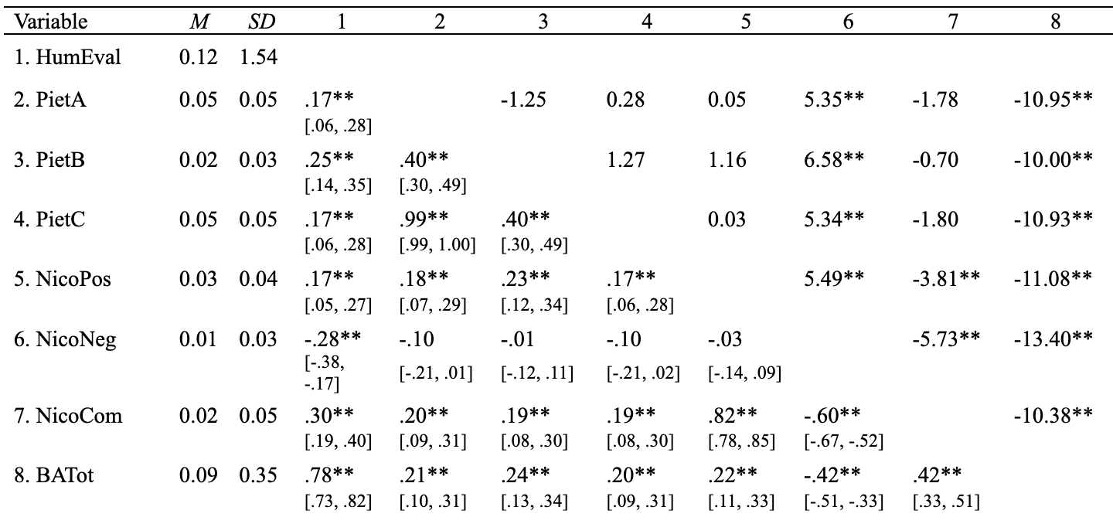
Validation of BERTAgent
deep learning wins versus DWC = dictionary word count
Human evaluation
BERTAgent
Z-statistics:
correlation is statistically more relevant that DWC
best correlation with Human evaluation

Slide 32
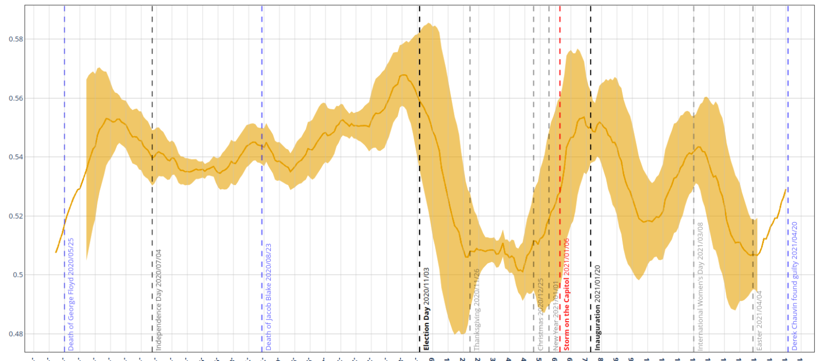
Agency in US elections
Twitter, 2020-2021
by Jan Nikadon @ swps
Election day
Capitol Hill
Women’s day
agency raises before elections than drops

