Slide 1
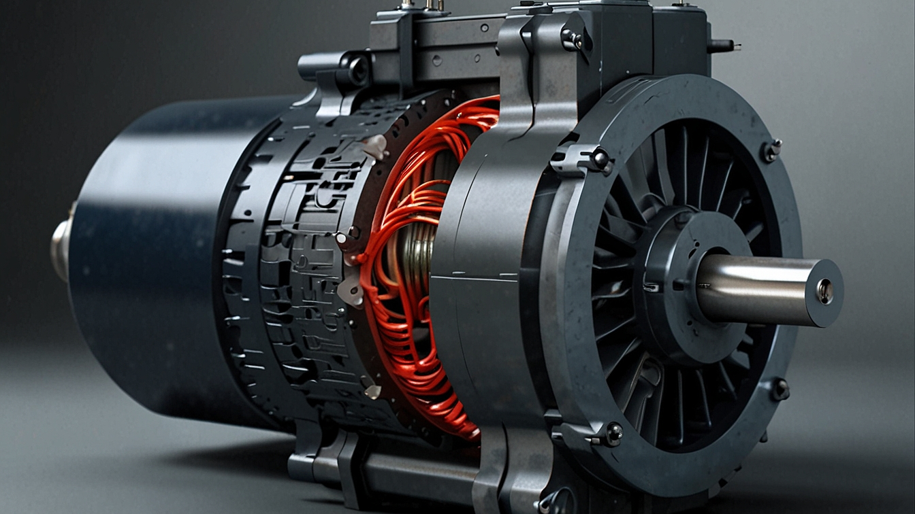
Supercondting motor and generators
Filippozzi Davide
Superconducting Materials 2023/2024

Slide 2
Why superconducting materials?
An IEA report of 2011 stated that globally, electric motor-driven systems consume at least 7000 TWh/yr, roughly equivalent to 45% of all end-use electricity consumption.
Superconductors could help increase the efficiency of this machines and reduce the overall energy consumption.
Source: IEA statistics, 2006; A+B International, 2009 (motors).

Slide 3
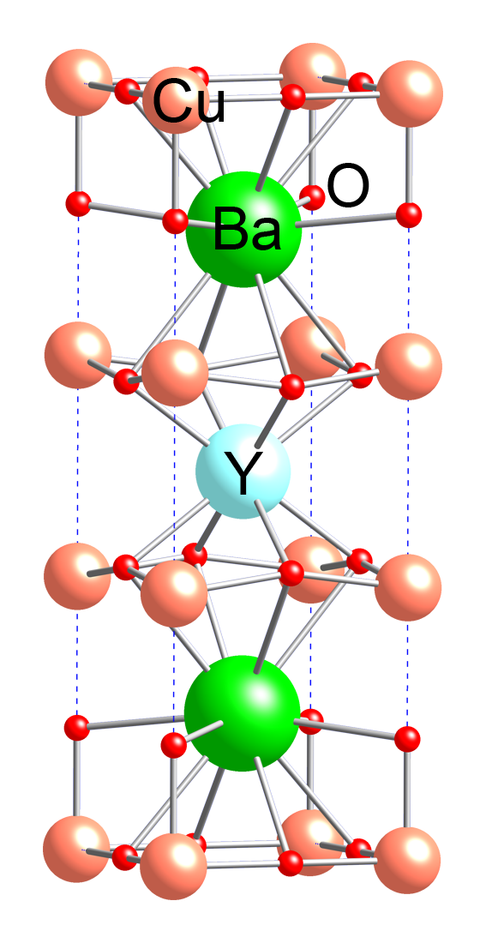
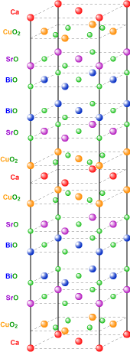
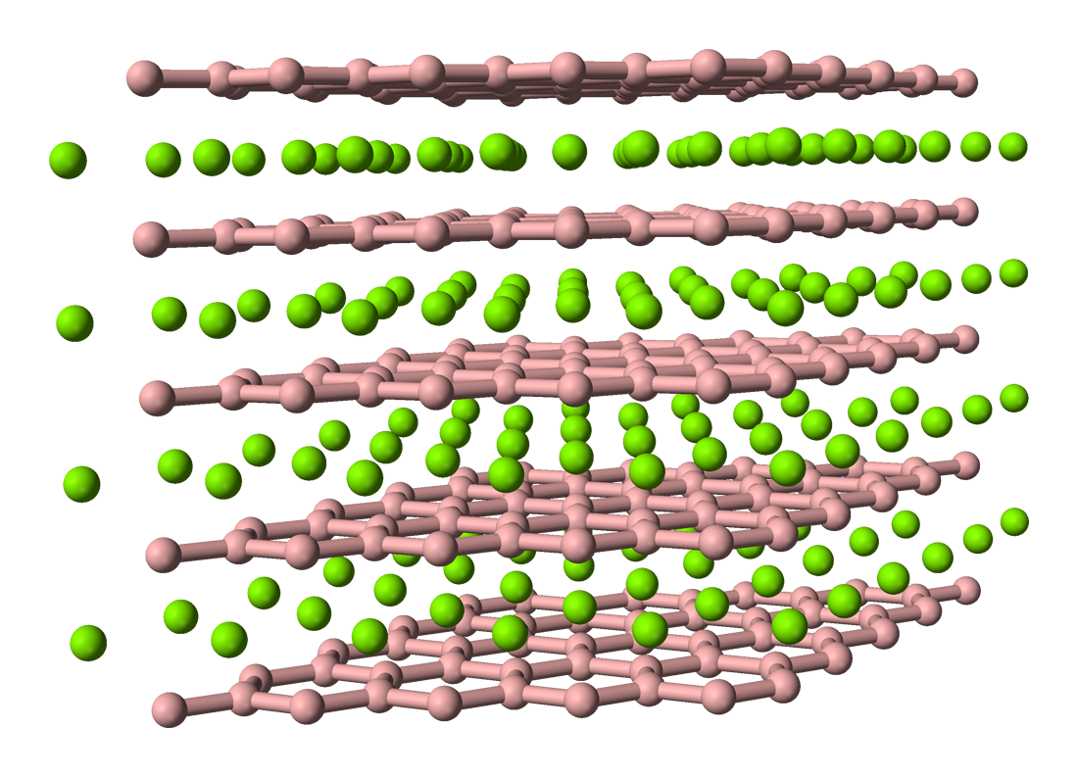
What type of superconductors can we use?
BSCCO
Bismuth strontium calcium copper oxide
can be used in two forms:
$Bi_{2}Sr_{2}CaCu_{2}O_{x}$ (Bi-2212)
$Bi_{2}Sr_{2}Ca_{2}Cu_{2}O_{x}$ (Bi-2223)
RE BCO
rare-earth barium copper oxides are usually used as:
YBCO
GdBCO
$$MgB_{2}$$
Crystal structure of$MgB_{2}$
Crystal unit cell of YBCO
Crystal unit cell of BSCCO-2212

Slide 4
In what form can these superconductors can be used?
Wires/tapes: BSCCO, and $MgB_{2}$ can be used as tapes or wires. REBCO is always used as a tape
Bulk: Superconducting materials in bulk form can trap large magnetic fields and function as permanent magnet (PM) analogues
Stacked tapes: Can also be used as PM. They also offer advantages like increased thermal stability and mechanical strength. Stacks can also be manufactured to more complicated shapes

Slide 5
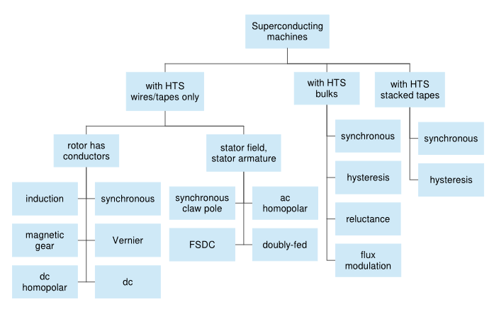
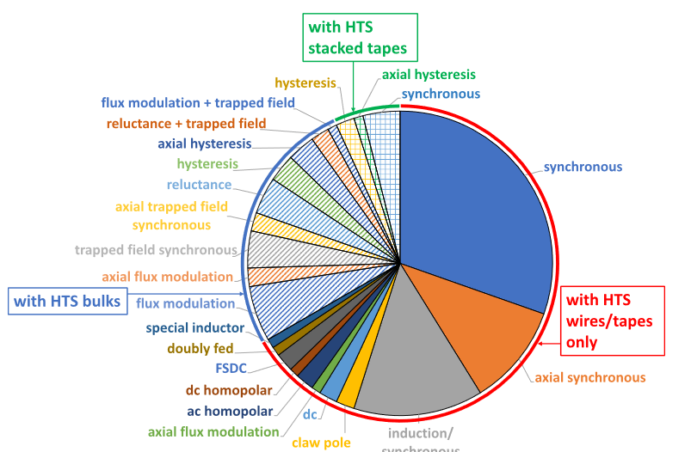
What type of machines can be built?
Classification of SC machines based on the form of the material.
Summary of the types of major superconducting machine prototypes build around year 2000
Source: High temperature superconducting rotating electrical machines: An overview Calvin C.T.

Slide 6
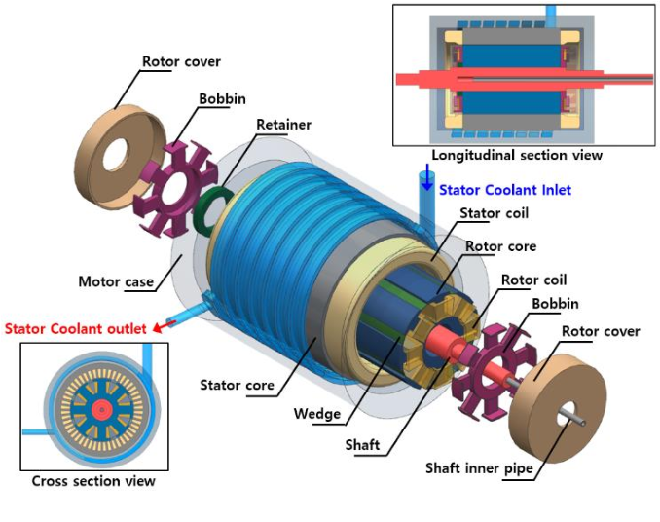
Working principle of a synchronous electric motor
Main components
Stator: The stationary part of the motor that contains windings connected to the AC power supply. When AC voltage is applied, it creates a rotating magnetic field.
Rotor: The rotating part of the motor, which usually has permanent magnets or electromagnets.
How it works
When AC power is supplied to the stator windings, it generates a rotating magnetic field.
The rotor, which has its own magnetic field (from permanent magnets or induced current), locks onto the rotating magnetic field of the stator.

Slide 7
Advantages
Disadvantages
The zero (dc) resistance in the superconducting state results in no ohmic loss when acting as a magnet carrying dc.
Much higher current density compared to copper.
Bulks and stacked tapes can provide magnetic field.
The weight and size of the machine can be reduced.
Ac loss when carrying ac current or experiencing time-varying magnetic fields
The cryogenic cooling power required to remove the heat generated is much larger than the raw loss, reducing the overall efficiency of the machine.
Superconducting wires/tapes also have limited mechanical strength and bending radii, adding an additional constraint with respect to conventional machines.
Wires/tapes can suffer from a quench

Slide 8
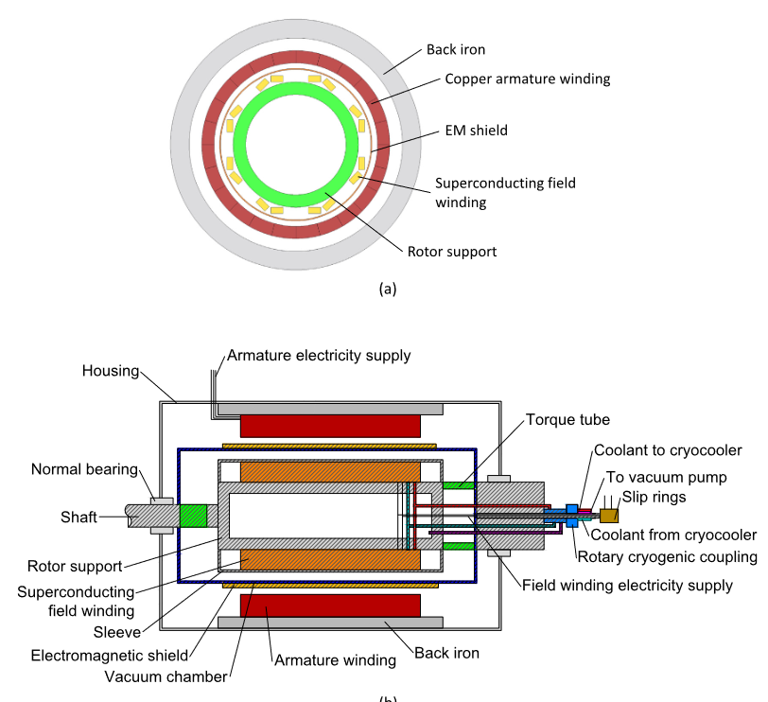
Synchronous superconducting motor
There are three main design:
Field-Superconducting: Is a partially-superconducting synchronous machine with HTS rotor field windings
Armature-Superconducting: Partially superconducting synchronous machine designs that employ an HTS armature winding
Fully-Superconducting: Both armature and rotor winding are superconducting

Slide 9
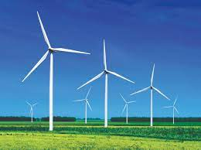
Possible applications
This machines can be used in a variety of applications which require lightweight and compact machines with high power density, particularly where size and weight are very significant cost drivers. The main one are:
Aircraft propulsion
Electric ship propulsion: This sector has seen major programs run by companies (AMSC, IHI, Kawasaki, DOOSAN).
Wind turbine generators: This sector has attracted the founding from major EU projects.

Slide 10
Future trends
Development of fully-superconducting machines where both the armature and field windings are superconducting
Design efforts are being focused on topologies that eliminate the need for placing HTS materials on the rotor.
Higher magnetic and electrical loadings, leading to an even higher power density, reduced design complexity
Eliminate the need for rotary cryogenic and current couplings, and reduce vibrational and rotational forces on the superconductors

Slide 11
THANKS FOR THE ATTENTION!

