Slide 1
SUPERCONDUCTING MAGLEV TRAIN
The fastest
train
in the world

Slide 2
What is conventional train limit?
Conventional trains produce friction between the wheels and rails while operating. This limits maximum speed because the wheels slip when moving too fast.
The SCMaglev overcomes this limitation by using magnetic force to levitate the train above the track. It is free from friction-induced noise because it has no contact between wheels and rails, or between contact wires and pantographs.

Slide 3
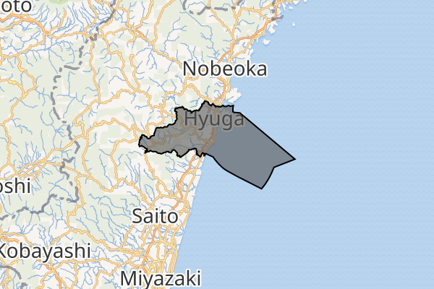
History 1.
1962
1972
1980
Japanese National Railways began research on a linear propulsion railway system to develop a train that could travel between Tokyo and Osaka in one hour.
The first successful SC Maglev runs on a short track at its Railway Technical Research Institute.
The 7 km Hyuga Miyazaki track was modified from a "reverse-T" shape to the "U" shape used today.

Slide 4
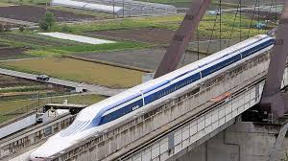
History 2.
1987
1990
2011
2027
Central Japan Railway Company took over SC Maglev development.
Construction of the Yamanashi maglev test line.
Until 2011 MLX01 trains were tested, when the facility was closed to extend the line to 43 km.
The one hour travel is expected to be opened to the public.

Slide 5
Superconducting magnets
Why not to use a normal magnet?
Not able to increase the current value beyond a certain limit due to the heating issue.
NbTi
9.2 K
700 kA
Daniela Gadaleta Superconducting materials 2023/2024 University of Padua

Slide 6
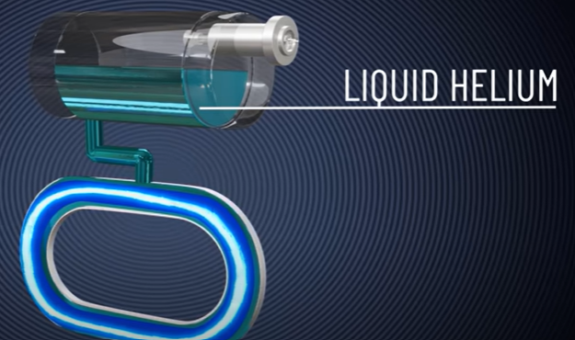
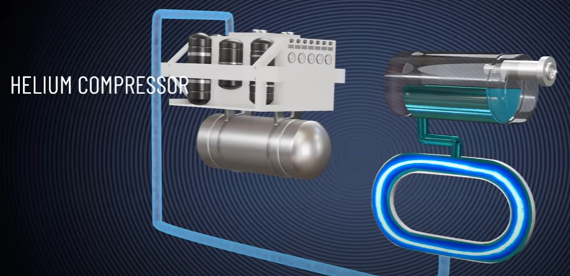
Refrigeration system 1.
To keep NbTi below Tc, liquid He at 4.5 K is circulated around it
To bring it back to the initial stage
Daniela Gadaleta Superconducting materials 2023/2024 University of Padua

Slide 7
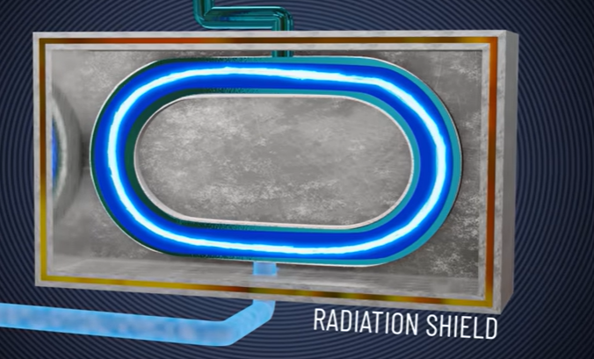
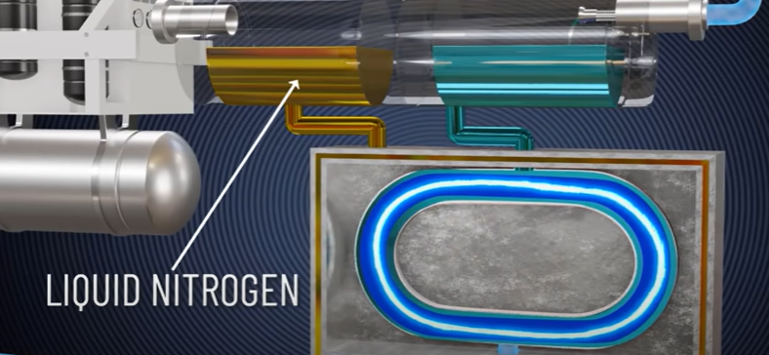
Refrigeration system 2.
To prevent absorption of radiation from the outside
To neutralize heating, liquid N2 is supplied
Daniela Gadaleta Superconducting materials 2023/2024 University of Padua

Slide 8
Objectives
PROPULSION
LEVITATION
GUIDANCE
→ the action of driving or pushing forwards
→ the action of rising or causing something to rise and hover in the air
→ the directing of the motion or position of something
Daniela Gadaleta Superconducting materials 2023/2024 University of Padua

Slide 9
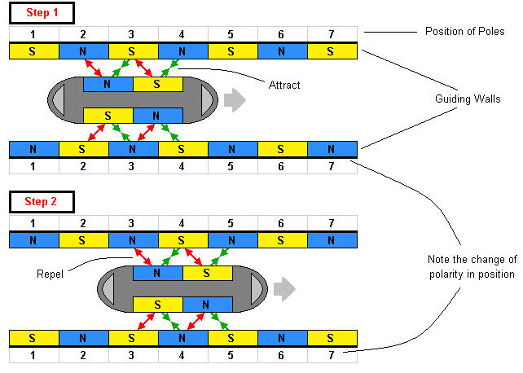
1) Propulsion
Propelling coils in the guideway
Step 1 → Net force in forward direction
Step 2 → As soon as the train reaches the next position, switch the electromagnets to the alternate polarity so that the net force is again in the forward direction.
Daniela Gadaleta Superconducting materials 2023/2024 University of Padua

Slide 10
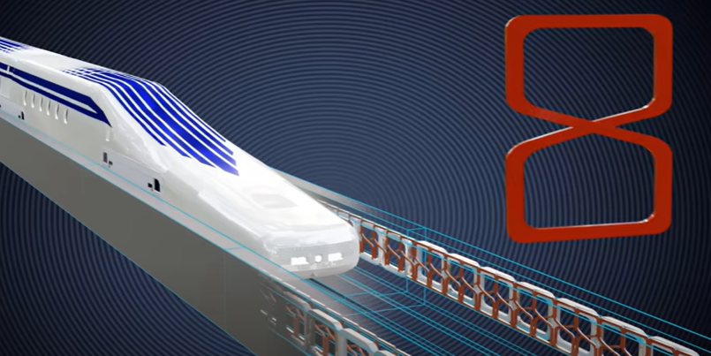
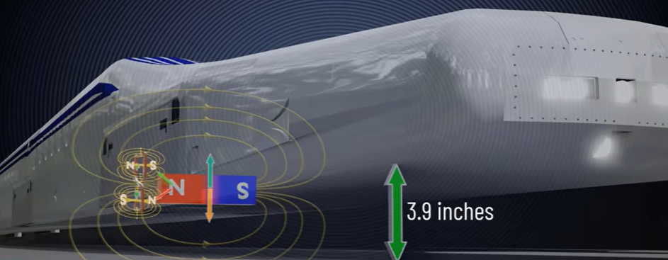
2) Levitation 1.
Figure-eight shaped coils
If a bar magnet moves parallel to the coils, the varying magnet flux will induce EMF on both the loops according to Faraday's law. The induced EMFs are opposite in direction, which means net EMF induced on this coil due to the bar magnet movement is zero, and no current will flow through the loop.
Daniela Gadaleta Superconducting materials 2023/2024 University of Padua

Slide 11
2) Levitation 2.
1
Magnet slightly offset to the loop
2
Bottom (or top) loop with higher magnetic flux
3
Bottom (or top) loop with higher induced EMF
4
5
6
7
8
9
10
Net current through the loop
Creation of poles
Resultant magnetic force upward
If higher than gravitational one, the magnet moves up
Reduction of difference between EMFs and currents
Upward force equals the gravitational pull
3,09 inches (7,85 cm) LEVITATION
There is no need to feed electricity to the coils to achieve train levitation
Daniela Gadaleta Superconducting materials 2023/2024 University of Padua

Slide 12
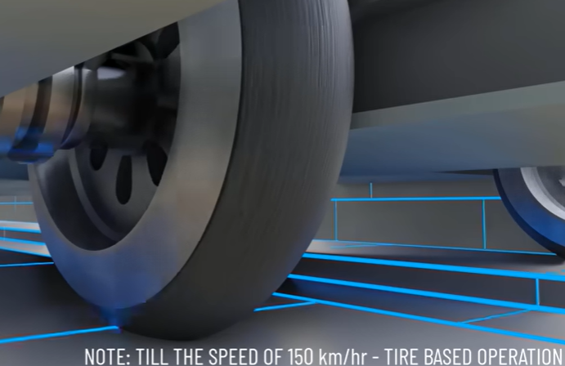
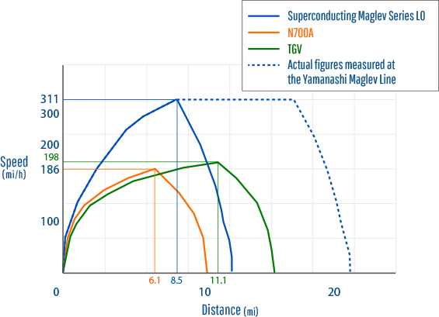
2) Levitation 3.
The higher the train speed, the greater the levitation force, which means that when the train is at rest, it cannot levitate.
This is why the SC Maglev train uses normal tires for starting and low-speed operation.
When the train achieves the 150 km/h critical speed, the tires retract, as the electromagnetic force is strong enough to levitate the train.
Daniela Gadaleta Superconducting materials 2023/2024 University of Padua

Slide 13
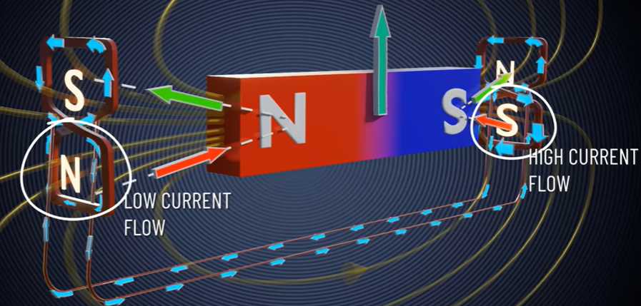
3) Guidance
On one side
EMF difference between right and left coils results in a current in the interconnecting coils.
It affects the current flow in the bottom loops, thus the pole strength of each loop.
The vertical components of the forces remain the same, but a net horizontal component manifests towards one side, which forces the train to move back to the centre.
As the train nears the centre, the currents in the interconnecting loops decrease and the horizontal force disappears.
Center
Induced EMFs on the right and left coils will be equal and no current will flow through the interconnecting coils
Daniela Gadaleta Superconducting materials 2023/2024 University of Padua

Slide 14
ADVANTAGES
HIGH
SPEED
(WORLD RECORD 603 km/h)
COMFORT
AND
SILENCE
ENERGY EFFICIENCY
GREATER
SLOPE ABILITY
REDUCED MAINTAINANCE COST
NOSE SHAPE TO REDUCE OF 13% AIR RESISTANCE
DISADVANTAGES
NEW
INFRASTRUCTURES
NEEDED
EXPENSIVE
Daniela Gadaleta Superconducting materials 2023/2024 University of Padua

Slide 15
THANK YOU FOR YOUR ATTENTION!
Daniela Gadaleta

