Slide 1
Perovskite Superconductor
Course of superconductor, Enrico Cremonesi
15/02/24, Padova

Slide 2
How can be use perovskite for superconductors?
Perovskite can be used to produce materials that manifest superconductivity at high T.
Perovskites have a typical structure of ABO3
A gives the structural stability
B favour the electrical conductivity
Structure ABO₃ for the SrTiO₃ perovskite
Firstly, in the 60’ scientist found Superconductivity for the SrTiO3 at 0.3K, after that in Switzerland others scientist raise up Tc at 1.2 K by doping with Nb.
That was the first correlation between perovskite and superconductors.

Slide 3
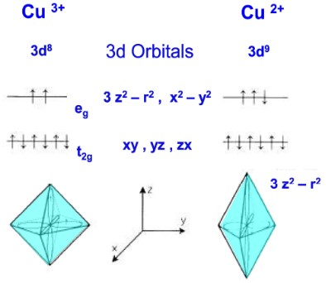
How are correlated perovskite and SC?
Elongation of octahedron for Cu³⁺ (blue) and for Cu²⁺ (red)
Nowadays, the most important family of perovskite for SC are cuprates.
Scientist in 86’ studied the Jahn-Teller effect that occur mostly for transition metals with d⁹ electronic configuration.
This effect corresponds to an axial elongation of the bonding called dynamic JT effect that cause the lattice vibration.
Although still in the research phase, this effect makes the Cooper pairs typical of superconductivity more effective.
Crystal field for Cu³⁺ and for Cu²⁺

Slide 4
REBCO
Perovskite SC are principle based on REBCO, a cuprate coordinate with Ba and a rare earth.
Differently from classical SC that follow the Matias Rules, cuprate perovskite have different rules:
•Crystal structures do not have high symmetry and aren’t cubic.
• Low density of electronic states.
• High content of Oxygen.
•proximity to a magnetic phase in the phase diagram.
• Compounds with a Eg that doesn’t depends on doping are insulators.
So, every point is totally opposed respect to classical SC.
II type perovskite superconductor vortex predict by BCS theory

Slide 5
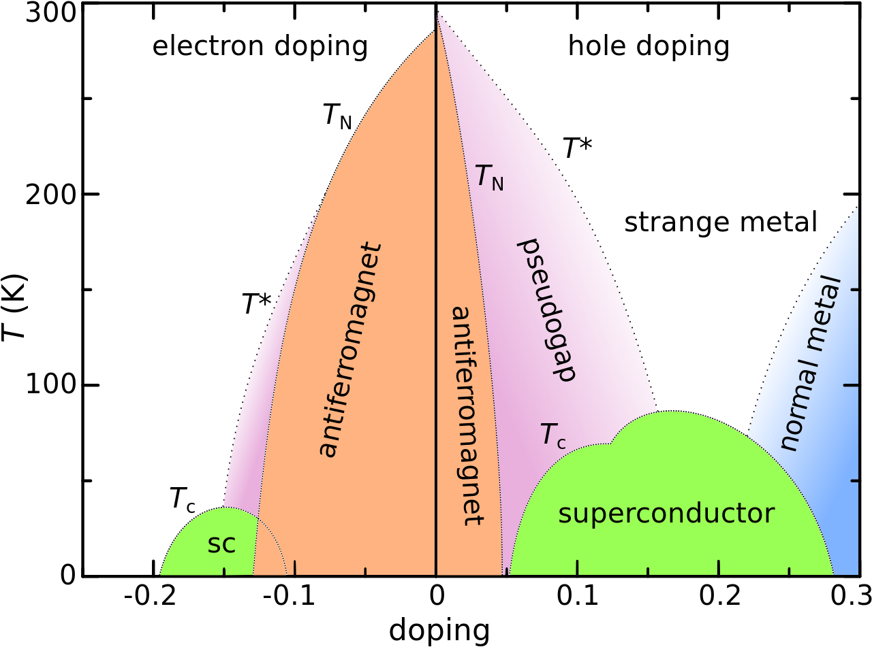
Phase diagram for Cuprate
From the diagram phase for cuprate can be seen there is only a small range of conditions of T and doping for SC.
(1 for n doping, 1 for p doping).
doping levels for every molecules of CuO2

Slide 6
YBCO
In Zurich (87’) was firstly found the cuprate La_{2-x}Ba_{x}CuO₄ , with an Tc of 35 K .
To raise up the Tc :
raise up the pressure until around 13 kbar to arrive to a Tc of 40 K,
exchanging La with Y in different stochiometric quantity
to form the YBCO or YBa₂Cu₃O₇ .
YBCO have a Tc of 90K , major than Liquid Nitrogen boiling point.
The unitary cell of the YBCO is composed of 3 sub-unite, respectively the plane of the Y stuck between the 2 planes of Ba.
Superconductivity takes place through the different layers, but property of the perovskite depends on the preparation
Orthorhombic structure of YBCO

Slide 7
Property of YBCO
YBCO planes are always stacked with a code Ba-Y-Ba, this gives a strong anisotropy for the superconductivity but not for the normal conductivity.
In fact, the conduction for superconductivity appears to be much greater parallel to the planes containing copper oxide, compared to the perpendicular direction.
While stoichiometry should give this formula: YBa₂Cu₃O₉, in the reality the perovskite works in condition of deficiency of oxygen, so the real formula should be : YBa₂Cu₃O_{7-x}, perovskite have SC properties:
only in the range of 0<x<0.65
peak of the superconductivity around 0.15 (O6.85)
Graph representing the stoichiometric amount of oxygen in function of the Tc for the YBCO

Slide 8
Preparation on YBCO
The properties of YBCO are strongly dependent on the preparation method used.
To obtain a crystalline material with the higher Tc possible the object must align between grain boundaries with careful control of annealing and hardening speeds.
YBCO can be prepared with various technique, the simplest one is by calcination and sintering of a mixture of Y₂O₃, BaCO₃ and CuO in the right proportion.
•Calcination at 900°C
•subsequently sintering at 950°C in the presence of oxygen
This operation it forms YBa₂Cu₃O₆, which through slow cooling becomes YBa₂Cu₃O_{7-x} with a transformation that is reversible.
Industrial technique to produce the YBCO
The production is still in phase of research due to issues of the fragile material, laser technique in future could guarantee best yield of exploitable tapes/wires

Slide 9
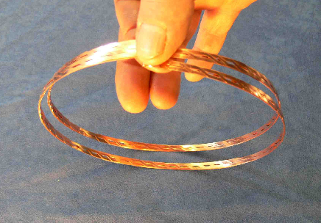
Use for YBCO
YBCO Superconductors are used to produce wires, superconducting permanent magnets and Josephson junctions.
They are they are already used commercially and not just for research purposes, but they have 2 problems:
YBCO single crystals have a high current density but polycrystals carry a low superconducting current.
fragile material, difficult to shape and draw, wire is product from tapes
The best way to use this material is to deposit a layer of YBCO on metal strips coated with buffer oxides. To fully exploit the potential of YBCO it is necessary arrange the 3 dependencies of the critical current density
Temperature
external magnetic field
angle between external field and crystallographic z-axis.
The material can be modified and optimized by creating artificial defects that act as pinning centers.
Structure of a YBCO wire, external higher, down internal

Slide 10
Perovskite SC magnets
Superconductor magnet must be cooled down the Tc before and all-over the use to permit the superconductivity.
More over Nb alloy that are frequently used, also YBCO can be used to produce a magnet at a high Tc respect to Nb alloy that can generate a sufficient high magnetic field.
Critical density in function of the magnetic film for various SC

Slide 11
Double perovskite
In addiction from YBCO can be developed a double perovskite with Nb and Ta atoms that replace Y in YBCO.
Among all there is a large improvement of the in-field current carrying capability and an aligned structure of nano-columns is obtained even for high deposition speeds.
Relative resistance for YBCO and NYBCO for various laser repetition

Slide 12
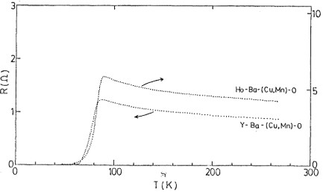
Others perovskite
On the left, HoBCO vs YBCO resistance, on the right BSSCO vs YBCO resistance
There are other perovskite that have superconductive properties like:
• HoBCO with Ho exchange with YBCO with Tc at 77K
• BSSCO with Bi, Sr and Ca exchange with Y and Ba with Tc at 107K
HoBCO respect to YBCO is simpler to deposit ,more durable and less degradable, above all in humid ambient.
BSSCO respect to YBCO is less hard to work it and more suitable to manufacturing wire and tape.

Slide 13
Conclusion
YBCO can be a valid substituent to the Nb alloy , because have properties sufficiently good to have commercial uses but the objective is to create a stable production line that forms a less fragile material.
In the future can be found other SC stable at higher Tc with an ideal objective to reach a stable SC at room temperature
YBCO SC under superconductive condition

Slide 14
References
https://doi.org/10.1016/j.jpcs.2023.111813
DOI 10.7567/JJAPS.26S3.1027
https://doi.org/10.1016/S1369-7021(08)70178-0
https://chimicamo.org/tutto-chimica/ybco-il-primo-high-temperature-superconductor/#:~:text=L'ossido%20di%20ittrio%2C%20bario,ad%20alta%20temperatura%20(HTS).
https://doi.org/10.1016/j.physc.2003.12.086
https://link.springer.com/article/10.1007/s10948-013-2178-4
https://cornerstone.lib.mnsu.edu/cgi/viewcontent.cgi?article=1345&context=etds
DOI 10.1088/1361-6668/acc4ed
https://www.researchgate.net/publication/325100815_Crystal_Structure_of_Cuprate_based_Superconducting_Materials
https://iopscience.iop.org/article/10.1088/1742-6596/1559/1/012043/pdf

