Slide 1
CHINA
The Central State and the Local Government
The Communist Party’s Rule
Regulating by principles and instructions

Slide 2
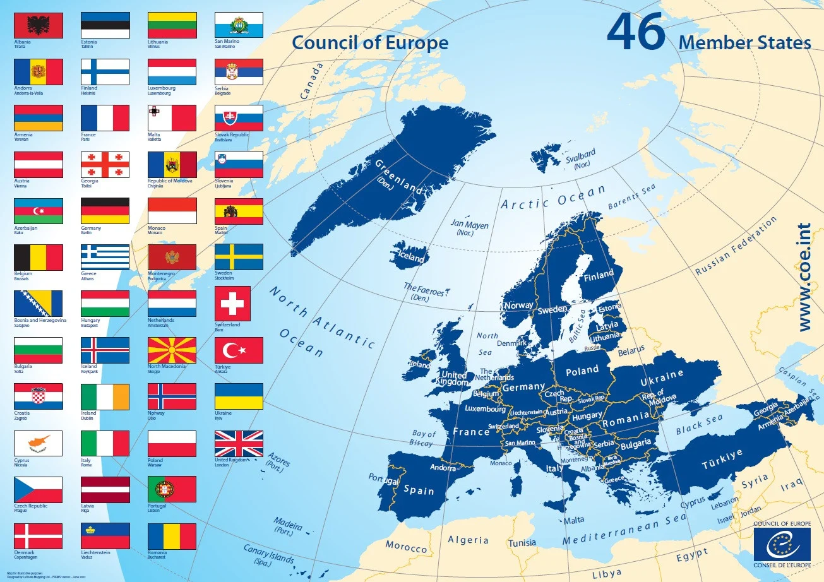
An Additional layer of complexity in Europe: The European Convention and the European Court of Human Rights

Slide 3
Art 8
1. Everyone has the right to respect for his private and family life, his home and his correspondence.
2. There shall be no interference by a public authority with the exercise of this right except such as is in accordance with the law and is necessary in a democratic society in the interests of national security, public safety or the economic well-being of the country, for the prevention of disorder or crime, for the protection of health or morals, or for the protection of the rights and freedoms of others.

Slide 4
Art. 10
1. Everyone has the right to freedom of expression. This right shall include freedom to hold opinions and to receive and impart information and ideas without interference by public authority and regardless of frontiers. This Article shall not prevent States from requiring the licensing of broadcasting, television or cinema enterprises.
2. The exercise of these freedoms, since it carries with it duties and responsibilities, may be subject to such formalities, conditions, restrictions or penalties as are prescribed by law and are necessary in a democratic society, in the interests of national security, territorial integrity or public safety, for the prevention of disorder or crime, for the protection of health or morals, for the protection of the reputation or rights of others, for preventing the disclosure of information received in confidence, or for maintaining the authority and impartiality of the judiciary.

Slide 5
The European Court of Human Rights’ powers
It intervenes after the exhaustion of domestic remedies
It addresses complaints against States
Its rulings establish obligations, but hardly have direct effects within state jurisdictions

Slide 6
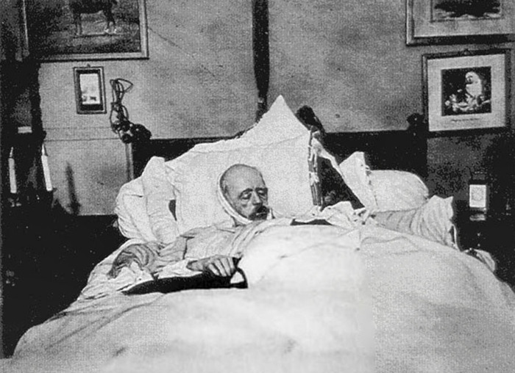
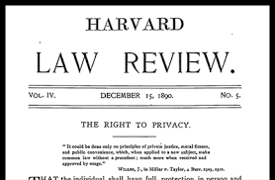
How Privacy Was Born

Slide 7
The Development of Privacy & Dignity
From Places…
To People…
From Protecting People from Private Powers…
To Protecting People from Public Powers
From People to Information

Slide 8
The Barbra Streisand Effect & the Paradox of Privacy

Slide 9
The Shield of Privacy: which limits? The Proportionality Scrutiny
Other interests can prevail over privacy–it depends on the jurisdiction
(es. Intellectual property)
Proportionality scrutiny: it is a means to assess the legitimacy of a solution

Slide 10
The structure of proportionality
Is the goal of a measure lawful?
Does the measure truly pursue the goal it purports to pursue?
Is the measure the least restrictive means to achieve the goal?
Do the benefits outweigh the damages?

Slide 11
Why the Proportionality Test is so important?
It shapes judicial assessments
It forces parliaments and executives to incorporate the proportionality analysis
It allows authorities without democratic legitimacy to address political issues
It incorporates technical considerations into legal analysis
It pushes private companies that deal with data to incorporate privacy analysis

Slide 12
An Example: Costeja Gonzalez v. Google Spain (C-131/12)
Google publishes results and ranks them
Costeja Gonzalez complains that by publishing old information about him it is damaging his reputation and privacy
The “Right to be Forgotten” is born
The “Right to be Forgotten” requires a proportionality assessment

Slide 13
Legal & Technical Problems
How do you translate a proportionality assessment into google search?
Can you review it? The problem of “gaming the system”
The problem of intellectual property
The more you use privacy, the more boring the Internet becomes

Slide 14
Art 17 GDPR The Right to Erasure (“to be forgotten”)
The data subject shall have the right to obtain from the controller the erasure of personal data concerning him or her without undue delay and the controller shall have the obligation to erase personal data without undue delay where one of the following grounds applies:
the personal data are no longer necessary in relation to the purposes for which they were collected or otherwise processed;
the data subject withdraws consent on which the processing is based according to point (a) of Article 6(1), or point (a) of Article 9(2), and where there is no other legal ground for the processing;
the data subject objects to the processing pursuant to Article 21(1) and there are no overriding legitimate grounds for the processing, or the data subject objects to the processing pursuant to Article 21(2);
the personal data have to be erased for compliance with a legal obligation in Union or Member State law to which the controller is subject;...

Slide 15
2. Where the controller has made the personal data public and is obliged pursuant to paragraph 1 to erase the personal data, the controller, taking account of available technology and the cost of implementation, shall take reasonable steps, including technical measures, to inform controllers which are processing the personal data that the data subject has requested the erasure by such controllers of any links to, or copy or replication of, those personal data.
3. Paragraphs 1 and 2 shall not apply to the extent that processing is necessary:
for exercising the right of freedom of expression and information;
for compliance with a legal obligation which requires processing by Union or Member State law to which the controller is subject or for the performance of a task carried out in the public interest or in the exercise of official authority vested in the controller;
for reasons of public interest in the area of public health in accordance with points (h) and (i) of Article 9(2) as well as Article 9(3);
for archiving purposes in the public interest, scientific or historical research purposes or statistical purposes in accordance with Article 89(1) in so far as the right referred to in paragraph 1 is likely to render impossible or seriously impair the achievement of the objectives of that processing; or
for the establishment, exercise or defence of legal claims.

