Slide 1
The Law v. The Code
The Law
The Code

Slide 2
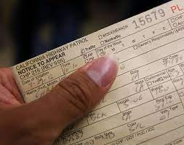
How do we regulate digital technologies?

Slide 3
The role of law in technology
Phenomena
Technological Sovereignty
The Splinternet
The Brussels Effect
Problems
Intellectual Property
Economic Disincentives to Technological Developments
The “Matthew Effect”

Slide 4
What are legal systems?
People
Laws
Institutions
Institutions serve to legitimize, enact, and enforce laws

Slide 5
The two main legal models
Civil law: Parliaments enact legislation
Common law: judges make law by adjudicating cases
The Constitution: is above the law, says how laws must be enacted, and usually requires that laws against the constitution be struck down
Common law countries: have narrow–but growing numbers of–statutes

Slide 6
The two main models when it comes to data
United States
The Federation has
limited legislative powers
its own judiciary
Each State has
broad legislative powers
its own judiciary
Most legislation that is relevant is state legislation
Exception: Federal Trade Commission regulations
European Union
EU has
limited powers
the Court of Justice
States have
most powers
the bulk of the judicial activity
Most rules that are relevant are EU rules

