Slide 1
Privacy and the Types of Data
personal/non personal data
anonymized/pseudonymized data
synthetic data

Slide 2
Social Credit & Biases
Garbage In, Garbage Out
Bias–how do you fix biases? — The Reading on Affirmative Algorithms

Slide 3
PUBLIC SPACE & AFR
The Problem of Privacy in Public Spaces
what do we expect when we are in public?
is there any difference between a human observer and AI?
The case of South Welsh Police

Slide 4
The GDPR: Art. 22
The data subject shall have the right not to be subject to a decision based solely on automated processing, including profiling, which produces legal effects concerning him or her or similarly significantly affects him or her.
Paragraph 1 shall not apply if the decision:
is necessary for entering into, or performance of, a contract between the data subject and a data controller;
is authorised by Union or Member State law to which the controller is subject and which also lays down suitable measures to safeguard the data subject’s rights and freedoms and legitimate interests; or
is based on the data subject’s explicit consent.
In the cases referred to in points (a) and (c) of paragraph 2, the data controller shall implement suitable measures to safeguard the data subject’s rights and freedoms and legitimate interests, at least the right to obtain human intervention on the part of the controller, to express his or her point of view and to contest the decision.

Slide 5
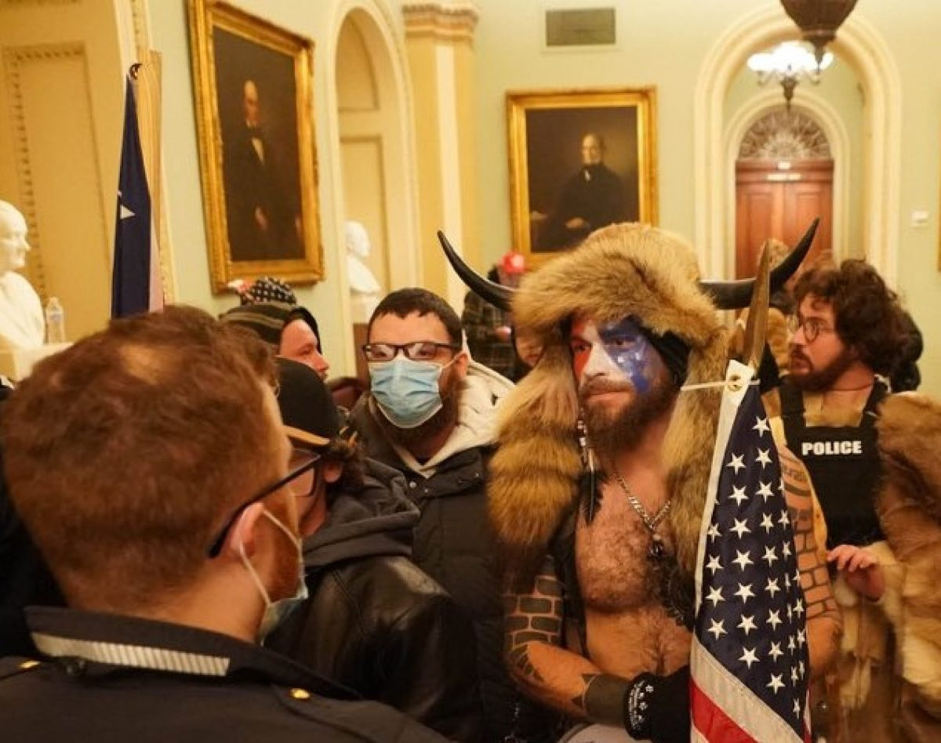
Politics and echo chambers
https://osome.iu.edu/demos/echo/

