Slide 1
Types and Patterns of Innovation

Slide 2
Overview
Several dimensions are used to categorize innovations.
These dimensions help clarify how different innovations offer different opportunities (and pose different demands) on producers, users, and regulators.
The path a technology follows through time is termed its technology trajectory.
Many consistent patterns have been observed in technology trajectories, helping us understand how technologies improve and are diffused.

Slide 3
There is no single agreed-upon taxonomy used to describe different kinds of technological innovations.
The performance improvement rate of a technology through time is referred to as its trajectory and the trajectory usually takes on an S-curve pattern. The diffusion pattern of a technology also conforms to an s-curve pattern.

Slide 4
Types of Innovation
Four of the dimensions most commonly used to categorize innovations are:
1.product versus process innovation
2.radical versus incremental
3.competence enhancing versus competence destroying
4. architectural versus component.
It is important to emphasize that these dimensions are not independent and do not offer a straightforward system for categorizing innovations in a precise and consistent manner.

Slide 5
Product versus Process Innovation
Product innovations are embodied in the outputs of an organization – its goods or services.
Process innovations are innovations in the way an organization conducts its business, such as in techniques of producing or marketing goods or services.
Product innovations can enable process innovations and vice versa.
What is a product innovation for one organization might be a process innovation for another.
For example, UPS creates a new distribution service (product innovation) that enables its customers to distribute their goods more widely or more easily (process innovation).

Slide 6
Product versus Process Innovation
New product innovations and process innovations often occur in tandem.
When not in tandem product innovation can be preceded by process innovation and vice versa.
Finally, a product innovation for one firm may simultaneously be a process innovation for another

Slide 7
Radical versus Incremental Innovation
A number of criteria have been posed to distinguish between radical and incremental innovation.
Most of these criteria turn on the degree of newness and differentness of the innovation and the amount of risk associated with the innovation.
Innovation is often risky because of uncertainty in both technology (e.g., will the technology perform as expected?) and customer requirements (e.g., what features will customers ultimately value?).

Slide 8
Radical versus Incremental Innovation
The radicalness of an innovation is the degree to which it is new and different from previously existing products and processes (wireless communication)
Incremental innovations may involve only a minor change from (or adjustment to) existing practices (new type of screen of a cell phone that makes it more resistant)

Slide 9
Radical versus Incremental Innovation
The radicalness of an innovation has a rather high degree of risk (especially in terms of success, technical feasibility, costs)
The radicalness of an innovation is relative; it may change over time or with respect to different observers.
For example, digital photography a more radical innovation for Kodak (expert in chemical photography) than for Sony (already expert in digital recording).

Slide 10
Competence-Enhancing versus Competence-Destroying Innovation
An innovation is considered to be
competence enhancing if it builds on the firm's existing knowledge base (e.g., the 286, 386, 486, Pentium, Pentium II, Pentium III, Pentium 4 platforms each built on Intel’s existing competencies) and
competence destroying if it does not build on existing competencies or renders them obsolete (the hand-held calculator’s replacement of the slide rule is a good example of competence-destroying innovation).

Slide 11
Slide rule
https://www.youtube.com/watch?v=FOp1AR461wA&list=PLc6EeKrKYKClN48ow3Irj_sO0zQEY-Vwu&index=41
https://www.youtube.com/watch?v=xYhOoYf_XT0&list=PLc6EeKrKYKClN48ow3Irj_sO0zQEY-Vwu&index=42

Slide 12
Architectural versus Component Innovation
An innovation is considered to be a component innovation (or "modular innovation") if it entails changes to one or more components but does not significantly affect the overall configuration of the system (such as the incorporation of gell-filled material for additional cushioning in a bicycle seat that does not require any changes in the rest of the bicycle architecture).
An architectural innovation entails changing the overall design of the system or the way that components interact (in the bicycle example the transition from the "high-wheel bicycle" to the "safety bicycle" was an architectural innovation).
Architectural innovations are often considered more radical and competence destroying.
Most architectural innovations require changes in the underlying components also.

Slide 13
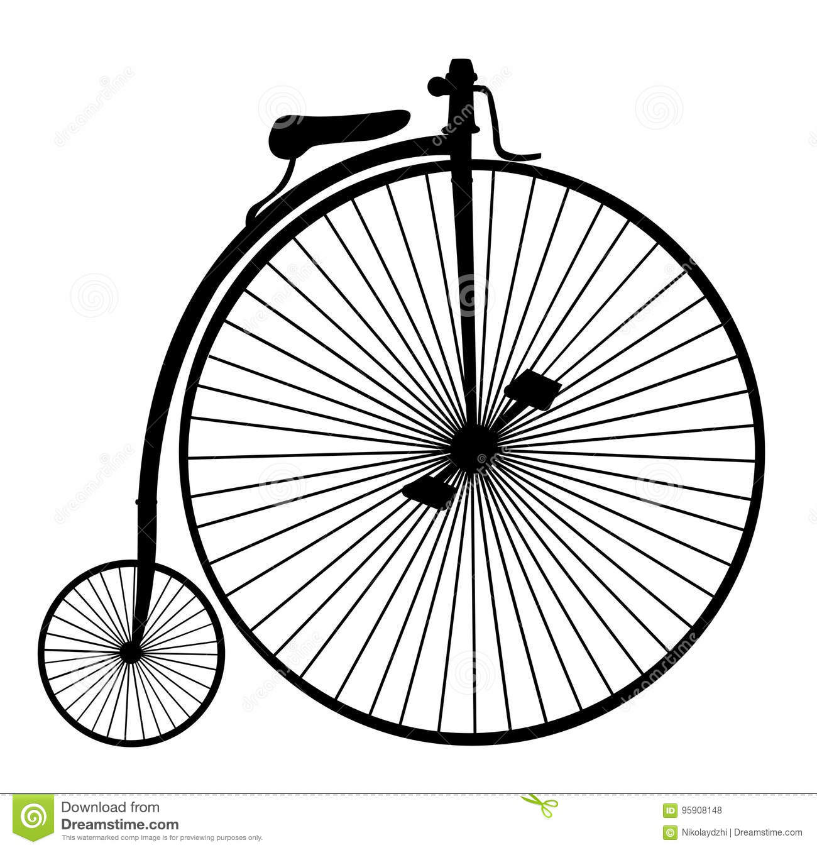
High-Wheel bicycle
https://www.youtube.com/watch?v=z2Ih_MCL1Pc

Slide 14
Safety bicycle
https://www.youtube.com/watch?v=ejhbraKxlsg

Slide 15
Innovating in India: The Chotukool Project
In rural India up to 90% of families cannot afford appliances, have no electricity, and have no refrigeration.
Appliance manufacturer Godrej & Boyce decided to make a smaller, cheaper refrigerator to tap this market.
Many of their assumptions turned out to be wrong; they ended up making a lightweight portable battery operated refrigerator with customizable skins to make them cool and aspirational, and sold to multiple market segments, including the urban affluent.
Godrej & Boyce also pioneered a novel distribution system: the Chotukool would be sold at the post office.
The Chotukool won several design awards and FastCompany gave Godrej its “Most Innovative Company” award.

Slide 16
Innovating in India: The Chotukool Project 1
https://www.youtube.com/watch?v=IUADltOgj3w&list=PLc6EeKrKYKClN48ow3Irj_sO0zQEY-Vwu&index=37
https://www.youtube.com/watch?v=eg51ozBqVM4&list=PLc6EeKrKYKClN48ow3Irj_sO0zQEY-Vwu&index=39
https://www.youtube.com/watch?v=AblFyfv6hLc&list=PLc6EeKrKYKClN48ow3Irj_sO0zQEY-Vwu&index=38

Slide 17
Questions
What product and process innovations did the Chotukool entail? Would you consider these incremental or radical? Architectural or component?
Using thermoelectric cooling and a battery was a pretty big component innovation. Offering skins for the refrigerators was also a component innovation. Selling the refrigerators through the post office was a process innovation.
Competence enhancing or competence destroying?
All of these innovations are, arguably, competence enhancing for Godrej.

Slide 18
Patterns Of Innovation: Technology S-Curves
.
S-curves are used to map the performance of a technology and its diffusion rate.
S-curves in Technological Improvement: When the performance of a technology is plotted against the amount of effort and money invested in the technology, it typically shows slow initial improvement (due to poor understanding of the technology, and a lack of legitimacy of the technology), then accelerated improvement (due to a deeper understanding of the technology), then diminishing improvement (as the technology reaches its inherent limits).
Access the text alternative for these images

Slide 19
Technology S-Curves
Both the rate of a technology’s improvement, and its rate of diffusion to the market typically follow an s-shaped curve.
Technology improves slowly at first because it is poorly understood.
Then accelerates as understanding increases.
Then tapers off as approaches limits.
Access the text alternative for these images

Slide 20
Technology S-Curves
Technologies do not always get to reach their limits.
May be displaced by new, discontinuous technology.
A discontinuous technology fulfills a similar market need by means of an entirely new knowledge base.
For example, switch from carbon copying to photocopying, or vinyl records to compact discs.
Technological discontinuity may initially have lower performance than incumbent technology.
For example, first automobiles were much slower than horse-drawn carriages.
Firms may be reluctant to adopt new technology because performance improvement is initially slow and costly, and they may have significant investment in incumbent technology.

Slide 21
Discontinuous technologies
Discontinuous technologies build on an entirely new knowledge base and can prevent existing technologies from reaching their limits by fulfilling a similar market need in a better way.
Initially, the technological discontinuity may have lower performance and lower returns than the incumbent technology. These two factors make incumbent firms reluctant to switch.

Slide 22
Discontinuous technologies
When a disruptive technology has a steeper s-curve and/or a higher performance limit the returns to effort invested in the new technology may become much higher than effort invested in the incumbent technology. The new disruptive technology is likely to displace the incumbent technology under these conditions.

Slide 23
S-Curves in Technology Diffusion
S-curves in technology diffusion are obtained by plotting the cumulative number of adopters of the technology against time.
S-curves in technology diffusion are often explained as a process of different categories of people adopting the technology at different times (e.g. electronic calculators were first adopted by scientists and engineers and ultimately became a mass market product).

Slide 24
S-Curves in Technology Diffusion
Adoption is initially slow because the technology is unfamiliar.
It accelerates as technology becomes better understood.
Eventually market is saturated and rate of new adoptions declines.
Technology diffusion tends to take far longer than information diffusion.
Technology may require acquiring complex knowledge or experience.
Technology may require complementary resources to make it valuable (for example, cameras not valuable without film).

Slide 25
Diffusion of Innovation and Adopter Categories
Everett M. Rogers created a typology of adopters:
Innovators are the first 2.5% of individuals to adopt an innovation. They are adventurous, comfortable with a high degree of complexity and uncertainty, and typically have access to substantial financial resources.
Early Adopters are the next 13.5% to adopt the innovation. They are well integrated into their social system and have great potential for opinion leadership. Other potential adopters look to early adopters for information and advice, thus early adopters make excellent "missionaries" for new products or processes.
Early Majority are the next 34%. They adopt innovations slightly before the average member of a social system. They are typically not opinion leaders, but they interact frequently with their peers.
Late Majority are the next 34%. They approach innovation with a skeptical air and may not adopt the innovation until they feel pressure from their peers. They may have scarce resources.
Laggards are the last 16%. They base their decisions primarily on past experience and possess almost no opinion leadership. They are highly skeptical of innovations and innovators and must feel certain that a new innovation will not fail prior to adopting it.

Slide 26
Diffusion of Innovation and Adopter Categories
Diffusion of Innovation and Adopter Categories
Access the text alternative for these images

Slide 27
Technology diffusion takes far more time than information diffusion and some firms adopt innovations more quickly than others. Two factors play a role in explaining the variance in the timing of innovation adoption:
The tacit nature of the knowledge underlying new technologies, and
the need for the firm to develop complementary resources required to make those technologies useful.

Slide 28
S-curves of diffusion are in part due to s-curves in improvement: as technologies are better developed, they become more useful to customers, and their costs may decrease.
Both of these outcomes can accelerate adoption.

Slide 29
Technology S-Curves 5
S-curves of diffusion are in part a function of s-curves in technology improvement.
Learning curve leads to price drops, which accelerate diffusion and household penetration
Source: Consumer Electronics Association.
Source: Consumer Electronics Association.
Access the text alternative for these images

Slide 30
S-Curves as a Prescriptive Tool
Several authors have argued that managers can use the s-curve model as a means by which to predict when a technology will reach its limits, and as a guide for determining whether and when the firm should adopt a new technology.
Though this sounds very desirable (what firm wouldn’t want to know when to shift to a new technology) the s-curve model has some severe limitations as a prescriptive tool.

Slide 31
S-Curves as a Prescriptive Tool: limits
True limits of technology may be unknown (or little known.
Shape of s-curve can be influenced by changes in the market, component technologies, or complementary technologies.
Firms that follow s-curve model too closely could end up switching technologies too soon or too late (IBM’s experience with disk drives).

Slide 32
whether and when a firm should adopt an innovation
The answer rests on several interdependent criteria:
the advantages offered by the new technology;
2) the amount of effort required to switch (develop new competencies if necessary);
3) the technology’s fit with the firm’s current abilities (and thus the amount of effort that would be required to develop new competencies);
4) whether or not the firm possesses the complementary resources needed to implement the innovation; and
5) the innovations affect on competitive dynamics (e.g. the rate at which competitors will adopt the innovation).

Slide 33
Often technology improvement trajectories are steeper than the trajectory of customer demands.
Why would firms provide higher performance than that required by the bulk of their customers?

Slide 34
This phenomenon occurs when
firms try to shift their sales into higher price tiers to maintain their margins;
2) as the price of the technology rises, the mass market may feel it is overpaying features it does not value; and
3) the time needed for customers to learn about and assimilate new features may be greater than the time needed to develop new performance features.

Slide 35
Theory In Action: segment zero
Technologies often improve faster than customer requirements demand.
This enables low-end technologies to eventually meet the needs of the mass market.
Access the text alternative for these images

Slide 36
Theory in Action “Segment Zero” –
For example, Intel identified "segment zero" as the demand for low-end personal computers (those less than $1000) that had been neglected.
Why should firms like Intel be concerned with segment zero?
Because it can become the breeding ground for companies that provide lower-end versions of the technology. As Grove notes, " the overlooked, underserved, and seemingly unprofitable end of the market can provide fertile ground for massive competitive change."

Slide 37
Theory in Action: the case of Microsoft
From 1980 to 2011, Microsoft was the dominant personal computer operating system.
However, operating systems for smartphones and tablets were improving to the point where they could replace many personal computer functions.
In 2015, Apple’s iPhone operating system and Google’s Android collectively controlled over 90% of the market for smartphone purchases. Microsoft’s Windows Phone held a share of only 3%.
As tablets based on these systems became fully functional computers, would Microsoft’s dominance evaporate?

Slide 38
Technological change is cyclical
Each cycle begins with a period of rapid improvement. This initial phase is followed by a period of diminishing returns to efforts made to improve the technology. The third and final phase occurs when the technology is displaced by a new technology (often referred to as a technological discontinuity).
A new technological discontinuity or a period of “creative destruction” can result in significant changes in the competitive structure of an industry, including the creation of new leaders and new losers.

Slide 39
The Theory of “creative destruction
Due to the economist Joseph Schumpeter
https://www.youtube.com/watch?v=UCpIWdarLwA&list=PLc6EeKrKYKClN48ow3Irj_sO0zQEY-Vwu&index=46
https://www.youtube.com/watch?v=WkENXciOrIg&list=PLc6EeKrKYKClN48ow3Irj_sO0zQEY-Vwu&index=45
And if you are interested into:
https://www.youtube.com/watch?v=0Hv-sMeNKGQ&list=PLc6EeKrKYKClN48ow3Irj_sO0zQEY-Vwu&index=44

Slide 40
Technology Cycles: Utterback and Abernathy
Technology cycles have also been divided into phases based on the degree to uncertainty experienced in each phase.
Utterback and Abernathy characterized the technology cycle into two phases:
1. The fluid phase (when there is considerable uncertainty about the technology and its market; firms experiment with different product designs in this phase).
2. After a dominant design emerges, the specific phase begins (when firms focus on incremental improvements to the design and manufacturing efficiency)

Slide 41
Technology Cycles: Anderson and Tushman
Anderson and Tushman built on the Utterback & Abernathy model in their study of the U.S. minicomputer, cement, and glass industries through several cycles of technological change.
They characterized the technology cycle into three phases
Era of Ferment
Dominant Design
Era of Incremental Change
Access the text alternative for these images

Slide 42
The Era of Ferment
Phase I is characterized by turbulence and uncertainty and begins with the introduction of a new technological discontinuity.
In this phase the new technology displaces the incumbent technology (Anderson and Tushman refer to this as substitution) but there is considerable design competition as firms experiment with different forms of the technology.
Access the text alternative for these images

Slide 43
The Dominant Design
In Phase II ―a dominant design will emerge as long as a new technological discontinuity doesn’t arrive too soon.

Slide 44
The Era of Incremental Change
Phase III is characterized by a shift in firm focus to efficiency and market penetration (e.g. by offering different models and price points).
This period continues until the next technological discontinuity

Slide 45
Technology Cycles: Anderson and Tushman
Each discontinuity inaugurates a period of turbulence and uncertainty (era of ferment) until a dominant design is selected, ushering in an era of incremental change.
Access the text alternative for these images

Slide 46
Technology Cycles: Anderson and Tushman
Anderson and Tushman found that:
A dominant design always rose to command the majority of market share unless the next discontinuity arrived too early.
During the era of incremental change, firms often cease to invest in learning about alternative designs and instead focus on developing competencies related to the dominant design.
This explains in part why incumbent firms may have difficulty recognizing and reacting to a discontinuous technology.

Slide 47
Some final points
Why do incumbent firms resist the transition to a new technology? Many firms focus on refining their current competencies and cease investing in learning about alternative design architectures. The more a firm focuses on its current capabilities and processes the less the firm is able to identify and respond to a major architectural innovation.
Not all industries follow these models. When heterogeneity in products and/or processes is valued the emergence of a dominant design is undesirable (e.g. art and cuisine).

Slide 48
Discussion Questions
What are some of the reasons that established firms might resist the adoption of a new technology?
Are well-established firms or new entrants more likely to a) develop and/or b) adopt new technologies? What are some reasons for your choice?
Think of an example of an innovation you have studied at work or school. How would you characterize it on the dimensions described at the beginning of the chapter?
What are some of the reasons that both technology improvement and technology diffusion exhibit s-shaped curves?
Why do technologies often improve faster than customer requirements? What are the advantages and disadvantages to a firm of developing a technology beyond the current state of market needs.
In what industries would you expect to see particularly short or long technology cycles? What factors might influence the length of technology cycles in an industry?

