Slide 1
The Echo Chamber Effect, Courts, and Political Polarization
Moshe Cohen-Eliya

Slide 2
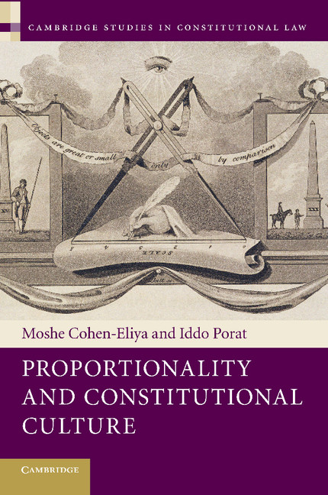

Slide 3
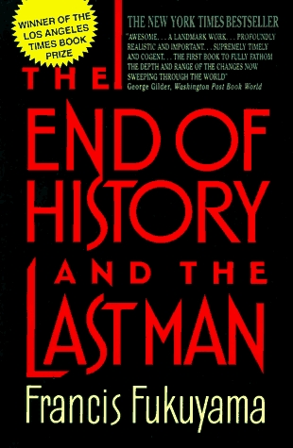
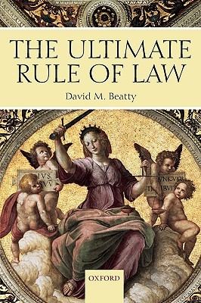

Slide 4
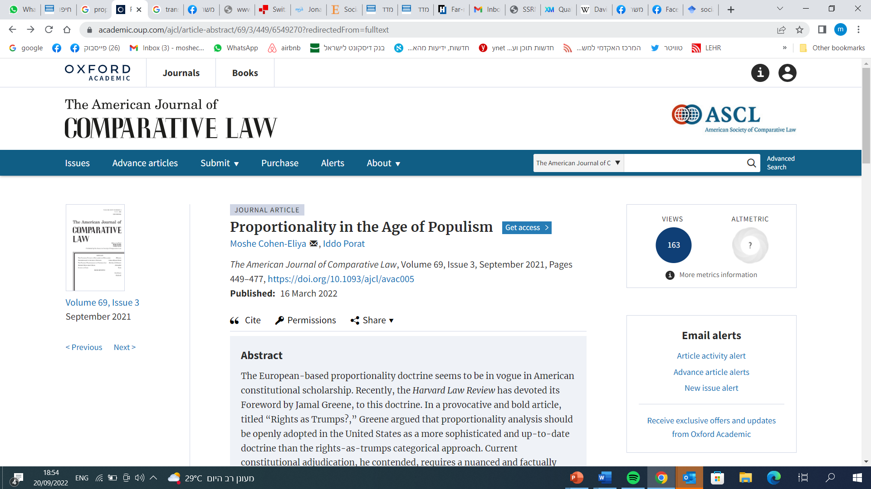

Slide 5
Political Polarization

Slide 6
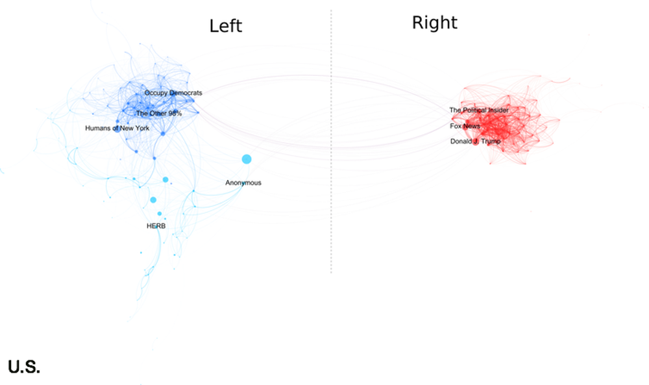

Slide 8
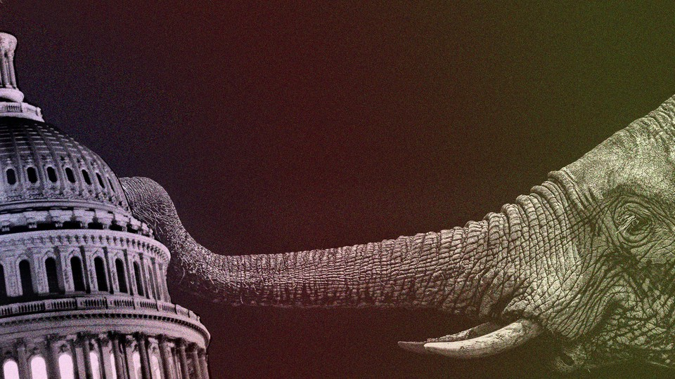

Slide 11
Ideology as Identity

Slide 12
Affective Polarization

Slide 13
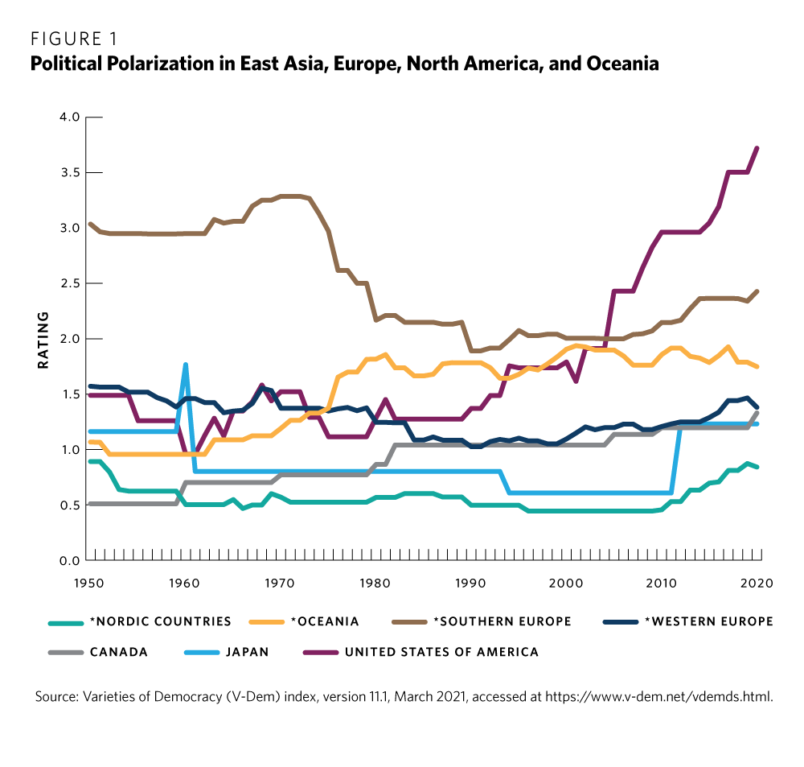

Slide 14
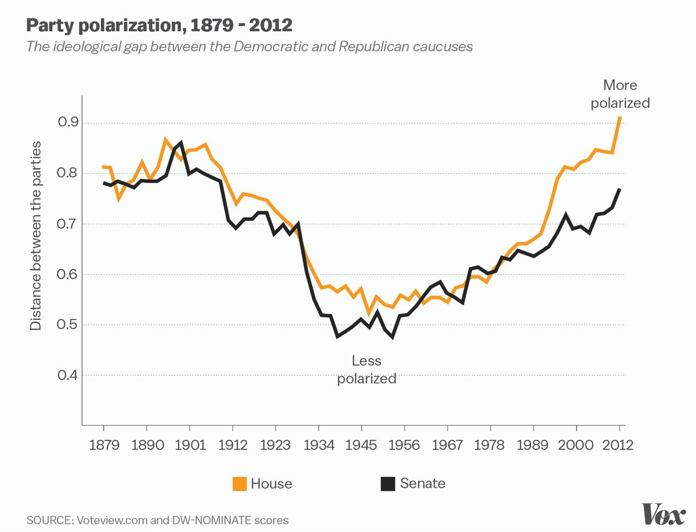

Slide 15
Reasons

Slide 16
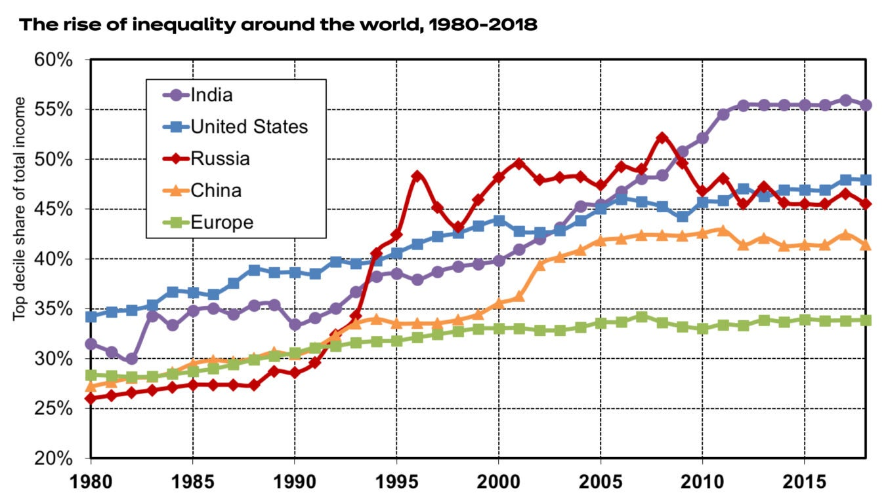

Slide 17
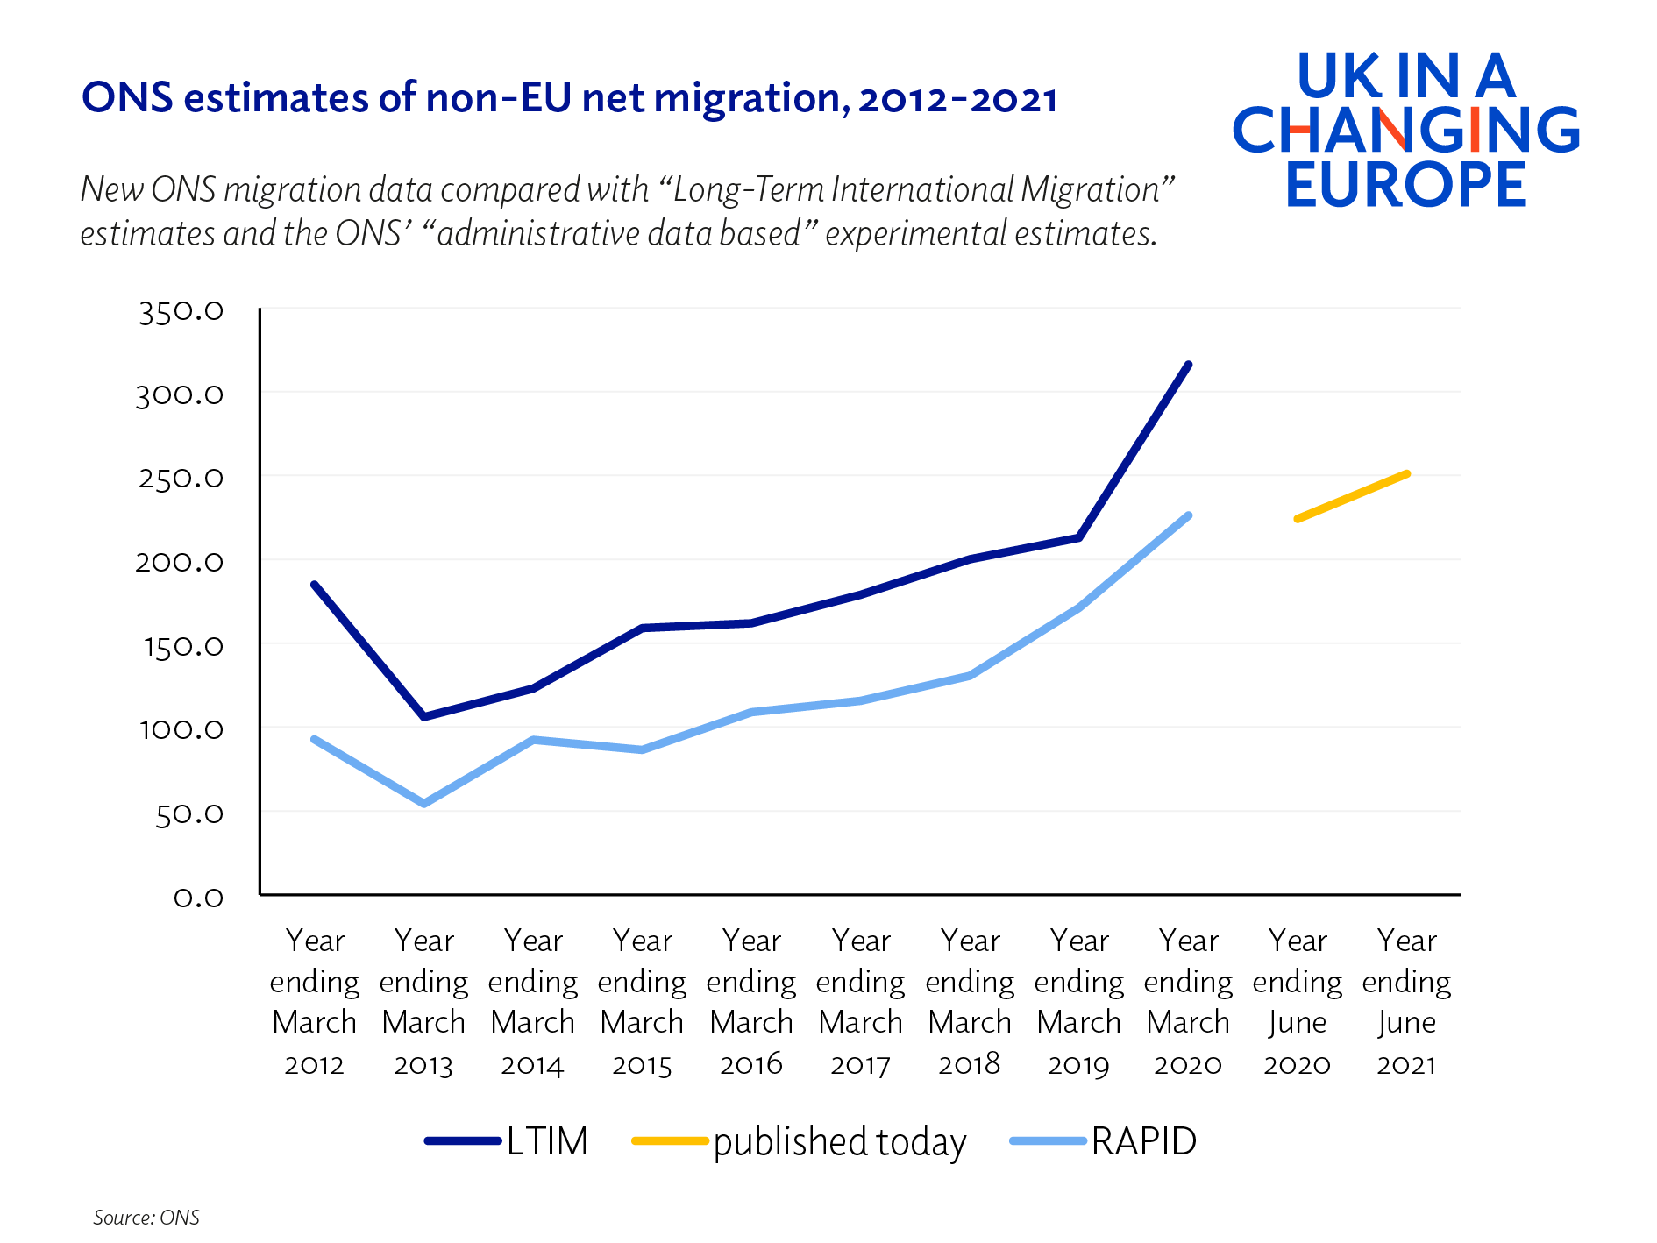

Slide 19
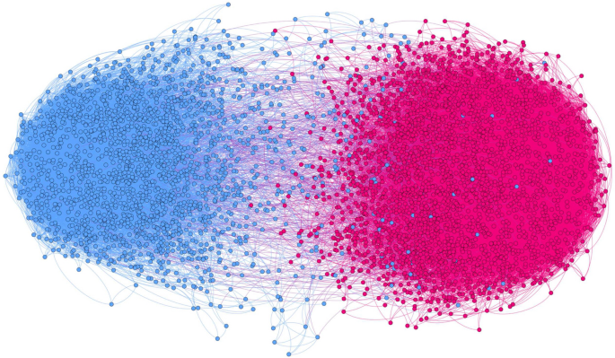
Echo chamber
an environment where a person only encounters information or opinions that reflect and reinforce their own

Slide 20
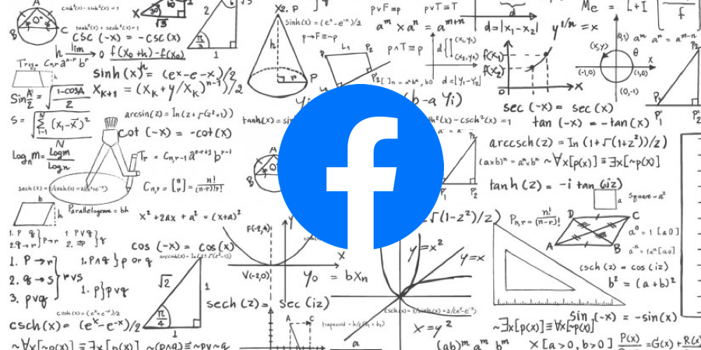

Slide 21
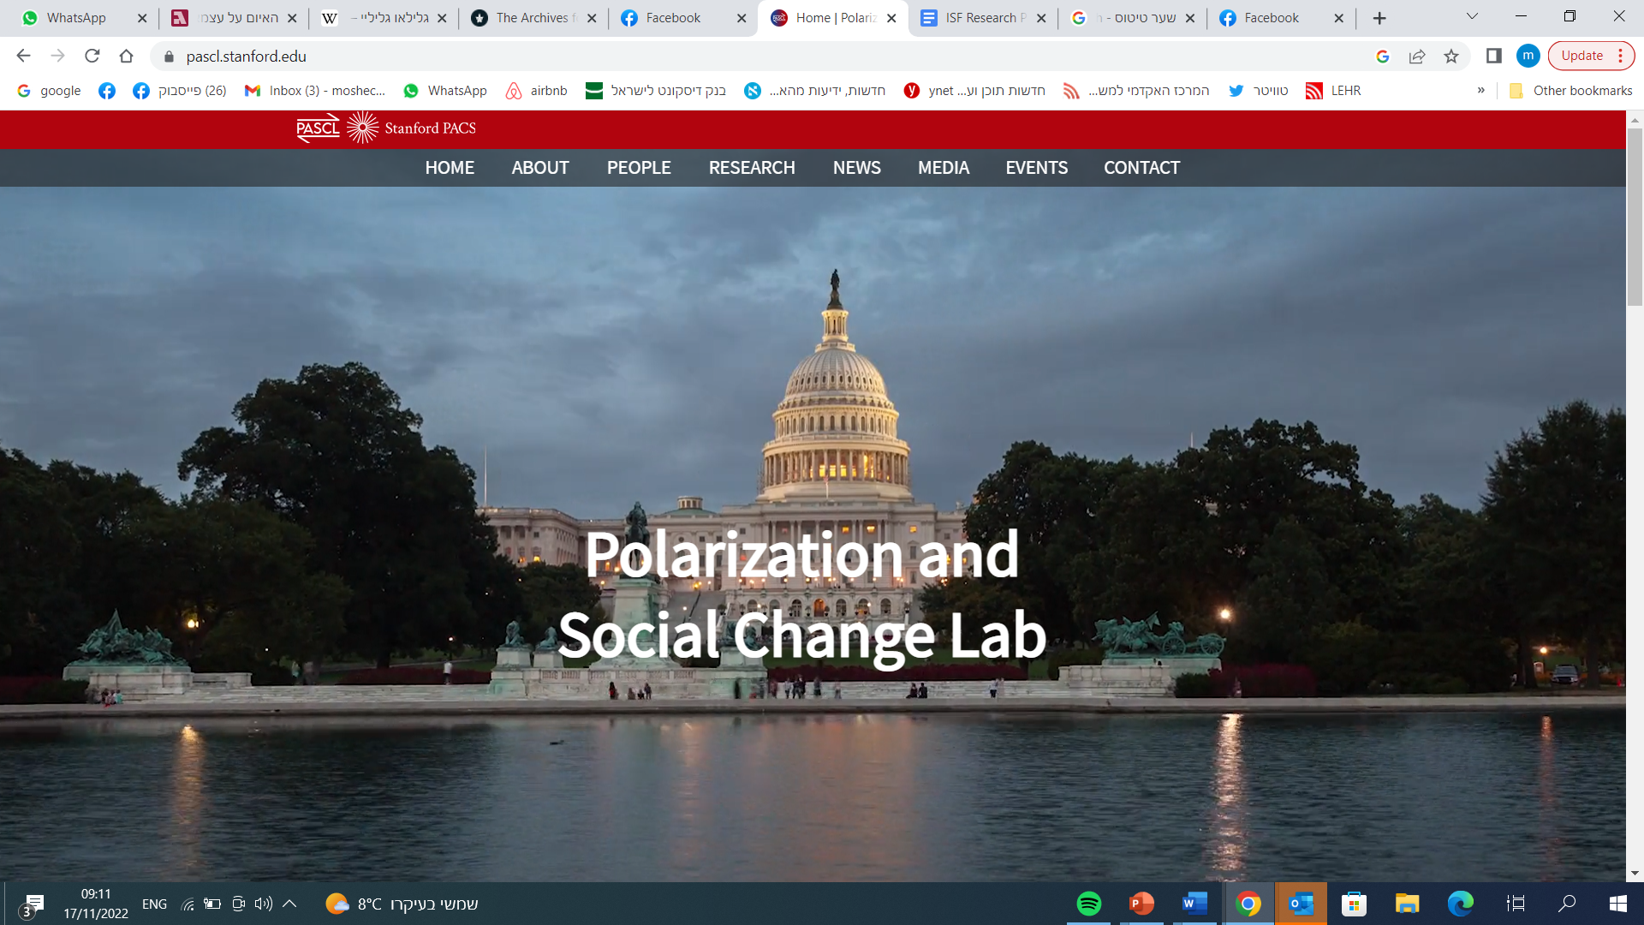

Slide 22
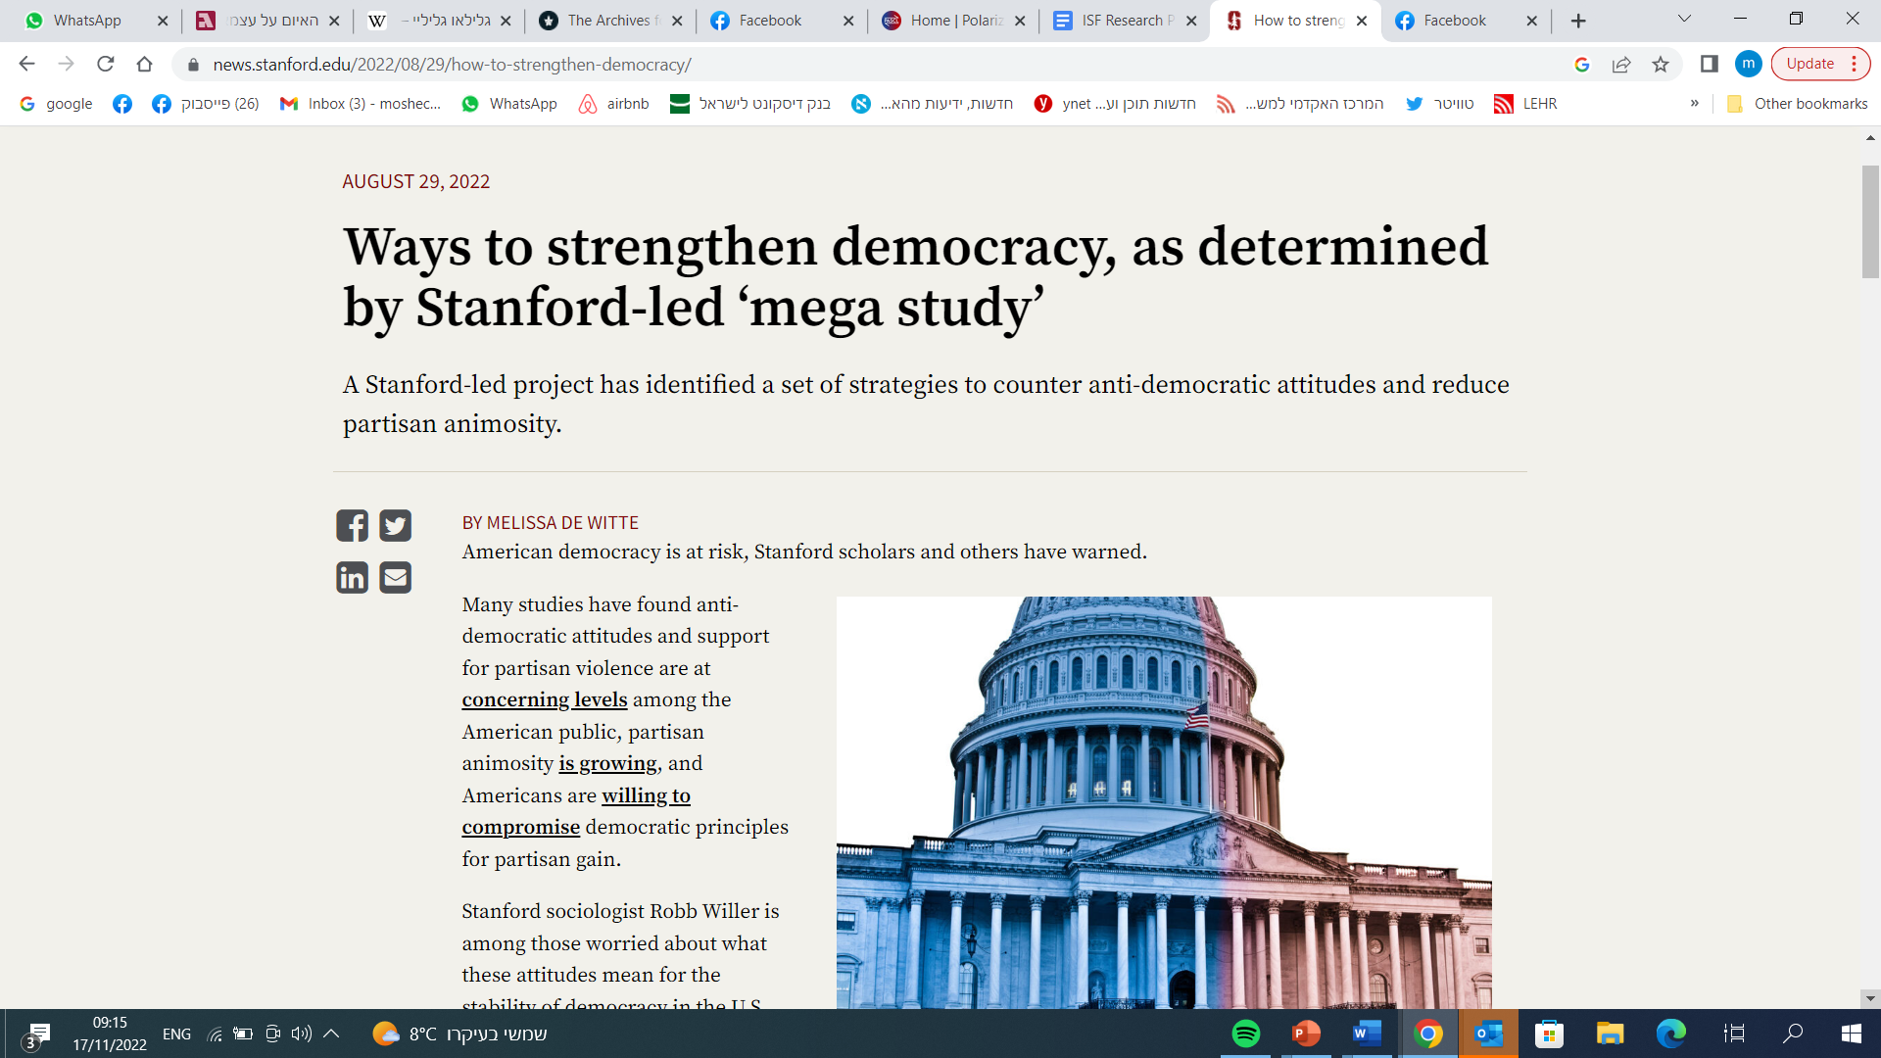

Slide 23
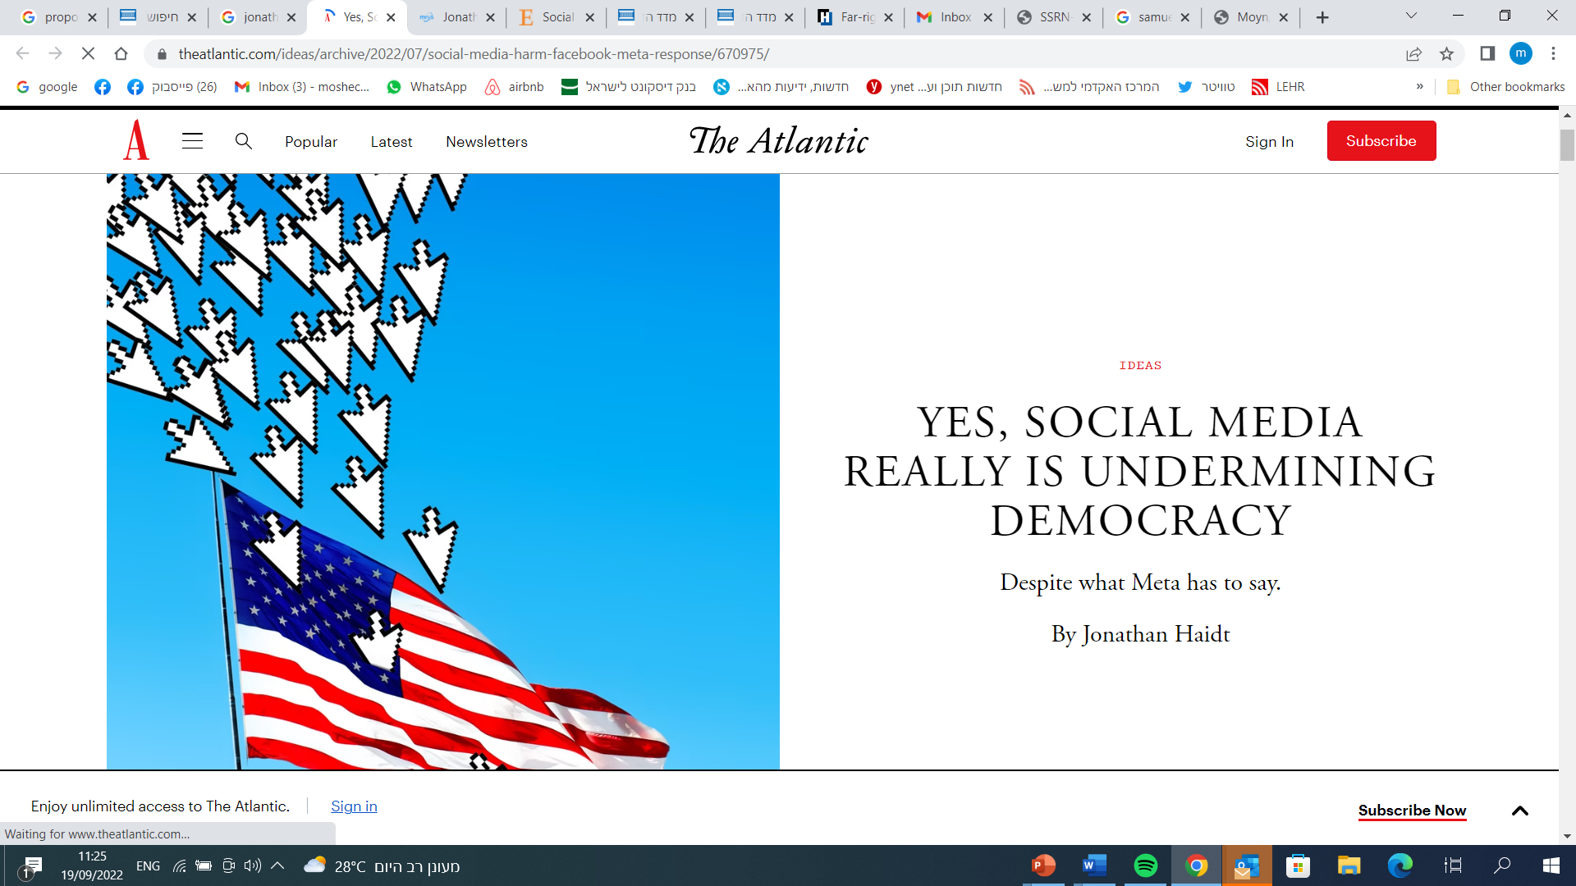

Slide 24
PP affects Institutions

Slide 25
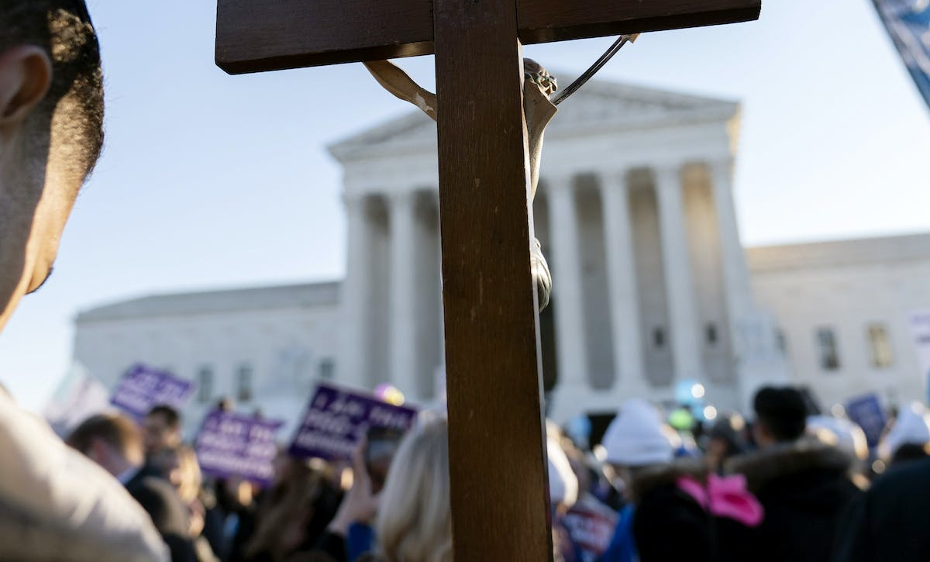

Slide 26
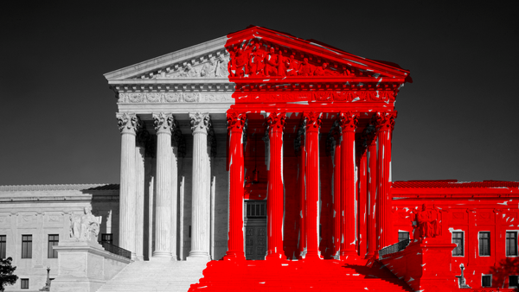

Slide 27
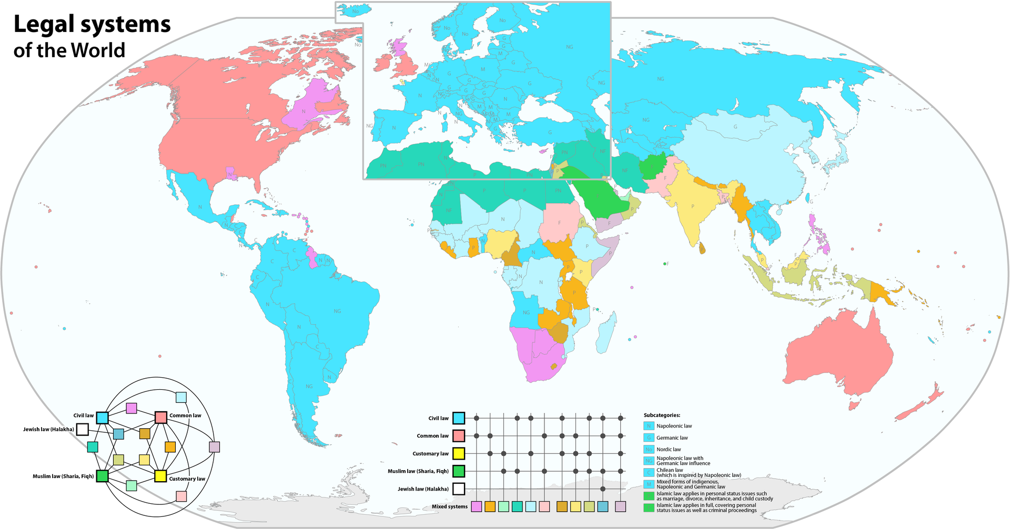

Slide 28
Westminster
Professional
Legitimacy

Slide 29
Professionalism

Slide 30
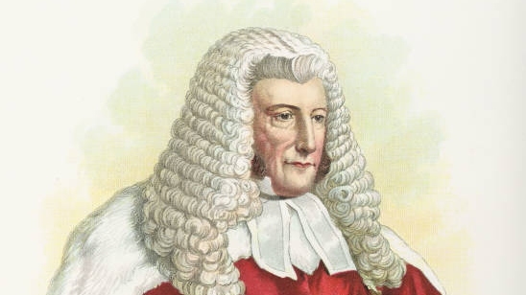

Slide 31
Destabilizing

Slide 32
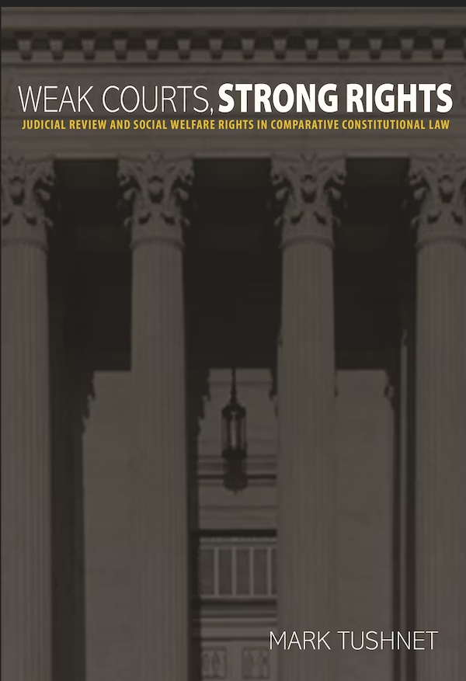

Slide 33
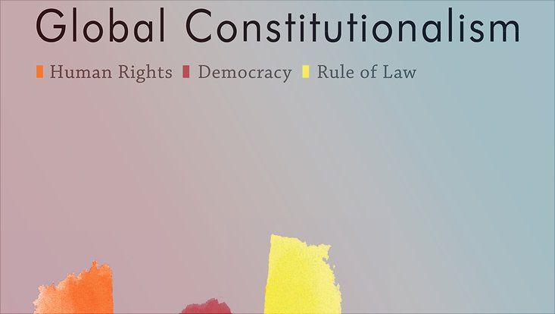

Slide 35
Political backlash

Slide 36
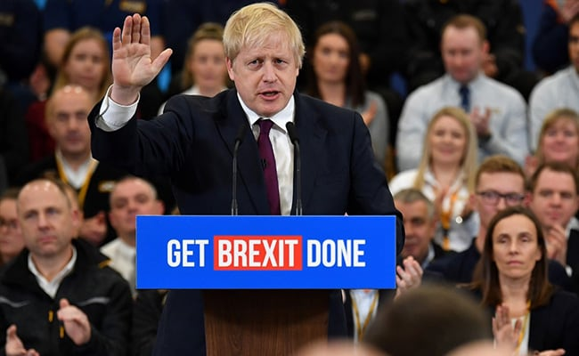

Slide 37
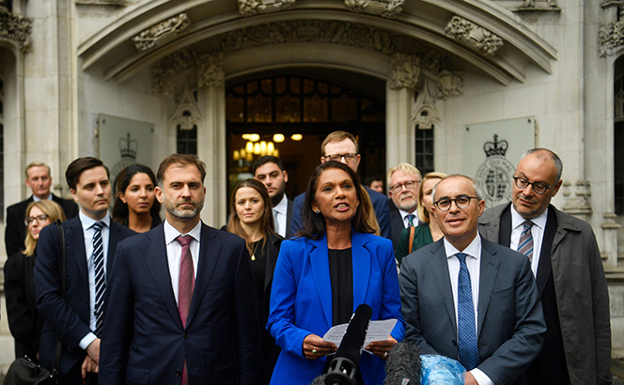

Slide 38
Canada

Slide 39
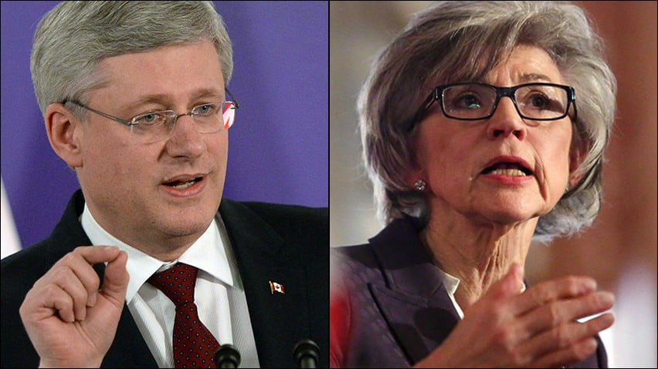

Slide 40
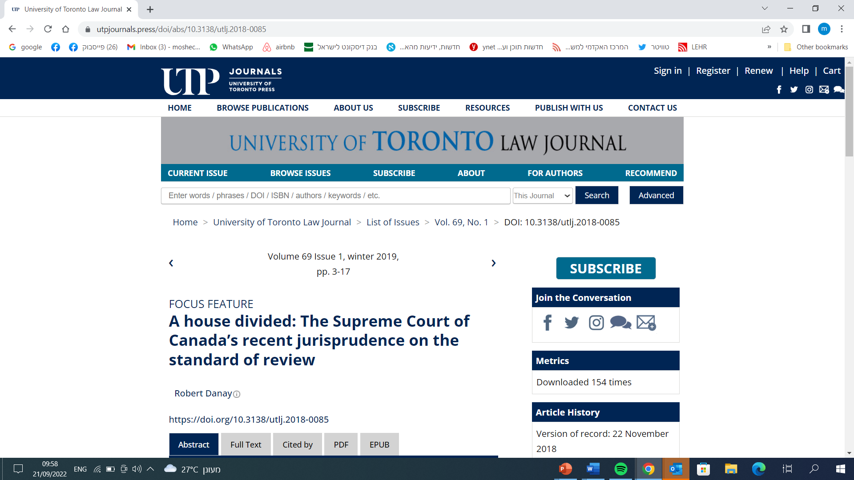

Slide 41
Israel

Slide 42
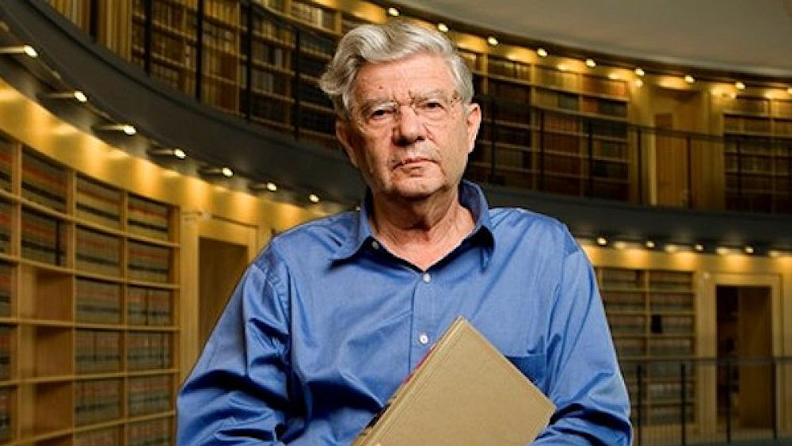

Slide 44
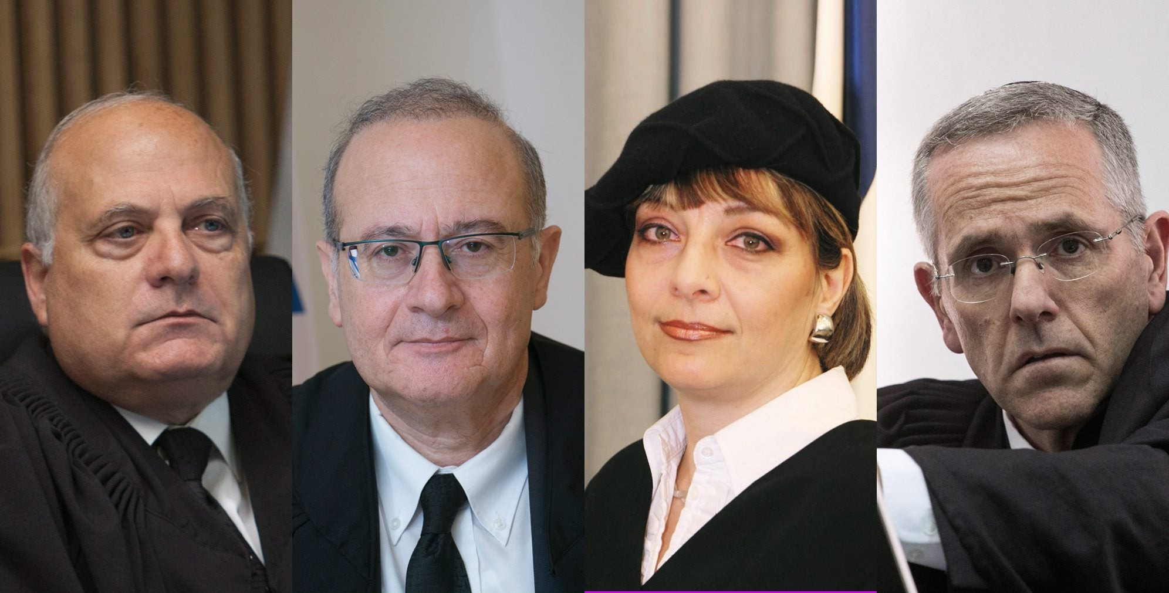

Slide 45
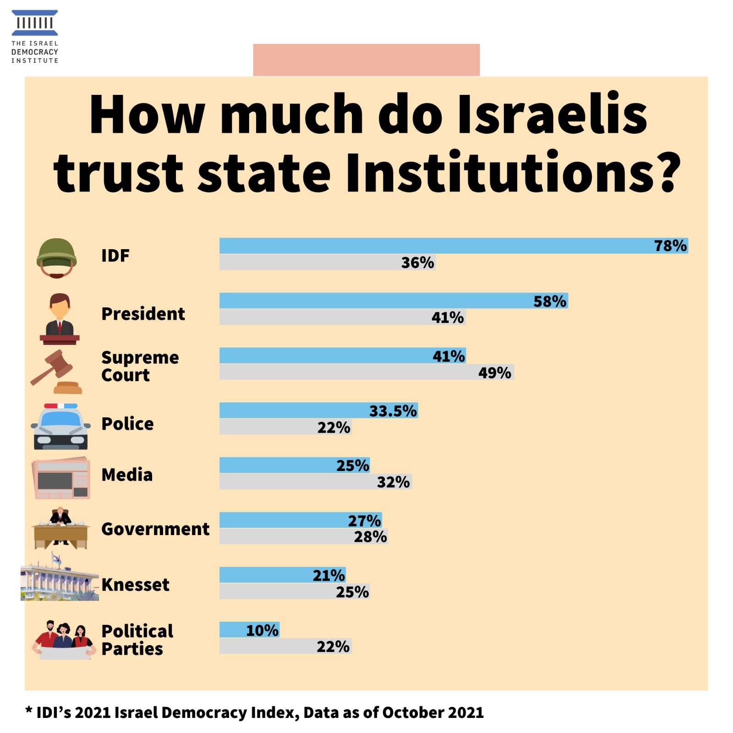
Trusting the Court Left: 87% Right: 32%

Slide 46
United States
Pluralist Legitimation

Slide 47
Umpire

Slide 48
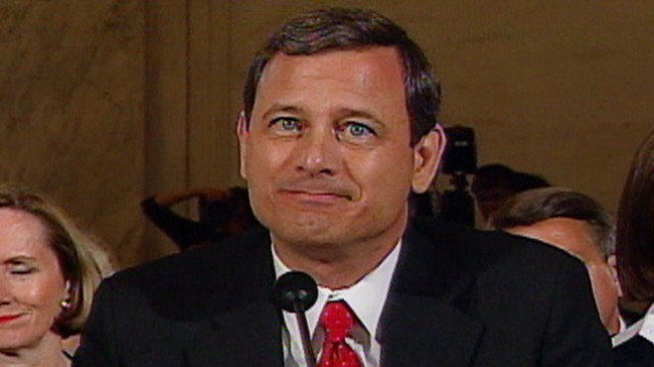

Slide 49
Partisan nominations

Slide 50
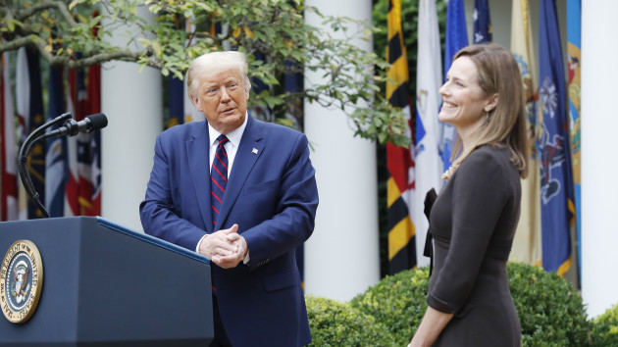

Slide 51
Partisan Judicial decision making

Slide 52
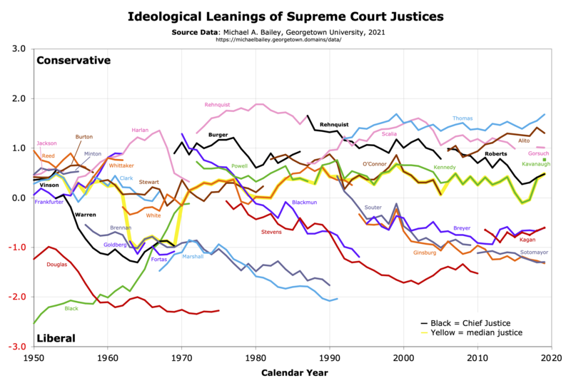

Slide 53
Partisan Trust in the Court

Slide 54
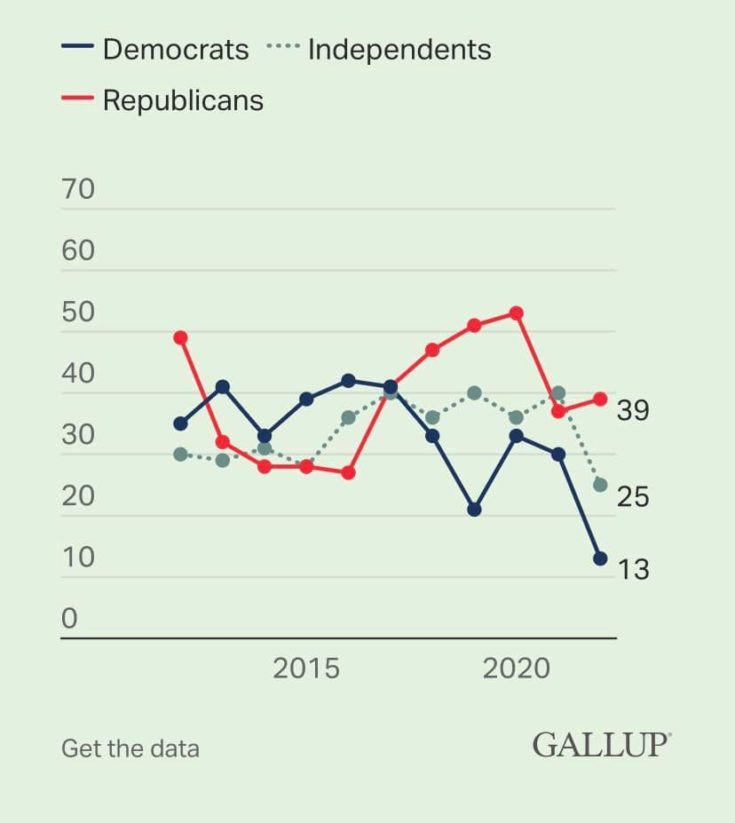

Slide 56
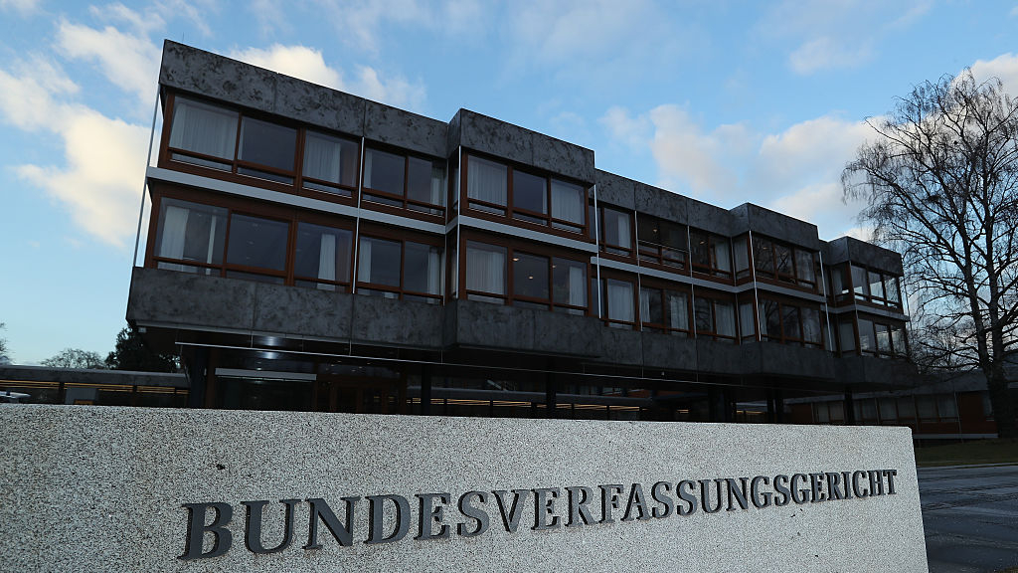
Europe
Organic Legitimation

Slide 57
Organic and Consensus

Slide 58
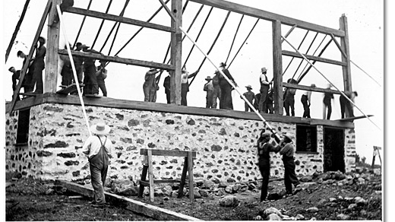

Slide 59
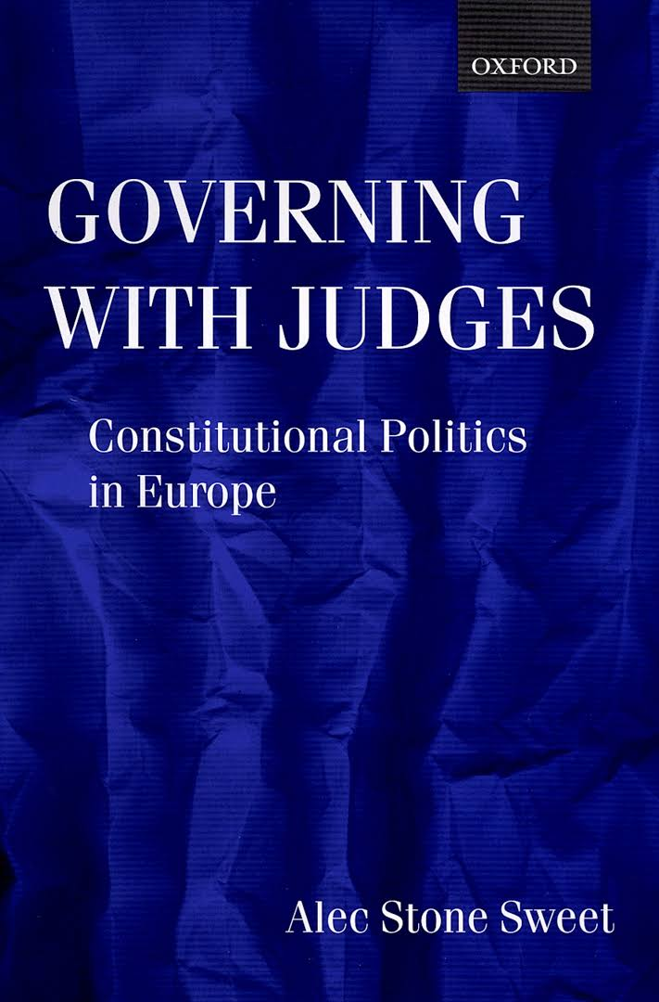

Slide 60
Cracks in the Consensus

Slide 61
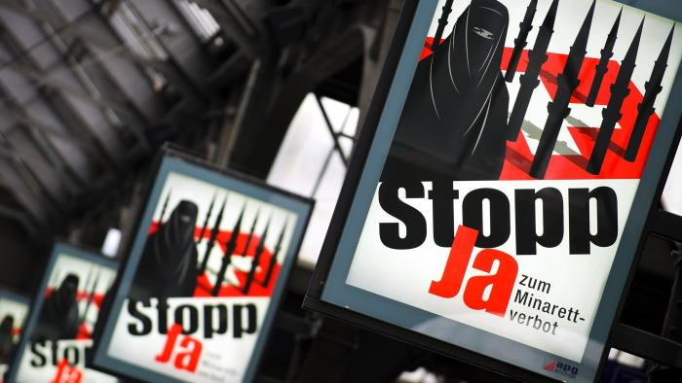

Slide 63
Regaining Legitimacy

Slide 64
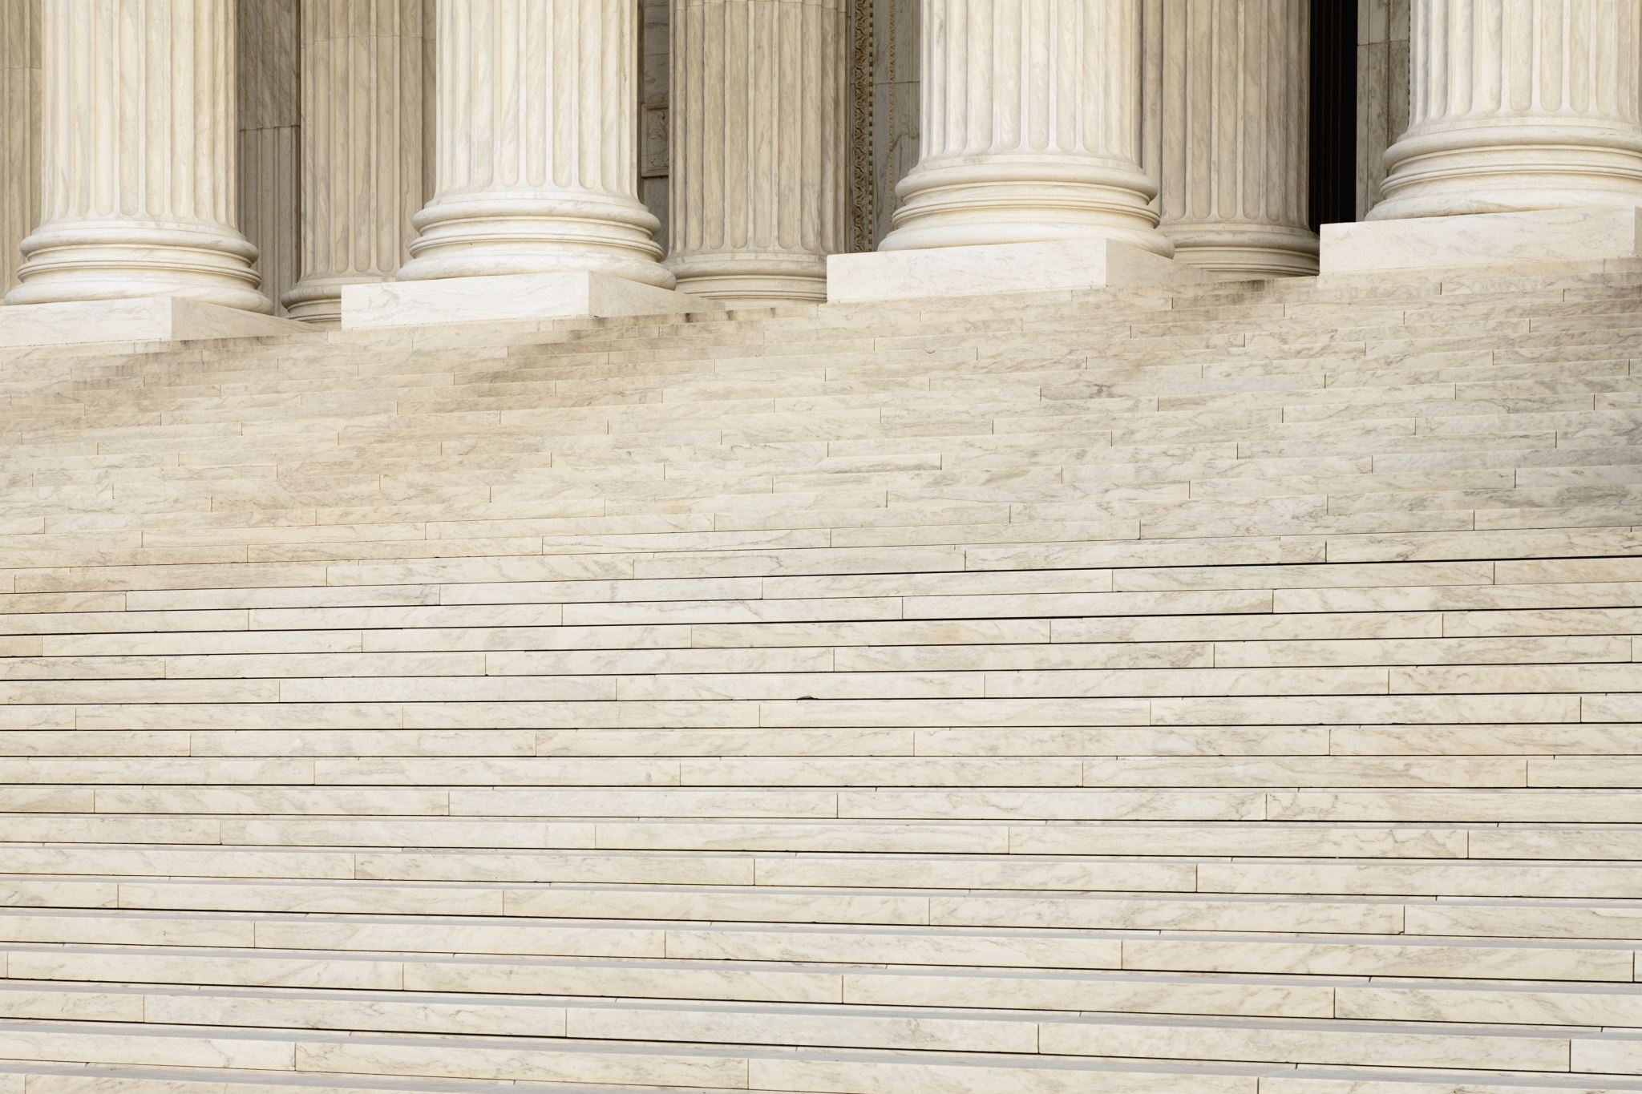
Depoliticization
v.
Balancing

Slide 65
De-Politicization

Slide 66
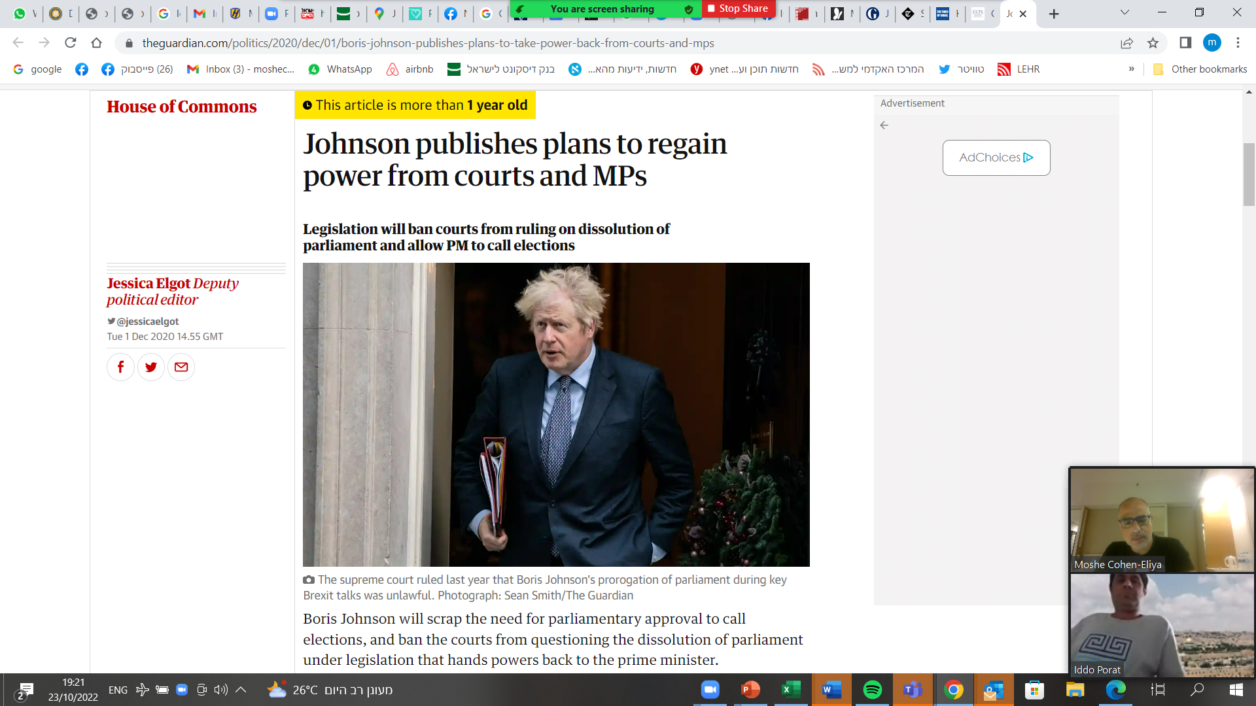
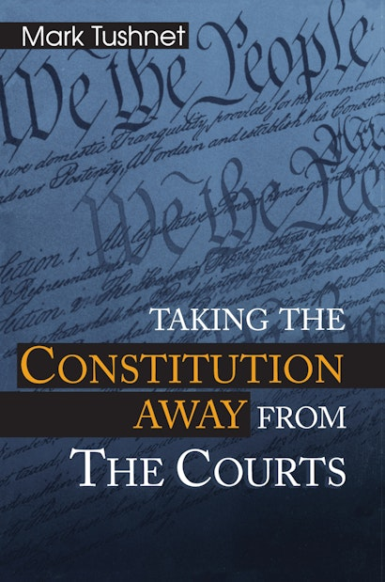

Slide 67
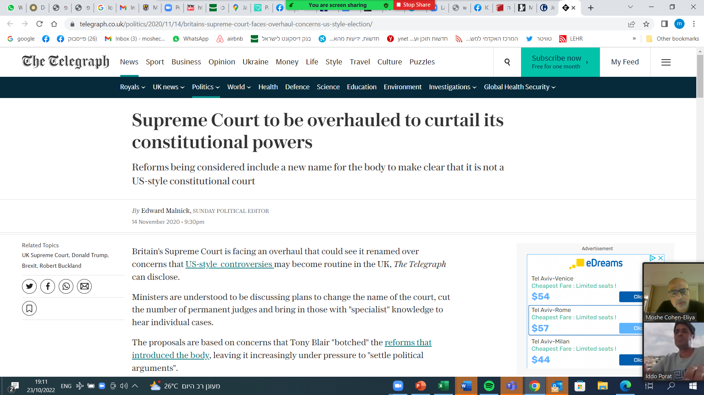

Slide 68
Balancing

Slide 69
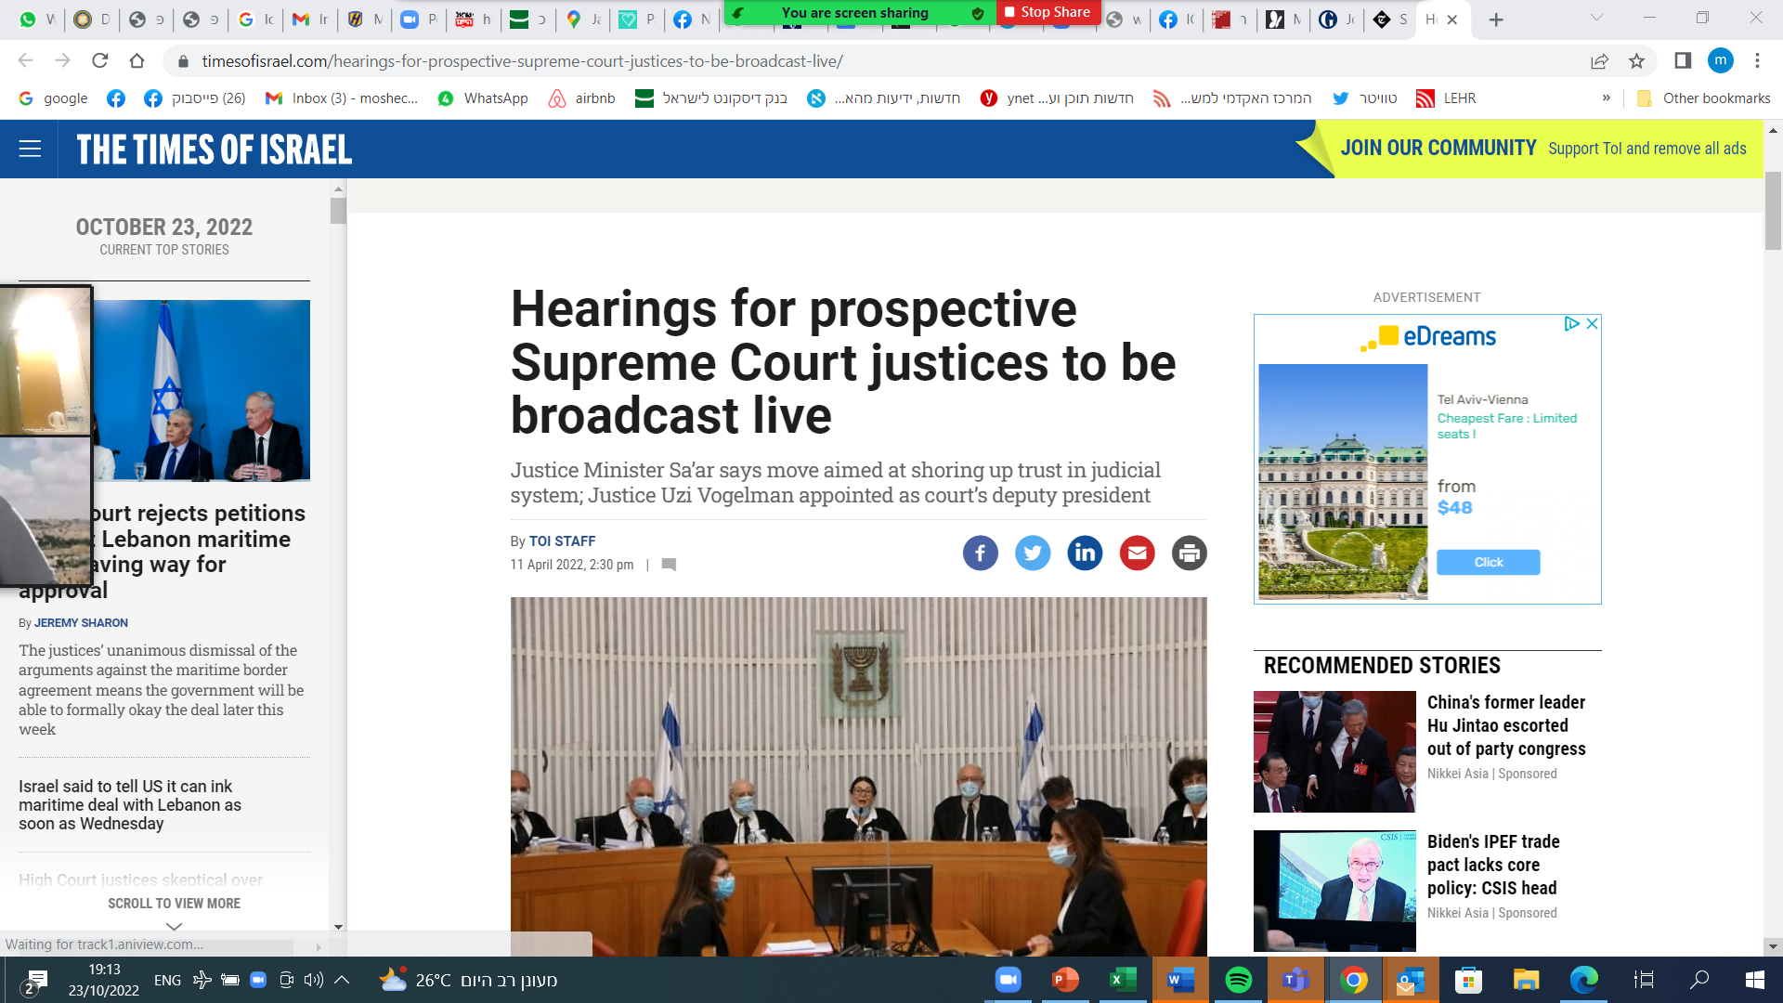

Slide 70
Westminster model – Depoliticization
Nominations | No politicians involved in nominations,
Decision Making | Taking away or limiting judicial review, limiting judicial review over governmental decisions, enhancing procedural barriers, differential doctrines of review

Slide 71
Westminster model Balancing
Nominations | Increasing political representation in nominations, [supermajority], hearings to nominees, term limits
Decision Making | en banc, supermajority

Slide 72
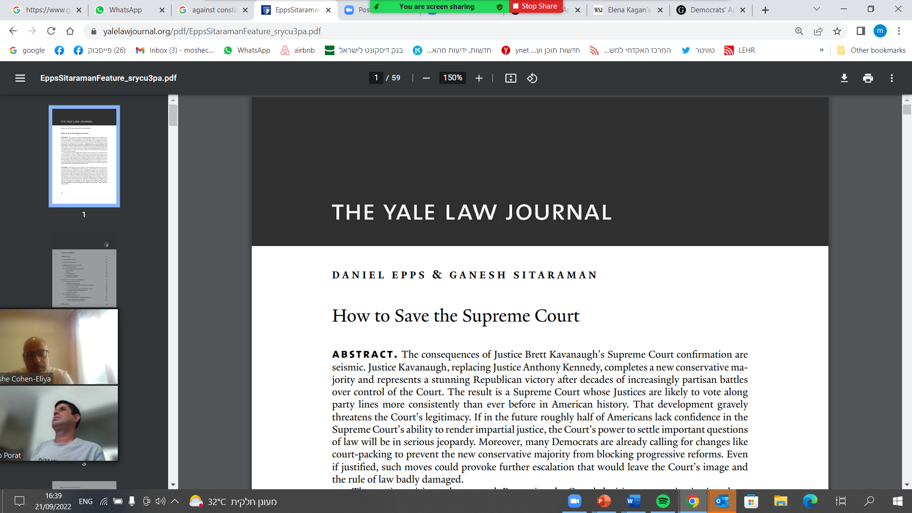

Slide 73
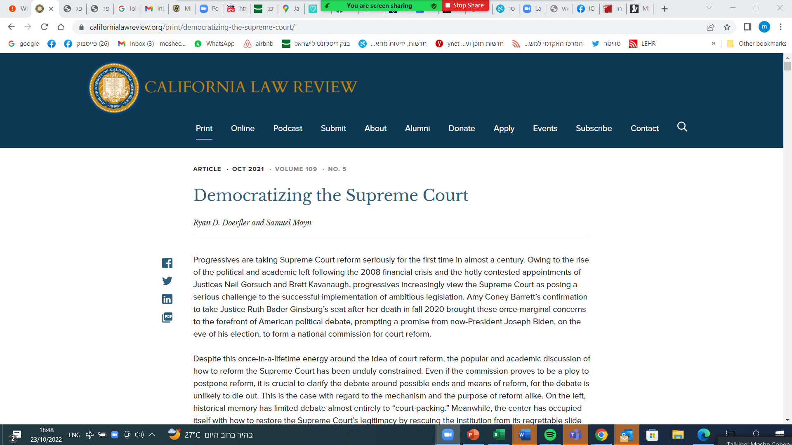

Slide 74
U.S. model
 | Depoliticization | Balancing
Nominations | -- | balanced bench, lottery, term limits, [supermajority]
Decision Making | Stripping authority, deferential/ formalist doctrines of review, further increasing procedural barriers | panels, supermajority

Slide 75
Continental model
 | Depoliticization | Balancing
Nominations | -- | allow for mechanism to deal with fringe parties’ nominees
Decision Making | -- (reduce power of ECJ so that it does not impose a political view on the member states) | Allowing dissenting opinions

Slide 76
Both Strategies? Lexical order?

Slide 77
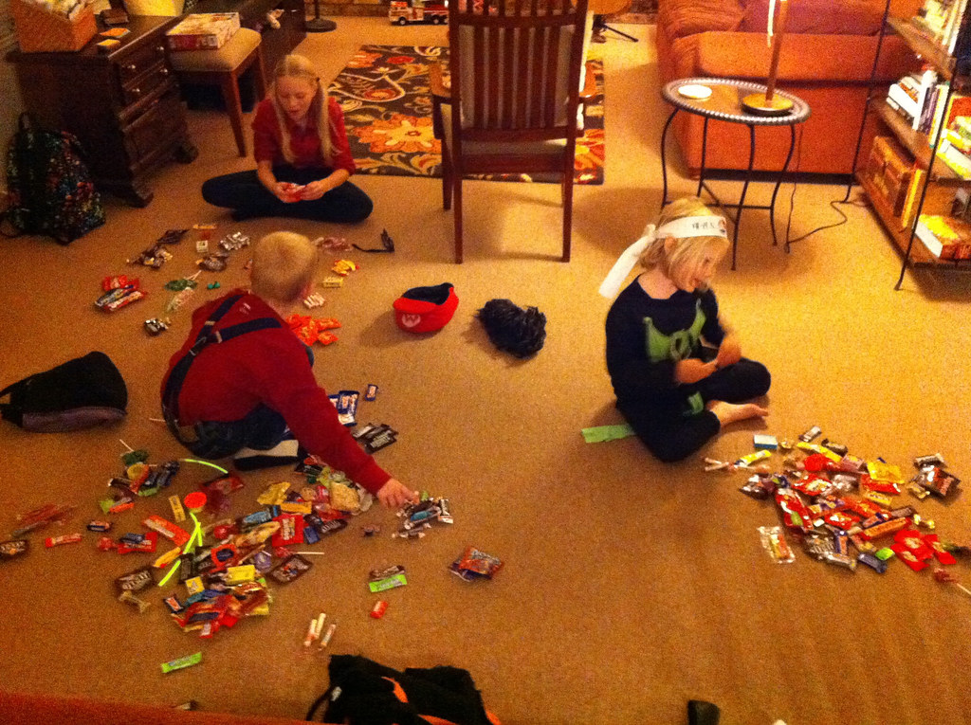
Dividing the Spoils or Consensus

Slide 78
Balance or representation

Slide 79
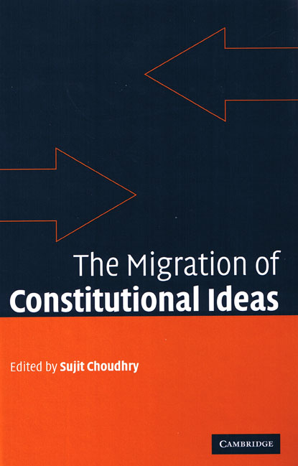
Legal transplants
A word of caution

Slide 80
Depoliticization
or
Weakening the Court

Slide 81
Echo chamber

