Slide 1
Why the EU is so powerful?
“Direct effect” doctrine
“EU law supremacy” doctrine

Slide 2
Why the Court of Justice of the EU is so important?
The preliminary ruling procedure:
a domestic case starts
the local judge thinks that EU law is involved
EU law is ambiguous
the local judge suspends the proceedings and requests the CJEU to issue a preliminary ruling
the domestic trial resumes and the local judge will enforce the EU rule as interpreted by the CJEU

Slide 3
The Regulatory State and the Technocratic Institutions
USA: The Federal Trade Commission
EU: The Privacy Authority
At the State Level: Privacy Authorities
Such institutions often have: regulatory, executive, and judicial powers

Slide 4
CHINA
The Central State and the Local Government
The Communist Party’s Rule
Regulating by principles and instructions

Slide 5
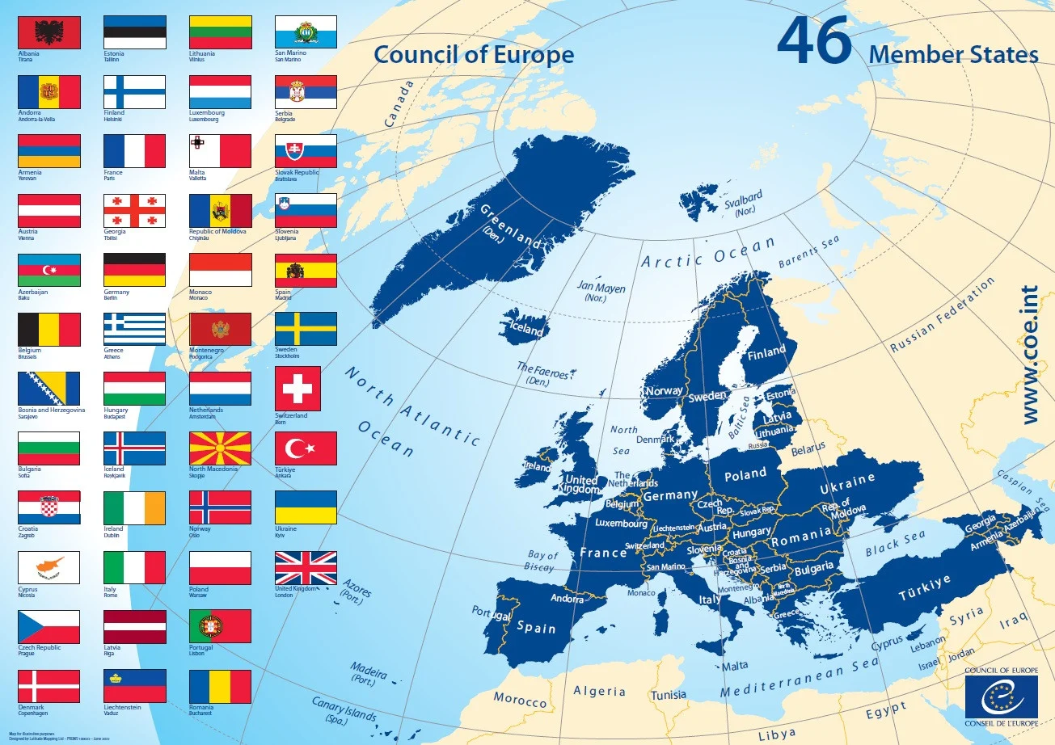
An Additional layer of complexity in Europe: The European Convention and the European Court of Human Rights

Slide 6
Art 8
1. Everyone has the right to respect for his private and family life, his home and his correspondence.
2. There shall be no interference by a public authority with the exercise of this right except such as is in accordance with the law and is necessary in a democratic society in the interests of national security, public safety or the economic well-being of the country, for the prevention of disorder or crime, for the protection of health or morals, or for the protection of the rights and freedoms of others.

Slide 7
Art. 10
1. Everyone has the right to freedom of expression. This right shall include freedom to hold opinions and to receive and impart information and ideas without interference by public authority and regardless of frontiers. This Article shall not prevent States from requiring the licensing of broadcasting, television or cinema enterprises.
2. The exercise of these freedoms, since it carries with it duties and responsibilities, may be subject to such formalities, conditions, restrictions or penalties as are prescribed by law and are necessary in a democratic society, in the interests of national security, territorial integrity or public safety, for the prevention of disorder or crime, for the protection of health or morals, for the protection of the reputation or rights of others, for preventing the disclosure of information received in confidence, or for maintaining the authority and impartiality of the judiciary.

Slide 8
The European Court of Human Rights’ powers
It intervenes after the exhaustion of domestic remedies
It addresses complaints against States
Its rulings establish obligations, but hardly have direct effects within state jurisdictions

Slide 9
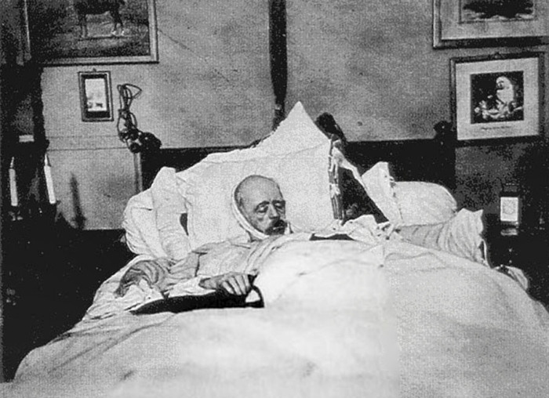
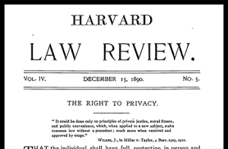
How Privacy Was Born

Slide 10
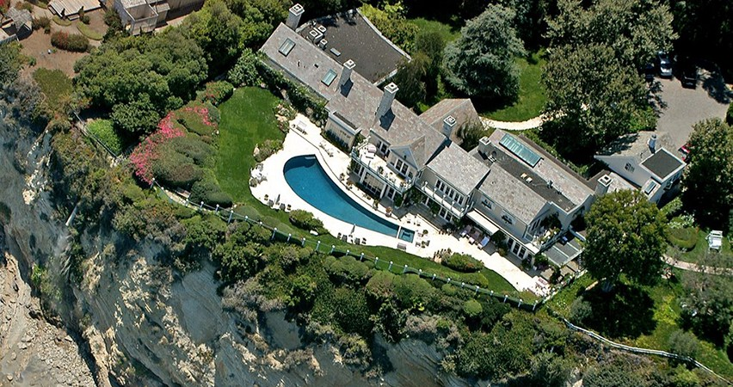
The Barbra Streisand Effect & the Paradox of Privacy

