Slide 1
Collaboration Strategies

Slide 2
The question posed
Whether to perform activities in house or with partners is a difficult decision for firms but the reality is that a significant portion of innovation comes from the collaborative efforts of multiple individuals or organizations.
Collaboration requires the firm to relinquish some degree of control over a technology’s development, share the financial returns and exposes a firm to the possibility of malfeasance by its partner. On the upside, collaboration also lowers the costs and risks associated with the development of a new technology.

Slide 3
Reasons for Going Solo
Why would a firm develop a technology on its own instead of collaboration with a partner?
A firm may go solo if
it possesses all the capabilities and resources in house that it needs,
the development of the new technology is an opportunity to develop new competencies,
the risk of transferring knowledge to a partner is too great,
the firm wants to control the subsequent trajectory of the technology’s development, or
if an appropriate partner is not available.

Slide 4
Reasons for Going Solo: example
For example, Monsanto developed on its own a genetically modified soybean seed that could be used in conjunction with Roundup, an herbicide.
They had to go solo because the biotechnology industry was in its infancy; there were no appropriate partners to supply the technology. Monsanto turned the need to develop this capability in house into an opportunity to make biotechnology its strategic focus.

Slide 5
Reasons for Going Solo: example
Honda Motors did not join the Alliance of Automobile Manufacturers when developing its Honda Insight hybrid electric vehicle because it wanted to retain control over the development process (and the profits) and because the company’s culture emphasizes independence and self-reliance.

Slide 6
Advantages of Collaborating
Collaborating can provide a firm with the needed skills or resources faster than developing them on their own.
Using the skills or resources of a partner can help a firm reduce its asset commitment (and avoid a large investment in a technology that may become obsolete quickly) and enable it to be more flexible; an especially important feature in markets characterized by rapid technological change.

Slide 7
Advantages of Collaborating
3. Collaboration can also be an important opportunity for the firm to acquire new knowledge, either through the transfer of knowledge between development partners or the more efficient creation of new knowledge as a result of the collaborative efforts.
4. Collaboration may also be advantageous if it results in the creation of a shared standard. Where compatibility and complementary goods are important to the commercialization efforts of a new technology, collaboration at the development stage can bring about cooperation at the commercial stage

Slide 8
Collaboration
Collaboration can take many forms and can be formed to accomplish almost any business function.
Potential partners include suppliers, customers, competitors, and complementors, organizations that offer similar products in different markets or offer different products in similar markets, non-profit organizations, government organizations and universities among others.
Firms may choose to collaborate in the areas of manufacturing, services, marketing, or technology-based objectives. Collaboration for the purpose of research and development ranks high among the reasons partners join efforts, particularly in North America.

Slide 9
Types of Collaborative Arrangements
Collaboration arrangements range from very informal alliances to highly structured joint ventures or technology exchange agreements (licensing). The most common forms of collaboration in technological innovation are
1. strategic alliances,
2 joint ventures,
3 licensing,
4 outsourcing, and
5 collective research organizations

Slide 10
1. Strategic alliances
Strategic alliances require a significant investment in time and resources but in exchange firms gain access to capabilities not available in house, leverage their capabilities by combining their efforts with another firm, achieve innovation goals faster, at a lower cost and with less risk.
Alliances can also provide a firm with the flexibility to pursue various opportunities for innovation or access different types and scale of capabilities, important in rapidly changing markets.

Slide 11
Strategic alliances: example
An alliance between a large pharmaceutical company and a small biotechnology firm provides the large firm access to drug discoveries and the smaller firm benefits from the capital resources, manufacturing, and distribution capabilities of the larger firm.

Slide 12
Strategic alliances
Doz & Hamel categorized alliance strategies along two dimensions:
Whether the alliance pools or transfers capabilities from one firm to another,
Whether the alliance is between two companies or three or more companies (i.e. collective network of alliances).

Slide 13
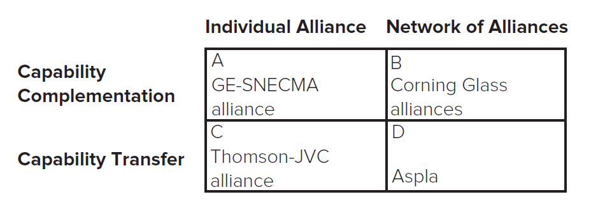
Types of Collaborative Arrangements
Doz and Hamel note that a firm’s alliance strategy might emphasize combining complementary capabilities or transferring capabilities.
It might also emphasize individual alliances or a network of alliances.
Access the text alternative for these images

Slide 14
Other Types of Collaborative Arrangements
Joint Ventures: A particular type of strategic alliance that entails significant equity investment and often establishes a new separate legal entity.
Licensing: a contractual arrangement that gives an organization (or individual) the rights to use another’s intellectual property, typically in exchange for royalties.
Outsourcing: When an organization (or individual) procures services or products from another rather than producing them in-house.
Collective Research Organizations: Organizations formed to facilitate collaboration among a group of firms.

Slide 15
Choosing a Mode of Collaboration: Solo
Solo internal development is relatively slow and expensive, offers little-to-no potential for accessing another firm’s competencies but enables a firm to retain control over how the technology is developed and used and is most likely to contribute the leveraging of existing competencies and the development of new ones.
Solo internal development is appropriate when a firm has strong competencies related to the new technology, access to capital, and is not under great time pressure.

Slide 16
Choosing a Mode of Collaboration: Strategic alliances
Strategic Alliances enable firms to quickly gain access to another firm’s technology, or to broader markets, to leverage existing competencies or develop new competencies depending on the structure of the alliance.

Slide 17
Choosing a Mode of Collaboration: Joint ventures
Joint Ventures offer a slight time advantage over solo development efforts due to combined efforts of partners.
Joint ventures also offer cost sharing, the potential for leveraging existing competencies and developing new competencies and the opportunity to access partners’ competencies.
Joint ventures are particularly desirable when a firm places value on access to other firms’ competencies.

Slide 18
Choosing a Mode of Collaboration: Licensing in
Licensing in is a fast and moderately priced way to access new technology. Licensing also has the potential to leverage the firm’s existing competencies, develop new competencies and provide access to another firm’s existing competencies.
On the downside, licensing in offers limited use of a technology and a low degree of control.

Slide 19
Choosing a Mode of Collaboration: Licensing out
Licensing out offers a fast and low cost way of expanding the use of a technology into new products or markets. It leverages the firm’s existing competencies and can enable it to access other firm’s competencies (for example, their superior knowledge of a particular market).
If offers little opportunity for development of new competencies.

Slide 20
example
Even if it is often stressed that a technology available for licence cannot be an important source of advantages Protcter & Gamble’s (P&G) tells another story
Through its connect and develop program it focuses on sourcing ideas and technologies external to the firm that it can then add value to in its labs.
https://www.youtube.com/watch?v=SAvwst8FAuk&list=PLc6EeKrKYKClN48ow3Irj_sO0zQEY-Vwu&index=73

Slide 21
Choosing a Mode of Collaboration: outsourcing
Outsourcing affords rapid access to another firm’s expertise and lower costs and leverages a firm’s existing competencies by allowing it to focus on activities providing the greatest return.
On the downside, the firm has little opportunity to build new competencies.
(e.g.manufacturing contractors)

Slide 22
Choosing a Mode of Collaboration: collective research organization
Collective Research Organization is a form of long-term commitment in which costs and degree of control can vary significantly.
These arrangements often enable a firm to leverage and build upon its existing competencies as well as to learn from other participating organizations.
These organizations are particularly useful in industries with complex technologies and/or industries that require considerable investments in basic science.

Slide 23
Choosing a Mode of Collaboration 1
Firms should match the trade-offs of a collaboration mode to their needs.
N A | Speed | Cost | Control | Potential for Leveraging Existing Competencies | Potential for Developing New Competencies | Potential for Accessing Other Firms’ Competencies
Solo Internal Development | Low | High | High | Yes | Yes | No
Strategic Alliances | Varies | Varies | Low | Yes | Yes | Sometimes
Joint Ventures | Low | Shared | Shared | Yes | Yes | Yes
Licensing In | High | Medium | Low | Sometimes | Sometimes | Sometimes

Slide 24
Choosing a Mode of Collaboration 2
N A | Speed | Cost | Control | Potential for Leveraging Existing Competencies | Potential for Developing New Competencies | Potential for Accessing Other Firms’ Competencies
Licensing Out | High | Low | Medium | Yes | No | Sometimes
Outsourcing | Medium/High | Medium | Medium | Sometimes | No | Yes
Collective Research | N A | N A | N A | N A | N A | N A
Organizations | Low | Varies | Varies | Yes | Yes | Yes

Slide 25
Choosing and Monitoring Partners
Risks of collaboration include difficulties in determining if the resources provided by partner are a good fit, the possibility that the partner will exploit the relationship by expropriating the company’s knowledge with little or no reciprocal contribution, and the possibility that managers will become overburdened by managing more collaborations than is reasonable.
→It is thus important to limit collaborations, choose partners carefully and establish monitoring and governance systems to limit risks.

Slide 26
Choosing and Monitoring Partners
→ Partner selection is crucial to success. Key factors fall into two dimensions:
- resource fit (e.g. partner’s relative size and strength and complementarity of resources) and
- strategic fit (e.g. alignment of objectives and similarity of values and culture).

Slide 27
Choosing and Monitoring Partners
Resource fit: How well does the potential partner fit the resource needs of the project? Are resources complementary or supplementary?
Strategic fit: Does the potential partner have compatible objectives and styles?
Impact on Opportunities and Threats: How would collaboration impact bargaining power of customers and suppliers, degree of rivalry, threat of entry or substitutes?
Impact on Internal Strengths and Weaknesses: Would collaboration enhance firm’s strengths? Overcome its weaknesses? Create a competitive advantage?
Impact on Strategic Direction: Would the collaboration help the firm achieve its strategic intent?

Slide 28
Choosing and Monitoring Partners
Partner Monitoring and Governance is as crucial to success as partner selection.
There are three main types of governance mechanisms used to manage collaborative relationships:
1. Alliance contracts
2. Equity ownership
3. Relational governance.

Slide 29
1. Alliance contracts
Alliance contracts clarify partners’ rights and obligations and specify legal remedies in the case of a violation of the agreement. Often included in the agreements are:
What each partner is obligated to contribute to the collaboration.
How much control each partner has in the collaboration.
When and how proceeds of the project will be distributed.
Mechanisms for monitoring each partner’s adherence to the agreement.
Provisions for periodic auditing.
Provisions for terminating the relationship.

Slide 30
2. equity ownership; 3. relational governance
May also use shared equity ownership (that is, each partner contributes capital and owns a share of equity in the alliance).
Helps to align incentives and provide sense of ownership.
May rely on relational governance (self-enforcing governance based on the goodwill, trust, and reputation of partners).
Built over time.
Can facilitate more extensive cooperation, sharing, and learning by partners.

Slide 31
Strategic Positions in Collaborative Networks
Firms should also think about how their alliances position them within the overall collaborative network.
Firms that occupy highly central positions might have access to more information and be able to access that information more quickly.
Firms that occupy “brokerage” positions (by bridging groups of otherwise disconnected firms) might have opportunities to make unique and valuable combinations between heterogeneous types of information and might also become valuable gatekeepers in the flow of information through the network.

Slide 32
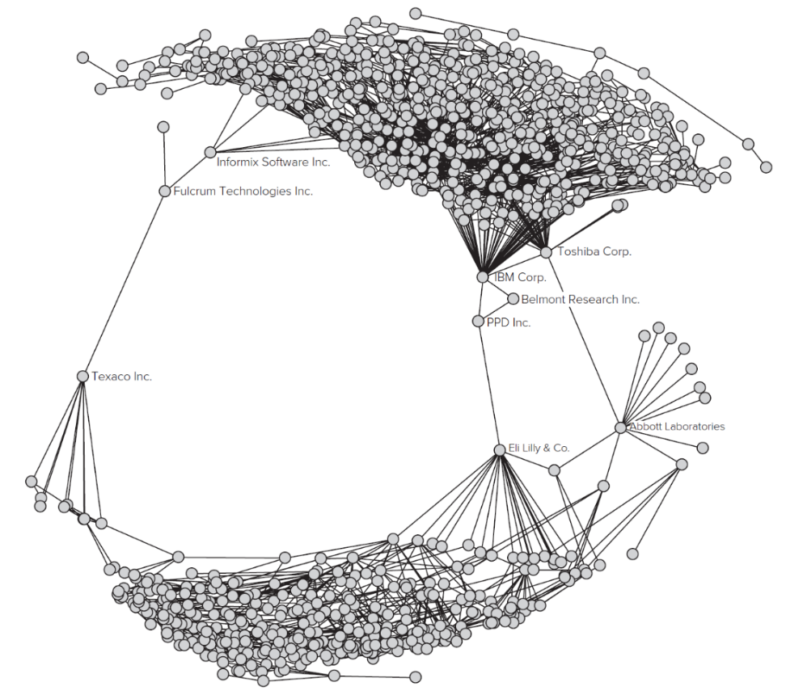
Global Technology collaboration network (1998)
A firm’s position within a collaborative network influences its access to information and other resources, and its influence over desired outcomes. Some of the key aspects of a firm’s position include centrality and opportunities for brokerage.
For example, in this graph, though P P D Inc. has only three alliances, it serves as an important bridge between the two lobes of the network, which should give it important opportunities for brokerage.
Access the text alternative for these images

Slide 33
NOW IT’S YOUR TURN
Focus on Two products: e.g. Remarkable and Amazon Alexa
Focus on Two companies: e.g. IKEA and Meta (Facebook)
Think out of the box what type of collaborations, pros and cons, antecedents and consequences

