Slide 1
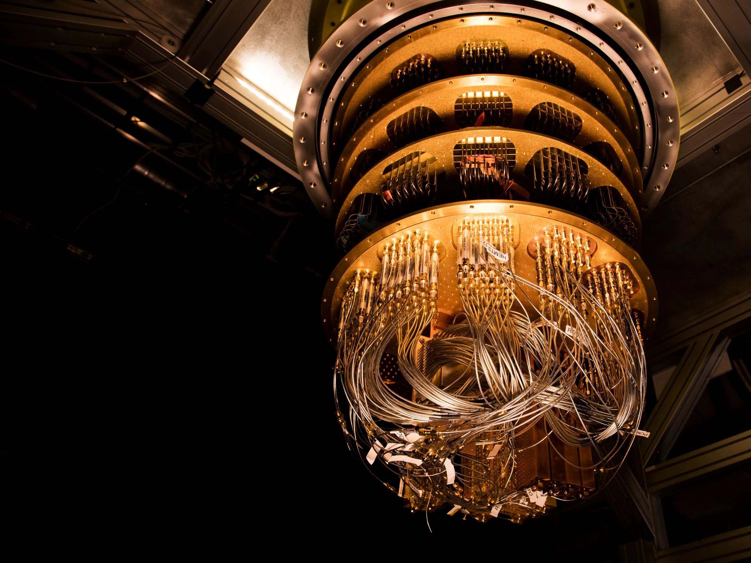
Superconductive Quantum Bits h "Artificial Atoms"

Slide 2
Key ingredients for implementing a quantum computer:
1. UNIT OF INFORMATION: QUBIT
2. MANIPULATING INFORMATION
3. READ OUT
4. COHERENCE TIMES

Slide 3
1. UNIT OF INFORMATION: QUBIT
A Qubit is a two level system: a quantum system characterized by two eigenstates |0> and |1>

Slide 4
1. UNIT OF INFORMATION: QUBIT
A Qubit can exist as a superposition of the two states |0> and |1> :
$$\left|ψ> = α \right|0>+ β \left|1>\right.$$

Slide 5
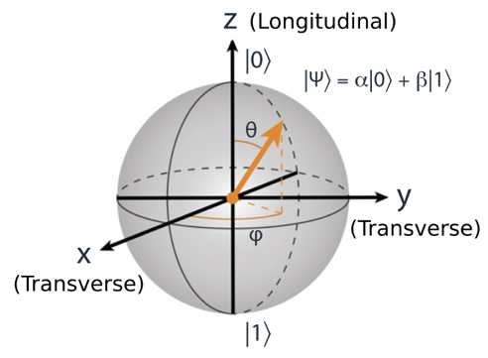
1. UNIT OF INFORMATION: QUBIT
$$\left|ψ> = α \right|0>+ β \left|1>\right.$$
$$=cos( θ/2) |0>+ e^{iφ} cos( θ/2) |1>$$

Slide 6
1. UNIT OF INFORMATION: QUBIT
N qubits generate $2^{N}$states vs N bits generate N states
2 qubits generate 4 states:
2 bits genrate 2 combinations:
$|00>,$ $|11>,$ $|10>$ and $|01>$
10 and 01
$\left|ψ> = α_{00} \right|0 0>+ α_{11} |11$ $>$ $+$
$+{ α}_{10} |10 >+ { α}_{01} |01$ $>$

Slide 7
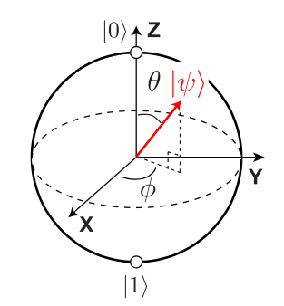
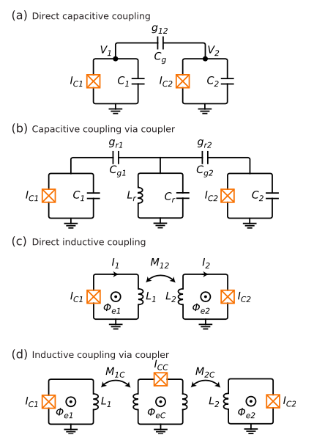
2. MANIPULATING INFORMATION
Operations on single Qubits
Operations on may Qubits: create entanglement

Slide 8
3. READ OUT

Slide 9
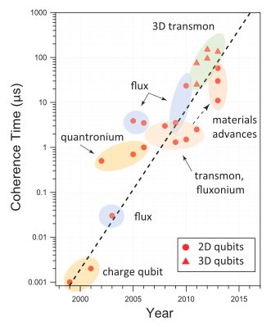
4. COHERENCE TIME
Today, the best performances have been demonstrated by superconducting qubits, for which we have managed to achieve coherence times on the order of hundreds of microseconds. The current record is 300 microseconds.

Slide 10
HOW SUPERCONDUCTING QUBITS ARE MADE?

Slide 11
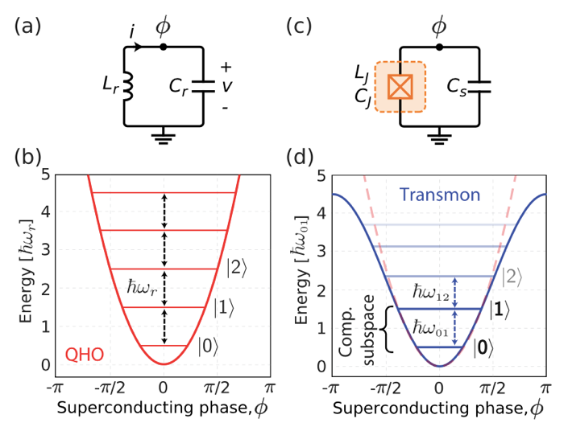
1. HARMONIC OSCILLATOR
Hamiltonian:
$$\hat{H}= \frac{{\hat{Q}}^{2}}{2C}+\frac{{\hat{Φ}}^{2}}{2L}$$
Energies:
$$\hat{H} \left|n> =ℏω_{0}\left(n+\frac{1}{2}\right)\right|n>$$

Slide 12
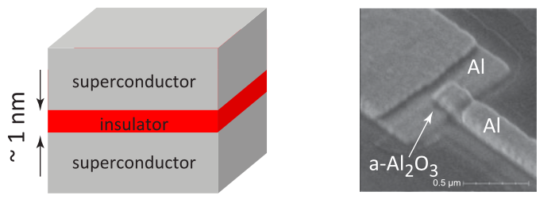
2. ANHARMONIC OSCILLATOR
It is necessary to introduce anharmonicity into the system. This can be done using a nonlinear and non-dissipative inductance: the Josephson Junction

Slide 13
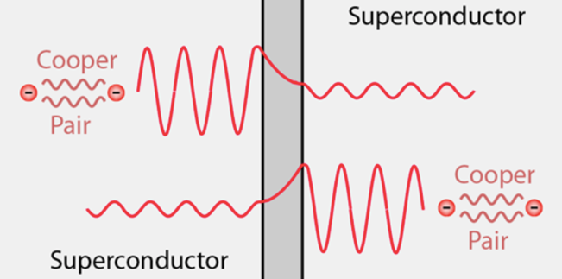
2. ANHARMONIC OSCILLATOR
Superconductive phase difference trought the junctiuon:
$φ=φ_{1}−φ_{2}$
Superconductive current:
$$I=I_{C} sin⁡(φ)$$
$$L_{J}=\frac{Φ_{0}}{I_{C} cos(φ)}$$
Potential difference:
$$V=L\left(\frac{dI}{dt}\right)$$
$$V=\frac{Φ_{0} dφ}{dt}$$
Junctiuon Induction

Slide 14
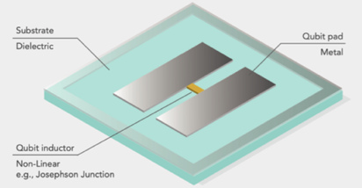

Slide 15
