Slide 1
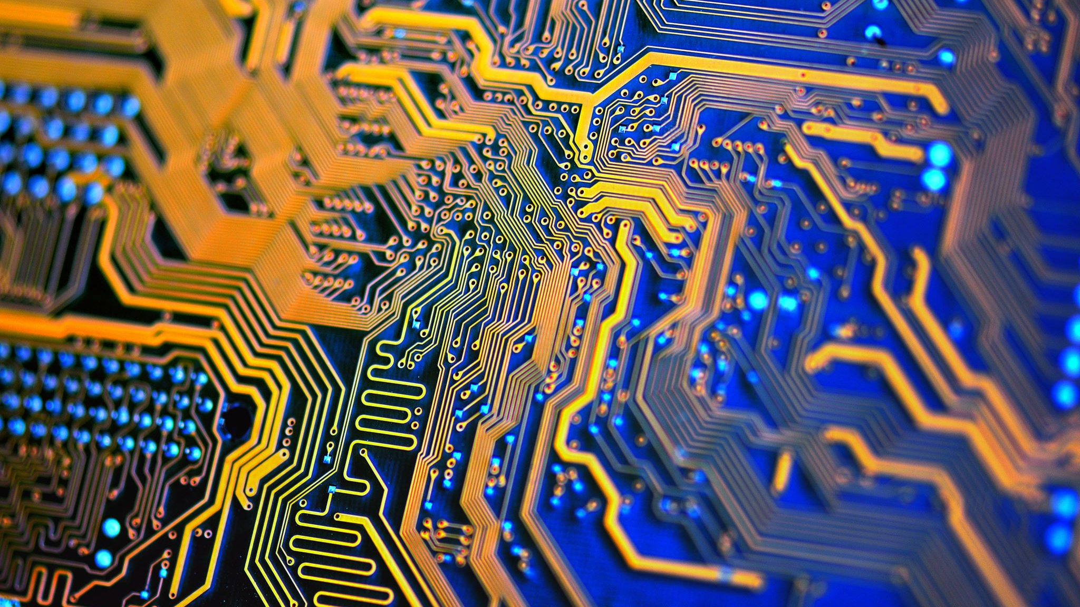
Superconducting Microelectronics
A deep dive into the history and change of microelectronics at Lincoln Lab, MIT
By
Iver Grønlien

Slide 2
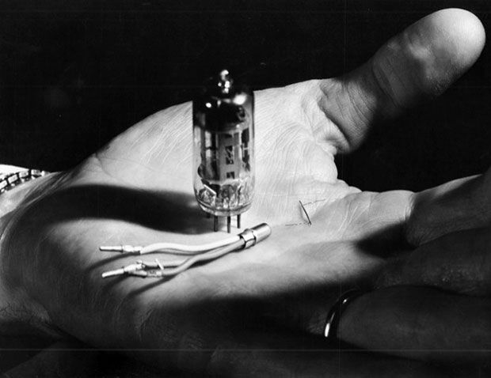
The Cryotron - 1956
Dudley Buck filed patent
Regulates current by using a magnetic field induced by the SC coil
Magnetic field kills SC state of Tantalum
Pros: - Less power due to lower resistance - Very small
Cons: - Very slow switching speed (switching from SC to NC) - Transistors tech. evolved more rapid, and got cheaper
Inspiration for the Josephson Junction
Photo: MIT MUSEUM

Slide 3
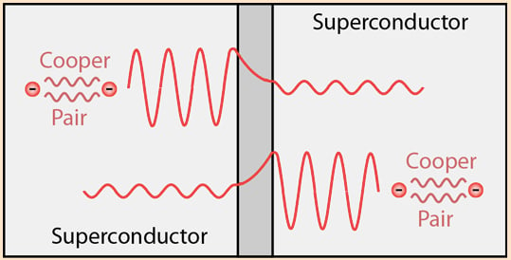
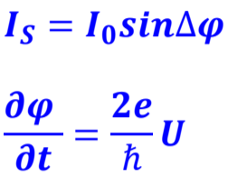
Josephson Effect- 1962
Predicted by Brian Josephson
Realised by Philip Anderson - 1963
Tunneling effect for cooper pairs due to overall phase difference
DC effect
AC effect, external power source
Source

Slide 4
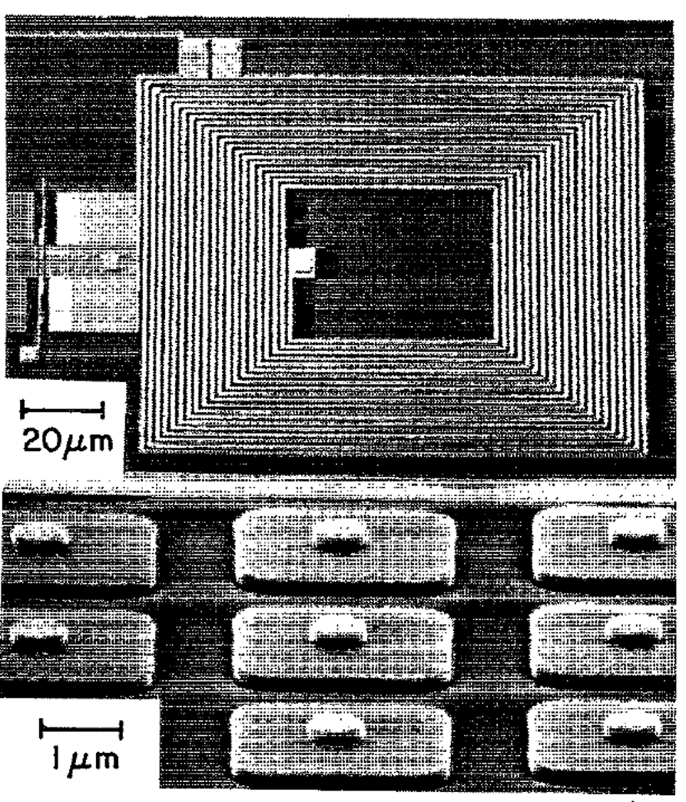
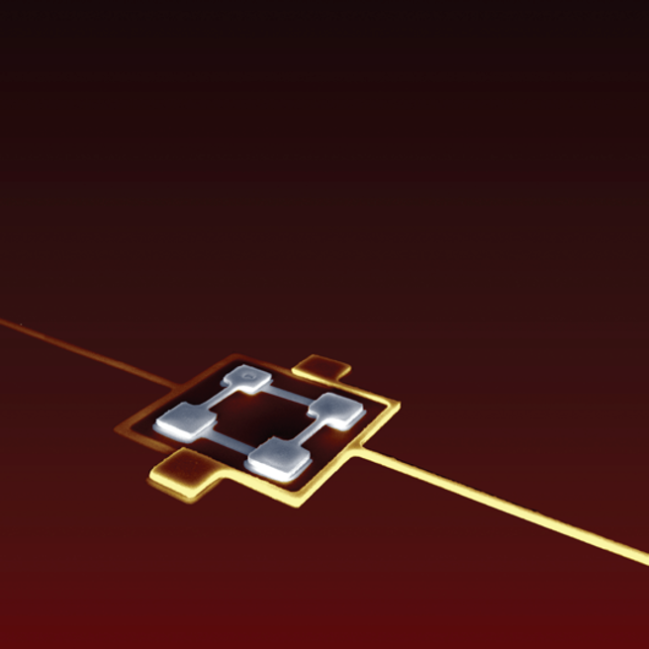
New spiking interest
Thin film superconductors for analog signal processing - 1979
Trilayer Josephson junction process – 1995 Nb/AlOx/Nb on silicon wafers
Qubits - 1999

Slide 5
Why Josephson Junction as a Qubit
Atoms can represent quantum information
Qubits are sensitive to losses -> SC reduces resistive losses
Anharmonic energy levels due to cosine energy potential
Source

Slide 6
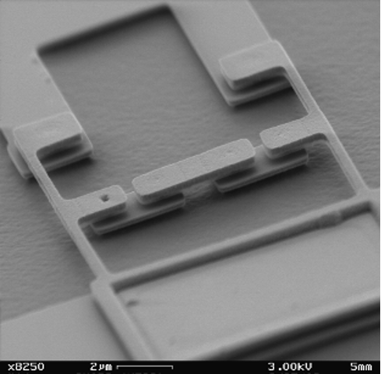
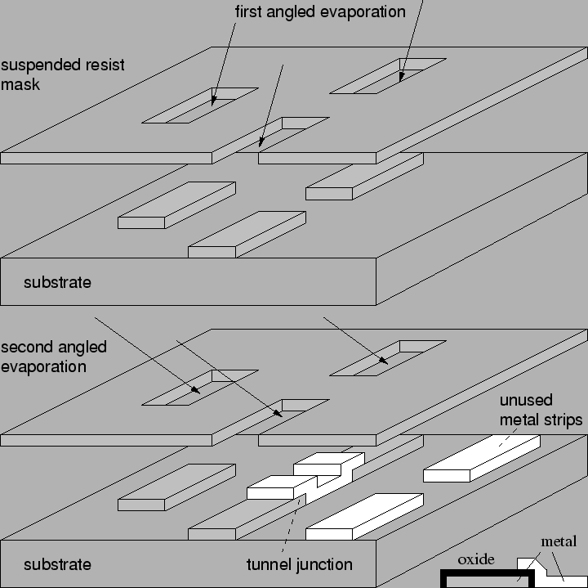
Further development
Too big junction sizes for quantum applications
Moved to new technique reducing junction size: 500nm -> 200nm
Increased coherence time, 10x than other groups
Also had to move away from fully planarized technique due to introduction of imperfections
Shadow Evaporation, state of the art coherence time
Source

Slide 7
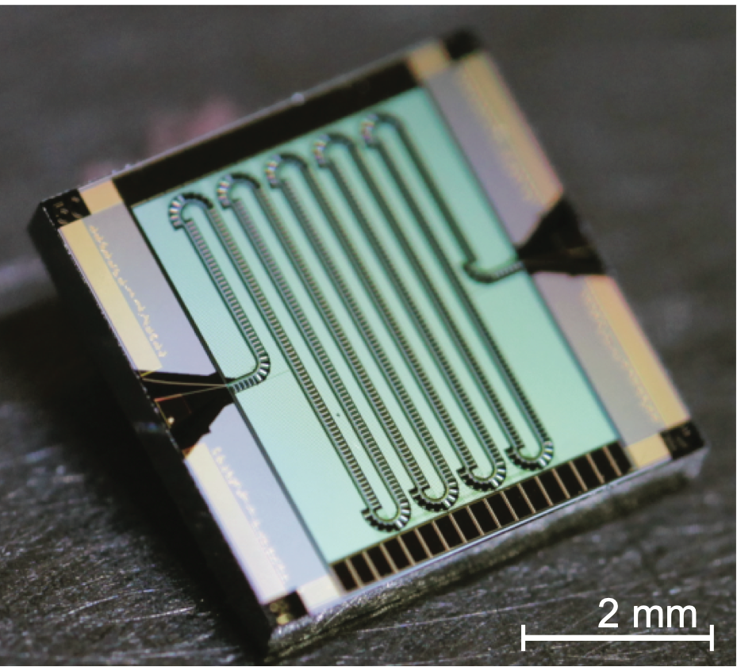
Recent research
Hard to detect one photon for low energy freq.
Superconducting Traveling-Wave Parametric Amplifiers - 2015
High gain, high quantum efficiency of 75% and a wide bandwith
Long chain of JJ
Can read out 20 SC qubits simultaneously

Slide 8
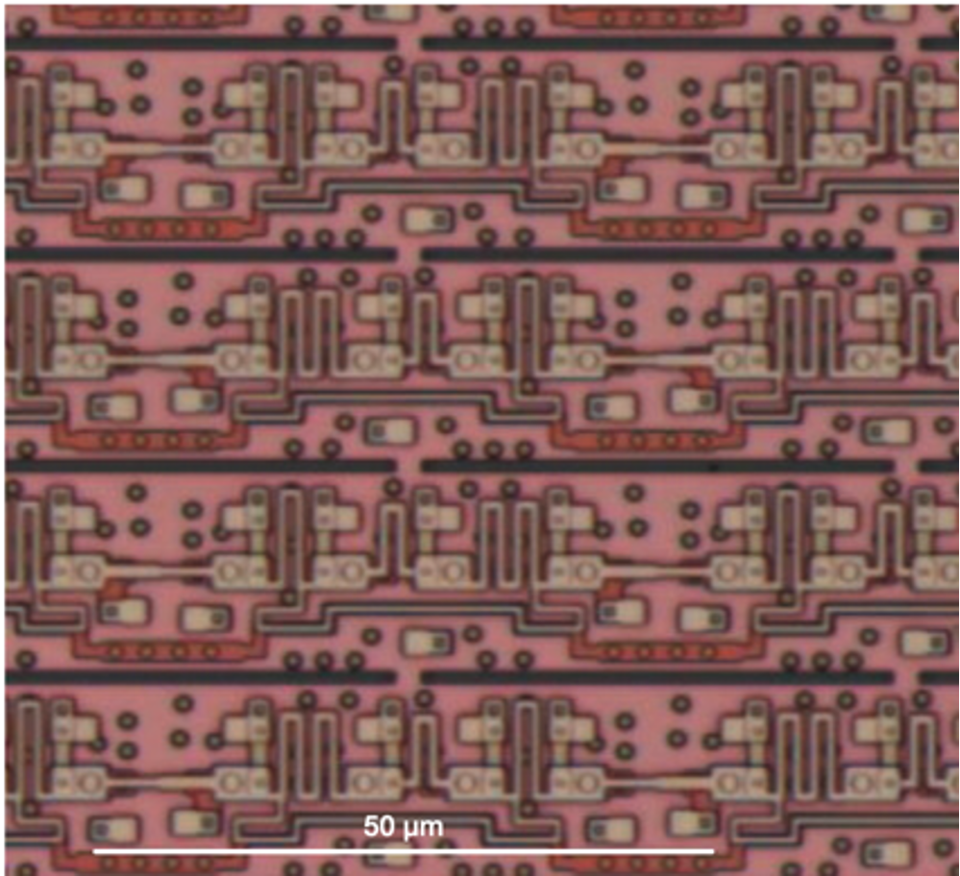
Recent research
Worlds leading-edge SC electronic process - 2017
4, 8 and 10 Nb metal layers
High speed and ultralow power dissipation
8-202k cells, with 4 around JJ per cell, world leading in circuit density

Slide 9
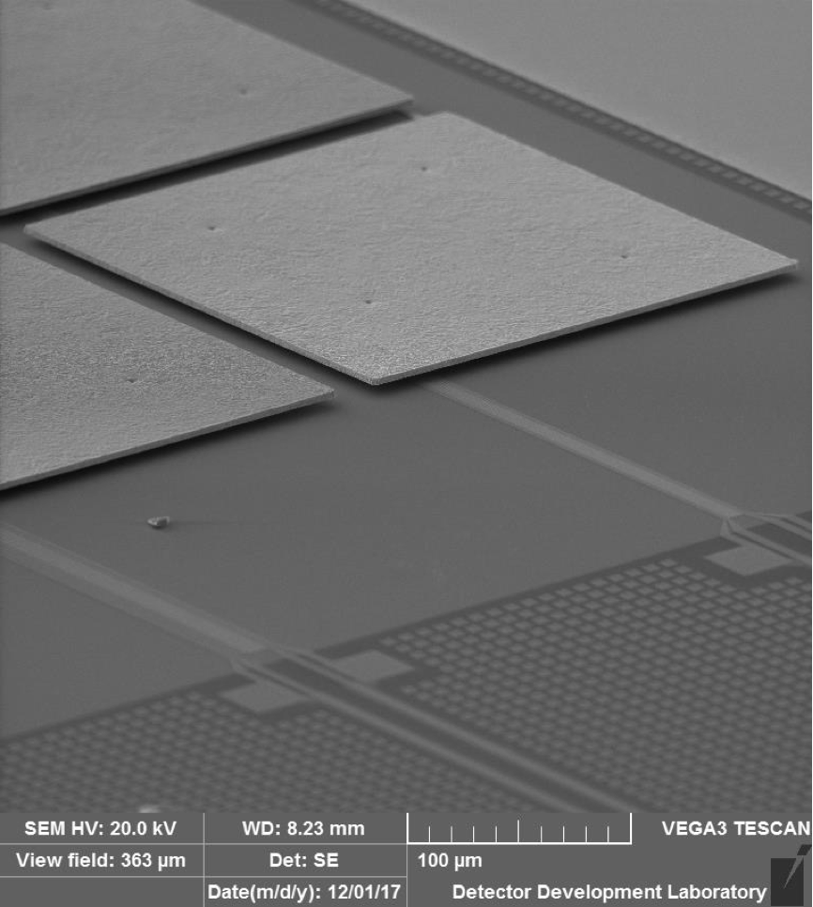
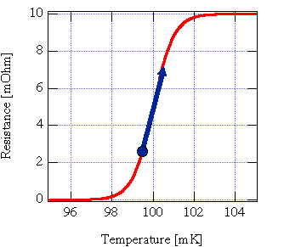
Recent research
Lynx: planned space observatory for NASA
Planned to launch in 2030s
R&D on TES component in X-ray Microcalorimeter - 2019
X-ray -> Heat -> electric signal (SC sensor)
NASA wants 100.000 pixel Transition Edge Sensor (TES)
A thermometer operating near Tc
Tc often around mK
Source

Slide 10
Sources
https://llmpf.ll.mit.edu/SC (All unmarked photos comes from this source)
https://en.wikipedia.org/wiki/Cryotron
https://link.springer.com/chapter/10.1007/978-3-030-20726-7_17 Anton Frisk Kockum and Franco Nori, 2019
https://www.science.org/doi/10.1126/science.aaa8525 MACKLIN et al., 2015
https://web.mit.edu/figueroagroup/ucal/ucal_tes/

