Slide 1
Aula F – Turno 1
NT
NT
NT
LPS
LPS
LPS
LPS
LPS
NT
LPS
Vinculin
125 kDa
38 kDa
Pro-IL-1β
28 kDa

Slide 2
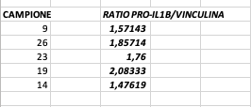
Aula G – Turno 1
52
9
55
26
58
23
36
19
46
14
Vinculin
125 kDa
38 kDa
Pro-IL-1β
28 kDa

Slide 3
Aula H – Turno 1
NT
LPS
NT
LPS
NT
LPS
NT
LPS
NT
LPS
Vinculin
125 kDa
38 kDa
Pro-IL-1β
28 kDa

