Slide 1
Signaling and metabolism

Slide 2
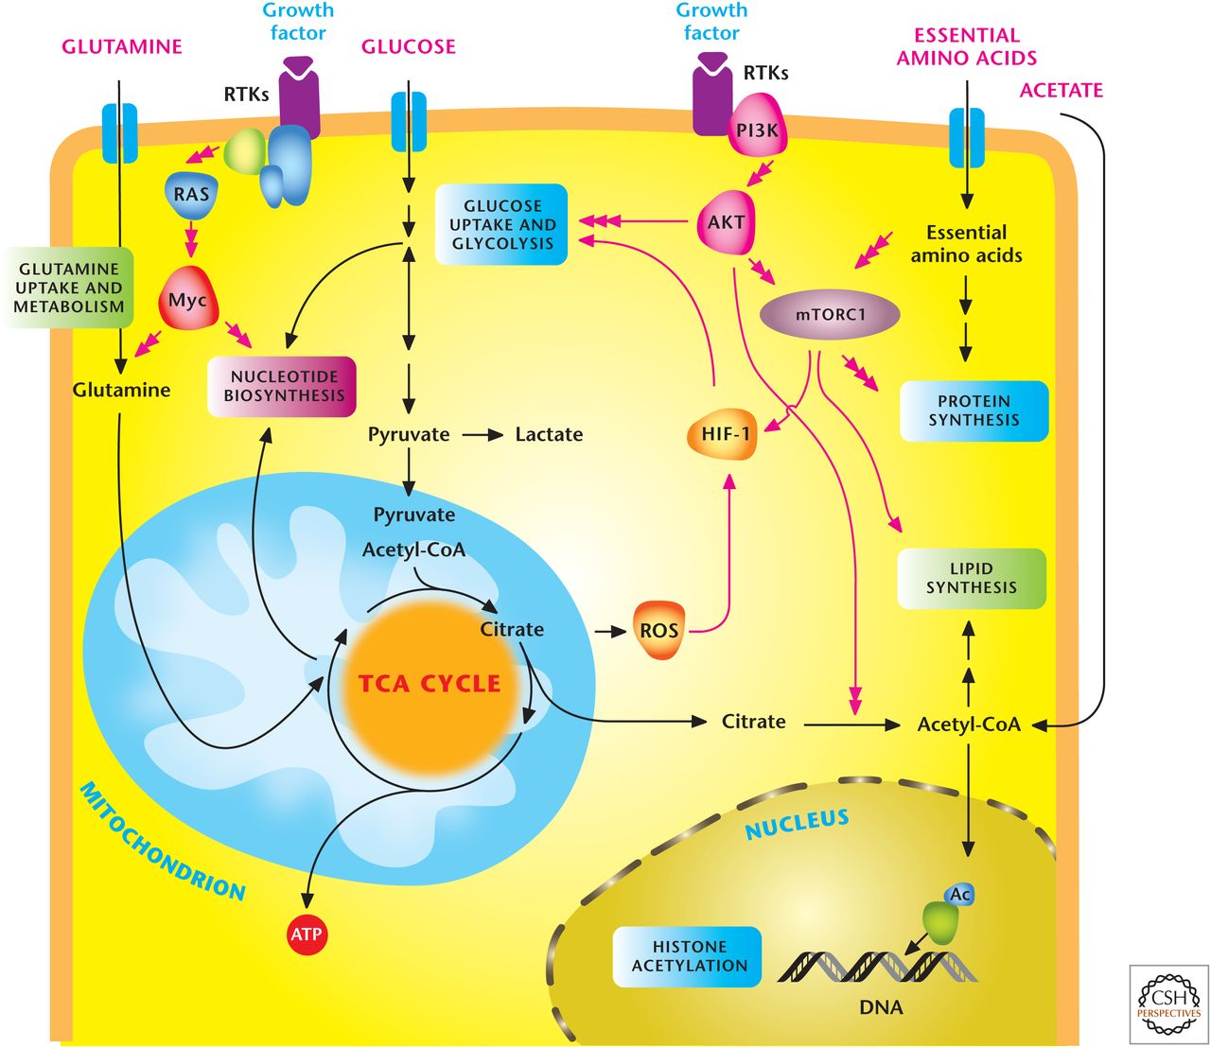
Signal transduction pathways regulate metabolism.
Notes:
Unlike yeast cells, which take up nutrients in a cell-autonomous manner, mammalian cells take up nutrients under the instruction of these signaling pathways,. These signaling pathways maintain homeostasis by allowing sufficient nutrient uptake to maintain metabolic demand. In the presence of ample nutrients and certain growth factors, cells grow in size and at times this is coupled with cell proliferation. If a particular nutrient (amino acid, oxygen, or glucose) becomes depleted, then cells have nutrient-sensing mechanisms that switch from an anabolic program to a catabolic program. Similarly, if nutrients are abundant, but the extracellular factors that activate signaling pathways for nutrient uptake are absent, then cells also undergo a catabolic program.
Autophagy (“self-eating”) is a catabolic metabolic program that is activated when intracellular nutrient uptake or availability is diminished. Autophagy generates intracellular amino acids and other substrates that can be used to generate ATP.
Insulin is perhaps the most potent anabolic factor. It stimulates the insulin receptor, a member of the cell membrane receptor tyrosine kinases (RTKs), resulting in uptake of glucose, amino acids, and fatty acids into cells and promotes synthesis of lipids, proteins, and carbohydrates.
Signal transduction pathways regulate metabolism. In multicellular organisms, cells use growth factors to uptake nutrients. Growth factors through receptor tyrosine kinases (RTKs) activate the PI3K to stimulate AKT and mTORC1, which promotes glycolysis and lipid synthesis. mTORC1 signaling responds to levels of essential amino acids to stimulate protein synthesis. The HIF-1 transcription factor further promotes glycolysis. RTK activation also activates Myc transcription factor, which enhances both glycolysis and mitochondrial metabolism. Myc stimulates glutamine metabolism necessary to sustain mitochondrial metabolism and nucleotide biosynthesis. Mitochondrial ROS and acetyl-CoA production promote HIF-1 activation and histone acetylation, respectively, as examples of metabolism feeding back on signaling.

Slide 3
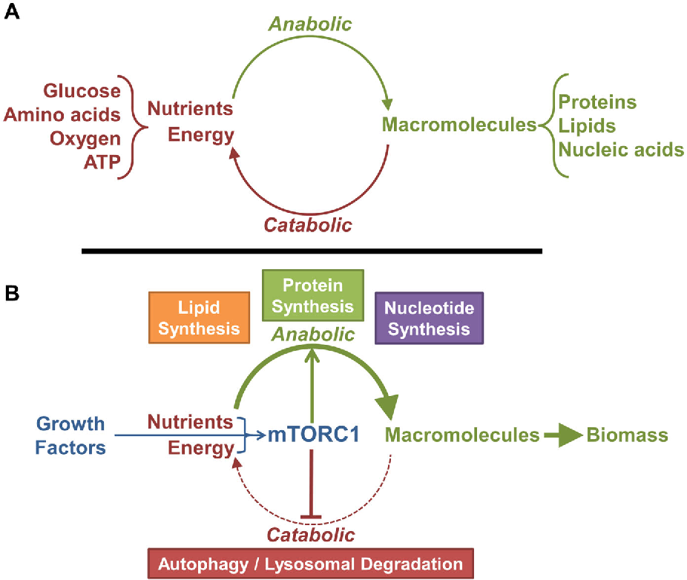
mTORC1 is a molecular switch between catabolic and anabolic processes.
Notes:
mTORC1 is a molecular switch between catabolic and anabolic processes.
A standard metabolic cycle. Anabolic processes convert nutrients and energy into macromolecules, and catabolic processes can convert macromolecules into their nutrient components and energy.
Through the sensing of exogenous growth factors and endogenous nutrients and energy, mTORC1 serves to tip the metabolic balance away from catabolic processes and toward anabolic processes to produce biomass.

Slide 4
mTOR characteristics
mammalian Target Of Rapamycin
High conserved
Serine/threonine kinase protein (289 kDa)
Belonging to PIKK (phosphatidylinositol 3-kinase-related kinase)
In mammalian cells → 2 distinct complexes

Slide 5
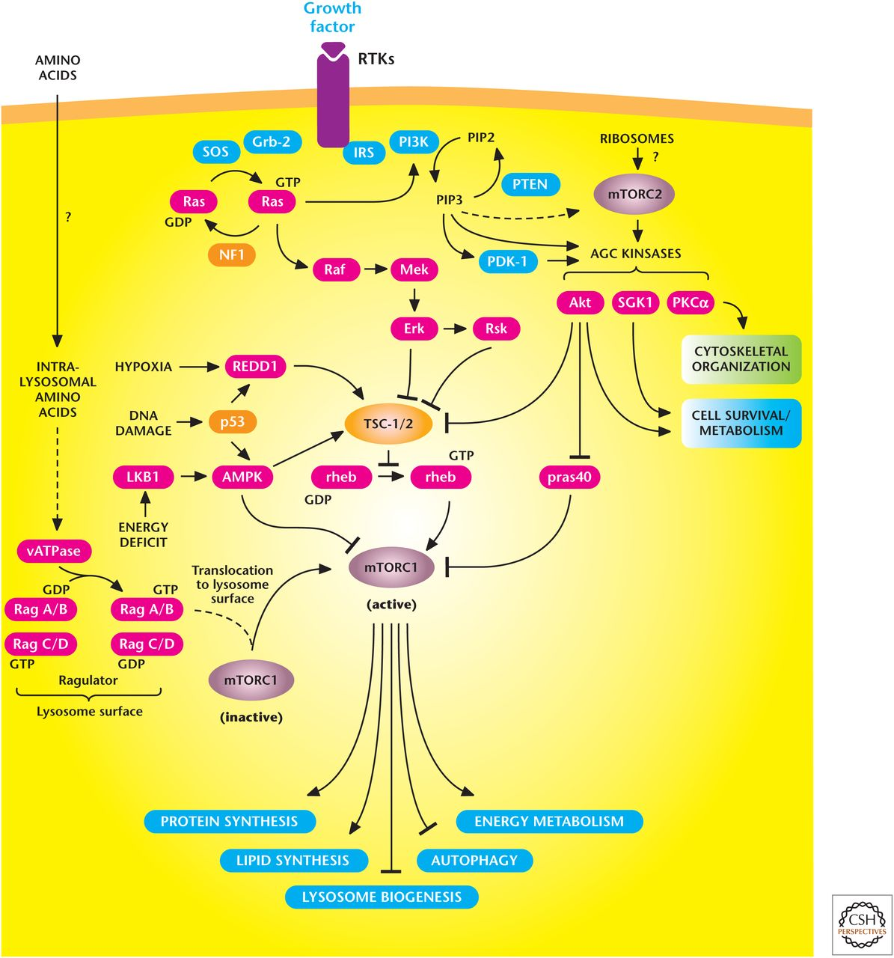
The mechanistic target of rapamycin (mTOR) signaling pathway controls metabolism and cell survival.
mTORC1 stimulates multiple anabolic metabolic pathways (lipid and protein synthesis) in the presence of nutrients and growth factors. Conversely, limiting nutrient or growth factor availability promotes catabolic pathways (autophagy).
mTORC2 promotes cell survival through activation of AKT.
Notes:
mTORC1 stimulates multiple anabolic metabolic pathways (lipid and protein synthesis) in the presence of nutrients and growth factors. Conversely, limiting nutrient or growth factor availability promotes catabolic pathways (autophagy).
mTORC2 promotes cell survival through activation of AKT.
A salient feature of mTORC1 is that it changes its activity in response to availability of amino acids, oxygen, and growth factors, as well as decreases in the energetic status of cells.
The upstream regulator of mTORC1 is the heterodimer consisting of tuberous sclerosis 1 and 2 (TSC1 and TSC2), which functions as a GTPase-activating protein for the Ras homolog enriched in brain (RHEB) GTPase. The GTP-bound RHEB stimulates mTORC1 kinase activity, and the TSC1/2 complex converts RHEB into the inactive GDP bound state. Thus, repressing TSC1/2 allows RHEB to stimulate mTORC1 kinase activity. There are many inputs that either repress or activate TSC1/TSC2 to control mTORC1 activity. Growth factor activation of AKT inhibits TSC1/ TSC2, resulting in mTORC1 stimulation to promote anabolism. In contrast, when cells are under limited oxygen (hypoxia) or energetically stressed, mTORC1 is inhibited to block energy consuming anabolic pathways and stimulate catabolic pathways, such as autophagy.
The availability of amino acids also regulates mTORC1 activity, but not through TSC1/TSC2. Instead, the abundance of amino acids, particularly leucine and arginine, through unknown mechanisms is sensed at the lysosome surface to activate RAG (Ras-related GTP binding) GTPases, which promote mTORC1 activation. It is important to note that when cells are energetically stressed or have diminished oxygen or amino acid availability, they inhibit mTORC1 activity, even in the presence of growth factor stimulation. Thus, growth factors cannot promote mTORC1-dependent anabolism in the absence of nutrients.
In contrast to mTORC1, mTORC2 primarily responds to growth factors and is insensitive to nutrients. It is not clear how mTORC2 is activated, but recent evidence suggests that perhaps ribosomes bind mTORC2 in a PI3K-dependent manner to activate mTORC2.

Slide 6
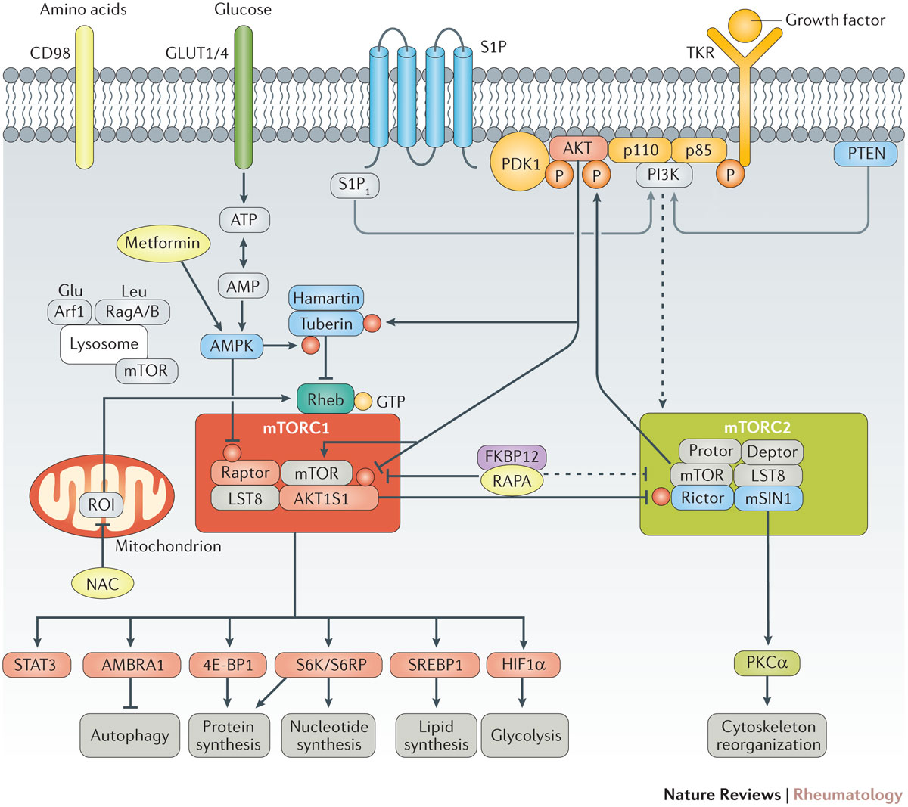
mTORC1/2 pathway downstream effectors
Notes:
Both nutrients and RTKs regulate metabolism. The atypical serine/threonine protein kinase mTOR integrates metabolic regulation by growth factors and nutrients
mTOR is a component of two large protein complexes known as mTOR Complex I (mTORC1) and mTOR Complex 2 (mTORC2). The two complexes share common proteins, but they also have distinct proteins within their complexes. Importantly, the two complexes participate in divergent biological functions.
mTOR pathway activation. Mechanistic target of rapamycin (mTOR) is regulated by metabolic cues, primarily glucose and amino acids, as well as by growth factors, hormones and cytokines. Glucose and amino acids enter cells via surface receptors such as glucose transporter type 1, erythrocyte/brain (GLUT1) or glucose transporter type 4, insulin-responsive (GLUT4) and CD98, respectively. Growth factors stimulate tyrosine kinase receptors (TKRs), which are activated through phosphorylation of tyrosine residues. In turn, TKR signals are transmitted to mTOR through phosphatidylinositide 3-kinase (PI3K), phosphoinositide-dependent kinase-1 (PDK1) and RAC serine/threonine-protein kinase (AKT). Signalling through sphingosine 1-phosphate receptor 1 (S1P₁) also activates mTOR complex 1 (mTORC1) via PI3K. Downstream, AKT phosphorylates mTOR, which forms two interacting complexes, mTORC1 and mTORC2.
mTORC1 is composed of mTOR, regulatory-associated protein of TOR (raptor), TORC subunit LST8 (LST8), DEP-domain-containing mTOR-interacting protein (deptor) and proline-rich AKT1 substrate 1 (AKT1S1)²³⁰.
mTORC2 is comprised of mTOR, rapamycin-insensitive companion of mTOR (rictor), stress-activated protein kinase interacting protein 1 (mSIN1, also known as TORC2 subunit MAPKAP1), protein observed with rictor-1 (protor-1), deptor and LST8. mTORC1 integrates growth signals reflecting the availability of nutrients and energy to promote either proliferation when conditions are favourable or autophagy when conditions are unfavorable; mTORC2 promotes cellular survival by activating AKT⁸². Pharmacologically targetable checkpoints are highlighted in yellow.

Slide 7
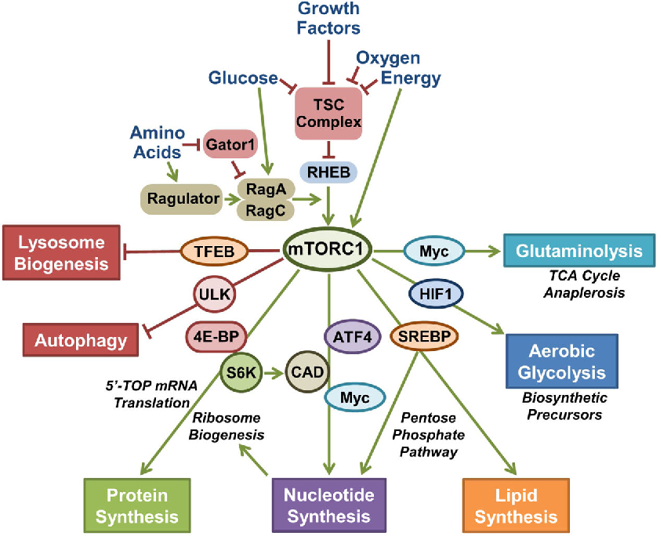
The mTORC1 network senses cellular growth signals and relays their status to an array of downstream metabolic processes.
Notes:
The mTORC1 network senses cellular growth signals and relays their status to an array of downstream metabolic processes. The activation state of mTORC1 in response to growth factors and nutrients depends on regulatory inputs into small GTPases of the Rheb and Rag families. The TSC complex integrates a variety of growth signals and, under conditions of nutrient or growth factor withdrawal ,functions as aG TPase-activating protein (GAP) to negatively regulate Rheb, which is an essential activator of mTORC1. A heterodimer of RagA or B bound to Rag C or D is regulated by aminoacids through e Gator1 and Ragulator complexes. In the presence of aminoacids, the Rag proteins bind to mTORC1 and promote its activation by Rheb. When activated, mTORC1 regulates various cellular processes that promote macromolecular synthesis and cell growth. This occurs through parallel transcriptional, translational, and post-translational effects on downstream targets. This figure emphasized the metabolic outputs of mTORC1signaling.

Slide 8
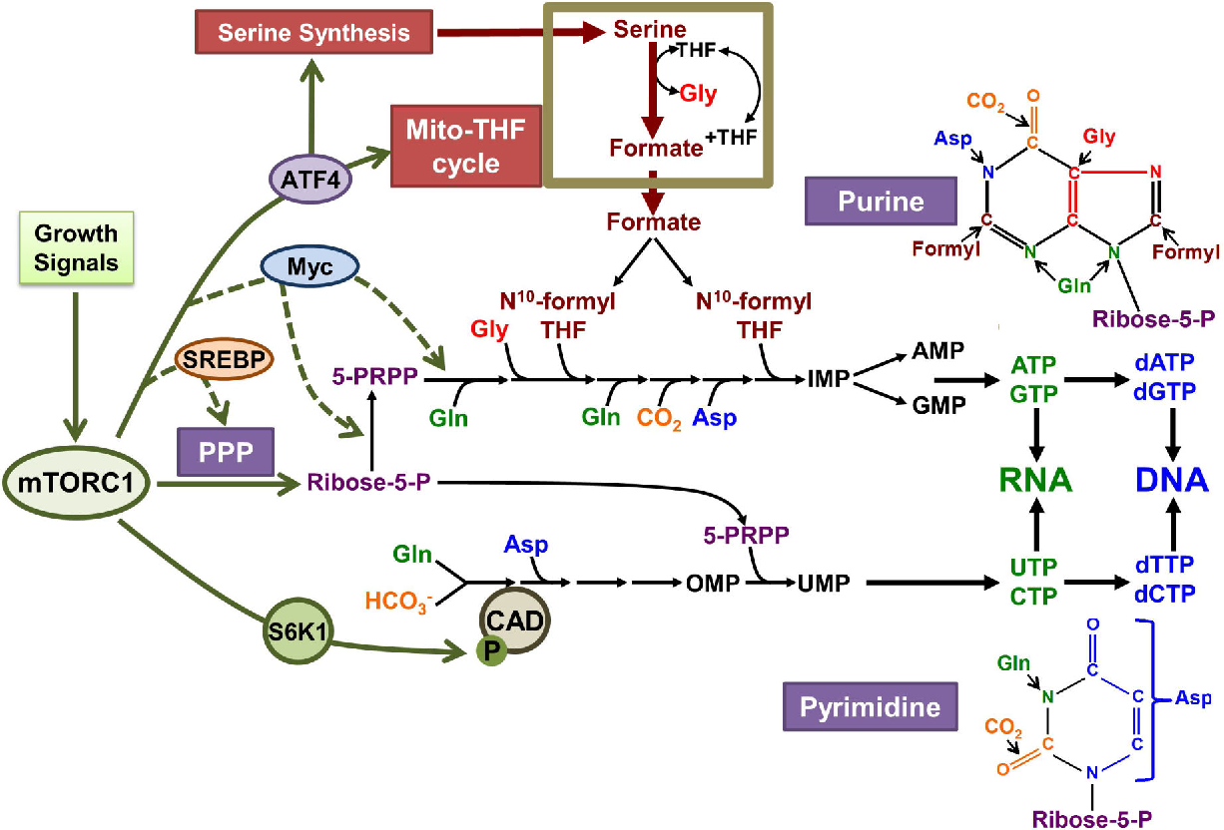
mTORC1 signaling stimulates de novo nucleotide synthesis through multiple downstream mechanisms
Notes:
mTORC1 signaling stimulates denovo nucleotide synthesis through multiple downstream mechanisms. In response to growth signals, mTORC1 activation leads to S6K1 mediated-phosphorylation of CAD, the rate-limiting enzyme of the denovo pyrimidine synthesis pathway, there by acutely stimulating an increase in pyrimidine synthesis. Through downstream effects on transcription factors that induce expression of key metabolic enzymes, mTORC1 activation also increases the denovo purine synthesis pathway. One such mechanism involves activation of ATF4 and its induction of serine synthesis and mTHF enzymes, which contribute one-carbonformyl units to the purine ring. Purine and pyrimidine nucleotides are depicted and color-coded by the source of their carbon, nitrogen, and oxygen moieties assembled through the denovo synthesis pathways.

Slide 9
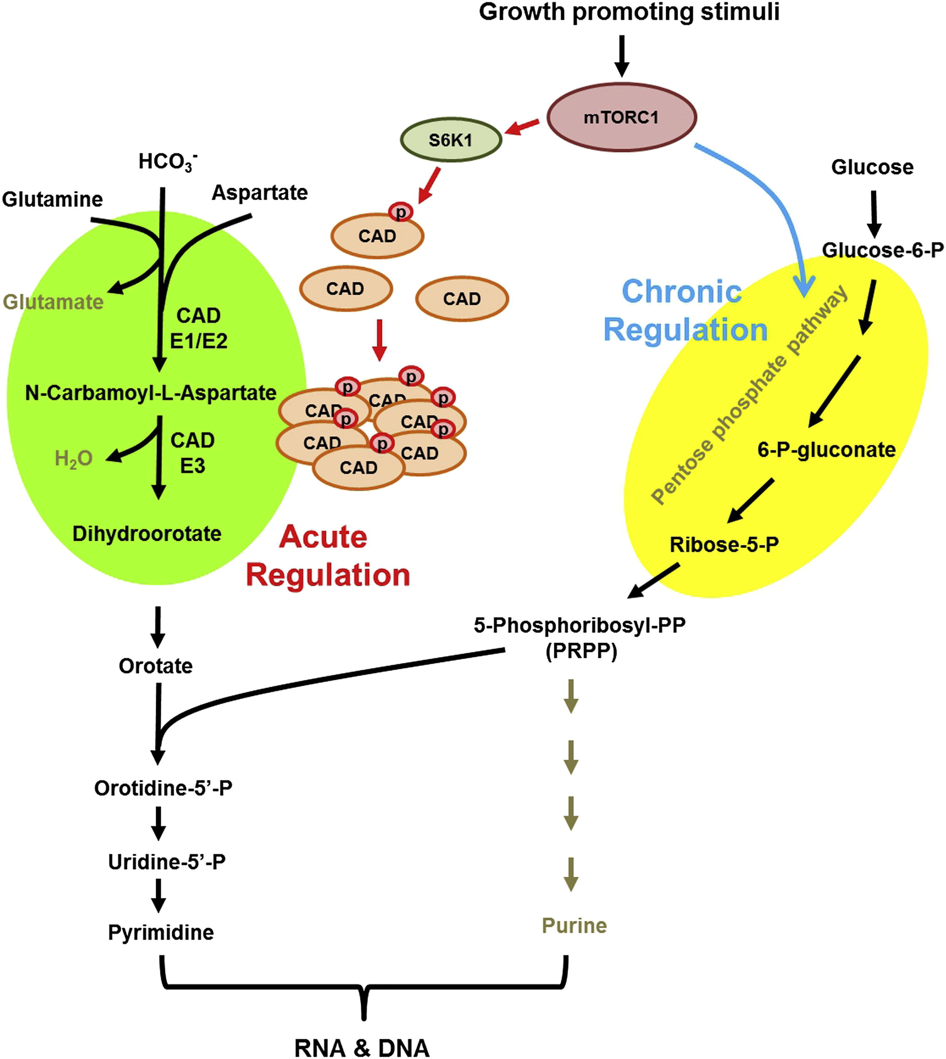
De Novo Pyrimidine Synthesis Is Regulated by mTORC1 Signaling via S6K1 Phosphorylation of CAD
Notes:
Figure 1 | mTOR pathway activation. Mechanistic target of rapamycin (mTOR) is regulated by metabolic cues, primarily glucose and amino acids, as well as by growth factors, hormones and cytokines. Glucose and amino acids enter cells via surface receptors such as glucose transporter type 1, erythrocyte/brain (GLUT1) or glucose transporter type 4, insulin-responsive (GLUT4) and CD98, respectively. Growth factors stimulate tyrosine kinase receptors (TKRs), which are activated through phosphorylation of tyrosine residues. In turn, TKR signals are transmitted to mTOR through phosphatidylinositide 3-kinase (PI3K), phosphoinositide-dependent kinase-1 (PDK1) and RAC serine/threonine-protein kinase (AKT). Signalling through sphingosine 1-phosphate receptor 1 (S1P₁) also activates mTOR complex 1 (mTORC1) via PI3K. Downstream, AKT phosphorylates mTOR, which forms two interacting complexes, mTORC1 and mTORC2. mTORC1 is composed of mTOR, regulatory-associated protein of TOR (raptor), TORC subunit LST8 (LST8), DEP-domain-containing mTOR-interacting protein (deptor) and proline-rich AKT1 substrate 1 (AKT1S1)²³⁰. mTORC2 is comprised of mTOR, rapamycin-insensitive companion of mTOR (rictor), stress-activated protein kinase interacting protein 1 (mSIN1, also known as TORC2 subunit MAPKAP1), protein observed with rictor-1 (protor-1), deptor and LST8. mTORC1 integrates growth signals reflecting the availability of nutrients and energy to promote either proliferation when conditions are favourable or autophagy when conditions are unfavorable; mTORC2 promotes cellular survival by activating AKT⁸². Pharmacologically targetable checkpoints are highlighted in yellow. 4E-BP1, eukaryotic translation initiation factor 4E-binding protein 1; AMBRA1, activating molecule in BECN1-regulated autophagy protein 1; AMPK, 5′-AMP-activated protein kinase; Arf1, ADP-ribosylation factor 1; FKBP12, peptidyl-prolyl cis-trans isomerase FKBP12; HIF1α, hypoxia-inducible factor 1α; NAC, N-acetylcysteine; PKCα, protein kinase C α type; PTEN, phosphatidylinositol 3,4,5-trisphosphate 3-phosphatase and dual-specificity protein phosphatase PTEN; RAPA, rapamycin; Rag-A/B, Ras-related GTP-binding protein A/B; ROI, reactive oxygen intermediate; S6K, ribosomal protein S6 kinase; SREBP1, sterol regulatory element-binding protein 1; STAT3, signal transducer and activator of transcription 3.

Slide 10
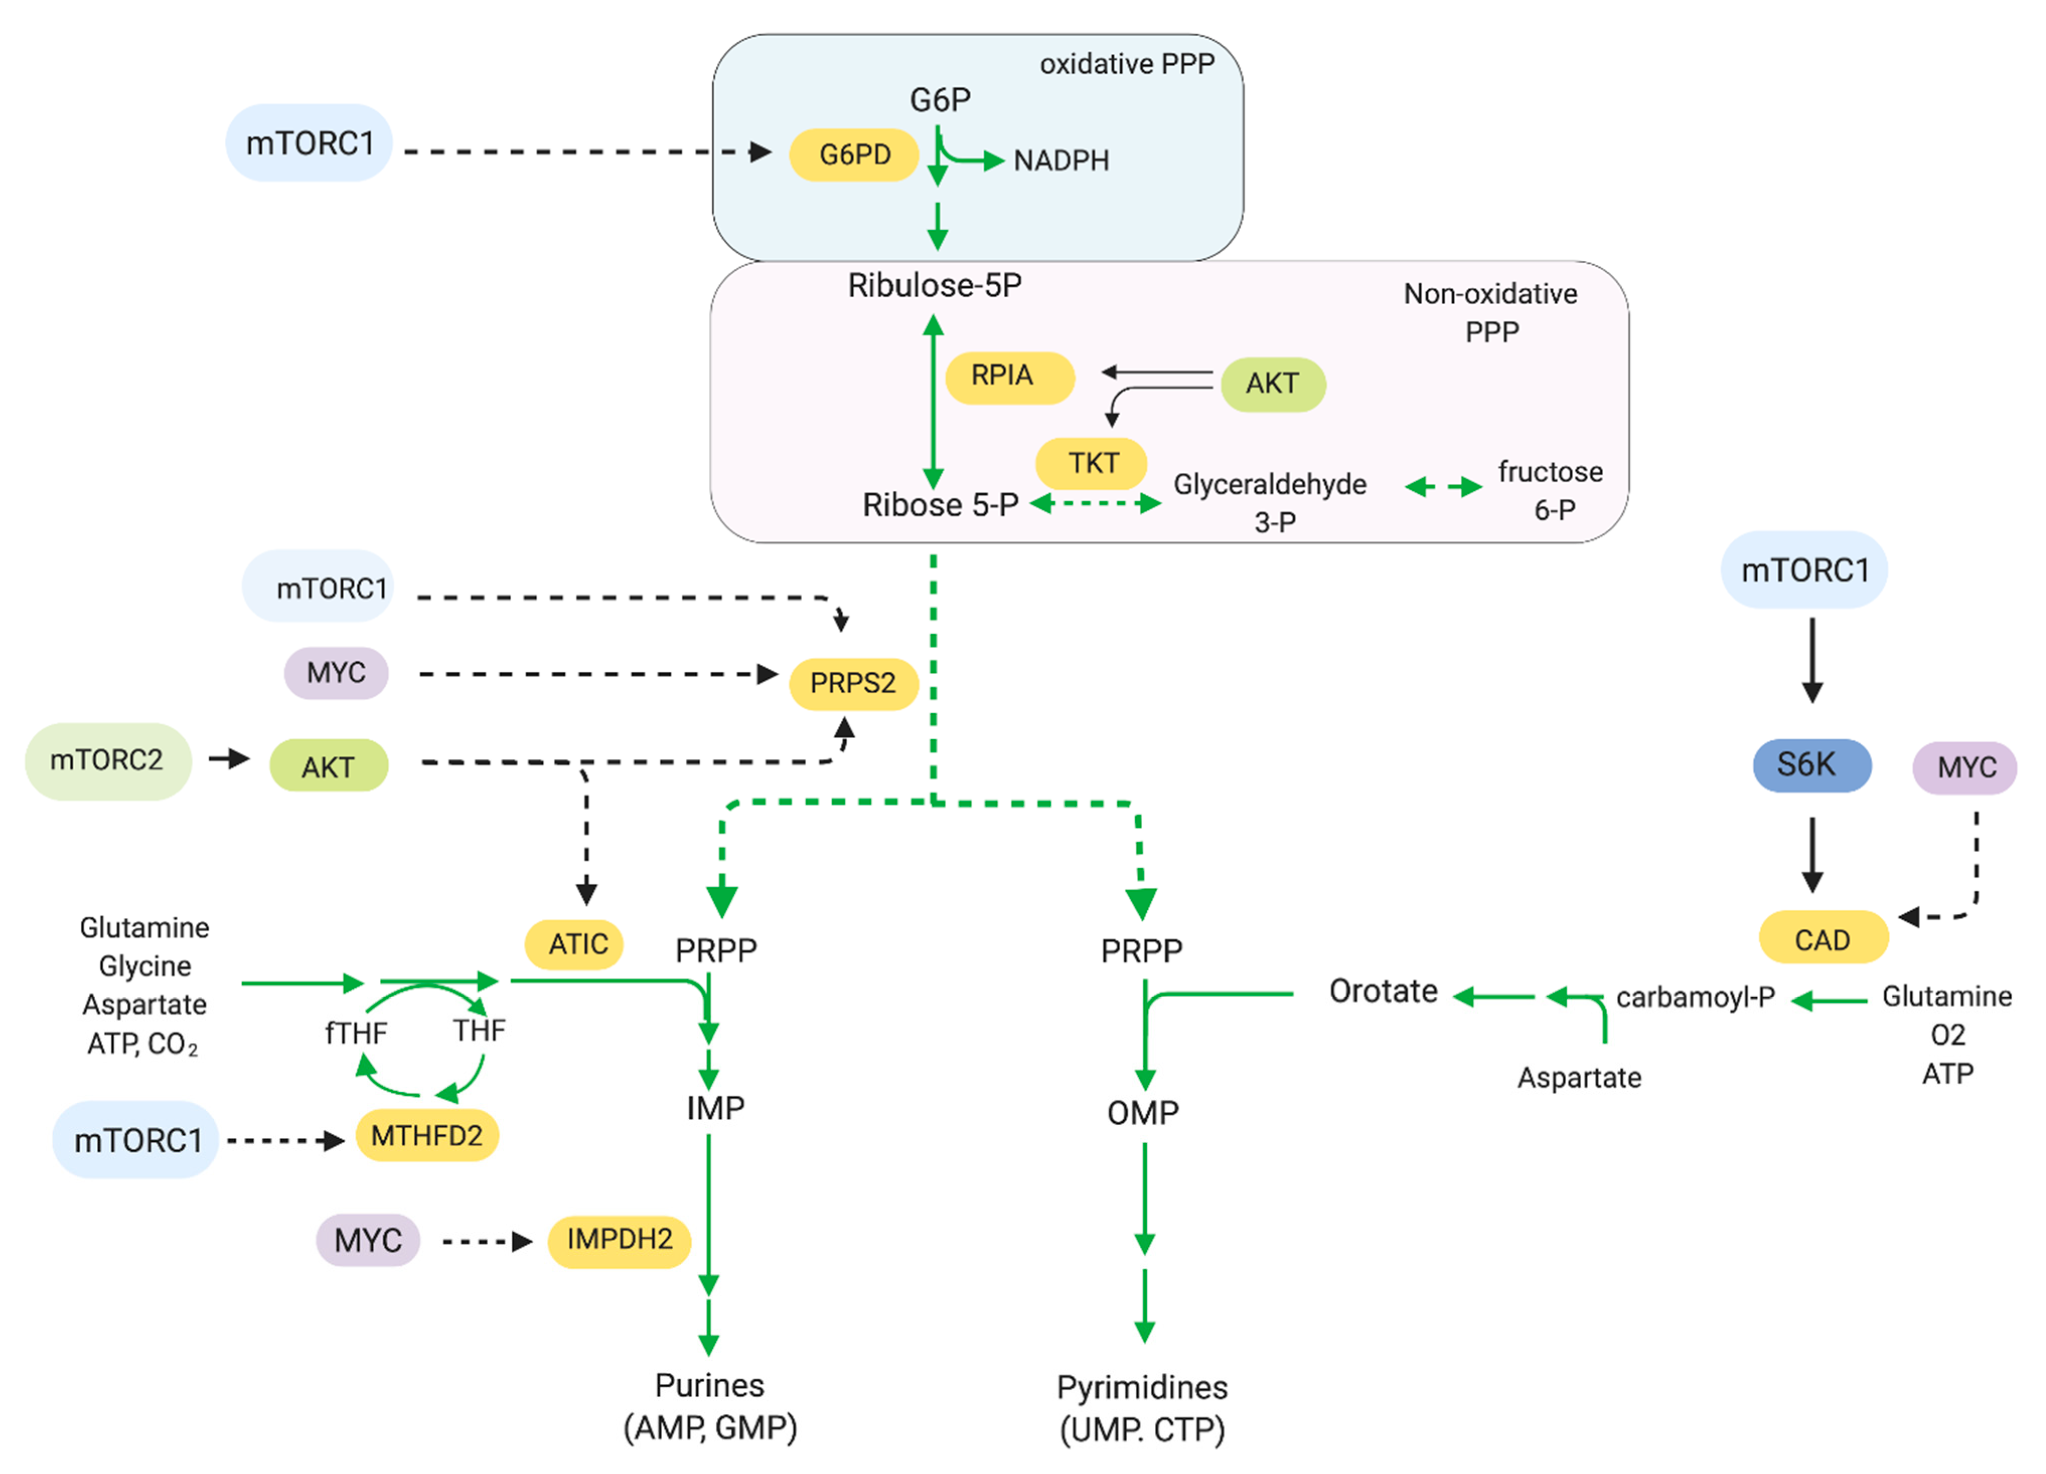
The role of mTOR in the pentose phosphate pathway and nucleotide synthesis. mTOR modulates the expression of the enzymes involved in the pentose phosphate pathway, purine and pyrimidine synthesis.

Slide 11
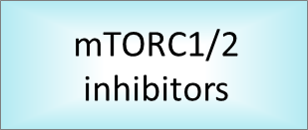
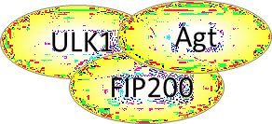
mTOR in mammalian cells
mTORC1
mTORC2
eIF4E
eIF4B S6
FoxO
Bad
Rac/Cdc2
AUTOPHAGY
GROWTH
CAP-DEPENDENT
TRANSLATION
SURVIVAL
RIBOSOME BIOGENESIS
CYTOSKELETON ORGANIZATION

Slide 12
mTOR complex 1
RAPTOR (Regulatory-associated protein of
mTOR)
facilitates the association between
mTORC1 and downstream substrates
binds in a rapamycin-sensitive or nutrient-responsive manner
mTOR activity could be modulated by
RAPTOR phosphorylation
mTORC1
eIF4E
eIF4B S6
AUTOPHAGY
CAP-DEPENDENT
TRANSLATION
RIBOSOME
BIOGENESIS

Slide 13
mTOR complex 1
mTORC1
mLST8/GβL
interacts with RAPTOR and mTOR in a nutrient- and rapamycin- sensitive manner
Positivity regulates mTORC1 activation
eIF4E
eIF4B S6
AUTOPHAGY
CAP-DEPENDENT
TRANSLATION
RIBOSOME
BIOGENESIS

Slide 14
mTOR complex 1
mTORC1
eIF4E
eIF4B S6
AUTOPHAGY
CAP-DEPENDENT
TRANSLATION
PRAS40
mTORC2 negative feedback
interacts with RAPTOR to prevent mTORC1 assembly
RIBOSOME
BIOGENESIS

Slide 15
mTOR complex 1
mTORC1
eIF4E
eIF4B S6
AUTOPHAGY
CAP-DEPENDENT
TRANSLATION
RIBOSOME
BIOGENESIS
DEPTOR (DEPDC6, DEP domain-containing protein 6)
negative feedback loop

Slide 17
mTOR complex 2
mTORC2
RICTOR (Rapamycin-insensitive companion
of mTOR)
Required for mTORC2 activation
gains integrity of mTORC2
exclusive of mTORC2
FoxO
Bad
Rac/Cdc2
GROWTH
SURVIVAL
CYTOSKELETON ORGANIZATION

Slide 18
mTOR complex 2
mTORC2
SIN1 (stress-responsive protein )
implicated in the JNK (c-Jun N-terminal kinase) and
MAPK (mitogen-activated protein kinase)/ERK
FoxO
Bad
Rac/Cdc2
(extracellular-regulated-protein kinase) pathways
GROWTH
essential for mTORC2 activity and AKT phosphorilation
SURVIVAL
CYTOSKELETON ORGANIZATION

Slide 19
mTOR complex 2
mTORC2
FoxO
Bad
Rac/Cdc2
GROWTH
mLST8/GβL
binds C-term mTOR favoring mTORC2 kinase activity
SURVIVAL
CYTOSKELETON ORGANIZATION

Slide 20
mTOR complex 2
mTORC2
FoxO
Bad
Rac/Cdc2
GROWTH
SURVIVAL
CYTOSKELETON ORGANIZATION
PROTOR (protein observed with rictor)
non-essential subunits
required for the phosphorylation of SGK1, but not of Akt and PKCα

Slide 21
mTOR complex 2
mTORC2
FoxO
Bad
Rac/Cdc2
GROWTH
SURVIVAL
CYTOSKELETON ORGANIZATION
DEPTOR (DEPDC6, DEP domain-containing protein 6)
negative feedback loop

Slide 22
mTORC1 downstream
mTORC1
eIF4E
eIF4B S6
AUTOPHAGY
CAP-DEPENDENT
TRANSLATION
RIBOSOME BIOGENESIS

Slide 23
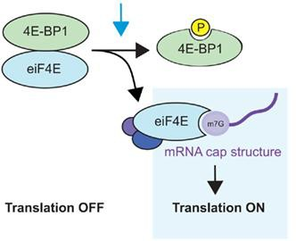
mTORC1 downstream
Prevents cap-binding eIF4E → NO eIF4E complex
eIF4E
CAP-DEPENDENT
TRANSLATION

Slide 24
mTORC1 downstream
eIF4B S6
RIBOSOME BIOGENESIS

Slide 25
mTORC1 downstream
p70S6K1 promotes multi stage mRNA translation
S6
RIBOSOME
BIOGENESIS
Phosphorilation S6:
binding SKAR → initiation/elongation through EJC (exon
junction complex)
phosphorylates the 40S ribosomal protein S6 (rpS6) → translation of mRNA with 5’ terminal oligopyrimidine tract (TOP mRNAs)
phosphorylates PDCD4 (programmed cell death 4), an
inhibitor of RNA helicase eIF4A → enhances eIF4A helicase activity and facilitates 40S ribosomal subunit scanning to the initiation codon

Slide 26
mTORC1 downstream
p70S6K1 promotes multistage mRNA translation
Phosphorilation eIF4B:
eIF4A and eIF-4B increasing levels → eIF3 complex (largest
eIF4B
scaffolding initiation factor; controls the assembly of 40S
ribosomal subunit on mRNA)
RIBOSOME
BIOGENESIS

Slide 27
mTORC1 downstream
p70S6K1 regulates ribosome biogenesis at different levels
biosynthesis of the translational machinery
production of ribosomal proteins, pre-rRNA processing and rRNA
synthesis
coordinates nuclear RNA polymerases, Pol I, Pol II and Pol III
interacts with rDNA (ribosomal DNA) promoters to promote Pol I and
Pol III transcription
RIBOSOME
BIOGENESIS
regulates the nuclear translocation of TIF1A, a transcription factor
(essential for Pol I-associated transcription initiation)
inhibits Maf1, a Pol III repressor, and so induces 5S rRNA and transfer
RNA (tRNA) transcription

Slide 28
mTORC1 downstream
recycling of damaged organelles and for the organismal and
cellular adaptation to nutrient starvation
Atg
phosphorylates and suppresses ULK1/Atg13/FIP200 (unc-51-like kinase 1/mammalian autophagy-related gene 13/focal adhesion kinase family-interacting protein of 200 kDa)
«open» and «closed» conformations → regulate autophagosome
activity
AUTOPHAGY

Slide 29
mTORC2 downstream
mTORC2
FoxO
Bad
Rac/Cdc2
GROWTH
SURVIVAL
CYTOSKELETON
ORGANIZATION

Slide 30
mTORC2 downstream
Protein kinase B (PKB)
serine-threonine kinase
FoxO
Rac/Cdc2
three isoforms are encoded by distinct loci → functional redundancy among Akt isoforms → lethal to development
Bad
activation by receptor tyrosine kinases, cytokine receptors, G-protein coupled receptors, B and T cell receptors and integrins
SURVIVAL
CYTOSKELETON
ORGANIZATION
insulin metabolism and cancer progression
drugs resistance

Slide 31
mTORC2 downstream
promotes cytoplasmic localization of CKIs (p21^{WAF1/CIP1} and p27^{KIP1}) → inhibiting their function
FoxO
stabilizes cyclin D1 e D3 levels→ progression through the G1 phase of the cell cycle
Bad
facilitates MDM2 nuclear localization → inhibitory action on p53
SURVIVAL
inhibits (phosphorylation) of pro-apoptotic signals (Bad and FoxO) → anti-apoptotic effets

Slide 32
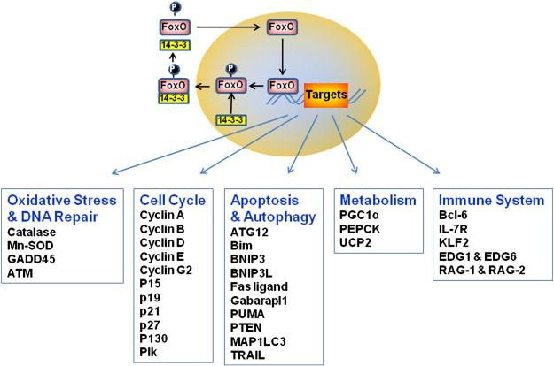
FoxO functions
tumor suppressors
nuclear localization of FoxOs suspends cell cycle progression, promotes apoptosis and
negatively regulates angiogenesis

Slide 33
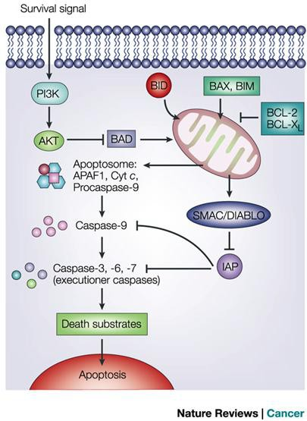
Bad functions
Bcl-2-associated death promoter
member of BCL-2 family
inhibits anti-apoptotic BCL-2-family
members (BCL-x and Bcl-2)
allows two pro-apoptotic proteins (BAK
and BAX)
induce release of cytochrome c → caspase activation → apoptosis

Slide 34
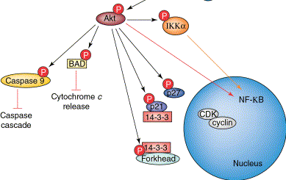
Akt functions
Anti apoptotic effects and proliferation effects through inhibition of BAD and
FoxO and activation of ciclins involved in cell cicle progression

Slide 35
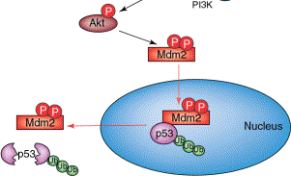
Akt functions
Anti apoptotic effects through activation of Mdm2

Slide 36
mTORC2 downstream
Protein kinase C
involved in controlling of other proteins
phosphorylation of hydroxyl groups of serine and threonine amino acid residues on proteins
Rac/Cdc2
Rac/Cdc2
Rho family of small G proteins (21-25 kDa) belong to the Ras superfamily
regulators of actin reorganization
CYTOSKELETON
ORGANIZATION
involved in chemoattractant gradient sensing
Rac
induces membrane ruffling and extension of
lamellipodia
Cdc42
induces the extension of membrane protrusions

Slide 37
mTORC2 downstream
Serum/glucocorticoid regulated kinase 1
serine/threonine kinases
role in cellular stress response
GROWTH
promoting cell survival by phosphorylating and inactivating
FOXO3a → inhibits apoptosis

Slide 38
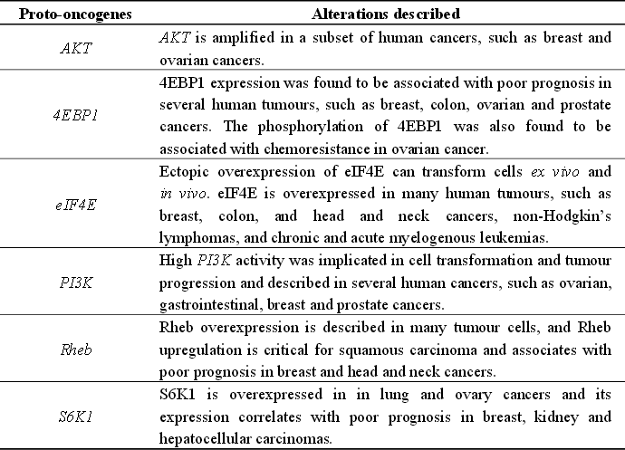
Proto-oncogenes linked to mTOR pathway

Slide 39
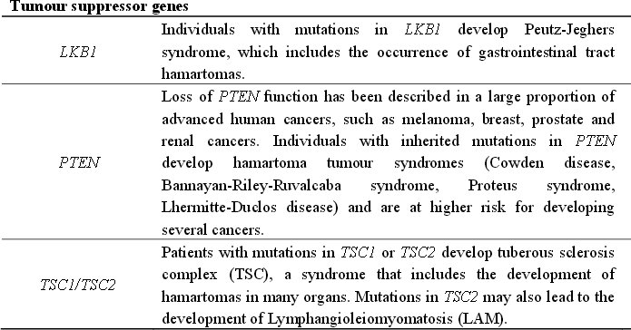
Tumor suppressor genes linked to mTOR pathway

Slide 40
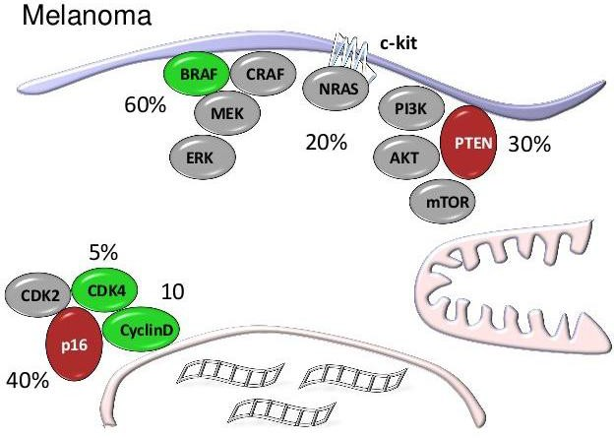
mTOR and melanoma
Loss of PTEN in 30-50% of melanomas
Akt amplification in 60%
In association with BRAF and NRAS mutations
Increased pAKT, loss of PTEN, MAPK mutations correlates with tumour progression , chemoresistance and shorter survival
Use of rapamycin increases apoptosis and chemosensitivity in melanoma cells
anti-tumour effects enhanced in association with MAPK and PI3K inhibitor

Slide 41
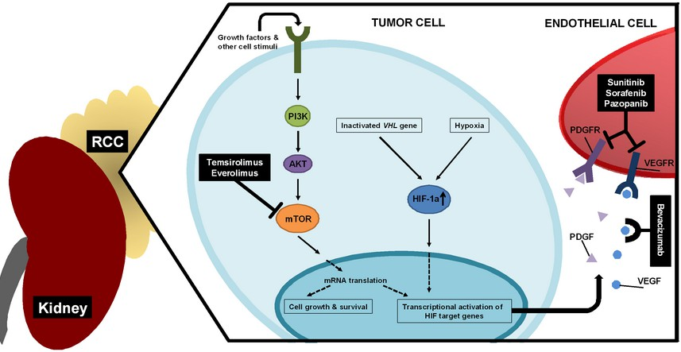
mTOR and RCC
Iperactivation of mTOR pathway:
overexpression or activation of growth factor
receptors
activation of mutations in PI3K/AKT
decresed expression of tuberous sclerosis tumor suppressor genes TCS1/2 or Von Hippel-Lindau (VHL) tumor suppressore gene

Slide 42
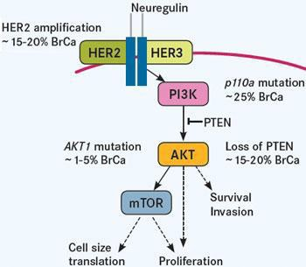
mTOR and breast cancer
Associated with overexpression or activation of HER2
Involved in resistance to endocrine therapy, human epidermal growth factor receptor 2
(HER2)-directed therapy (trastuzumab) and cytotoxic therapy
Preclinical studies indicate that inhibitors of the pathway can act synergically with
trastuzumab in resistance cells
Everolimus (rapamycin analog) is currently the only compound approved for the treatment of hormone receptor (HR)-positive, HER2-negative metastatic or locally advanced breast cancer

Slide 43
mTOR inhibitors
mTORC1
mTORC2

Slide 44
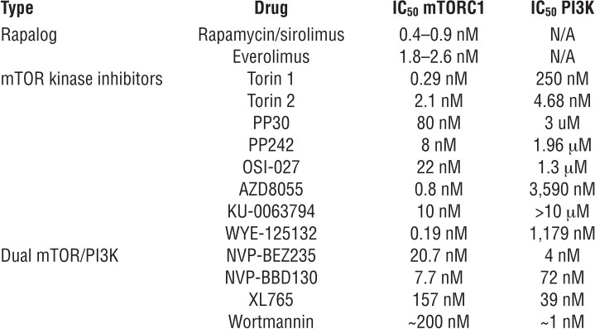
mTOR inhibitors

Slide 45
mTOR inhibitors

Slide 46
mTOR inhibitors

Slide 47
mTOR inhibitors

Slide 48
mTOR inhibitors

Slide 49
mTOR inhibitors

Slide 50
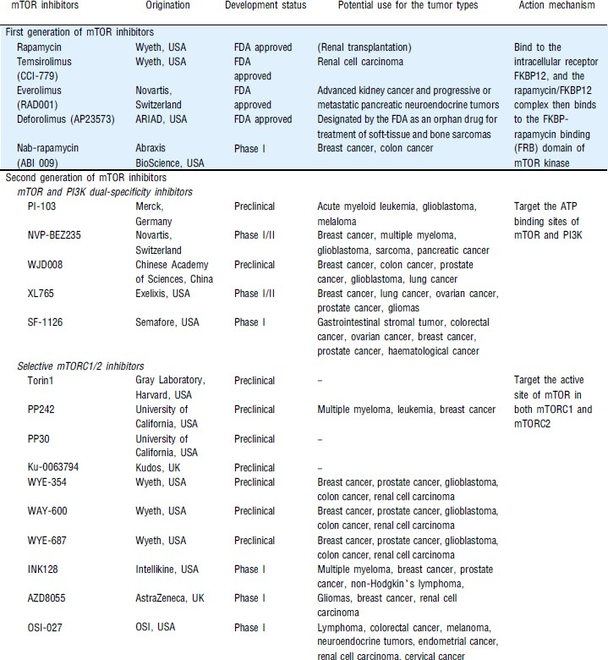
mTOR inhibitors

Slide 51
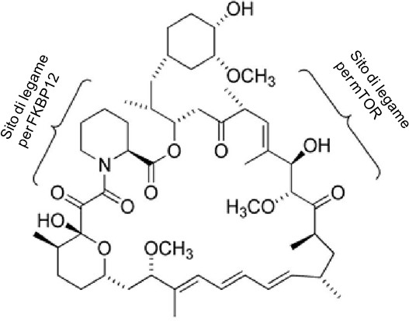
Rapamycin and Rapalos (I)
RAPAMYCIN or Sirolimus
natural macrocyclic lactone antibiotic produced by S. hygroscopicus
Discover in 1970s Easter Island Rapa Nui
soil
anti-fungal drug against Candida albicans, Cryptococcus neoformans and Aspergillus fumigatus
initially used as immunosuppressive drug
(prevention of renal allograft reject)
cytostatic agent, inhibits cell proliferation,
survival and angiogenesis

Slide 52
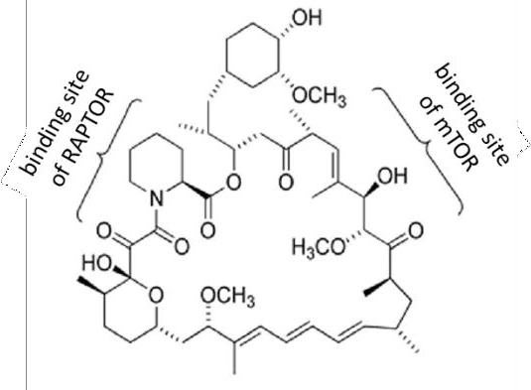
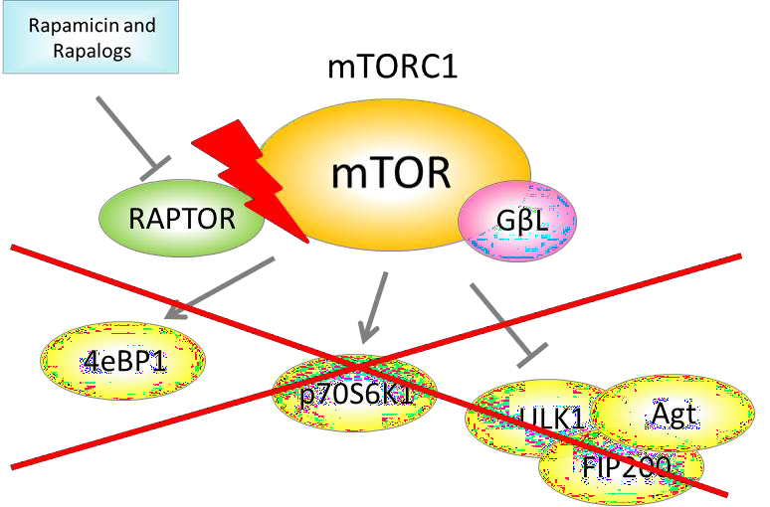
Rapamycin and Rapalos – Mechanism of action
binds FKBP12 (FK 506-binding protein of 12 kDa)
complex interacts with the FRB (FKBP12-rapamycin binding) domain located in the C-terminus
of mTOR
inhibition of mTOR

Slide 53
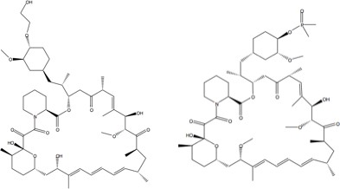
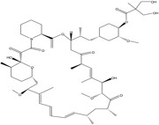
Rapamycin and Rapalos (II)
TEMSIROLIMUS
EVEROLIMUS
DEFOROLIMUS
CCI-779
water-soluble ester derivatived
identified by Wyeth Ayerst as a noncytotoxic agent
antitumour activity alone or in combination with cytotoxic agents in gliomas, rhabdomyosarcoma, primitive neuroectodermal tumour such as medulloblastoma, head and neck, prostate, pancreatic and breast cancer cells

Slide 54
Rapamycin and Rapalos (II)
TEMSIROLIMUS
EVEROLIMUS
DEFOROLIMUS
CCI-779
RAD001
water-soluble ester derivatived
immunosuppressive activity
in vitro
identified by Wyeth Ayerst as a noncytotoxic agent
antiangiogenic activity →
inhibits HUVECs proliferation
antitumour activity alone or in combination with cytotoxic agents in gliomas, rhabdomyosarcoma, primitive neuroectodermal tumour such as medulloblastoma, head and neck, prostate, pancreatic and breast cancer cells
increases progression G0/G1
phase of the cell cycle.

Slide 55
Rapamycin and Rapalos (II)
TEMSIROLIMUS
EVEROLIMUS
DEFOROLIMUS
CCI-779
RAD001
AP23573
water-soluble ester derivatived
immunosuppressive activity
in vitro
stable in organic solvents, aqueous solutions at a variety of pHs, and in plasma and whole blood, both in vitro and in vivo
identified by Wyeth Ayerst as a noncytotoxic agent
antiangiogenic activity →
inhibits HUVECs proliferation
antitumour activity alone or in combination with cytotoxic agents in gliomas, rhabdomyosarcoma, primitive neuroectodermal tumour such as medulloblastoma, head and neck, prostate, pancreatic and breast cancer cells
increases progression G0/G1
phase of the cell cycle.
preliminary antitumour activity observed at all dose levels

Slide 56
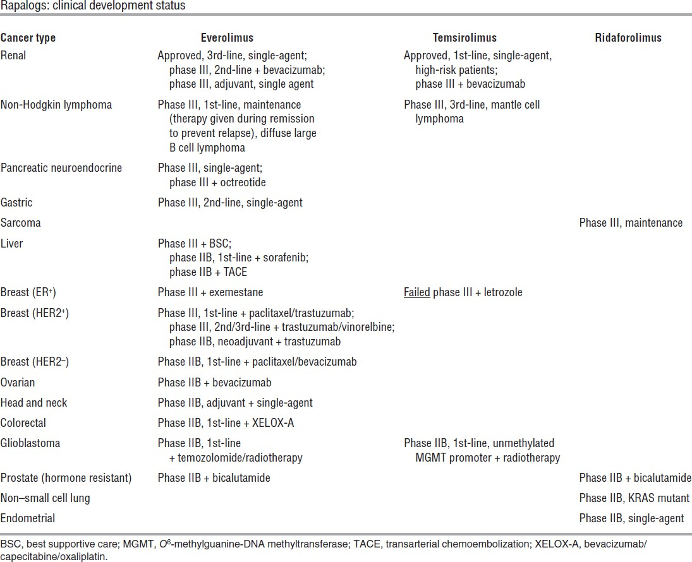
Rapamycin and Rapalos (III)

Slide 57
Rapamycin and Rapalos (III)

Slide 58
Rapamycin and Rapalos (III)

Slide 59
Rapamycin and Rapalos (III)

Slide 60
Rapamycin and Rapalos (IV)
Rapamycin and analogs act as cytostatic agents, slowing or arresting cell growth
Inhibit cell proliferation, survival and angiogenesis
Clinical trial to evaluate the efficacy of rapamycin and analogues in combination with
chemotherapeutic agents are in progress
Tested in combination with EGFR or HER-2 inhibitors (trastuzumab)
Synergistic effects with conventional chemotherapy agents (paclitaxel, carboplatin,
cisplatin, doxorubicin)
Enhances apoptosis in vitro and
anti-tumour efficacy in vivo

Slide 61
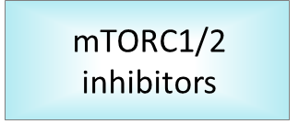
New generation of mTOR inhibitors
Small molecules
ATP-binding site competitors
catalytic domain homologous to the p110α subunit of PI3K and mTOR
mTORC1
mTORC2

Slide 62
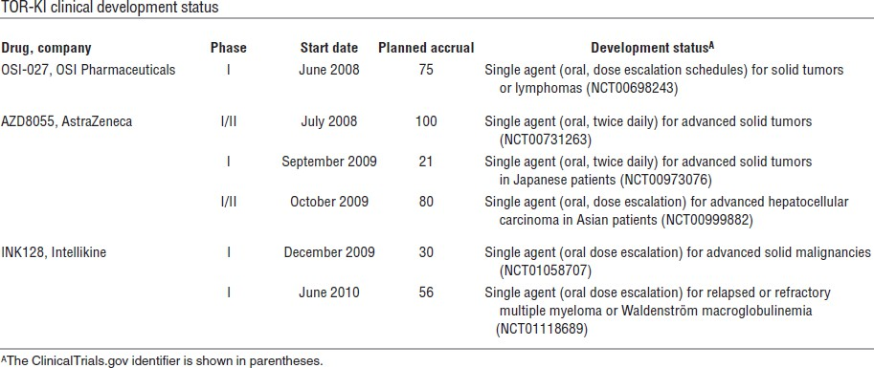
New generation of mTOR inhibitors (I)

Slide 63
New generation of mTOR inhibitors (II)
Dual mTOR inhibitors
PP242 and PP30 inhibit phosphorylation of AKT and reduce protein syntesis and cell
proliferation
Torin 1 inhibit cell growth more effectively than rapamycin

Slide 64
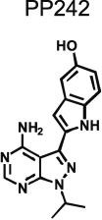
New generation of mTOR inhibitors (III)
mTORC1
mTORC2
Pyrazolopyrimidines
Small molecules
ATP-binding site competitors
No activities against PI3K family
Anti-myeloma effects (Hoang et al. 2010 and 2012)

Slide 65
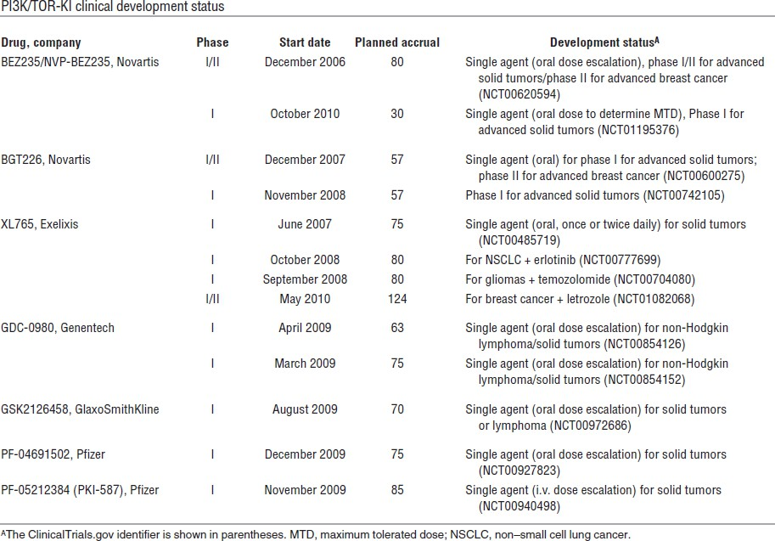
New generation of mTOR inhibitors (IV)

Slide 66
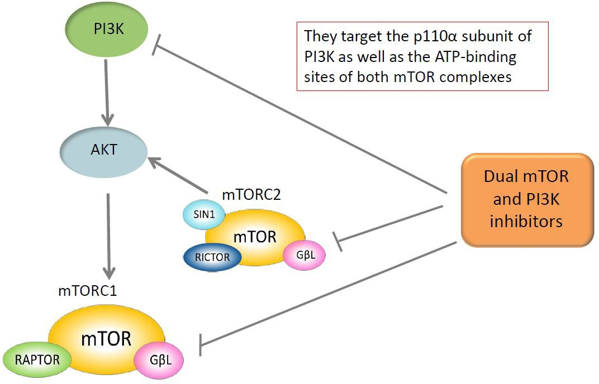
New generation of mTOR inhibitors (V) Dual mTOR and PI3K inhibitors

Slide 67
New generation of mTOR inhibitors (VI) Dual mTOR and PI3K inhibitors
Potently block proliferation, strong induction of apoptosis, more cytotoxic
effects than rapamycin
PI-103 and NVP-BEZ235 phase I/II clinical trials for the treatment of advanced solid
tumours and metastatic breast cancer
XL765 phase I for solid tumours and gliomas

Slide 68
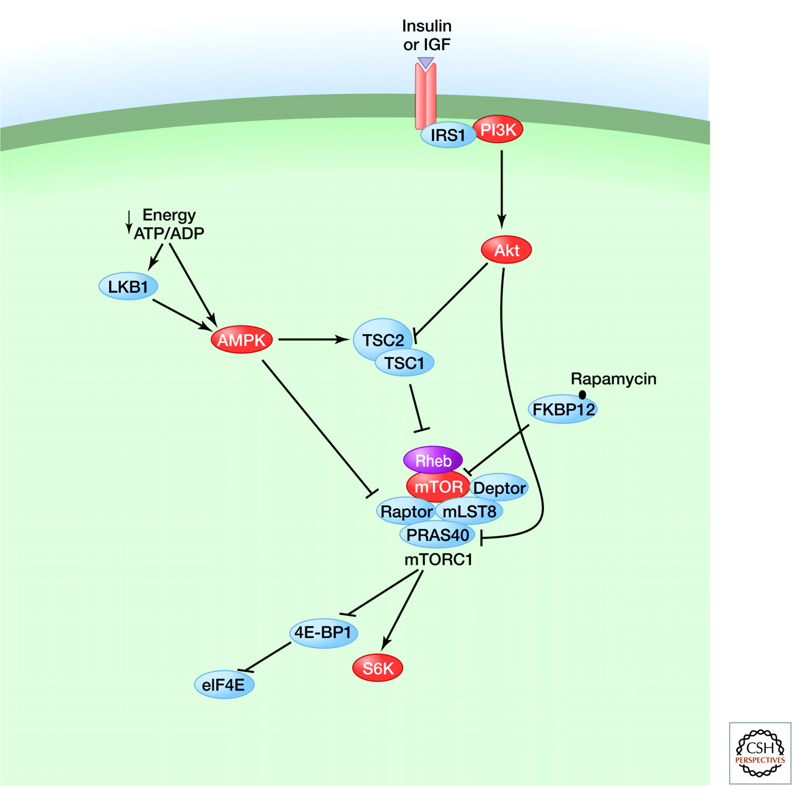
A simplified view of the mTOR pathway.
Mathieu Laplante, and David M. Sabatini Cold Spring Harb Perspect Biol 2012;4:a011593
©2012 by Cold Spring Harbor Laboratory Press
Notes:
A simplified view of the mTOR pathway.

Slide 69
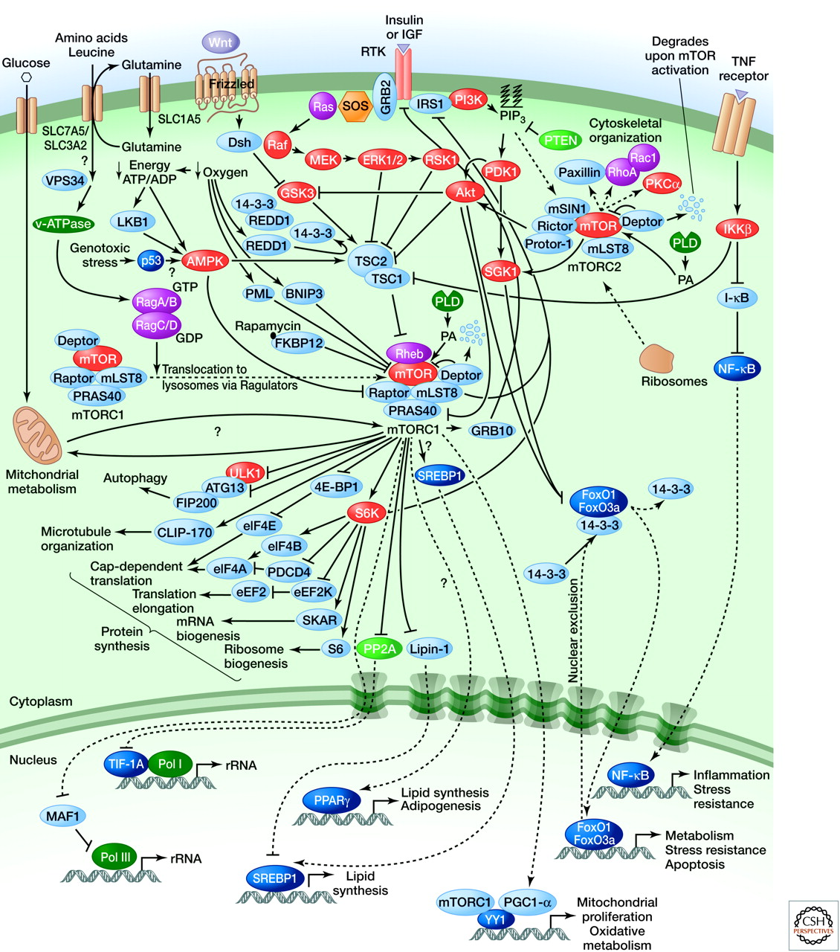
The mTOR pathway.
Mathieu Laplante, and David M. Sabatini Cold Spring Harb Perspect Biol 2012;4:a011593
©2012 by Cold Spring Harbor Laboratory Press
Notes:
The mTOR pathway.

Slide 70
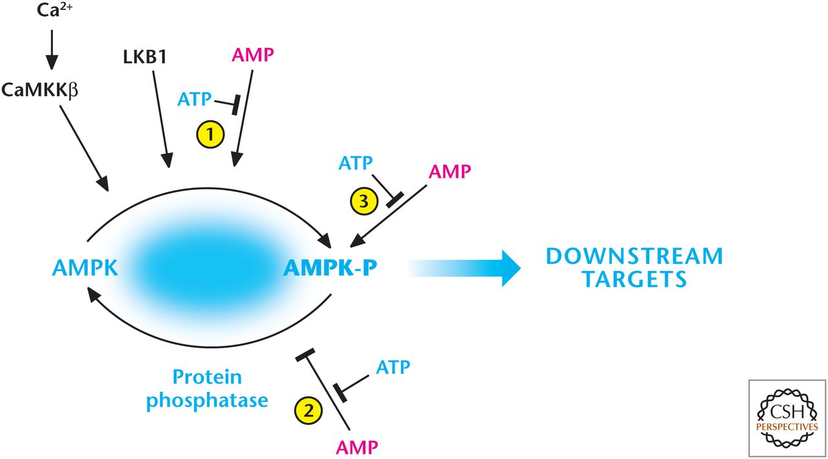
AMP and calcium activate AMP-activated protein kinase (AMPK).
Notes:
mTOR positively regulates anabolic processes when nutrients are ample, but cells also have signaling mechanisms to switch to a catabolic program when nutrients are limiting. Cells constantly require an optimal energy charge.
Thus, ATP demand and supply have to be balanced. AMPK (AMP-activated protein kinase) is activated when metabolic demand exceeds metabolic supply, resulting in a decrease in the ATP/ADP ratio, which switches off anabolic pathways, such as lipid and protein synthesis, while promoting catabolic pathways, such as autophagy, to restore energy homeostasis. A typical energetically unstressed cell has an ATP/ ADP ratio of 10:1 and an ATP/AMP ratio of 100:1.
The kinase AMPK responds to increases in AMP levels (Fig. 3).
AMP and calcium activate AMP-activated protein kinase (AMPK). AMP displaces ATP on the AMPK-γ subunit to (1) promote phosphorylation and (2) inhibit dephosphorylation of threonine-172, resulting in robust activation of AMPK. The constitutively active kinase LKB1 is required for phosphorylation of threonine-172. AMP further activates the phosphorylated AMPK (3). AMPK can also be activated by threonine-172 phosphorylation catalyzed by CaMKKβ, which also activates AMPK at threonine-172 through an increase in intracellular calcium, but independent of AMP and LKB1.

Slide 71
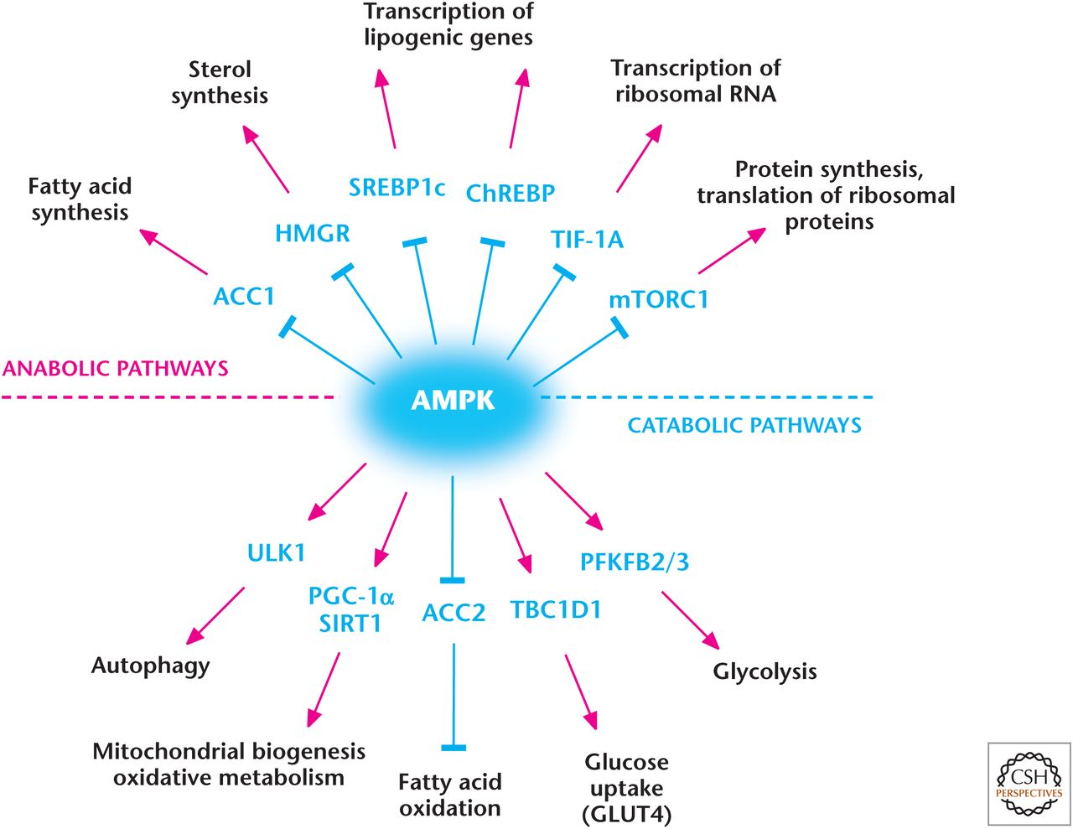
AMP-activated protein kinase (AMPK) regulates metabolism.
Notes:
AMP-activated protein kinase (AMPK) regulates metabolism. AMPK positively and negatively regulates catabolic and anabolic pathways, respectively.

Slide 72
Overview of autophagy
There are three types of autophagy: macroautophagy, microautophagy, and chaperone-mediated autophagy (CMA).
Macroautophagy pathway can be broken down into several discrete phases:
Notes:
Autophagy is thought to have evolved as a stress response to allow unicellular eukaryotic organisms to survive starvation by generating amino acids needed to produce a subset of proteins required for adaptation to starvation and are catabolized through the TCA cycle to produce ATP for survival. Autophagy has been shown to be crucial for surviving starvation in multiple organisms, including yeast, ﬂies, worms and mammals. induction of low levels of autophagy is thought to promote longevity by clearing damaged organelles and aberrant proteins that accumulate over time.
There are three types of autophagy: macroautophagy, microautophagy, and chaperone-mediated autophagy (CMA). Macroautophagy occurs when large regions of the cytosol containing organelles are sequestered into a double-membrane vesicle called the autophagosome, which fuses with lysosomes for degradation; this generates metabolites, such as amino acids, which can be used to generate ATP for survival. In contrast, in microautophagy, the lysosomal membrane invaginates to sequester small regions of the cytosol, which are internalized into the lysosomal lumen as single membrane vesicles. In CMA, substrate proteins are speciﬁcally recognized by a cytosolic chaperone that transports them to the surface of the lysosome where they translocate by receptor-mediated mechanisms to the lysosomal lumen for degradation. It is important to note that autophagy occurs at a basal level in the presence of growth factors and ample nutrients as it is involved in degradation of damaged organelles and proteins. Nutrient and/or growth factor deprivation that limits nutrient uptake dramatically induce macroautophagy.
The macroautophagy pathway can be broken down into several discrete phases, including initiation involving the formation of a pre-autophagosomal structure leading to an isolation membrane followed by vesicle expansion and autophagosome maturation. Subsequently, the autophagosome fuses with the lysosome and the autophagosomal contents are degraded by lysosomal acid hydrolases generating metabolites, such as amino acids, which can be used as a fuel source to maintain an optimal energy charge for survival. These molecular events are executed by homologs of products of the ATGs (Atg) originally identiﬁed in yeast.

Slide 73
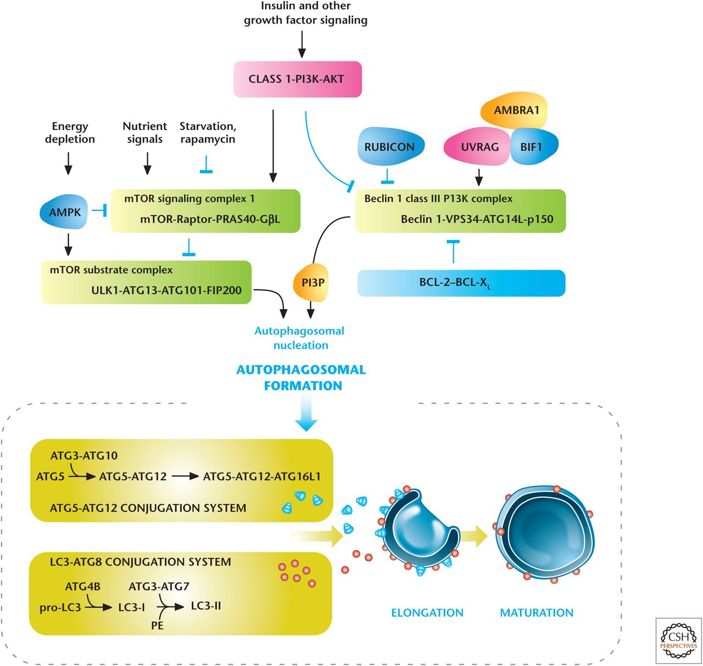
Regulators of autophagy.
Notes:
Autophagy has to be tightly controlled so that it is not inadvertently stimulated when intracellular nutrient availability is ample and cells are in an anabolic mode. The kinases mTORC1 and AMPK are two dominant regulators of autophagy. mTORC1 phosphorylates and negatively regulates ULK1 to suppress autophagy when nutrients are available, especially amino acids. Nutrient limitation also activates AMPK (as discussed above), which inhibits mTORC1, and also directly phosphorylates ULK1 to initiate autophagy.
Growth factors and nutrients through PI3K/AKT and mTORC1, respectively, negatively regulate autophagy.
AMP-activated protein kinase (AMPK) positively regulates autophagy.
Autophagosomal elongation requires the ATG5-ATG12 and LC3-ATG8 ubiquitin-like conjugation systems. In mammals, the conversion of LC3-I (free-form) to LC3-II (phosphoethanolamine-conjugated form) is used as a marker of autophagy.
Autophagosomal membrane initiation requires translocation of a complex consisting of UNC-51-like kinase 1 (ULK1), ATG13, ATG101, and FIP200 from the cytosol to certain domains of the endoplasmic reticulum, resulting in the recruitment of the Beclin 1 interacting complex (consisting of Beclin 1, the class III phosphatidylinositol 3-kinase [VPS34], and ATG14 L) to generate phosphatidylinositol-3-phosphate (PIP3), the key initiating step.
Autophagosomal expansion requires two ubiquitin-like conjugation systems, the microtubule-associated protein light chain 3 (LC3–ATG8) and the ATG5–ATG12 complex. Autophagosome formation is indicated by the conversion of a cytosolic truncated form of LC3 (LC3-I) to its autophagosomal membrane-associated, phosphatidylethanolamine-conjugated form (LC3-II).
Autophagy is also regulated by the Beclin 1 interacting complex.

Slide 74
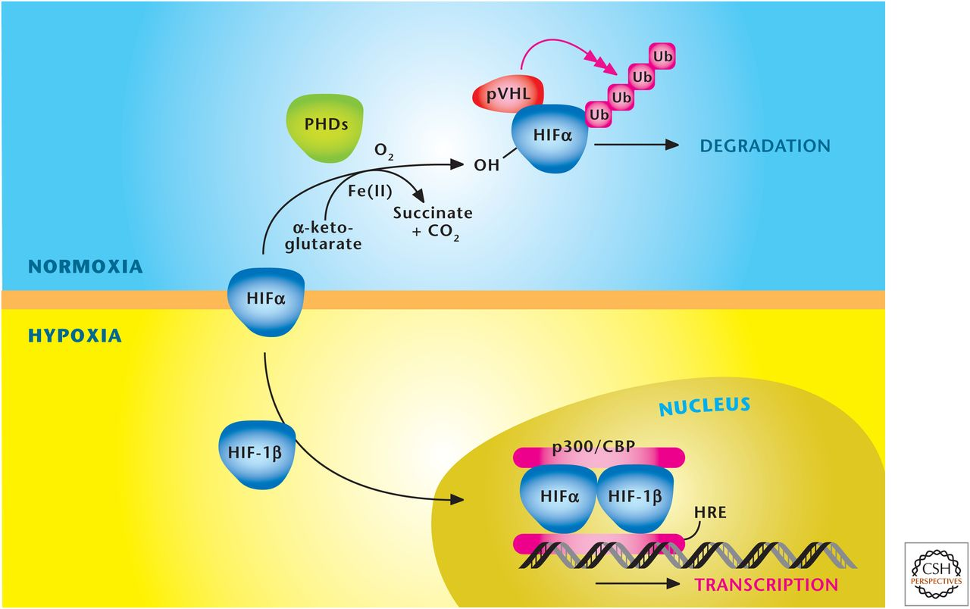
Oxygen levels control stabilization of HIFs. HIFs are a heterodimer, consisting of a constitutively stable HIF-1β and an oxygen-sensitive HIFα subunit.
Notes:
Oxygen levels control stabilization of HIFs. HIFs are a heterodimer, consisting of a constitutively stable HIF-1β and an oxygen-sensitive HIFα subunit. The HIFα subunit is hydroxylated at proline residues in the ODD by PHDs under normoxia. In addition to oxygen, the PHDs require iron (Fe²⁺) and α-ketoglutrate as substrates for hydroxylation. The von Hippel–Lindau protein (pVHL) recognizes hydroxylated proline residues and targets the HIFα subunit for rapid degradation by the proteasome. Hypoxia diminishes hydroxylation of HIFα to prevent its degradation and promote dimerization with HIF-1β to bind specific hypoxia response elements (HRE) in the promoter regions of its target genes. (

Slide 75
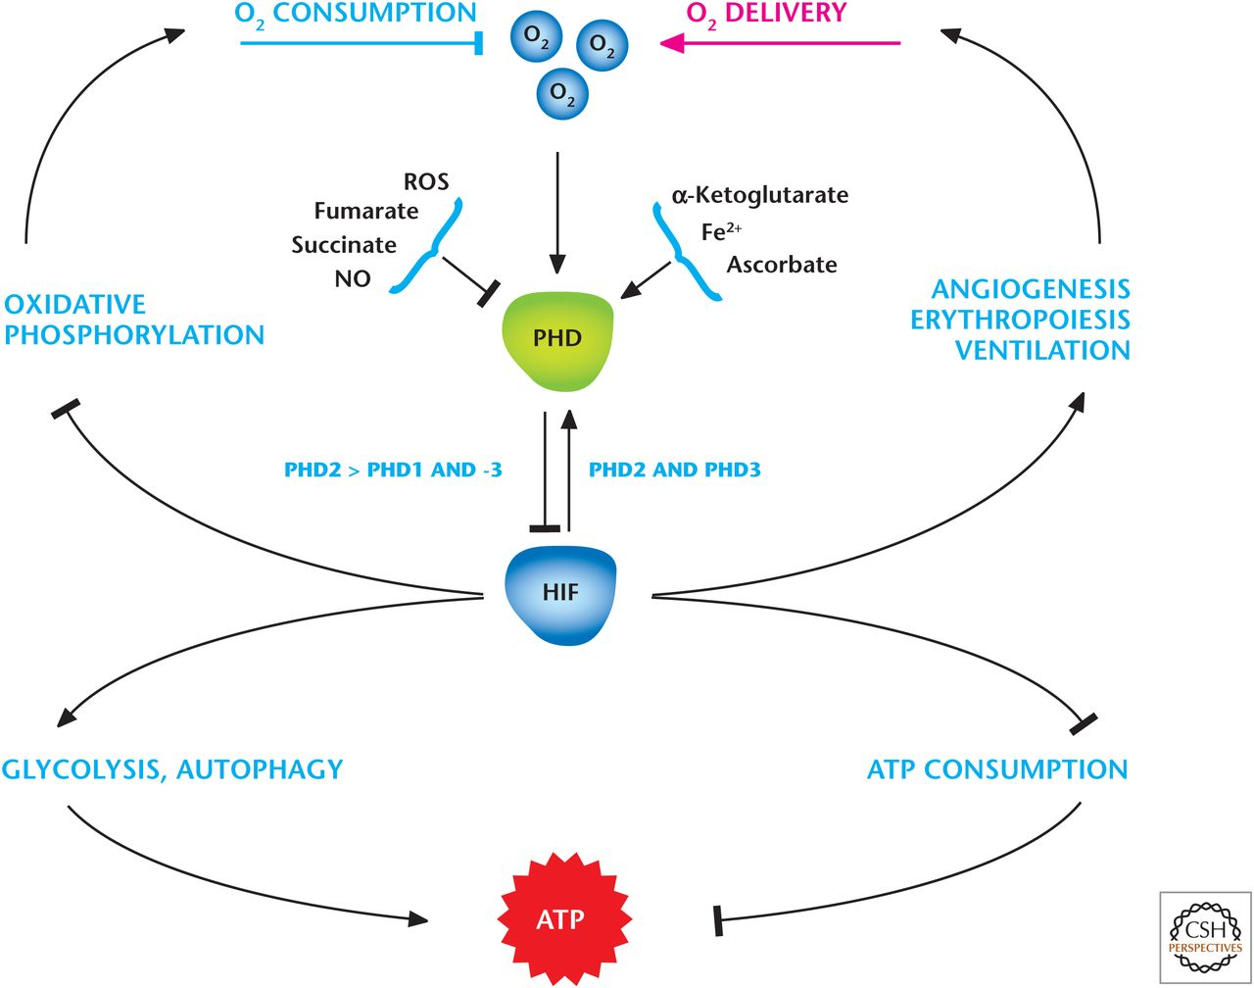
HIFs regulate adaptation to hypoxia.
Notes:
HIFs regulate adaptation to hypoxia. Multiple inputs, including hypoxia, ROS, TCA metabolites (succinate and fumarate), and NO, inhibit prolyl hydroxlases (PHDs) to activate hypoxia inducible factors (HIFs). At the organismal level, HIFs stimulate angiogenesis, erythropoiesis, and ventilation to increase oxygen delivery. At the cellular level, HIFs diminish oxidative phosphorylation and increase glycolysis. HIFs also suppress ATP-consuming generation to preserve a high ATP/ADP ratio in cells.

Slide 76
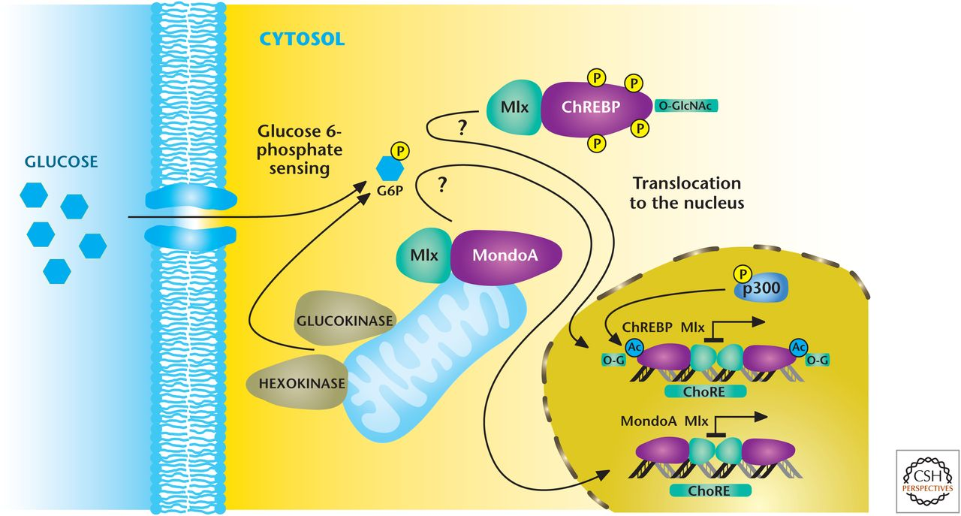
Mondo transcription factors respond to glucose flux.
Notes:
Mammalian cells also have mechanisms to monitor changes in glucose levels and couple them to transcriptional responses. Intracellular glucose is rapidly converted into glucose 6phosphate, which, through unidentiﬁed mechanisms, activates MondoA and ChREBP that in turn heterodimerize with the Mlx protein to make functional transcriptional factors. The MondoA/Mlx complex localizes to the outer mitochondrial membrane, whereas the ChREBP/Mlx is localized in the cytosol under low-glucose conditions. In response to an increase in glucose 6-phosphate levels, MondoA/ Mlx and ChREBP/Mlx complexes translocate to the nucleus where they bind to carbohydrate response elements (ChoRE), resulting in activation of genes that encode enzymes in glycolysis and lipid synthesis. The initial identiﬁcation of ChoRE allowed the puriﬁcation of ChREBP (carbohydrate response element binding protein).
ChREBP is detectable in most tissues, but is at its highest levels in liver. The ChREBP/Mlx complex redirects glucose metabolism to support lipogenesis by inducing a number of key genes involved in fatty acid synthesis, including ACC, fatty acid synthase, and stearoyl-CoA desaturase 1. The ChREBP/ Mlx complex also targets induction of the liver pyruvate kinase gene.
The Mondo/Mlx complex is also detectable in most tissues, but it is strongly expressed in skeletal muscle. The Mondo/Mlx complex transcriptionally induces many glycolytic enzymes, including the rate-limiting enzymes.

Slide 77
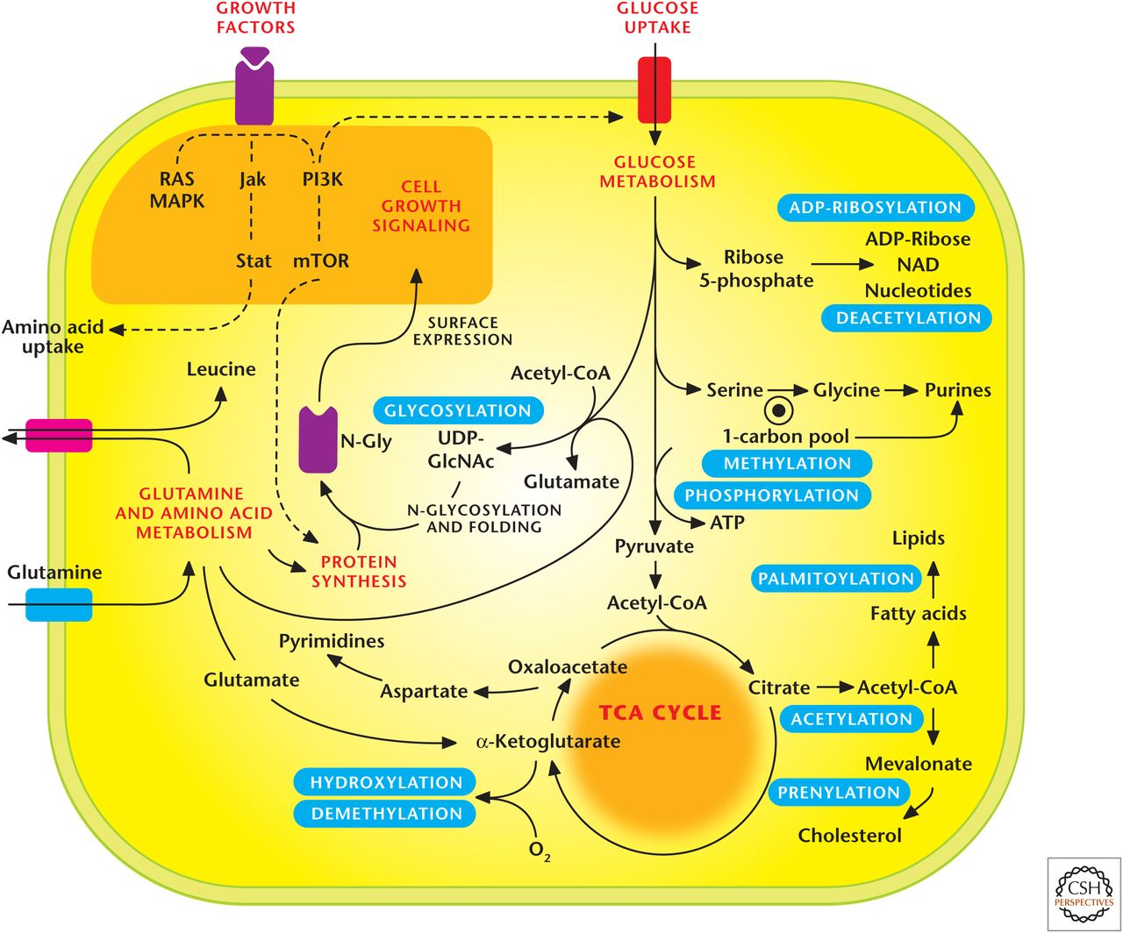
Metabolic pathways regulate signaling pathways.
Notes:
Metabolic pathways regulate signaling pathways.
addition to control of signaling by growth factor signaling and nutrients, intracellular metabolites can exert feedback control on signaling through PTMs of proteins, such as glycosylation, acetylation, methylation, and prenylation. These covalent modiﬁcations by metabolites change activity, localization, or stability of target proteins. The metabolic ﬂuxes through different pathways required to produce these PTM substrates ﬂuctuate in response to intracellular metabolite availability, as well as different cellular states—differentiation versus proliferation.
Metabolites also regulate RNA modifications
Metabolic pathways generate substrates that are used as posttranslational modifications (PTMs) to control signal transduction. Notable PTMs highlighted include glycosylation, prenylation, palmitoylation, hydroxylation, methylation/demethylation, phoshorylation, acetylation/deacyetylation, and ADP-ribosylation.

Slide 78
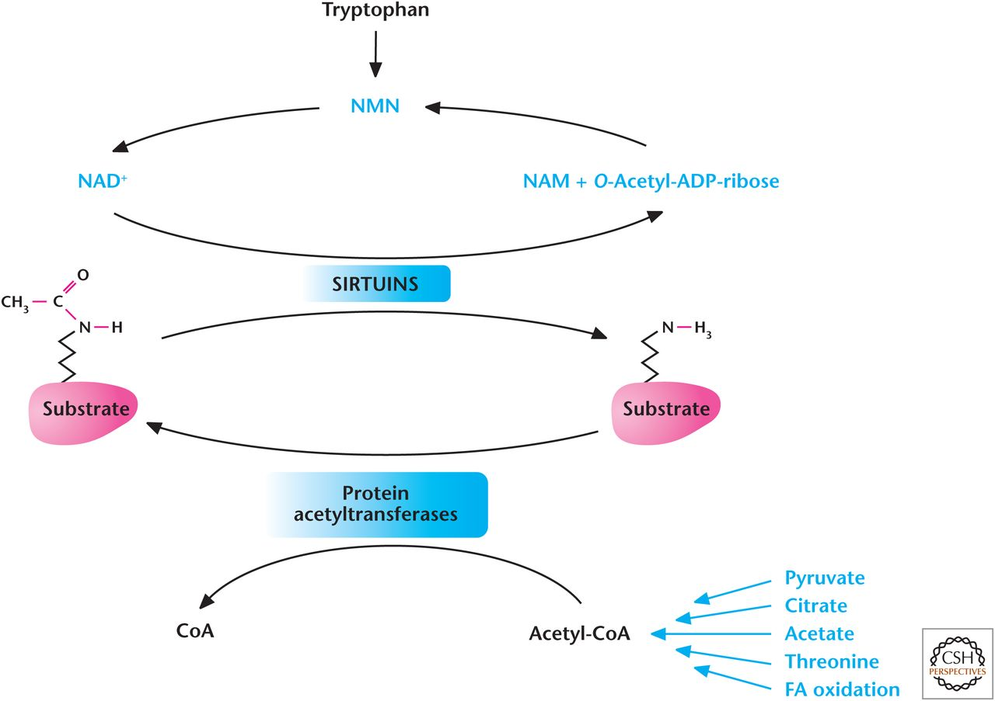
Metabolism regulates acetylation and deacetylation.
A key metabolite that governs many of these PTMs is acetyl-CoA.
Notes:
Metabolism regulates acetylation and deacetylation. Acetyl-CoA provides the acetyl group for acetylation reactions catalyzed by protein acetyltransferases. The Sirtuin family of deacetylases uses NAD⁺ to remove acetyl group from proteins.
The seven members of the sirtuin (SIRT1–7) family are localized to different compartments of the cells and, thus, have different functions. Mitochondrial and cytoplasmic sirtuins control the acetylation status of metabolic enzymes, whereas nuclear sirtuins control acetylation of factors that control transcription of genes.

Slide 79
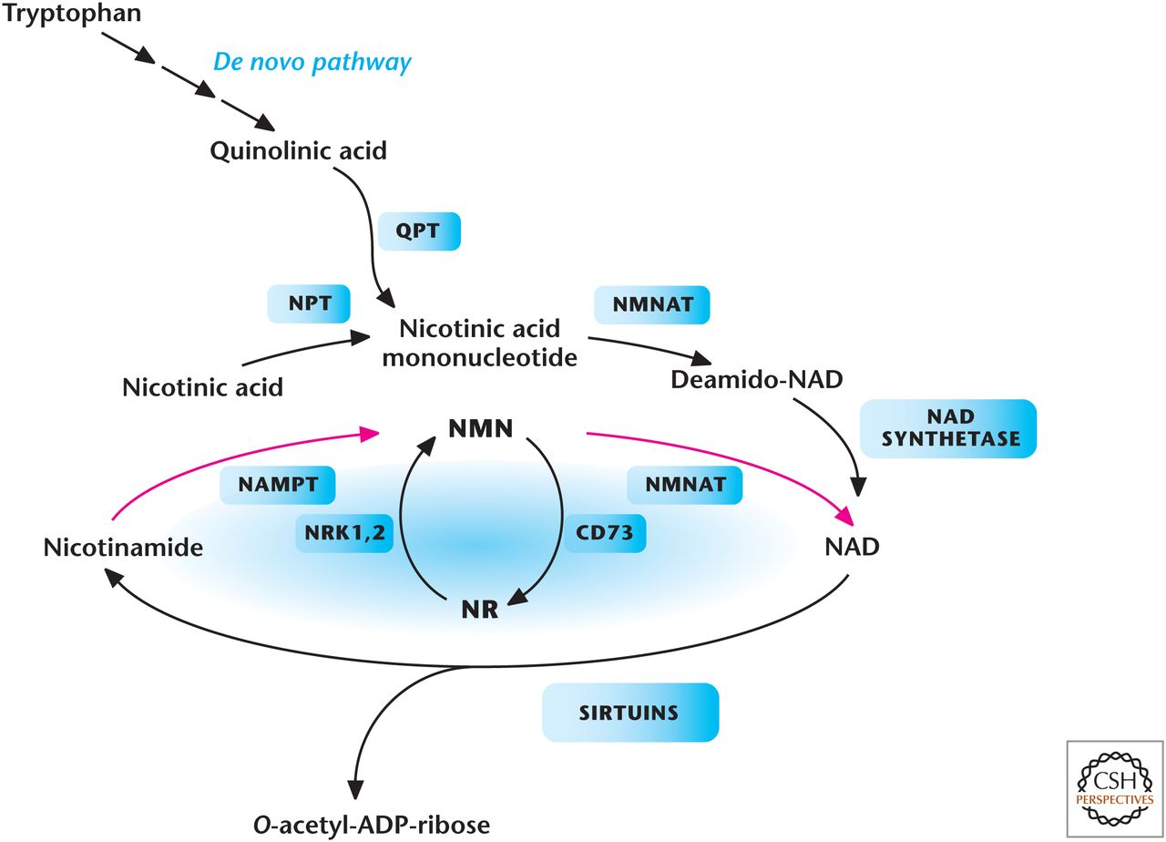
Metabolic pathways that generate NAD+ in mammals.
Notes:
Metabolic pathways that generate NAD⁺ in mammals. Tryptophan, nicotinic acid, nicotinamide (NAM), or nicotinamide riboside (NR) are all NAD⁺ precursors. Enzymes in the pathways are quinolinate phosphoribosyltransferase (QPT), NMNAT, nicotinamide riboside kinase 1 and (NRK1,2), NAMPT, nicotinic acid phosphoribosyltransferase (NPT), and ecto-5′-nucleotidase (CD73).

Slide 80
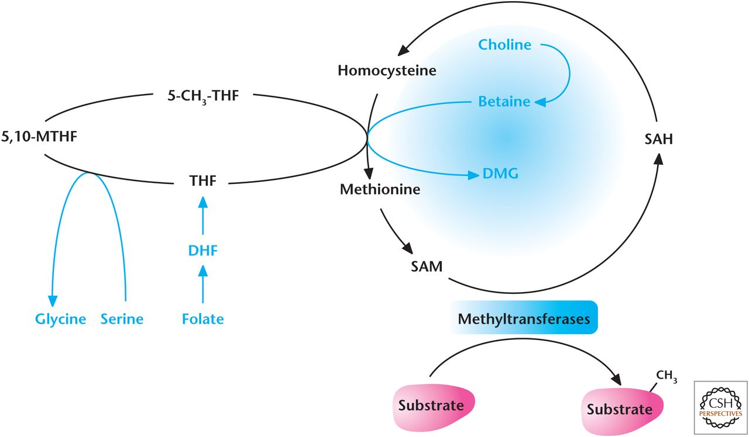
Metabolism regulates methylation.
Notes:
Metabolism regulates methylation.
Methylation of proteins (notably histones) and DNA is another PTM regulated by metabolism. Methylation is controlled by the collective activity of methyltransferases and demethylases. S-adenosylmethionine (SAM) is the methyl donor used by most methyltransferases, including those that methylate histones and DNA. SAM is derived from methionine and becomes S-adenosylhomocysteine (SAH) on donating its methyl group. SAH is converted into homocysteine, which is then converted back to a vitamin B12-dependent reaction that uses carbons derived from folate or choline. Thus, methyltransferases are dependent on a supply of methionine or carbon ﬂux into the folate pool.
‏

Slide 81
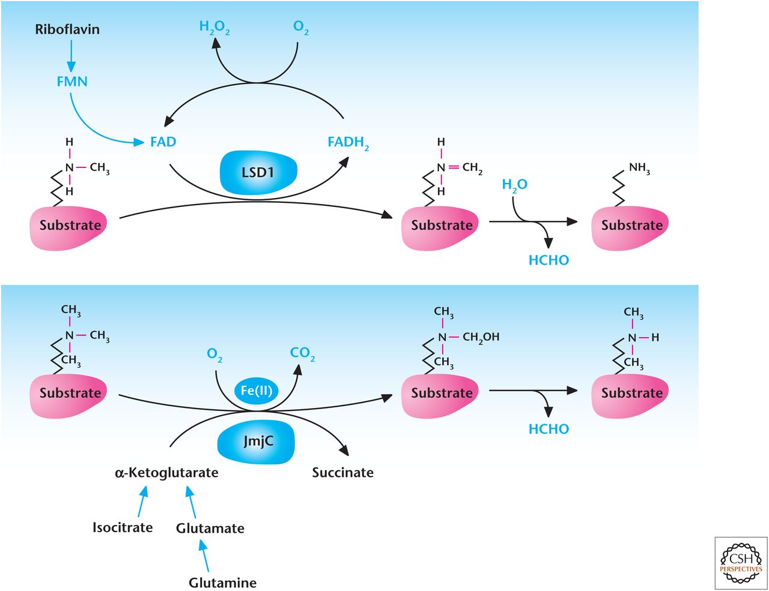
Metabolism regulates demethylation.
Notes:
Metabolism regulates demethylation.
Lysine-specific demethylases (LSD) couple oxidation of methyl groups in histones to reduction of FAD to FADH₂, which spontaneously causes demethylation of histone and produces formaldehyde (HCHO).
The family of demethylases that contain the Jumonji C (JmjC) domain are members of the αketoglutarate and Fe2+-dependent dioxygenase family. Similar to PHDs discussed above, these proteins consume oxygen, convert α-ketoglutrate to succinate, and require ascorbate to regenerate the Fe2+ cofactor as part of their enzymatic activity. JmjC demethylases use α-ketoglutarate, Fe(II), and oxygen to hydroxylate methylated histones resulting in their demethylation.

Slide 82
Notes:
Metabolites also control demethylases. Lysine-speciﬁc demethylase 1 (LSD1) is dependent on FAD reduction to FADH2.
The family of demethylases that contain the Jumonji C (JmjC) domain are members of the αketoglutarate and Fe2+-dependent dioxygenase family. Similar to PHDs discussed above, these proteins consume oxygen, convert α-ketoglutrate to succinate, and require ascorbate to regenerate the Fe2+ cofactor as part of their enzymatic activity.

