Slide 1
Password: L&D2223

Slide 2
The Law v. The Code
The Law
The Code

Slide 3
What are legal systems?
People
Laws
Institutions
Institutions serve to legitimize, enact, and enforce laws

Slide 4
The two main legal models
Civil law: Parliaments enact legislation
Common law: judges make law by adjudicating cases
The Constitution: is above the law, says how laws must be enacted, and usually requires that laws against the constitution be struck down
Common law countries: have narrow–but growing numbers of–statutes

Slide 5
The two main models when it comes to data
United States
The Federation has
limited legislative powers
its own judiciary
Each State has
broad legislative powers
its own judiciary
Most legislation that is relevant is state legislation
Exception: Federal Trade Commission regulations
European Union
EU has
limited powers
the Court of Justice
States have
most powers
the bulk of the judicial activity
Most rules that are relevant are EU rules

Slide 6
The Types of Laws
EU Treaties
EU regulations: create immediately enforceable rights
EU directives: address states. After the deadline, sufficiently precise rules are immediately enforceable

Slide 7
Why the EU is so powerful?
“Direct effect” doctrine
“EU law supremacy” doctrine

Slide 8
Why the Court of Justice of the EU is so important?
The preliminary ruling procedure:
a domestic case starts
the local judge thinks that EU law is involved
EU law is ambiguous
the local judge suspends the proceedings and requests the CJEU to issue a preliminary ruling
the domestic trial resumes and the local judge will enforce the EU rule as interpreted by the CJEU

Slide 9
The Regulatory State and the Technocratic Institutions
USA: The Federal Trade Commission
EU: The Privacy Authority
At the State Level: Privacy Authorities
Such institutions often have: regulatory, executive, and judicial powers

Slide 10
CHINA
The Central State and the Local Government
The Communist Party’s Rule
Regulating by principles and instructions

Slide 11
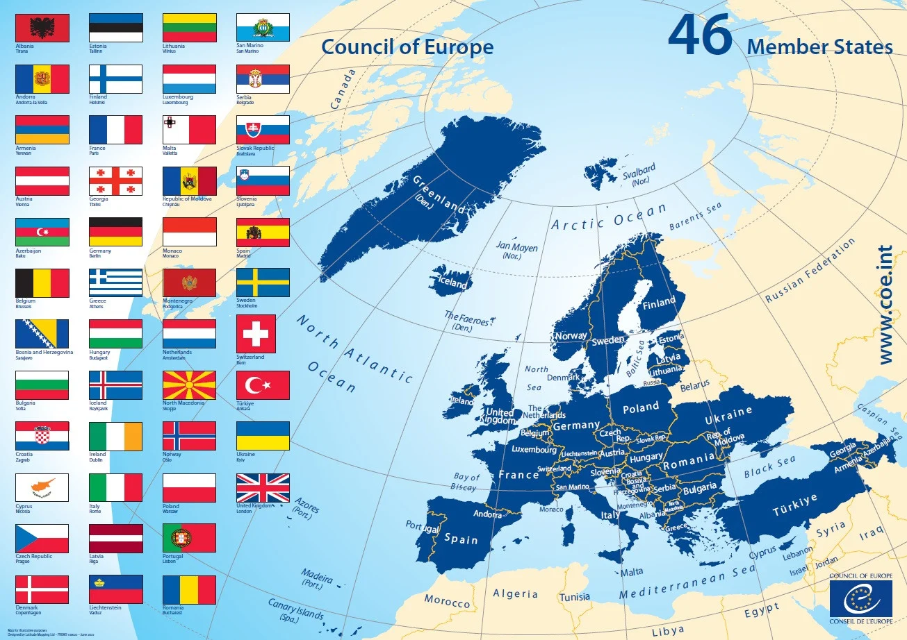
An Additional layer of complexity in Europe: The European Convention and the European Court of Human Rights

Slide 12
Art 8
1. Everyone has the right to respect for his private and family life, his home and his correspondence.
2. There shall be no interference by a public authority with the exercise of this right except such as is in accordance with the law and is necessary in a democratic society in the interests of national security, public safety or the economic well-being of the country, for the prevention of disorder or crime, for the protection of health or morals, or for the protection of the rights and freedoms of others.

Slide 13
Art. 10
1. Everyone has the right to freedom of expression. This right shall include freedom to hold opinions and to receive and impart information and ideas without interference by public authority and regardless of frontiers. This Article shall not prevent States from requiring the licensing of broadcasting, television or cinema enterprises.
2. The exercise of these freedoms, since it carries with it duties and responsibilities, may be subject to such formalities, conditions, restrictions or penalties as are prescribed by law and are necessary in a democratic society, in the interests of national security, territorial integrity or public safety, for the prevention of disorder or crime, for the protection of health or morals, for the protection of the reputation or rights of others, for preventing the disclosure of information received in confidence, or for maintaining the authority and impartiality of the judiciary.

Slide 14
The European Court of Human Rights’ powers
It intervenes after the exhaustion of domestic remedies
It addresses complaints against States
Its rulings establish obligations, but hardly have direct effects within state jurisdictions

Slide 15
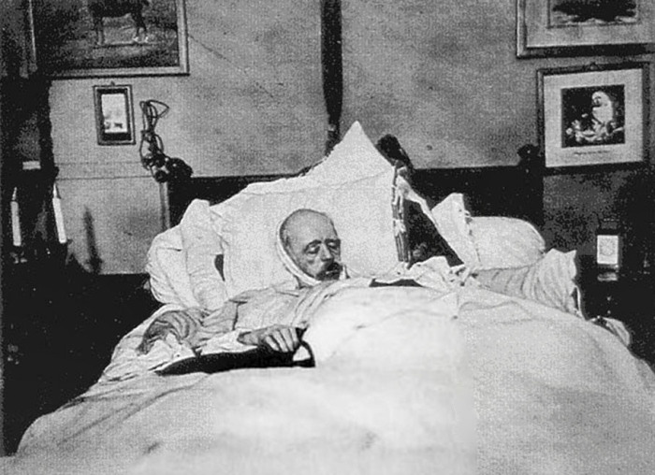
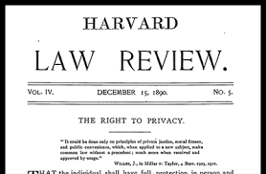
How Privacy Was Born

Slide 16
The Development of Privacy & Dignity
From Places…
To People…
From Protecting People from Private Powers…
To Protecting People from Public Powers
From People to Information

Slide 17
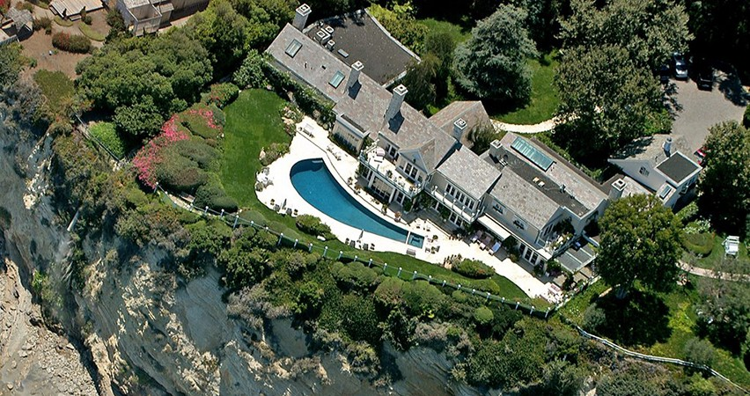
The Barbra Streisand Effect & the Paradox of Privacy

Slide 18
The Shield of Privacy: which limits? The Proportionality Scrutiny
Other interests can prevail over privacy–it depends on the jurisdiction
(es. Intellectual property)
Proportionality scrutiny: it is a means to assess the legitimacy of a solution

Slide 19
The structure of proportionality
Is the goal of a measure lawful?
Does the measure truly pursue the goal it purports to pursue?
Is the measure the least restrictive means to achieve the goal?
Do the benefits outweigh the damages?

