Slide 1
Omics in human diseases
Index
Omics data and Biological databases
NGS methods and data analysis
Prediction and interpretation of pathogenic variants
Protein-protein interaction networks
Course organization 2022/2023
Frontal lecture/ guided practical activity
How to pass the exam: multiple choice quiz (50%) + results from practical activities (50%) + Bonus points, e.g. summary of previous lecture (up to 10%)
Mail: emanuela.leonardi@unipd.it

Slide 2
Multi-Omics approach
Analysis of only one data type is limited
to correlations, mostly reflecting reactive processes rather than causative ones.
Integration of different omics data types is often used to elucidate potential causative changes that lead to disease, or the treatment targets, that can be then tested in further molecular studies.
Systems biology is applied to predict potential molecular interactions by integrating omics data from genomic, proteomic, transcriptional, and metabolic layers
Hasin Y., 2017 Genome Biol. PMID: 28476144

Slide 3
Multi-Omics approach
The systemic view on dynamic gene regulation shows that genes work as part of complex networks instead of acting alone to perform cellular processes.
The integrative multi-layer omics data, such as transcriptional factors, genes and their expression products, provides a comprehensive map of metabolism and molecular regulation when analyzing and predicting based on complex cellular networks.
This leads to the prediction of potential molecular interactions through latent information of omics data

Slide 4
Multi-Omics approach Network structure in systems biology
A network structure visualizes a wide range of components such as genes or proteins and their interconnections.
Network-based modeling can be established for systematic analysis based on omics data from various scale

Slide 5
Introduction to Network Biology
Behind every complex system (comprised of many interconnected parts, with a complicated arrangement) lies a network:
Networks encoding the interactions between genes, proteins, etc. the cellular network
The wiring diagram capturing the interactions between neurons, the neural network
The interactions of family, friends and colleagues, a social network
Communication networks, describing how communication devices interact with other
Power grid, trade networks and many - many more.

Slide 6
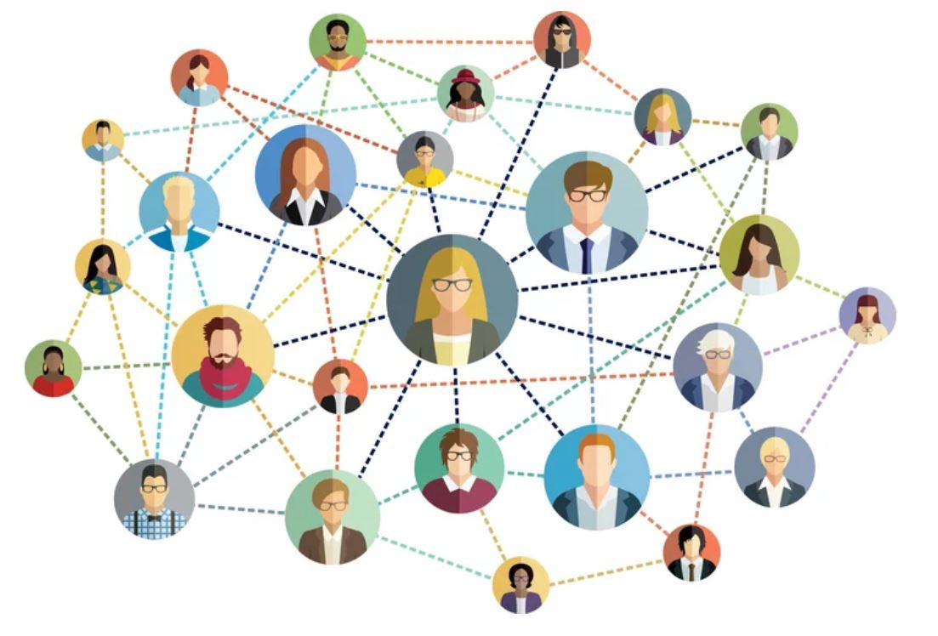
Network
Networks are very similar to graphs, the
terms are often used interchangeably:
It’s a structure amounting to a set of objects, in which pairs of objects are “related”
The difference:
- Usually graphs refer to the mathematical
representation of a network
- Networks are catalogs of a system’s
components, and often refer to a real
system (WWW, social ties, metabolic
network)

Slide 7
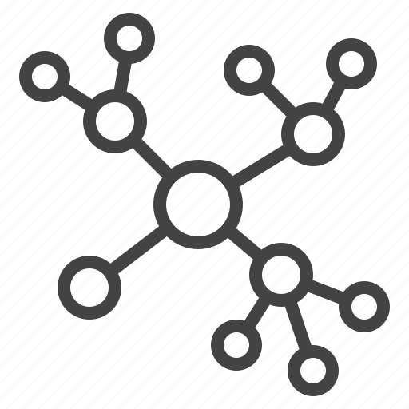
Network
Networks are collections of nodes and edges.
In network biology we use them to:
Visualize our biological entities
See overrepresented functions and their interactions
Make predictions about potential interactions

Slide 8
Network
This is a node
This is an edge
In network biology nodes can
represent various components:
Genes
Proteins
RNAs
and other biological entities
Edges represent the interactions occurring between two
nodes
They can be:
Directed or undirected
Weighted or unweighted
Stimulatory or inhibitory

Slide 9
Network Topology
Network properties, and particularly topological properties, can help us identify relevant sub-structures within a network.
Topology is the way in which the nodes and edges are arranged within a network.
Topological properties can apply to the network as a whole or to individual nodes and edges

Slide 10
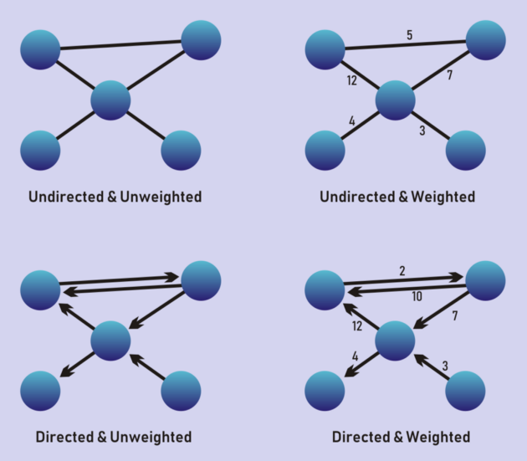
Network Topology: edge weight and directionality
In an undirected graph all edges are bidirectional

Slide 11
Physical or functional connections

Slide 12
Network Topology: node degree
The degree of a node represents the number of links it has to other nodes
Influences other characteristics, such as the centrality of a node
As networks can be directed or undirected for the former, in addition we differentiate between in-degree and out-degree
b
a
c
1
2
1
b
a
c

Slide 13
Network Topology: Hubs
a
1
Hubs are the largest
degree nodes in a network.
They are often very
important biologically and
their deletion can be lethal
(e.g. chaperone proteins).
e
d
b
1
1
4
c
1

Slide 14
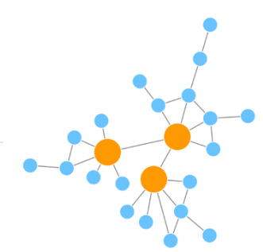
Network Topology: Scale-free network
Most of the nodes are connected to a low number of neighbours and there are a small number of high-degree nodes (hubs) that provide high connectivity to the network.

Slide 15
Network Topology: Paths
d
A path is a sequence of
nodes in which each node
is adjacent to the next one
The distance between two
nodes is defined as the
number of edges along the
shortest path connecting
them
c
a
b
a > b > c > d
a > b > c > e
e

Slide 16
Network Topology: Paths
c
a
The shortest path is the path with the shortest length (distance) between two nodes.
a < e
3 steps
4 steps
b
d
f
e

Slide 17
Network Topology: Connectedness
A graph is connected if any two nodes can be joined by a path.
We refer to the largest connected component as the giant component and the rest as isolates.
Bridges connect the various components – if you erase them the graph becomes disconnected

Slide 18
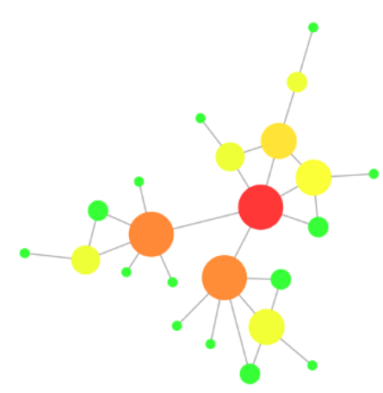
Network Topology: centrality
Centrality can be measured for nodes and for edges and gives an estimation on how important that node/edge is for the connectivity or the information flow of the network
Degree centrality
Betweenness centrality:
number of shortest paths which goes through a given node/edge
This measure shows which nodes are 'bridges' between nodes in a network
The most central nodes (according to their betweenness centrality) are highlighted in warm colours and the node size reflects its degree

Slide 19
Network Topology: Transitivity
Calculating clustering
coefficient
Ki = degree of node i
Ei = edges between the neighbours of node i
Transitivity relates to the presence of tightly interconnected nodes in the network called clusters or communities.
Clustering coefficient:
what fraction of your
neighbours are connected
(value between 0 and 1)
i
7 edges total
3 between
neighbours
Ci = 0.5
2 * 3
-------- = 0.5
4 * 3
Notes:
Clusters are groups of nodes that are more internally connected than they are with the rest of the network

Slide 20
Network Topology

Slide 21
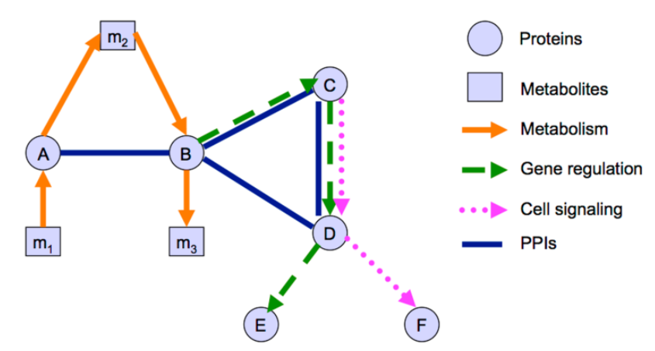
Types of Biological Networks
Notes:
Different types of information can be represented in the shape of networks in order to model the cell (Figure 10). The meaning of the nodes and edges used in a network representation depends on the type of data used to build the network and this should be taken into account when analysing it.

Slide 22
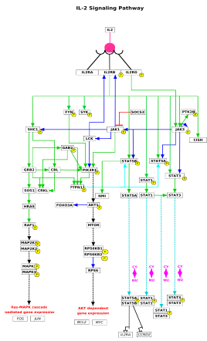
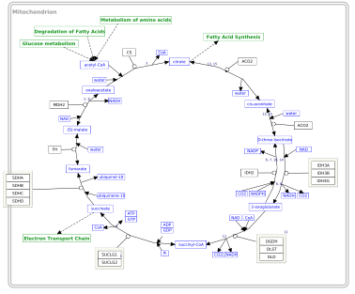
Biological Network Taxonomy
Pathways
Signaling, Metabolic, Regulatory, etc

Slide 23
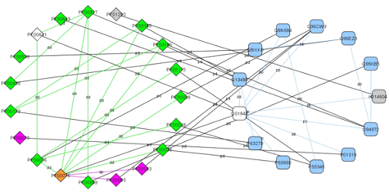
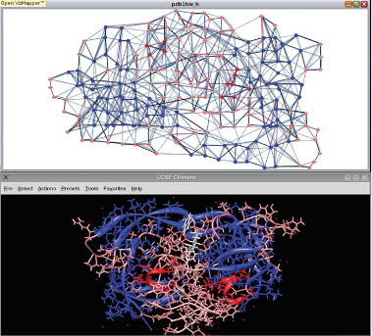
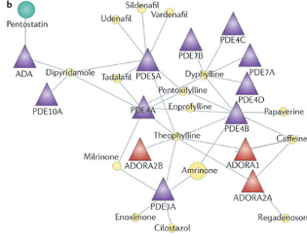
Biological Network Taxonomy
Interactions
Protein-Protein
Protein-Ligand
Domain-Domain
Residue or atomic
Cell-cell
Epidemiology
Social networks

Slide 24
The sources of data underlying biological networks
Size of the dataset used
Biological datasets are inherently noisy and incomplete.
Often, different types of evidence will not overlap or will be contradictory.
The way the data was obtained is an important aspect to consider here, with the information typically coming from the following sources:
Manual curation of scientific literature
High-throughput datasets
Computational predictions
Literature text-mining
Notes:
Manual curation of scientific literature: Scientific curators or domain experts evaluate existing published evidence and store it in a database. This provides high-quality, well represented information, but curation is an expensive and time consuming task and the size of the datasets is limited by these factors.
High-throughput datasets: Some experimental approaches can generate large amounts of data, such as large-scale PPI datasets generated via yeast two-hybrid or affinity purification plus mass spectrometry identification. They provide large, systematically produced datasets but the information suffers the inherent biases of the chosen technique and they vary in quality.
Computational predictions: Many methods use existing experimental evidence as their basis and aim to predict unexplored relationships between biological entities. For example, protein interactions in humans can be used to predict a similar interactions in mice if there are close enough orthologues in this organism. They provide a tool to broaden and even refine the space of experimentally derived interactions, but the datasets produced are understandably noisier than with the previous sources.
Literature text-mining: Multiple algorithms are used to computationally extract systematically represented relationships from the published literature. As with the previous case, although they can greatly increase the coverage of the data, natural language processing is a tricky business and the results tend to be rather noisy.

Slide 25
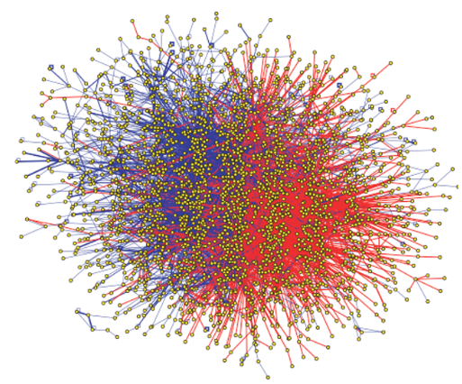
Protein-protein Interaction Network (PPI)
PPI network are mathematical representations of the physical contacts between proteins in the cell.
Contacts are specific, occur between defined binding regions in the proteins, have a particular biological meaning (i.e., they serve a specific function)
PPI information can represent both transient and stable interactions

Slide 26
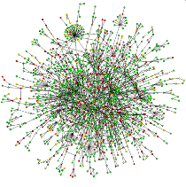
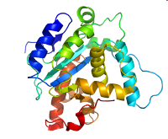
Why protein-protein interactions (PPI)?
Gene is the basic unit of heredity. Genomes are available.
Proteins, the working molecules of a cell, carry out many biological activities
Proteins “work” by interacting with other proteins.

Slide 27
Why protein-protein interactions (PPI)?
PPIs are involved in many biological processes:
Signal transduction, protein complexes or molecular machinery
Protein carrier
Protein modifications (phosphorylation) …
PPIs help to decipher the molecular mechanisms underlying the biological functions (e.g. in human diseases) and enhance new drug discovery

Slide 28
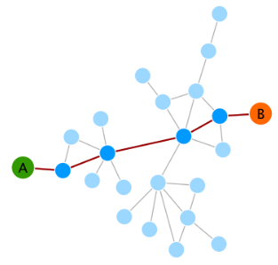
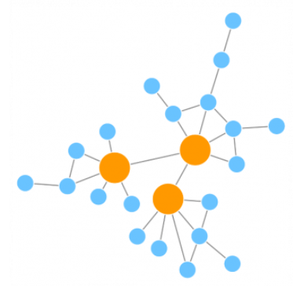
PPI network
PPI networks show a small world effect meaning that there is great connectivity between proteins network’s diameter (the maximum number of steps separating any two nodes) is small
The “six degrees of separation” theory
PPI networks are scale-free networks

Slide 29
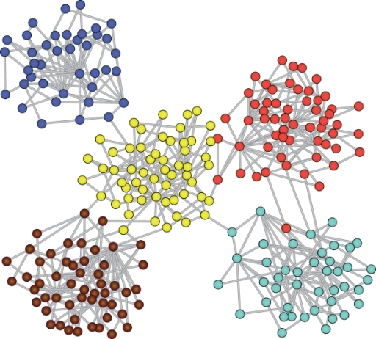
PPI Network: Modularity
The transitivity or clustering coefficient of a network is a measure of the tendency of the nodes to cluster together.
High transitivity means that the network contains communities or groups of nodes that are densely connected internally.
In biological networks, finding these communities is very important, because they can reflect functional modules and protein complexes

Slide 30
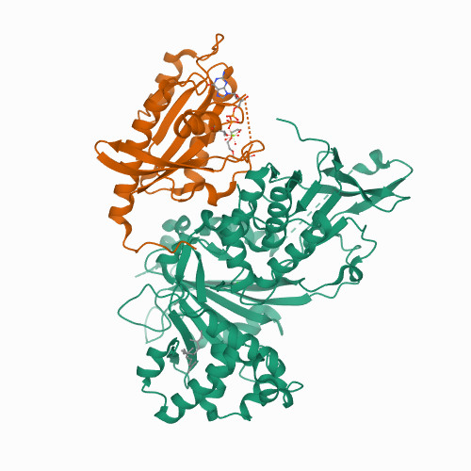
PPI Network: Modules
A module is an exchangeable functional unit.
Protein complexes can be considered a type of module in which proteins are interacting with each other in a stable manner, maintaining a more or less fixed configuration in time and space.
Modules help reduce the complexity of biological networks by giving us a set of reducible, functional units that can be studied as an integrated entity.
Topological study of PPINs can help detect and define these modules.

Slide 31
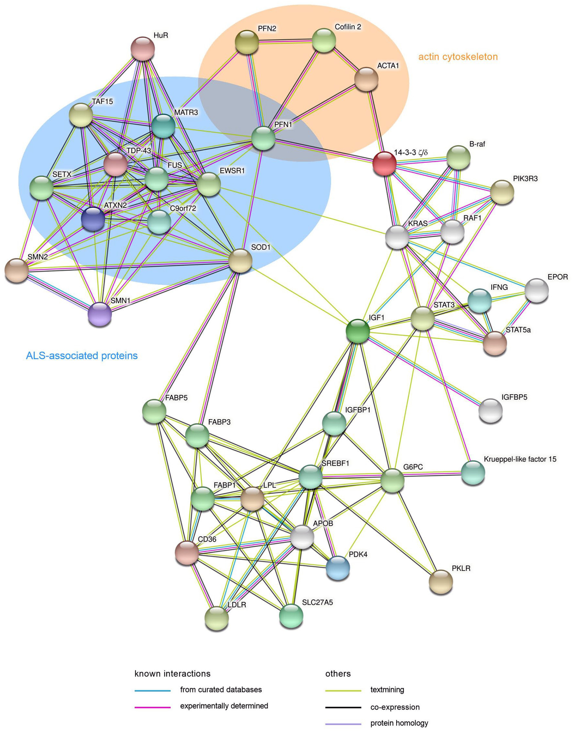
Modules
Useful when defining intermodular interactions and proteins.
These are the edges/nodes that link different communities within a network.
They can act as switches or high-level modulators that, for example, mediate cross-talk between different complexes or pathways
doi/full/10.1177/26331055221087740
Notes:
Network analysis revealed SOD1 and PFN1 as inter-modular nodes in a network representing proteins that are involved in SMA and ALS pathogenesis. Components of the actin cytoskeleton (orange circle) include actin-binding proteins profilin1 and 2 (PFN1 and PFN2) as well as cofilin2 (CFL2) and actin alpha 1 (ACTA1). This cluster is linked to proteins which are associated with ALS (blue circle). SOD1 is an inter-modular node that connects ALS- or SMA-caused proteins, respectively, with the cluster of proteins that are altered in fatty acid metabolism in SMA mice. Most of the shown proteins have functions in fatty acid metabolism. Family members of the STAT kinases (STAT3 and STAT5A) are connected to KLF15 which regulates energy pathways in muscles. B-Raf and its interactor 14-3-3 ζ/δ are linked to the cluster of actin-binding proteins or to STAT kinases via RAF1, respectively. Complete protein names are listed in Tables 1 and 2.

Slide 32
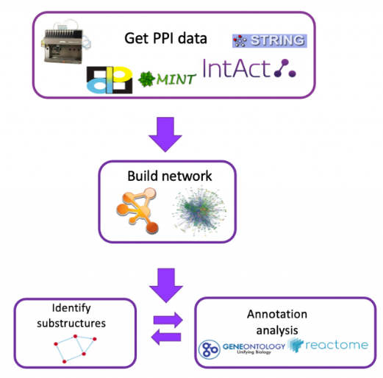
Building and analysing PPINs
Retrieve Protein-protein interaction data
Create and analyze networks
Find structure in networks, search for modules or motifs
Analyze results using known databases, functional enrichment, expression data, organelle information, etc...

Slide 33
How do we know that a pair of proteins interact?
The easiest answer: The two proteins have been co-crystallized
Protein A
Protein B

Slide 34
How do we know that a pair of proteins interact?
The easiest answer: The two proteins have been co-crystallized… very slow..
High throughput interaction screening methods:
Yeast two hybrid experiments (Y2H)
Co-Immunoprecipitation (co-IP)
Proteome Mass Spectrometry
Problem with high throughput method:
significant amount of false positives and false negatives

Slide 35
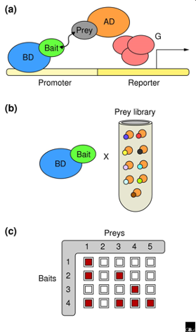
Two hybrid system
A protein of interest, referred to as "bait," is bound to a DNA Binding Domain (BD)
A separate protein, called the "prey," is bound to an open reading frame (AD)
If these two proteins (the bait and prey) interact, a reporter gene is transcribed
In general, used for initial identification of interacting proteins, not for detailed characterization of the interaction

Slide 36
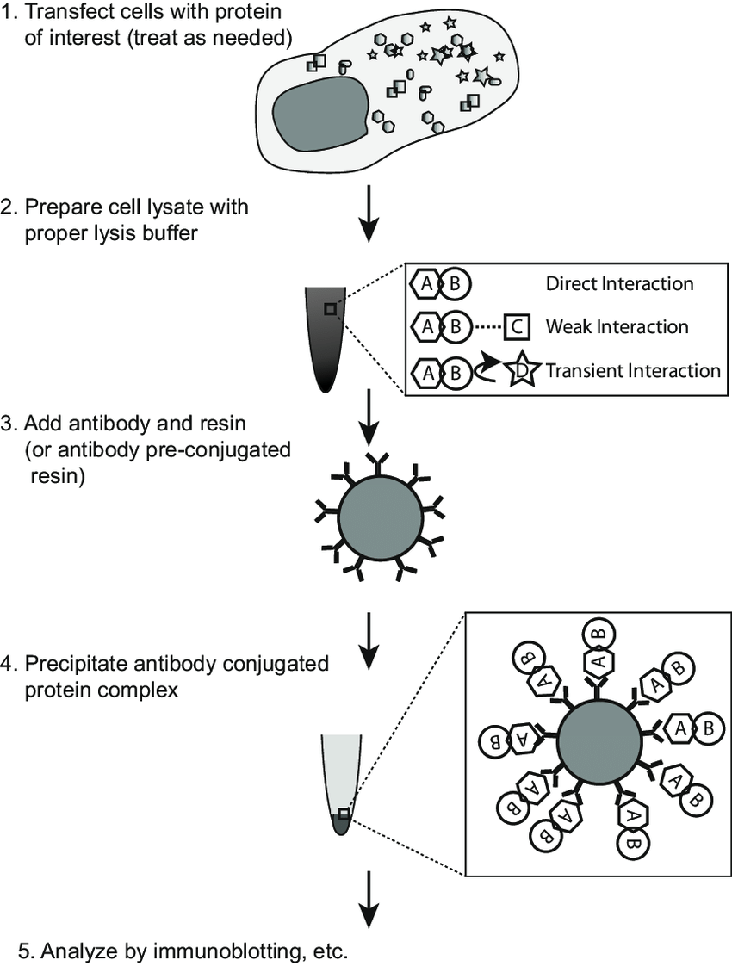
Co-Immunoprecipitation (co-IP)
Co-Immunoprecipitation (co-IP) to find out what is binding
The protein itself is used as an affinity reagent to isolate its binding partners
Compared with two-hybrid approach, this strategy has the advantages that the fully processed and modified protein serves as bait

Slide 37
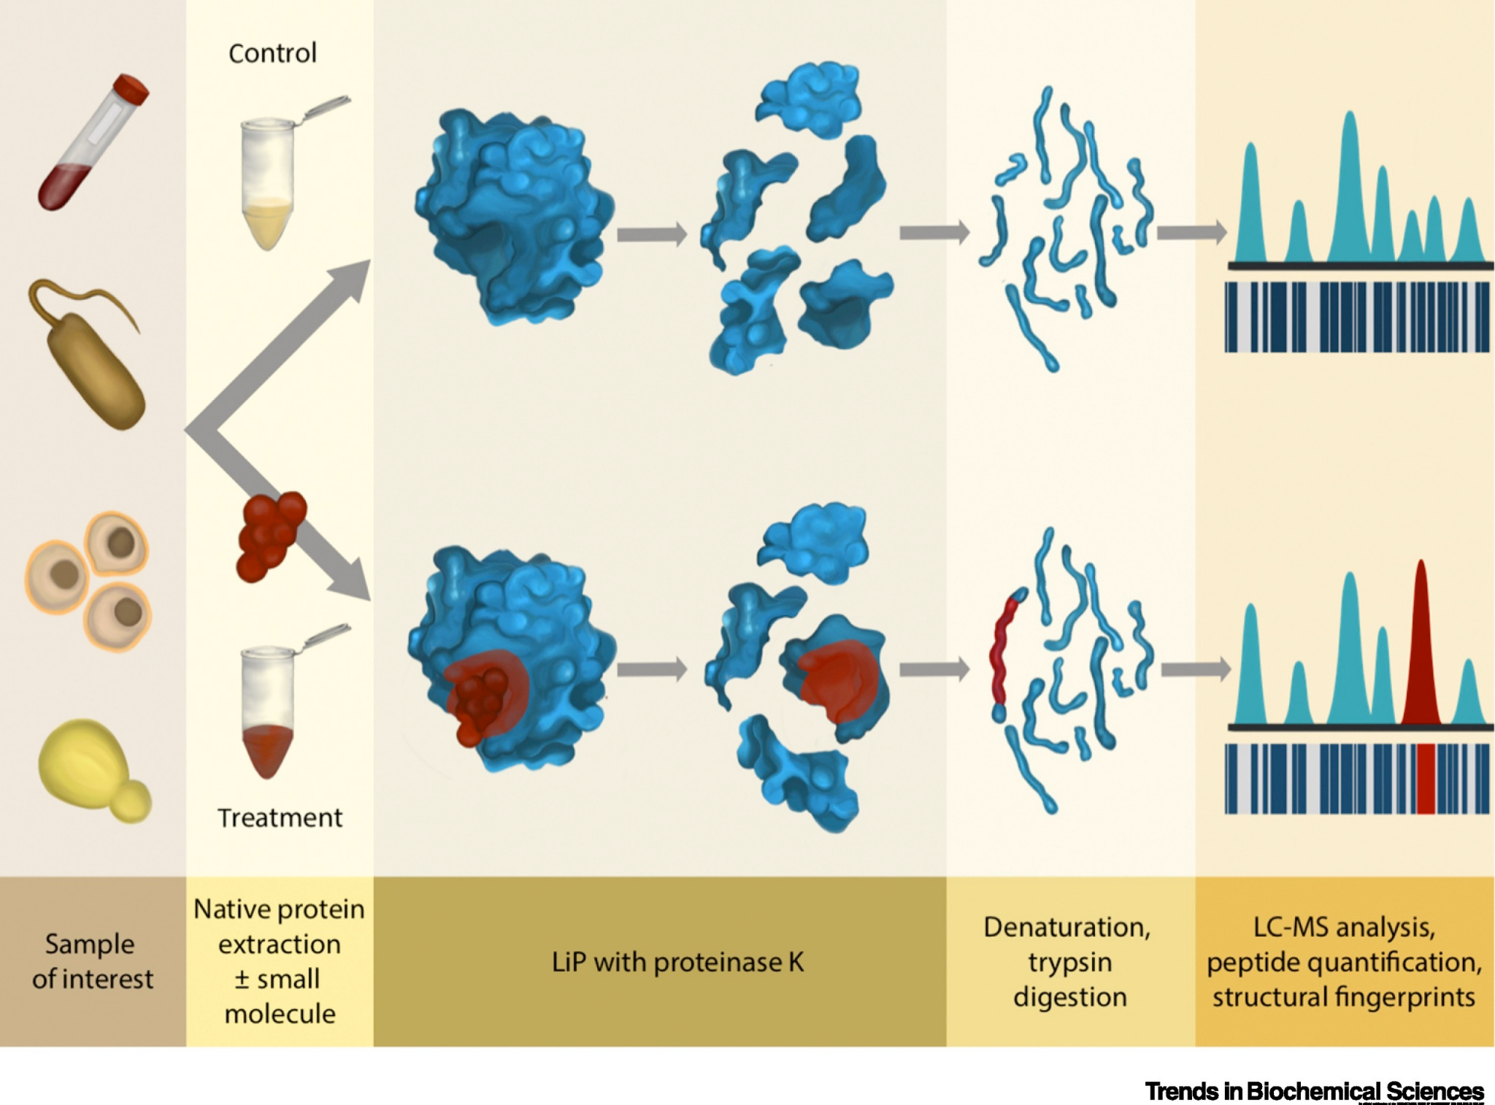
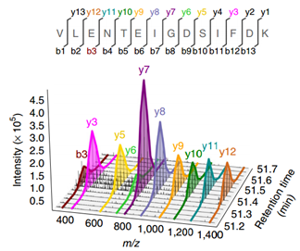
Proteome Mass Spectrometry
Results:

Slide 38
Other useful approaches:
Low throughput techniques:
Xray crystallography
NMR
SAXS
ELISA Binding Assays
Computational methods:
Text mining
Search literature for references to protein-protein interactions
Orthology
Predicts interaction based orthologous pairs in another species
Domain pairs
Predicts interaction based on domains interacting in other proteins

Slide 39
Public Repositories
PPI Data
Pathway Commons (https://www.pathwaycommons.org/)
BioGRID (https://thebiogrid.org/)
IntAct (https://www.ebi.ac.uk/intact/home)
Model organisms databases
STRING (https://string-db.org/)

Slide 40
Building and analysing PPINs
Retrieve Protein-protein interaction data
Create and analyze networks
Find structure in networks, search for modules or motifs
Analyze results using known databases, functional enrichment, expression data, organelle information, etc...

Slide 41
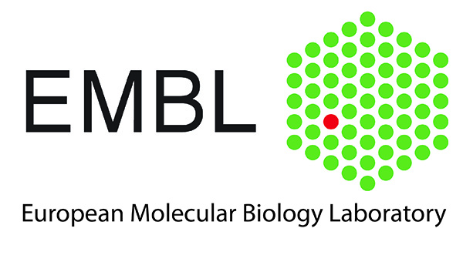
STRING: Search Tool for the Retrieval of Interacting Genes/Proteins
DOI: 10.1093/nar/gkaa1074
A database of known and predicted protein interactions
Direct (physical) and indirect (functional) associations
The database currently covers 67,6 millions proteins from 14.000 organisms
Derived from these sources:
Supported by:

Slide 42
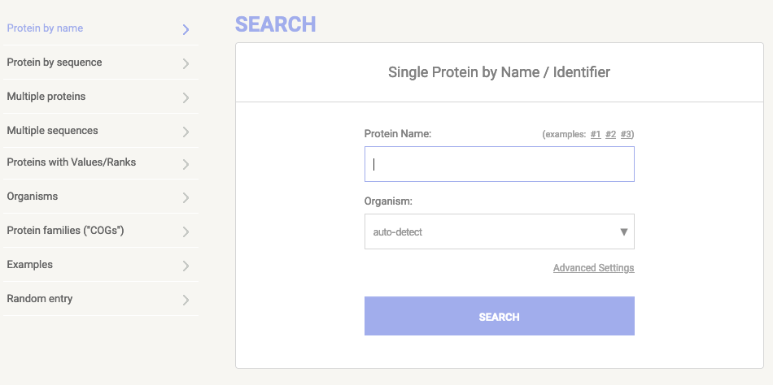
STRING - Searching information
Query information via protein names or protein sequences

Slide 43
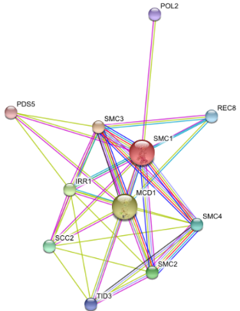
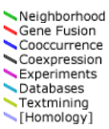
STRING - Graph of PPIs
Nodes are proteins
Colored lines are an evidence of interaction between two proteins. The color encodes the method used to detect the interaction.
Click on each node to get the information of the corresponding protein.
Click on each edge to get information of the interaction between two proteins.

Slide 44
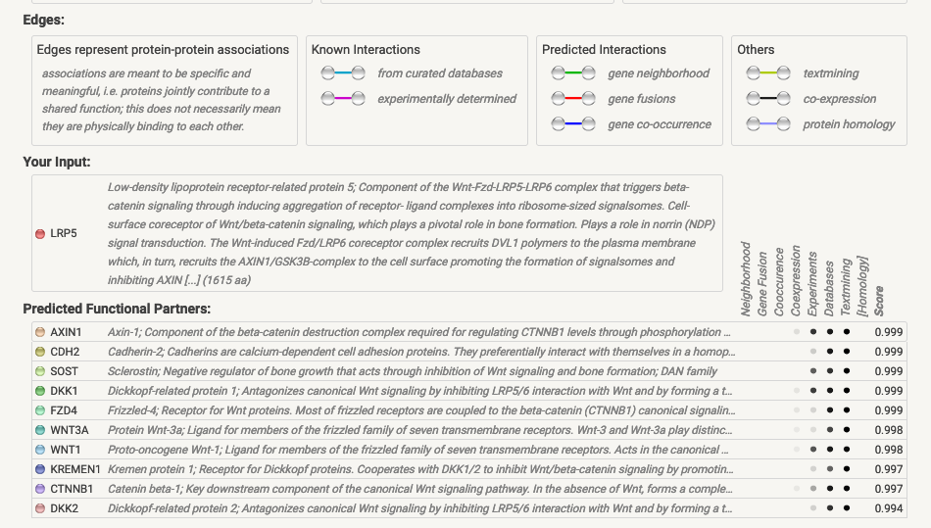
STRING - list of predicted partners

Slide 45
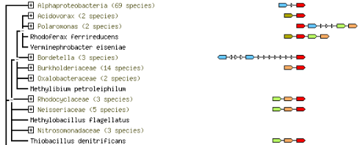
STRING - Neighborhood View
The red block is the queried protein while others are its neighbors in different organisms
The close organisms show the similar protein neighborhood patterns
This view helps to find out the close genes/proteins in genomic region
Notes:
This view shows runs of genes that occur repeatedly in close neighborhood in (prokaryotic) genomes. Genes located together in a run are linked with a black line (maximum allowed intergenic distance is 300 bp). Note that if there are multiple runs for a given species, these are separated by white space. If there are other genes in the run that are below the current score threshold, they are drawn as small white triangles. Gene fusion occurrences are also drawn, but only if they are present in a run (see also the Fusion section below for more details).

Slide 46
STRING - Occurence Views
Represents phylogenetic profiles of proteins.
Color of the boxes indicates the sequence similarity between the proteins and their homologous protein in the organisms.
The size of box shows how many members in the family representing the reported sequence similarity.

Slide 47
STRING - Gene Fusion View
This view shows the individual gene fusion events per species
Two different colored boxes next to each other indicate a fusion event.
Hovering above a region in a gene gives the gene name; clicking on a gene gives more detailed information

Slide 48
Building and analysing PPINs
Retrieve Protein-protein interaction data
Create and analize networks
Find structure in networks, search for modules or motifs
Analyze results using known databases, functional enrichment, expression data, organelle information, etc...

Slide 49
Analyzing PPI networks
Biological networks … seldom tell us anything by themselves
Analysis involves:
Understanding the characteristics of the network
Modularity
Comparison with other networks (e.g., random networks)
Visualization involves:
Placing nodes in a meaningful way (layouts)
Mapping biologically relevant data to the network
Node size, node color, edge weights, etc...
…which then allowing for more analysis!

Slide 50
Analyzing PPI networks
Topological PPI network analysis: analysing the topological features of a network is a useful way of identifying relevant participants and substructures that may be of biological significance (e.g. centrality analysis and topological clustering)
Annotation enrichment analysis: uses gene/protein annotations provided by knowledge-bases such as Gene Ontology (GO) or Reactome to infer which annotations are over-represented in a list of genes/proteins that can be taken from a network. This is a widely used technique that helps characterise the network as a whole or sub-sets of it, such as inter-connected communities found through topological clustering analysis

Slide 51
Topological PPINs analysis: centrality
Network Measures
Diameter: the largest distance between two nodes
Radius: the minimum of the maximum shortest path between any two nodes
Characteristic path length: average shortest path length
Density: how dense the network is populated with edges
Heterogeneity: tendency of the network to contain hub nodes
Connected components: number of disconnected groups of nodes
Network topology statistics
such as node degree, degree distribution, centrality, clustering coefficient, shortest paths, and robustness of the network to the random removal of single nodes are important network characteristics.

Slide 52
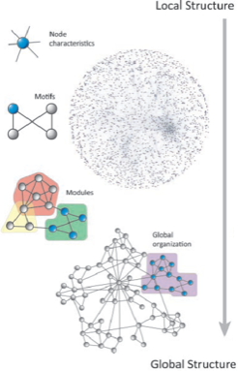
Topological PPINs analysis: clustering
The levels of organization of complex networks:
Node degree provides information about single nodes
Three or more nodes represent a motif
Larger groups of nodes are called modules or communities

Slide 53
Topological PPINs analysis: network alignment
DOI: 10.1186/s13637-015-0022-9
Biological network alignment aims to find regions of topological and functional (dis)similarities between molecular networks of different species.

Slide 54
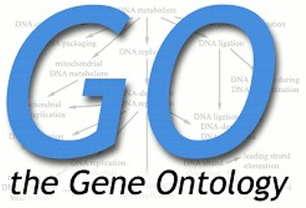
Annotation Enrichment analysis
Most frequently performed using GO annotation as a reference
Other annotations such as pathways, expression fold change etc.
It is used in combination with topological clustering analysis
Gene Ontology
Molecular function (specific tasks)
Biological process (broad biological goal)
Cellular component (location)

Slide 55
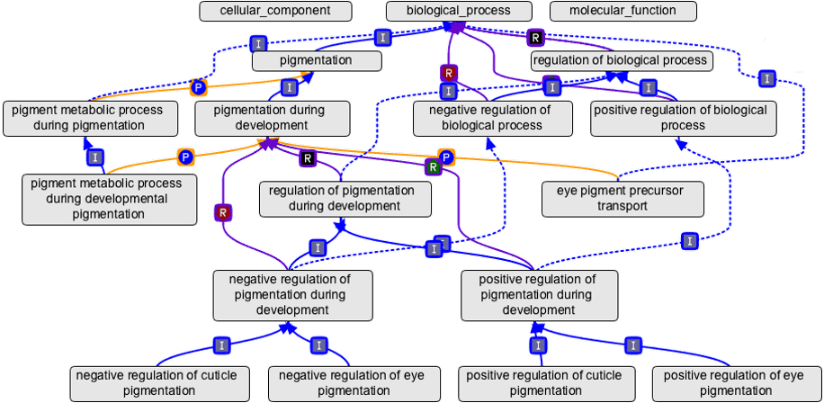
Gene Ontology (GO)

Slide 56
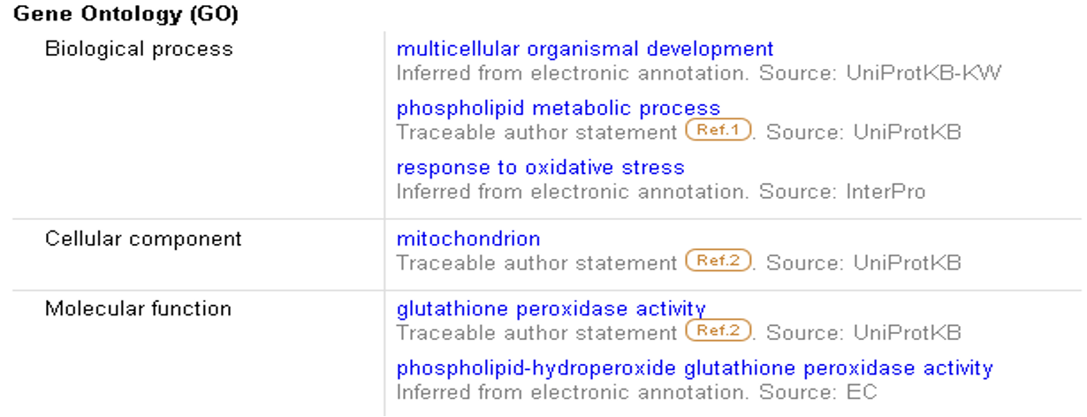
Gene Ontology (GO)
The three components are:
Molecular function: describes the “function” of a protein. For the enzymes, it reports the EC in keywords.
Biological process: describes the process in which the protein is involved.
Cellular component
Use of a controlled dictionary (ontology) of functional terms is defined

Slide 57
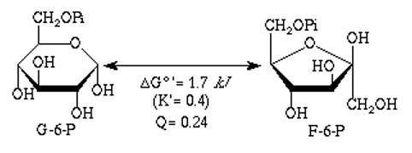
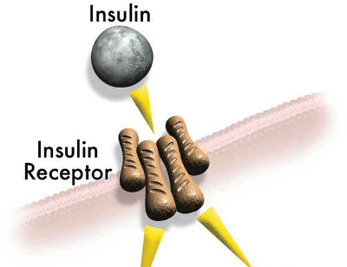
GO: Molecular Function (activities or “jobs” of a gene product)
glucose-6-phosphate isomerase activity
insulin binding
insulin receptor activity
Drug transporter activity

Slide 58
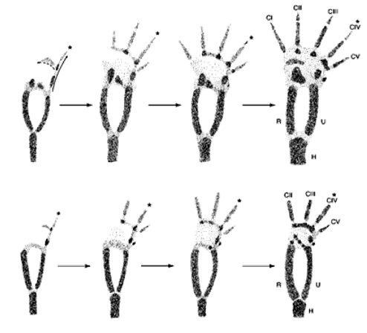
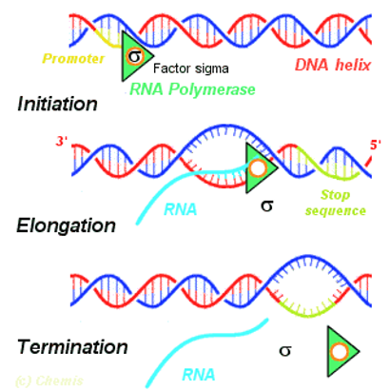
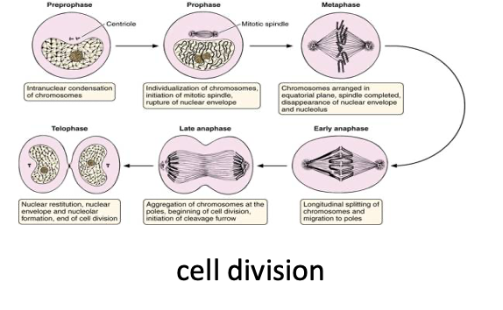
GO: Biological Process
Cell division
limb development
transcription

Slide 59
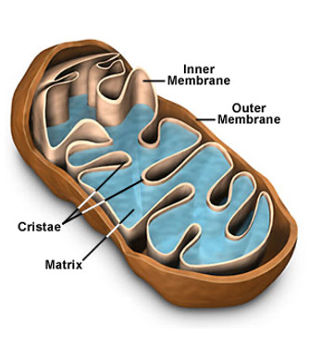
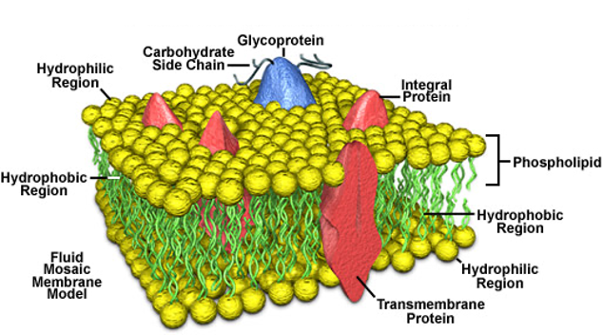
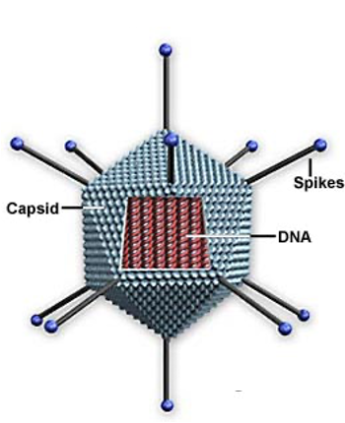
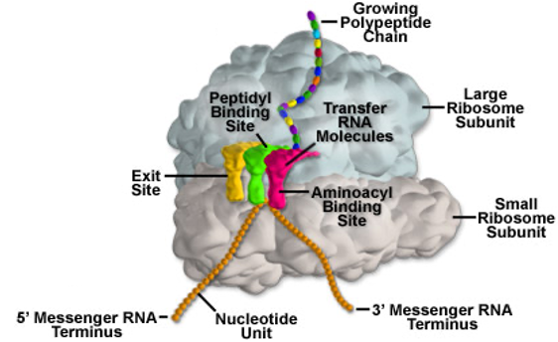
GO: Cellular Component (where a gene product acts)

Slide 60
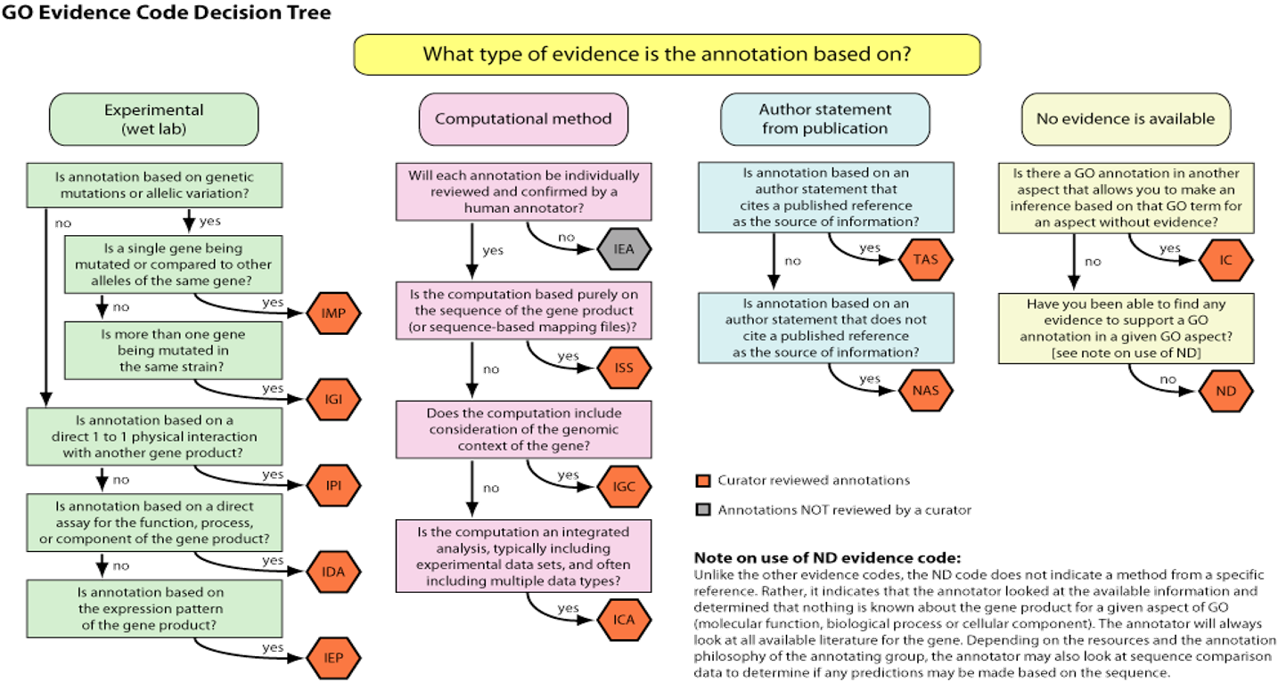

Slide 61
Enrichment limitations
Different level of annotation depending on the biological area
manual annotation or by computational approaches
complexity and detail of annotation associated with large gene or protein sets
> Use semplified ontology

Slide 62
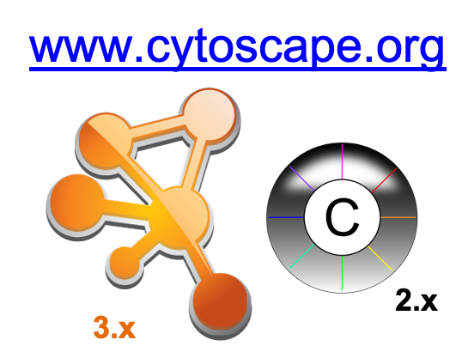
Visualize and analyze a Network
Cytoscape is one of the most popular network analysis tools.
It is an open-source, Java-based, multi-platform desktop application that is widely used for network representation, integration and analysis

Slide 63
Introduction to Cytoscape
Overview
Core Concepts
Data Integration (Joint network and annotation tables)
Visual Properties
Network data analysis (Cytoscape Apps)
Working with Data
Loading networks from files and online databases
Loading data tables from CSV or Excel files
The Table Panel

Slide 64
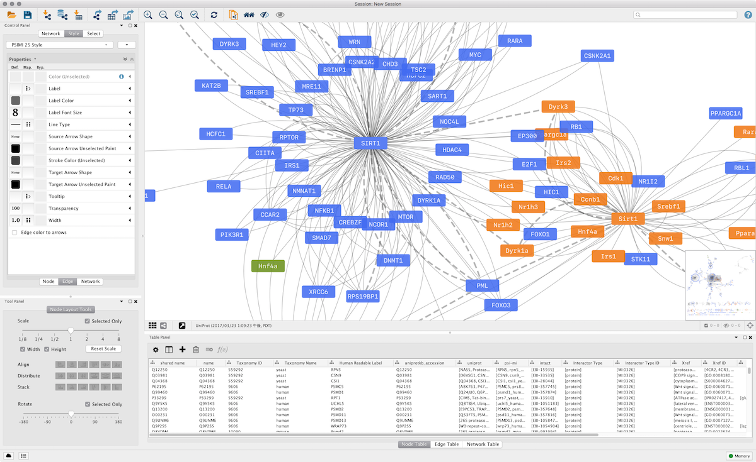
Cytoscape desktop

Slide 65
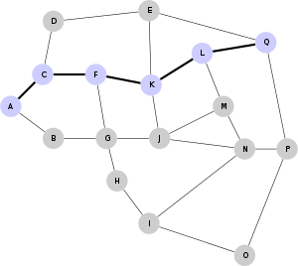
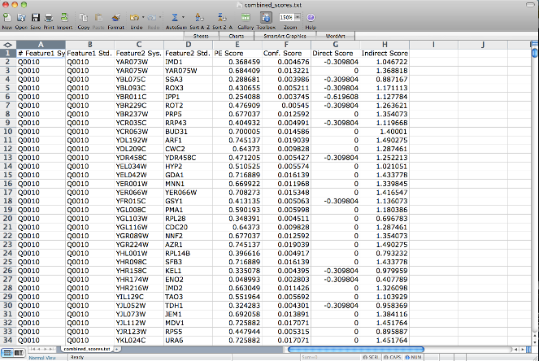
Core Concepts
Networks
e.g., PPIs or pathways
Tables
e.g., data or annotations

Slide 66
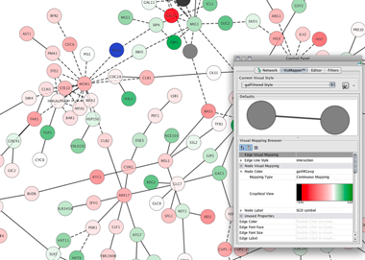
Core Concepts: visual styles
Networks
e.g., PPIs or pathways
Tables
e.g., data or annotations
visual style

Slide 67
Core Concepts: network analysis
Cytoscape Apps!
(plugins that extend its functionality)

Slide 68
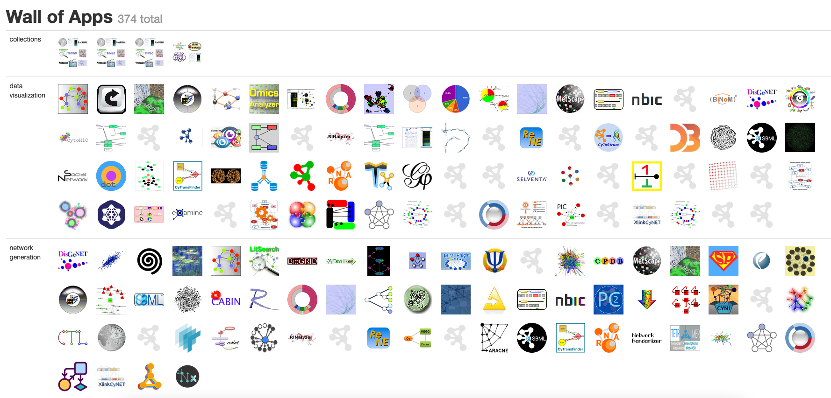
Core Concepts
Cytoscape Apps!
(plugins that extend its functionality)

Slide 69
Loading Data
Cytoscape can import network data from:
Files (or URL)
Excel, TSV, CSV
Simple Interaction Format: SIF
eXtensible Graph Markup and Modelling Language:XGMML
Graph Markup Language: GML
Systems Biology Markup Language
BioPAX
PSI-MI
… and others depending on loading Apps

Slide 70
Loading Data
Cytoscape can directly connect to the external public databases and imports network and annotation data.
Public repositories:
EBI/PSICQUIC
Proteomics Standard Initiative Common Query InterfaCe
STRING (via the stringApp)
Reactome (via the ReactomeFI App)
Wikipathways (via the Wikipathways App)
Pathway Commons (via the CyPath2 App)

Slide 71
Loading Data

Slide 72
Loading Data

Slide 73
Loading Data

Slide 74
Filtering Data
Subnetwork restricted to proteins expressed in both eye and kidney
Notes:
Subnetwork restricted to proteins expressed in both eye and kidney

Slide 75
Saving and exporting
Sessions save everything as .cys files: Networks, Tables, Styles, Screen sizes, etc (very useful to restore a network...)
Export networks in different formats:
SIF, GML, XGMML, BioPAX, PSI-MI 1 & 2.5
Export tables as CSV files
Publication quality graphics in several formats: PDF, SVG, PNG, and JPEG

Slide 76
Network analysis - plugins

Slide 77
Clustering
Unsupervised classification
Goal:
Group related items (typically nodes) together
Groups can be discrete or “fuzzy”
Ways to group:
Topology (connectivity)
Relating attributes
Clustering coefficient

Slide 78
Clustering
Clustering coefficient is a measure of the degree to which nodes in a graph tend to cluster together. MCODE finds clusters (highly interconnected regions) in a network. Clusters mean different things in different types of networks. For instance, clusters in a protein-protein interaction network are often protein complexes and parts of pathways, while clusters in a protein similarity network represent protein families.

Slide 79
Motif finding
Motif finding
Search directed networks for network motifs (feed-forward loops, feedback loops, etc.)

Slide 80
Motif finding
Network motifs are sub-graphs that repeat themselves in a specific network or even among various networks.
Each of these sub-graphs, defined by a particular pattern of interactions between vertices, may reflect a framework in which particular functions are achieved efficiently.
Indeed, motifs are of notable importance largely because they may reflect functional properties.

Slide 81
Enrichment analysis
Overrepresentation analysis
Find terms (GO) that are statistically overrepresented in a network
Very useful for visualization

Slide 82
Useful links
Download link
https://cytoscape.org/download.html
Online manual
http://manual.cytoscape.org/
Cytoscape App Store
https://apps.cytoscape.org/apps/

