Slide 1
Quantum non-demolition of an iterant microwave photon
S. Kono , K. Koshino , Y. Tabuchi , A. Noguchi and Y. Nakamura

Slide 2
Why QND?
Qubit
Protected
Access
Photons
Conventional methods destroys photon
QND solves problem

Slide 3
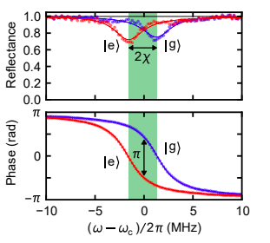
$$\frac{H}{ℏ}=ω_{c}a^{†}a+\frac{ω_{q}}{2}σ_{z}−χa^{†}aσ_{z}$$

Slide 4
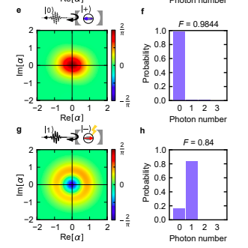
Verification of QND properties of photon
Analyze reflected pulse mode
Wigner tomography
Conditioned results for reflected pulse without and with phase-flip
Strong correlation between outcomes of the qubit operation and properties of the reflected pulse mode

Slide 5
Entanglement
Examine composite state of qubit and reflected pulse mode.
Qubit measured in different directions, quadrature of pulse mode in different phases.
Density matrix constructed using iterative ML reconstruction
Diagonal elements enables QND detection of an itinerant photon
Off-diagonal elements: presence of entanglement
N(ρ) indicates entanglement.

Slide 6
Sources
https://arxiv.org/pdf/1711.05479

