Slide 1
WELCOME EVENTS
1) Presentation of the Bachelor degree in INFORMATION ENGINEERING
Marco Santagiustina – Programme coordinator
Tuesday October 4, 2022, 12.30
Aula Magna – Department of Information Engineering
https://unipd.zoom.us/j/85671119619
2) Presentation of the Department and the University Services (fellowships, housing, tutoring …) to new International Students
Friday October 7, 2022, 3.30pm
Room Ke– Department of Information Engineering
https://unipd.zoom.us/j/88649892537
A WELCOME RECEPTION WILL FOLLOW!

Slide 2
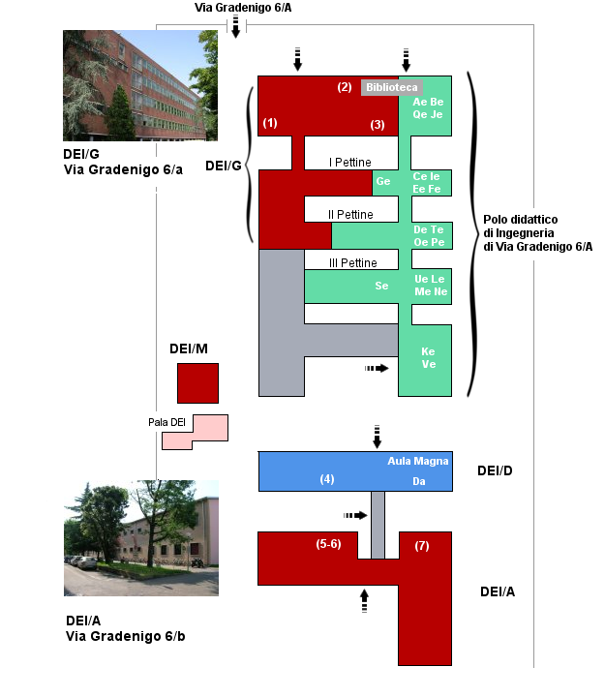
Room Ke
Aula Magna

